Slide 1
EVALUATION SHORT –TERM RESULTS of SURGICAL TREATMENT METHODS FOR DYSPLASIA DEVELOPMENT OF HIP (DDH) at HTO
Phan Duc Minh Man
Phan Van Tiep
Ho Ngoc Can
Le Viet Can
Truong Hung Quoc
Vo My Hanh

Slide 2
Objective
analysis the results of anatomical reconstruction to the surgical methods in DDH disease after short-term follow-up.

Slide 3
Method
retrospective study is used for all of consecutive cases which operated at the Pediatric Orthopedics ward of HTO and admited during 2 years from 2014 to 2015.

Slide 4
Surgical Technique
8-20 mths open reduction ( Ludloff)
> 20 mths – 6 ys old : open reduc. + femoral osteotomy ( ± varus derotation ) + Salter
> 6 ys old: open reduc. + shorthening and rotation of femur ± pelvic osteotomy (acetabuloplasty)

Slide 5
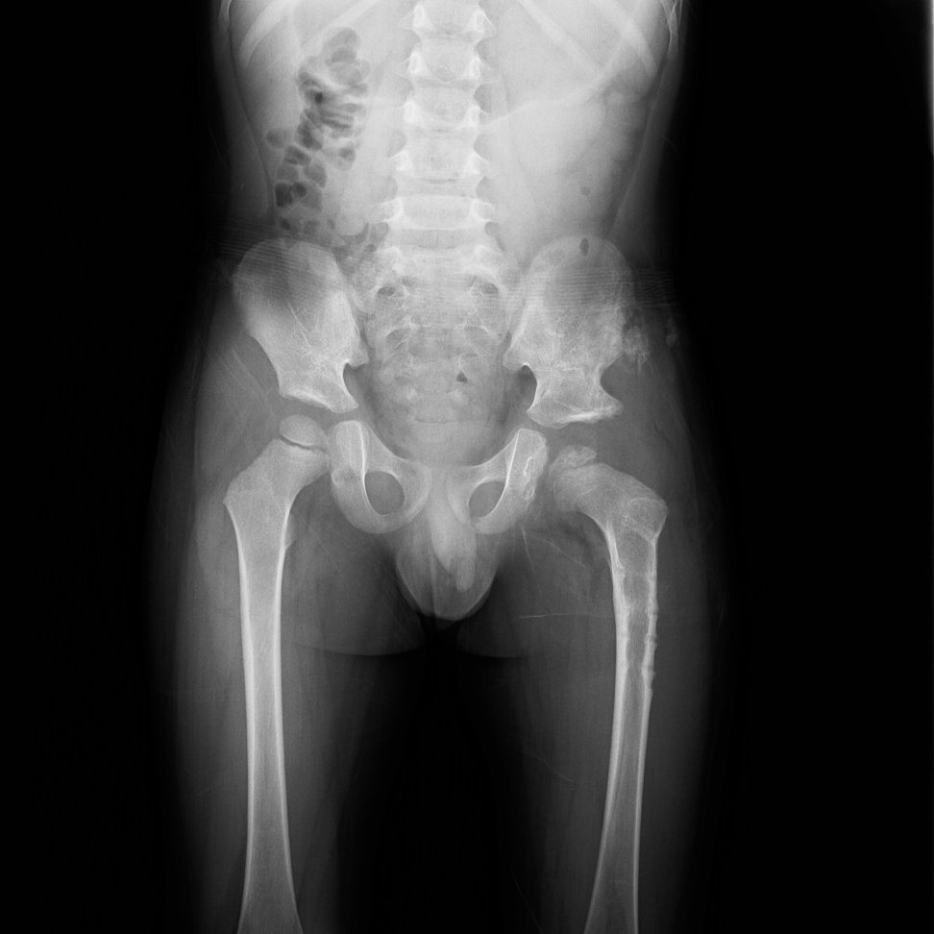
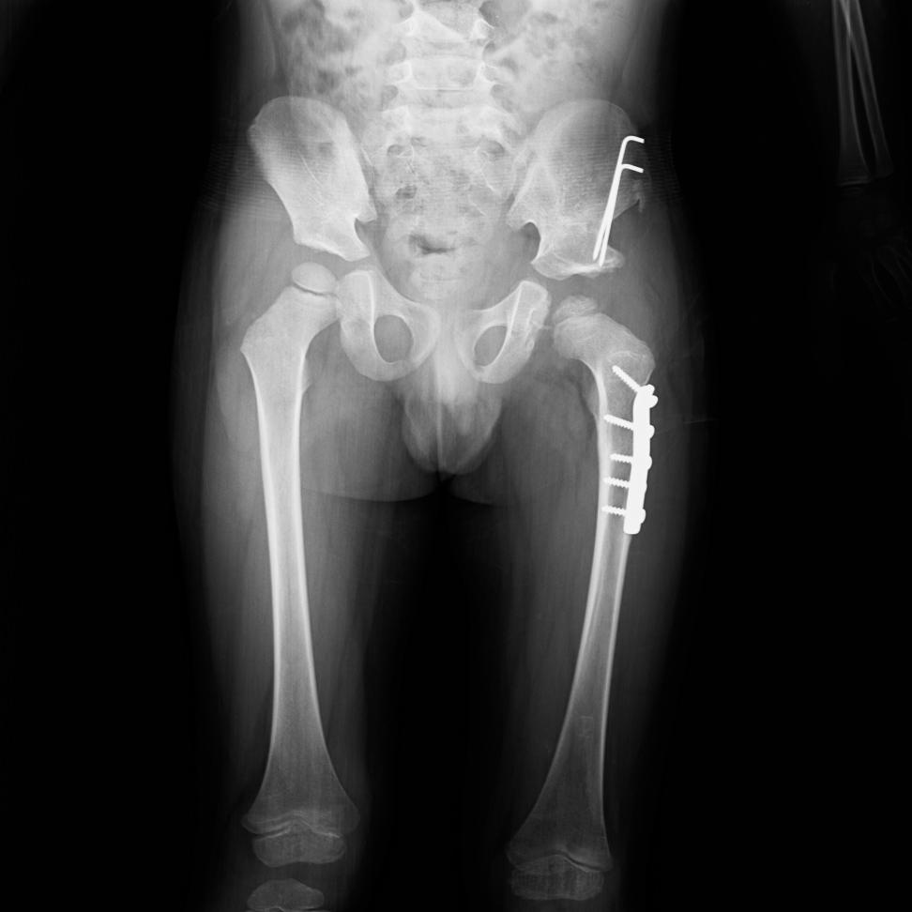
Case : Quản Th. Trung, 48mths

Slide 6
Timing for analysis
Evaluation for the results concerning to open reduction, acetabular index, infection, complications post-op and complement surgeries if necessary.
Data based on evidences on the x-ray and clinical signs at the time of material removed (almost 6 months post-op)

Slide 7
Result
This study consists of 106 DDH cases with 121 hip joints that operated open reduction.
Age is from 08 months to 10 years with male 13 and female 93.

Slide 8
Results
There are 15 cased done both sides and 91 one side (R=33, L=58).
Successful result remarked on 99 cases (95,2%) and 7 cases noted the sub-luxation post-op and needed to do secondary opened reduction ( consist of the 2 cases from the other hospital done before).

Slide 9
There are 6 cases done Ludloff technique with good result applied on the group under 20 months old.
Shortening and rotation on the femoral osteotomy applied on 116 femoral bone and Salter technique arrived with 110 pelvic bone ( 6 cases no SALTER) applied on the group from over 20 months to under 10 years old.
There are 14 cases operated in group from over 5 to 10 years old.

Slide 10
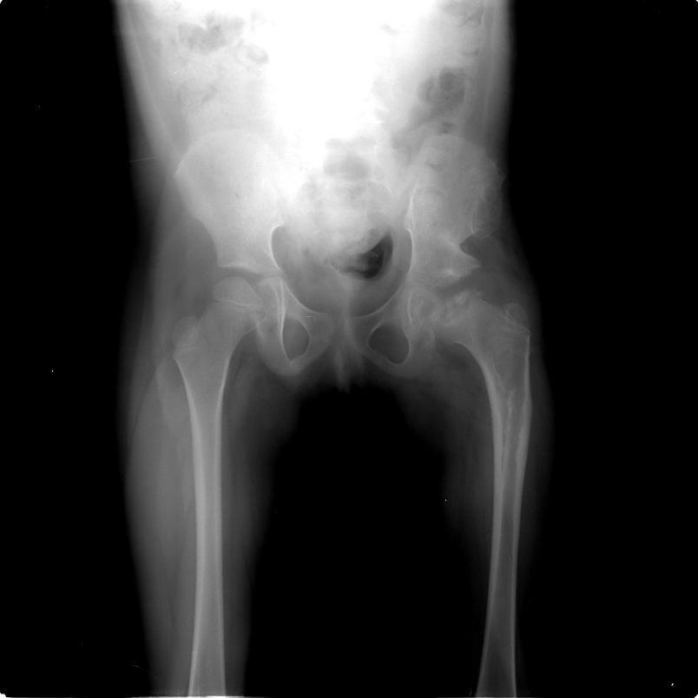
AVN noted on 6 cases (0.6%) at the moment of leaving material.
No cases got infection.
Average operation time is 179,05 minutes (range from 120 to 240).

Slide 11
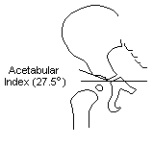

Acetabular index changes from pre-op ( avg= 39,1⁰) to post-op ( avg= 23,3⁰).
Blood transfusion happened in 6 cases (1 UI. blood at post-op)

Slide 12
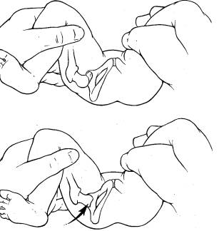
Discussion 1
Open reduction + femur/pelvic osteotomy happened almost to the group of walking children ( after 2 year old) → lack of screening program for DDH in VN

Slide 13
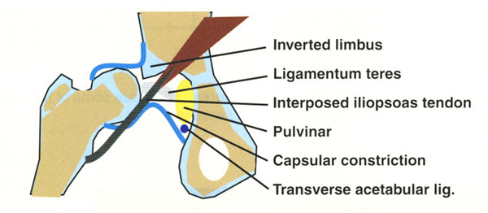
Discussion 2
Solutions for successful open reduction
take all of Psoap tendon

Slide 14
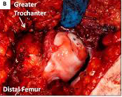
release to soft tissue from surround on the neck of femur enough to large

Slide 15
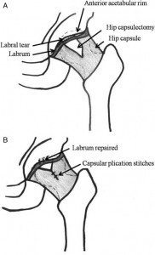
capsulorraphy get stability.

Slide 16
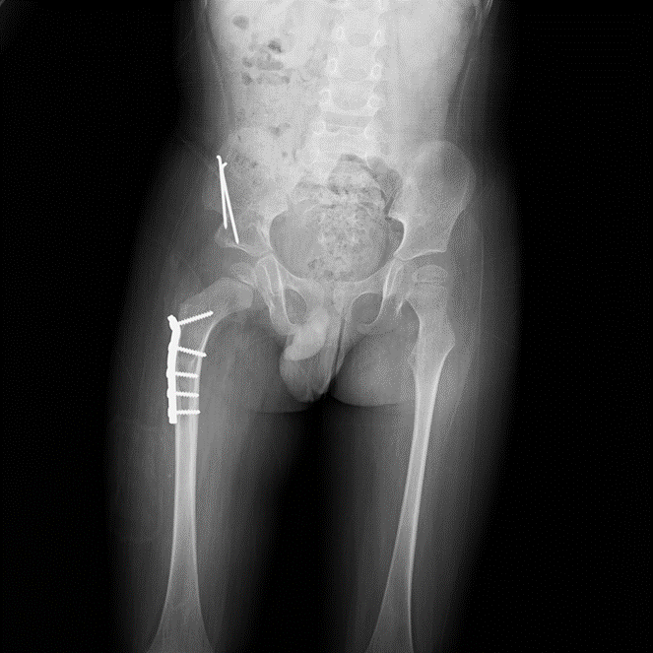
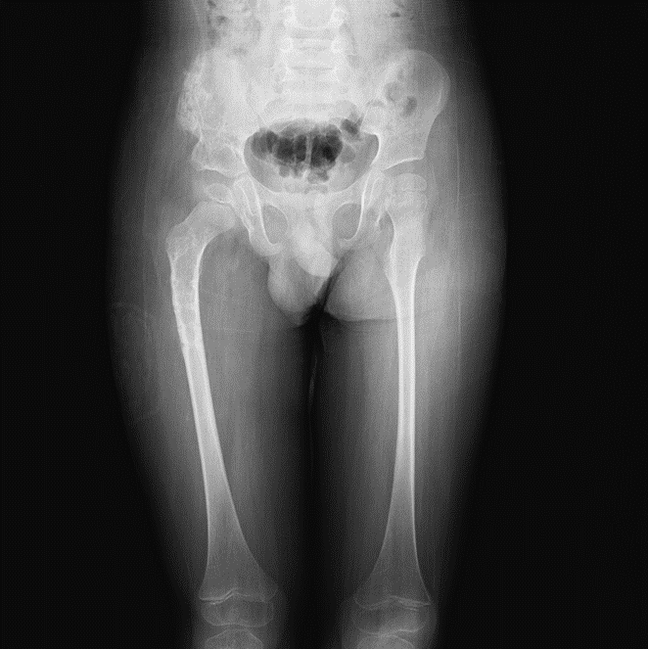
Discussion 3
How do we correct rotation deformity on the neck of femur exactmently?
  Based on CT-Scan?
  Based on experience during operating?

Slide 17
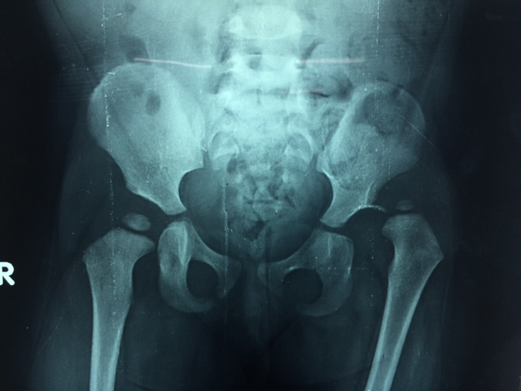
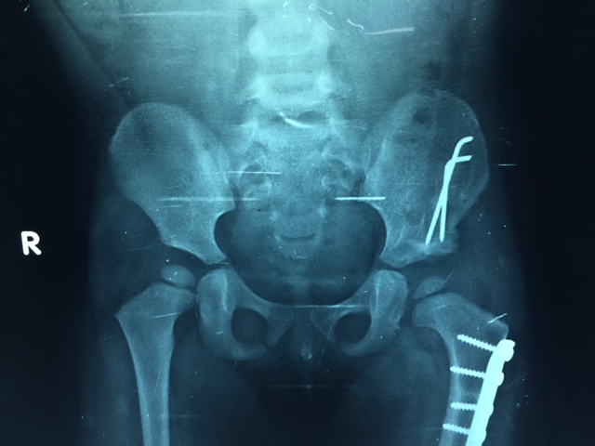
Case 1, 36 mths,

Slide 18
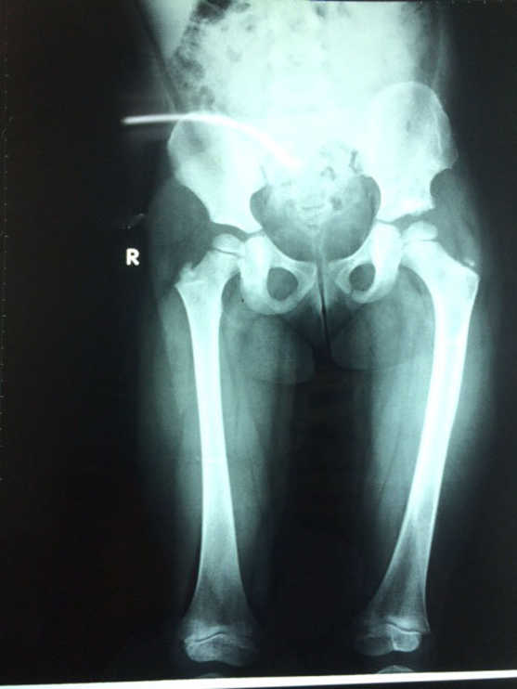
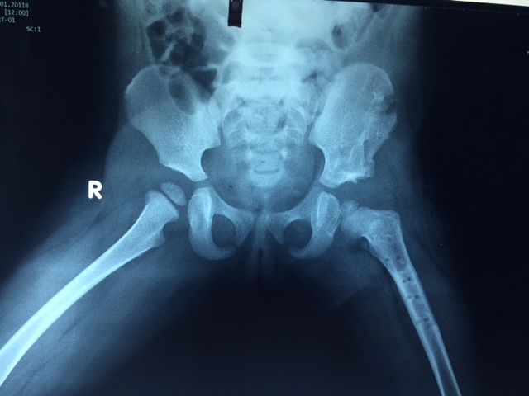
FU 4 YRS

Slide 19
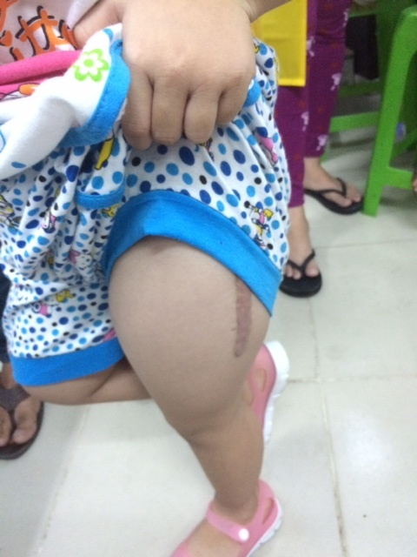
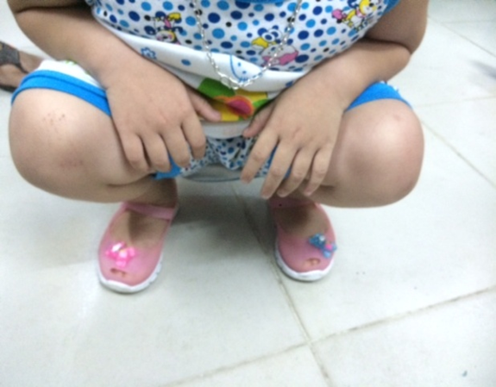
Ph. Hg. Kim Ngọc, FU 4 yrs

Slide 20
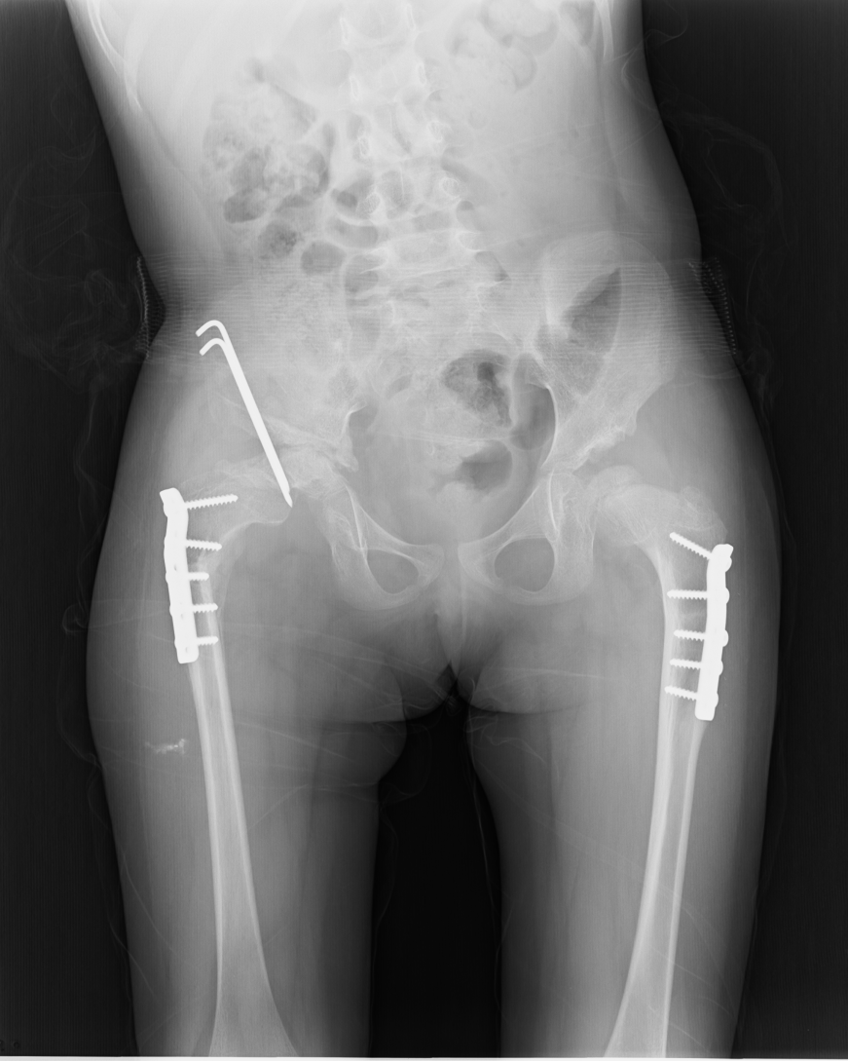
Case 2, DDH 2 sides, 6 yrs old
1st time, open reduc. + femur osteo. Left side with good result
2nd time, same technique on the opposite side but failure, addition Salter

Slide 21
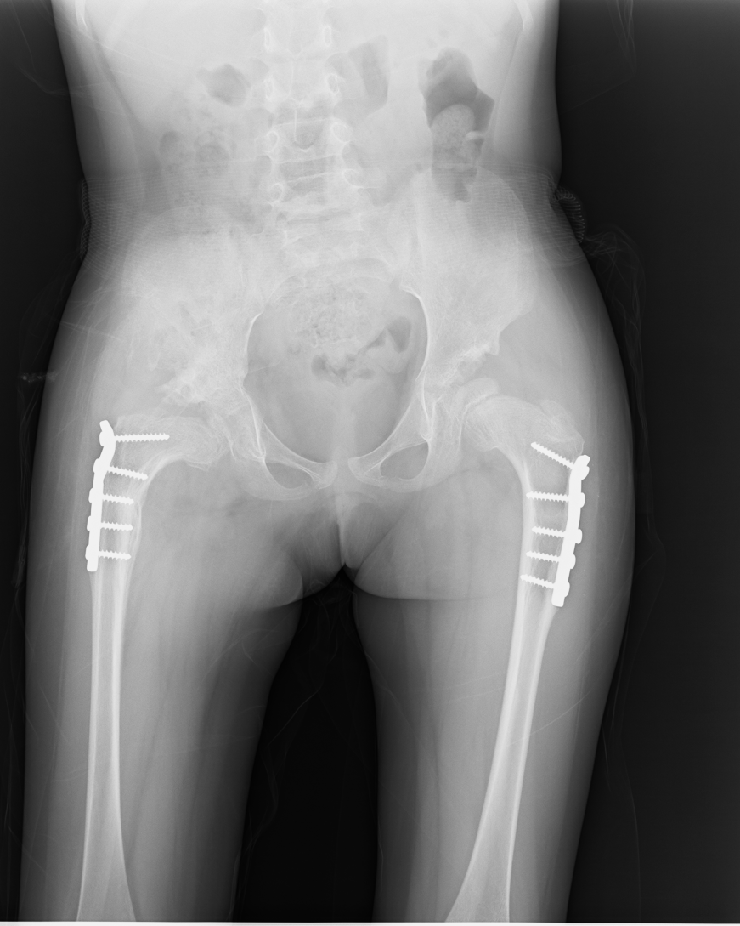
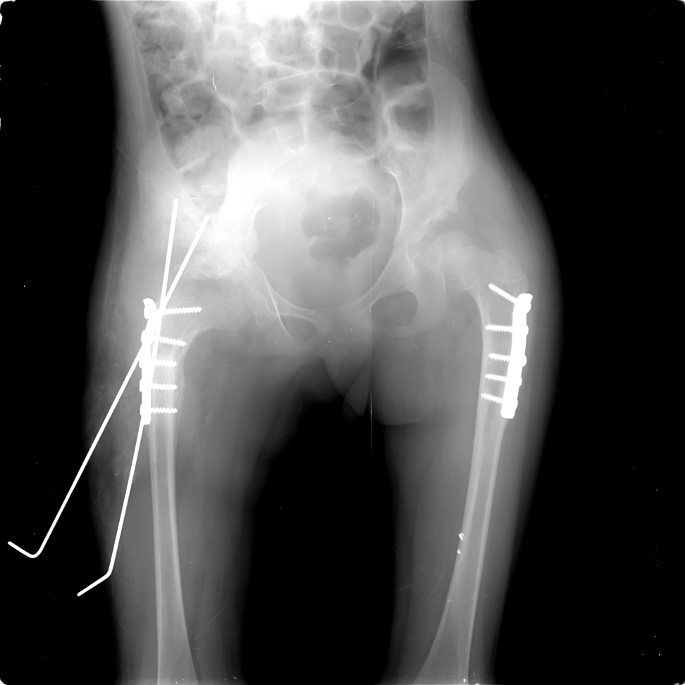
Ng.t.minh Thư, 6 yrs old, 3 rd time operating

Slide 22
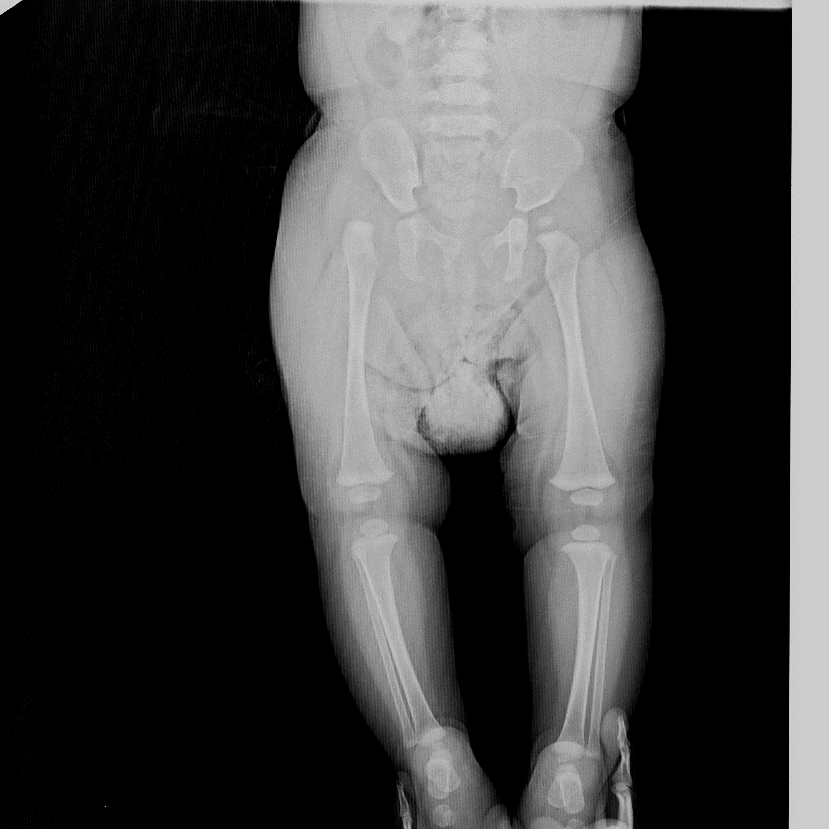
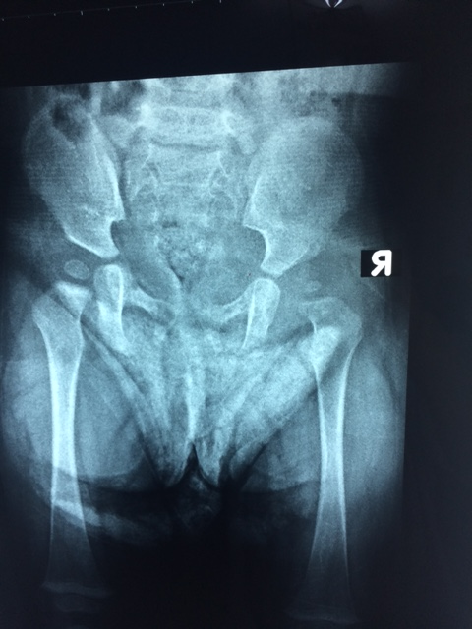
Case 3, Vy, 8 mths, Ludloff

Slide 23
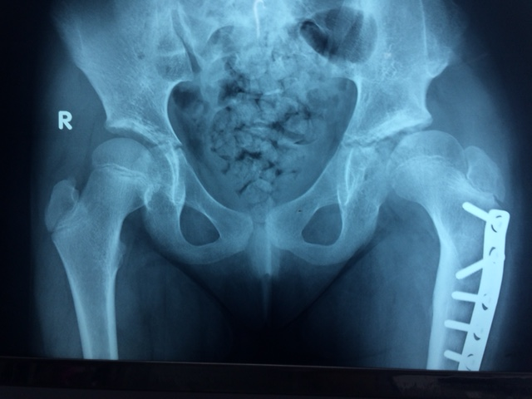
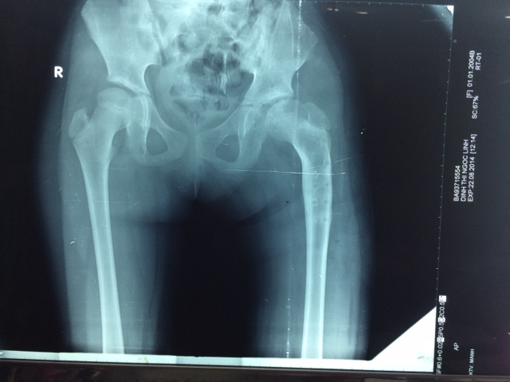
Case 4, no Salter, FU 2 yrs

Slide 24

THANKS FOR ATTENTION

Slide 25
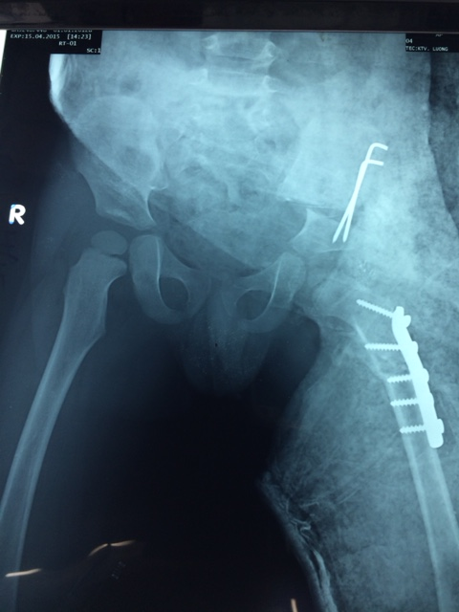
Case 1 , 36 mths

Slide 26
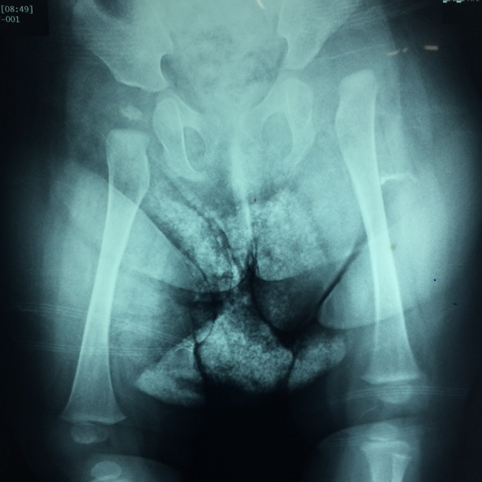
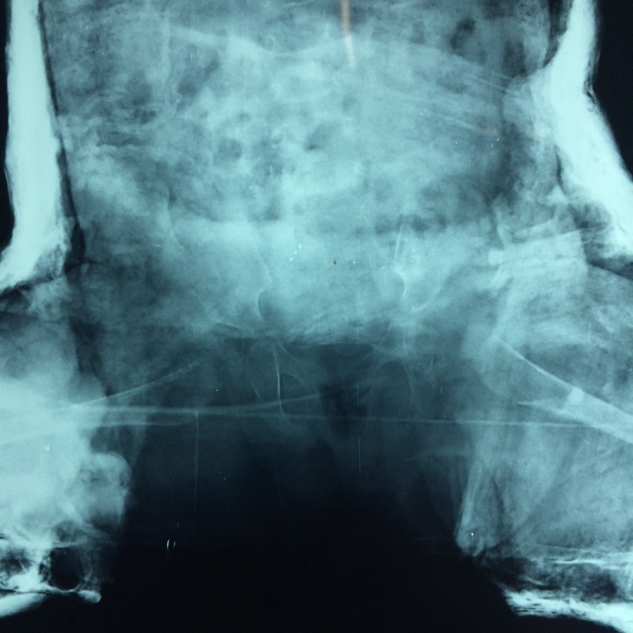

Slide 27
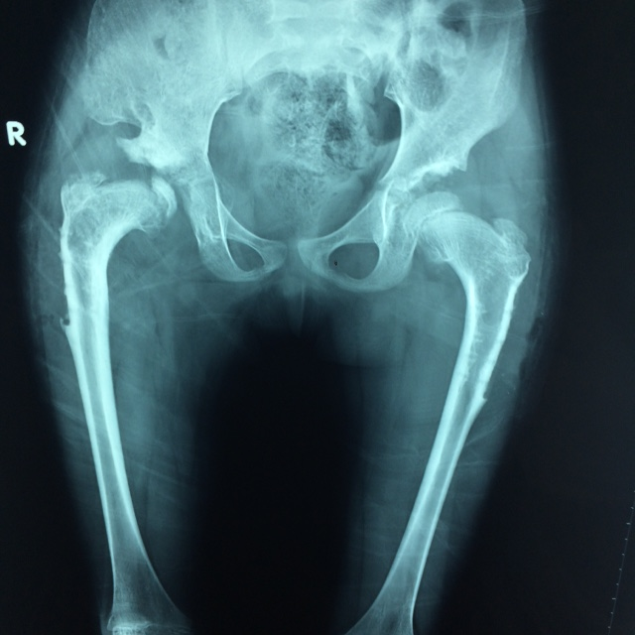

Slide 28
