Slide 1
complete PLC injury: treatment options
Trần Đăng Khoa
Trương Viết Thông et al
BV Chấn thương Chỉnh hình

Slide 2
Introduction
once referred to as the dark side of the knee
occult injuries
associated with PCL or ACL tears, with only 28% of all in isolation

Slide 3
Introduction
fail to address a PLC injury compromise concurrent cruciate ligament and lead to early knee degenerative osteoarthritis
complete PLC lesions treated surgically
acute surgical intervention results in superior outcomes compared with chronic reconstruction

Slide 4
Anatomy
3 major static stabilizers:
fibular collateral ligament
popliteus tendon
popliteofibular ligament
➔
Popliteus COMPLEX

Slide 5
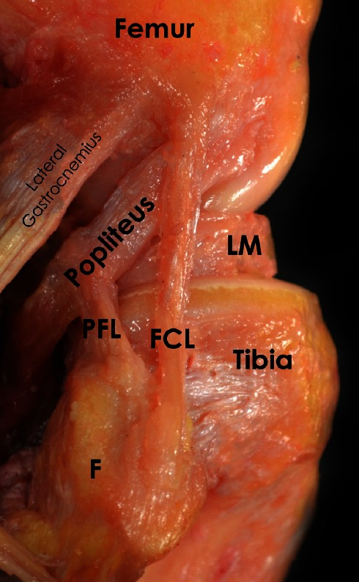
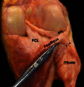
Anatomy

Slide 6
Anatomy
FCL: primary varus stabilizer
- femoral attachment: proximal (1.4 mm) and posterior (3.1 mm) to the lateral epicondyle
- distal attachment: distal one-third of the lateral aspect of the fibular head

Slide 7
Anatomy
PLT:
- femoral attachment: at the point of an average of 18.5 mm anteriorly (17 – 23 mm) from the FCL attachment with the knee at 70º
- tibial attachment: the posteromedial tibia

Slide 8
Anatomy
PFL:
- originates at the musculotendinous junction of the popliteus
- distal attachment: two divisions, the posterior division larger, inserts to fibular head

Slide 9
Anatomy
secondary stabilizers: static and dynamic manners
1/lateral capsular thickening of the mid-third lateral capsular ligament
2/coronary ligament
3/lateral gastrocnemius tendon (important landmark)
4/fabellofibular ligament
5/long and short head of the bicepsfemoris
6/iliotibial band

Slide 10
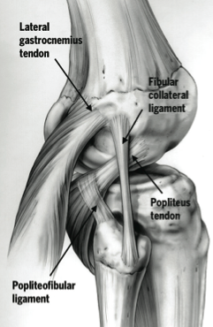
Anatomy

Slide 11
Biomechanics
PLC:
primary restraint to varus forces as well as posterolateral rotation
secondary stabilizer to anterior and posterior tibial translation

Slide 12
Biomechanics
FCL:
primary restraint to varus stress across the knee
in regards to tibial external rotation:
- FCL and the popliteus complex are the primary restraints, especially between 30° and 40° of flexion
- PCL is secondary restraint

Slide 13
Mechanisms of injury
a direct blow to the anteromedial knee
hyperextension
non-contact varus stress injuries
most often, PLC tears are associated with PCL and/or ACL injuries

Slide 14
Symptoms
pain
perceived side-to-side instability near extension
difficulty walking on uneven ground or up and down stairs
ecchymosis
swelling
paresthesia or foot drop; peroneal nerve injury occurs in up to one third of PLC injuries

Slide 15
Clinical evaluation
high index of suspicion
thorough examination
performed bilaterally

Slide 16
Clinical evaluation
Varus tress test: at 0° and 20° - 30°
knee flexed 20° - 30: (+) → injury to the FCL and the secondary stabilizers
full extension:
- (+) and restored → injury to the isolated FCL
- (+) and persisted → injury to the FCL, PLC and cruciate ligaments

Slide 17
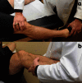
Clinical evaluation

Slide 18
Clinical evaluation
External rotational tests:
dial test:
30⁰: (+) → PLC injury
90⁰: (++) → PLC + PCL injuries

Slide 19
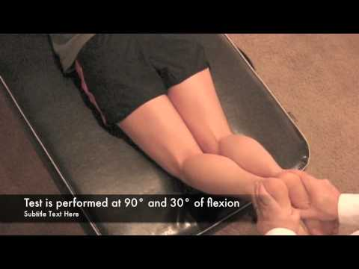
Clinical evaluation

Slide 20
Clinical evaluation
External rotational tests:
Reverse pivot shift test:
(+): the previously subluxated lateral tibial plateau reduces at approximately 35 ̊ to 40 ̊ of flexion

Slide 21
Imaging
Radiographs
AP
lateral
sunrise view
long standing AP
varus stress (20° of knee flexion) for the objective diagnosis

Slide 22
Imaging
MRI
assist in the diagnosis of acute lesions
assess concurrent injuries
determine the location of the damaged structures

Slide 23
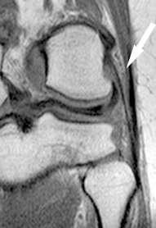
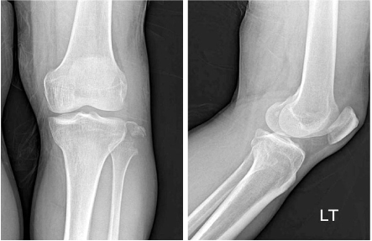
Imaging

Slide 24
Classification
Grade I (0-5mm of lateral opening and minimal ligament disruption)
Grade II (6-10mm of lateral opening and moderate ligament disruption)
Grade III (>10mm of lateral opening and severe ligament disruption and no endpoint)

Slide 25
Treatment
PLC physiological load-sharing pattern:
LCL represents a larger in situ force near full extension, decreasing with increasing flexion angle of the knee
popliteus complex represents a larger in situ force with the knee in flexion than with the knee in extension

Slide 26
Treatment
PLC reconstruction should be performed at same time or prior to ACL or PCL to prevent early cruciate failure
after cruciate ligament reconstruction, PLC reconstruction is initiated

Slide 27
Treatment
2 surgical techniques: combined tibial-fibular-based techniques and fibular-based techniques
LaPrade (tibial-fibular-based):
reconstructing all three major PLC components at each precise insertion site
increased technical difficulty and potential overconstraint of external and varus rotations of the knee

Slide 28
Treatment
2 surgical techniques: combined tibial-fibular-based techniques and fibular-based techniques
modified Larson (fibular-based):
reproduce a physiological tension pattern for LCL and PFL using a single ST autograft
advantages of technical simplicity and reproduction of a more physiological load-sharing pattern

Slide 29
Treatment
Veltri and Warren: advocated reconstruction of PFL and LCL as sufficient to adequately control posterolateral instability such as posterior tibial translation and external and varus rotations

Slide 30
Treatment
“A comparison of modified Larson and 'anatomic' posterolateral corner reconstructions in knees with combined PCL and posterolateral corner deficiency.”
Apsingi S1, Nguyen T, Bull AM, Unwin A, Deehan DJ, Amis AA.
Both PLC reconstructions could restore both external rotation and varus laxity to normal
The three-stranded anatomical reconstruction did not perform better than the modified two-strand Larson technique

Slide 31
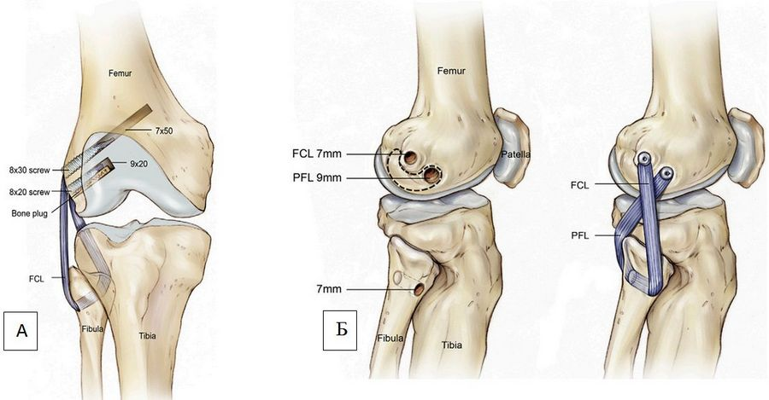
Techniques
modified Larson:

Slide 32
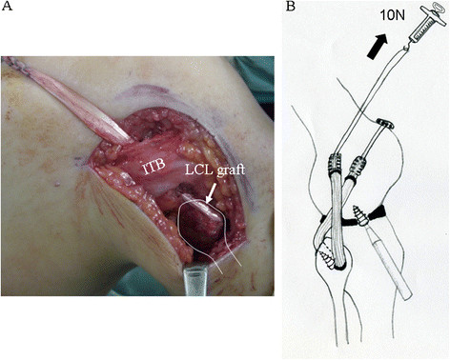
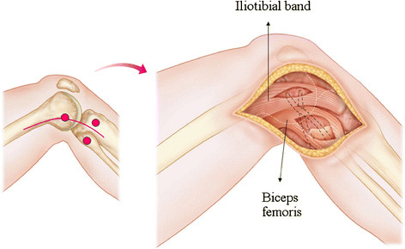
Techniques
modified Larson:

Slide 33
Techniques
modified Larson:
Less invasive and less technically demanding
LCL and PFL secured independently with intended tension at the intended flexion angle of the knee, achieving differential physiological tension patterns for each
LCL is secured at full extension with 10 N, whereas the PFL is secured at 90° with 10 N

Slide 34
Post-op Rehabilitation
hinged functional brace for 3 months
first 2 weeks:
immobilized in extension
ROM exercises using CPM device from 0° to 90°
partial weight-bearing in extension with gradual progression
from week 4:
ROM exercises >90°
full weight-bearing

Slide 35
Complications
Arthrofibrosis
Peroneal nerve injury (15-29%)

Slide 36
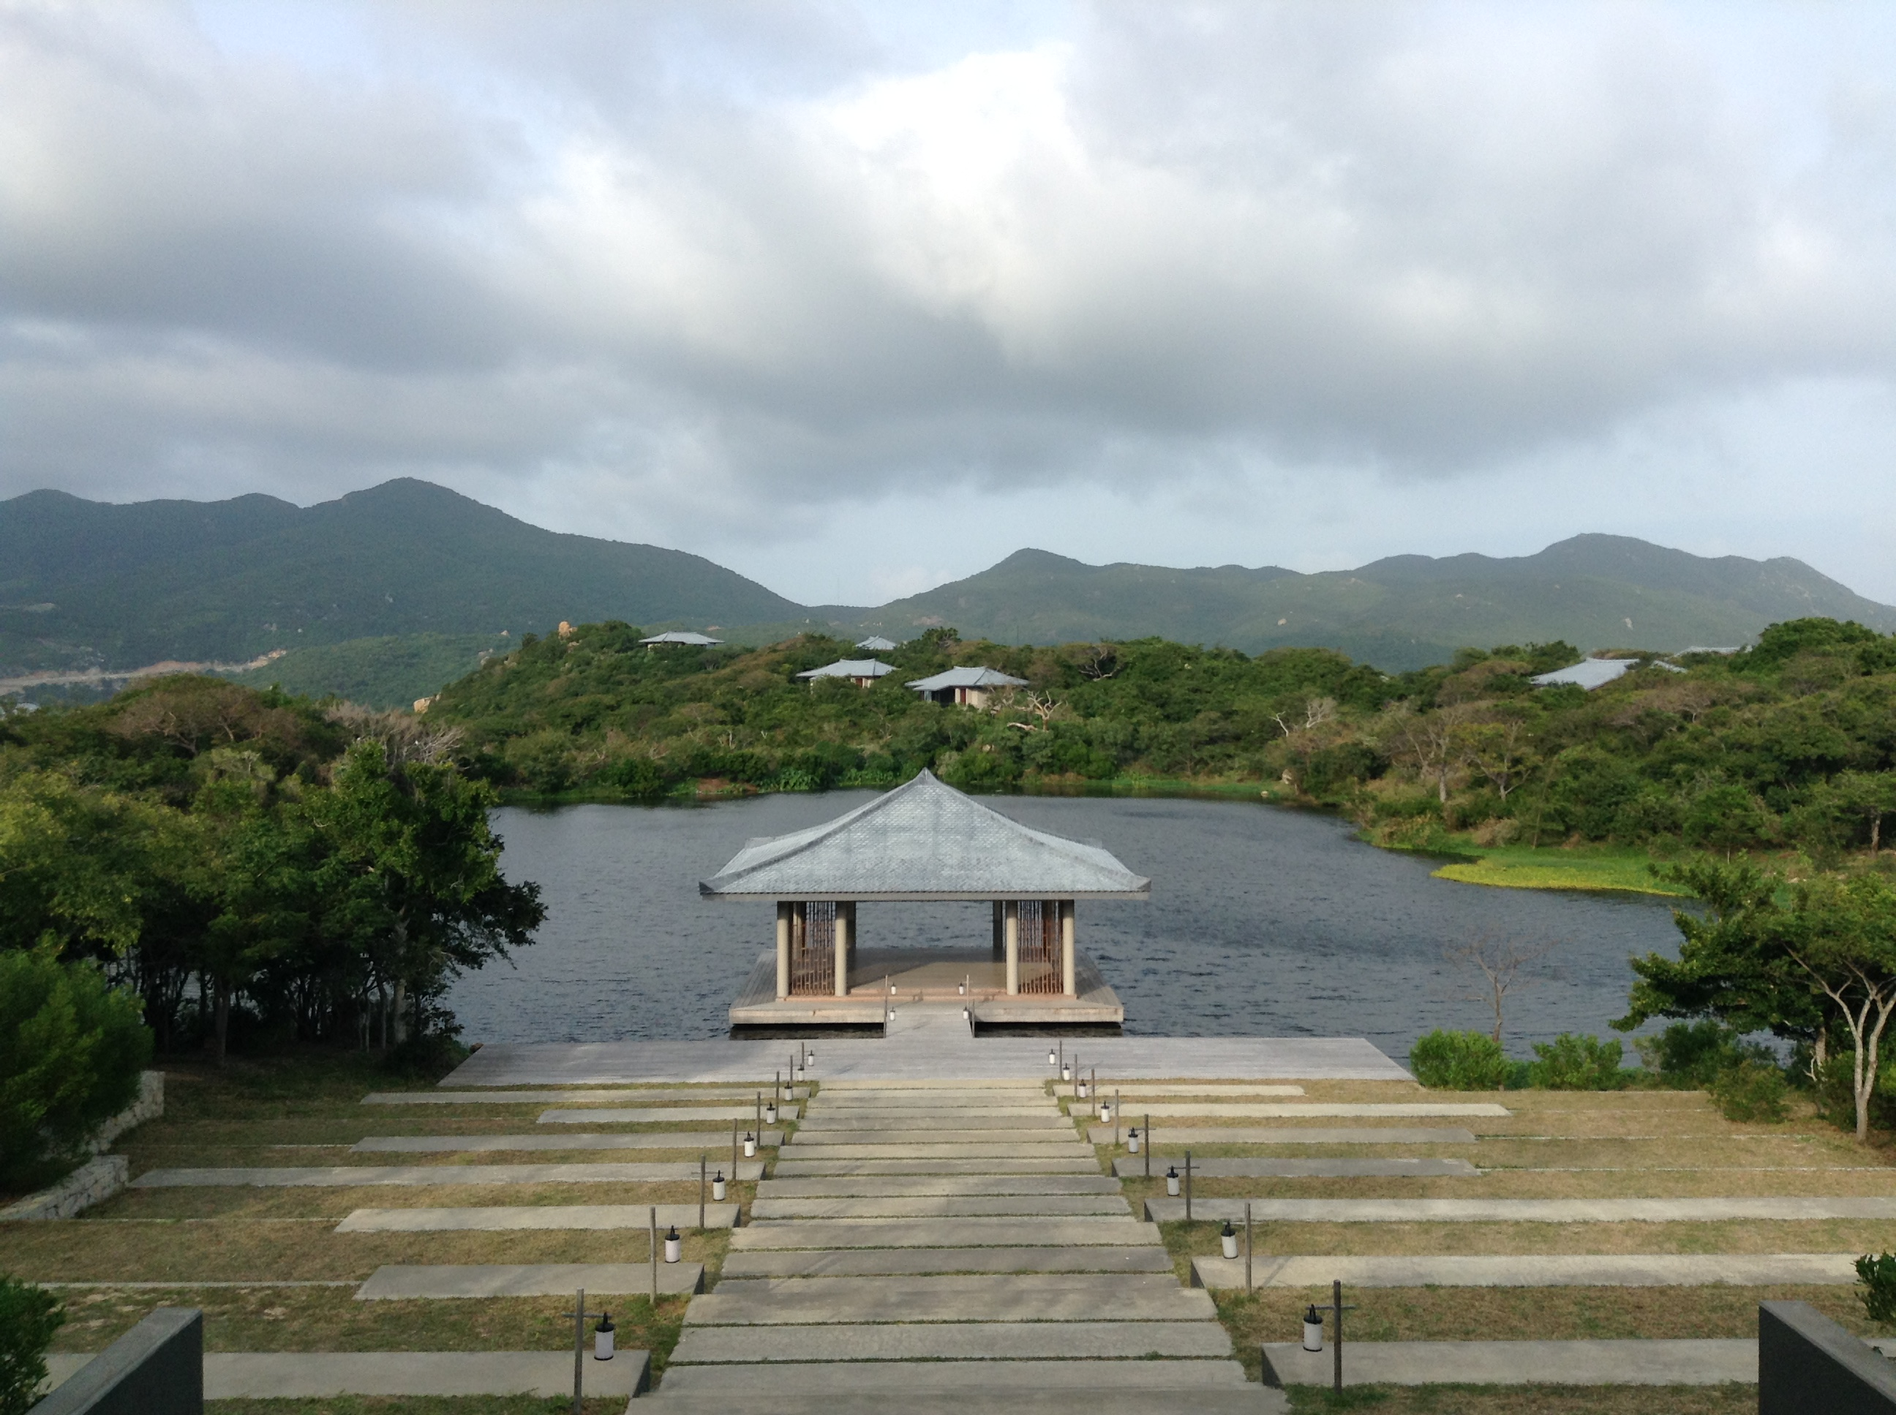
Thank you!

