Slide 1
DYNAMIC COMPRESSION OF
THE CERVICAL SPINAL CORD
IN SYMPTOMATIC PATIENTS:
A CASE- CONTROL STUDY
WITH THE HELP OF
KINETIC MRI
HTO ORTHOPEDIC CONGRESS 2017
TRUC VU MD.
SPINAL SURGERY DEPARTMENT
HOSPITAL FOR TRAUMATOLOGY & ORTHOPEDICS
HOCHIMINH CITY, VIETNAM

Slide 2
BACKGROUNDS
Static MRI (sMRI) of cervical spine:
Lack of
  Dynamic effect
  Weight-bearing effect
Discrepency between imagery & clinical symptoms not uncommon
Kinetic MRI (kMRI), upright weight-bearing MRI (pMRI): more popular

Slide 3
Dynamic change of the spinal canal during motion: Symptomatic patients ≠ healthy individuals ?
→ Case-control study to answer the question

Slide 4
MATERIALS AND METHODS
Symptomatic patients with informed consent: kinetic MRI
Contraindications:
  Acute neck pain
  Acute injuries of the cervical spine
  Severe compression of spinal cord on static MRI

Slide 5
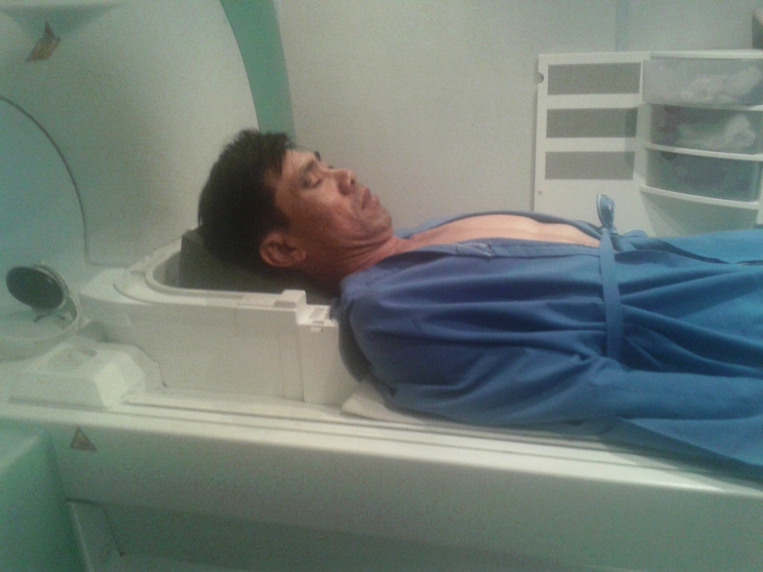
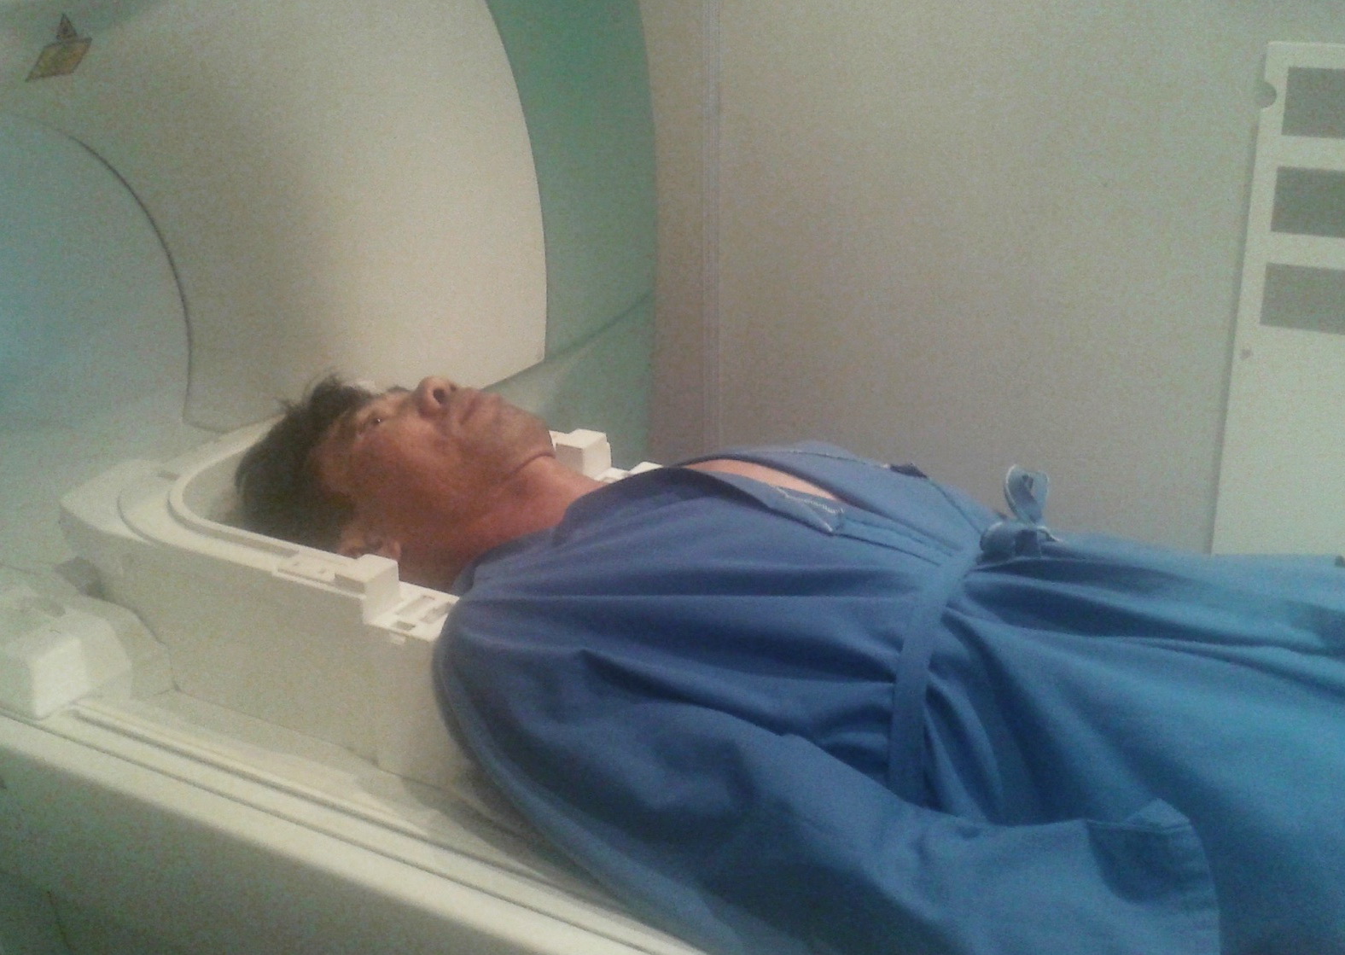
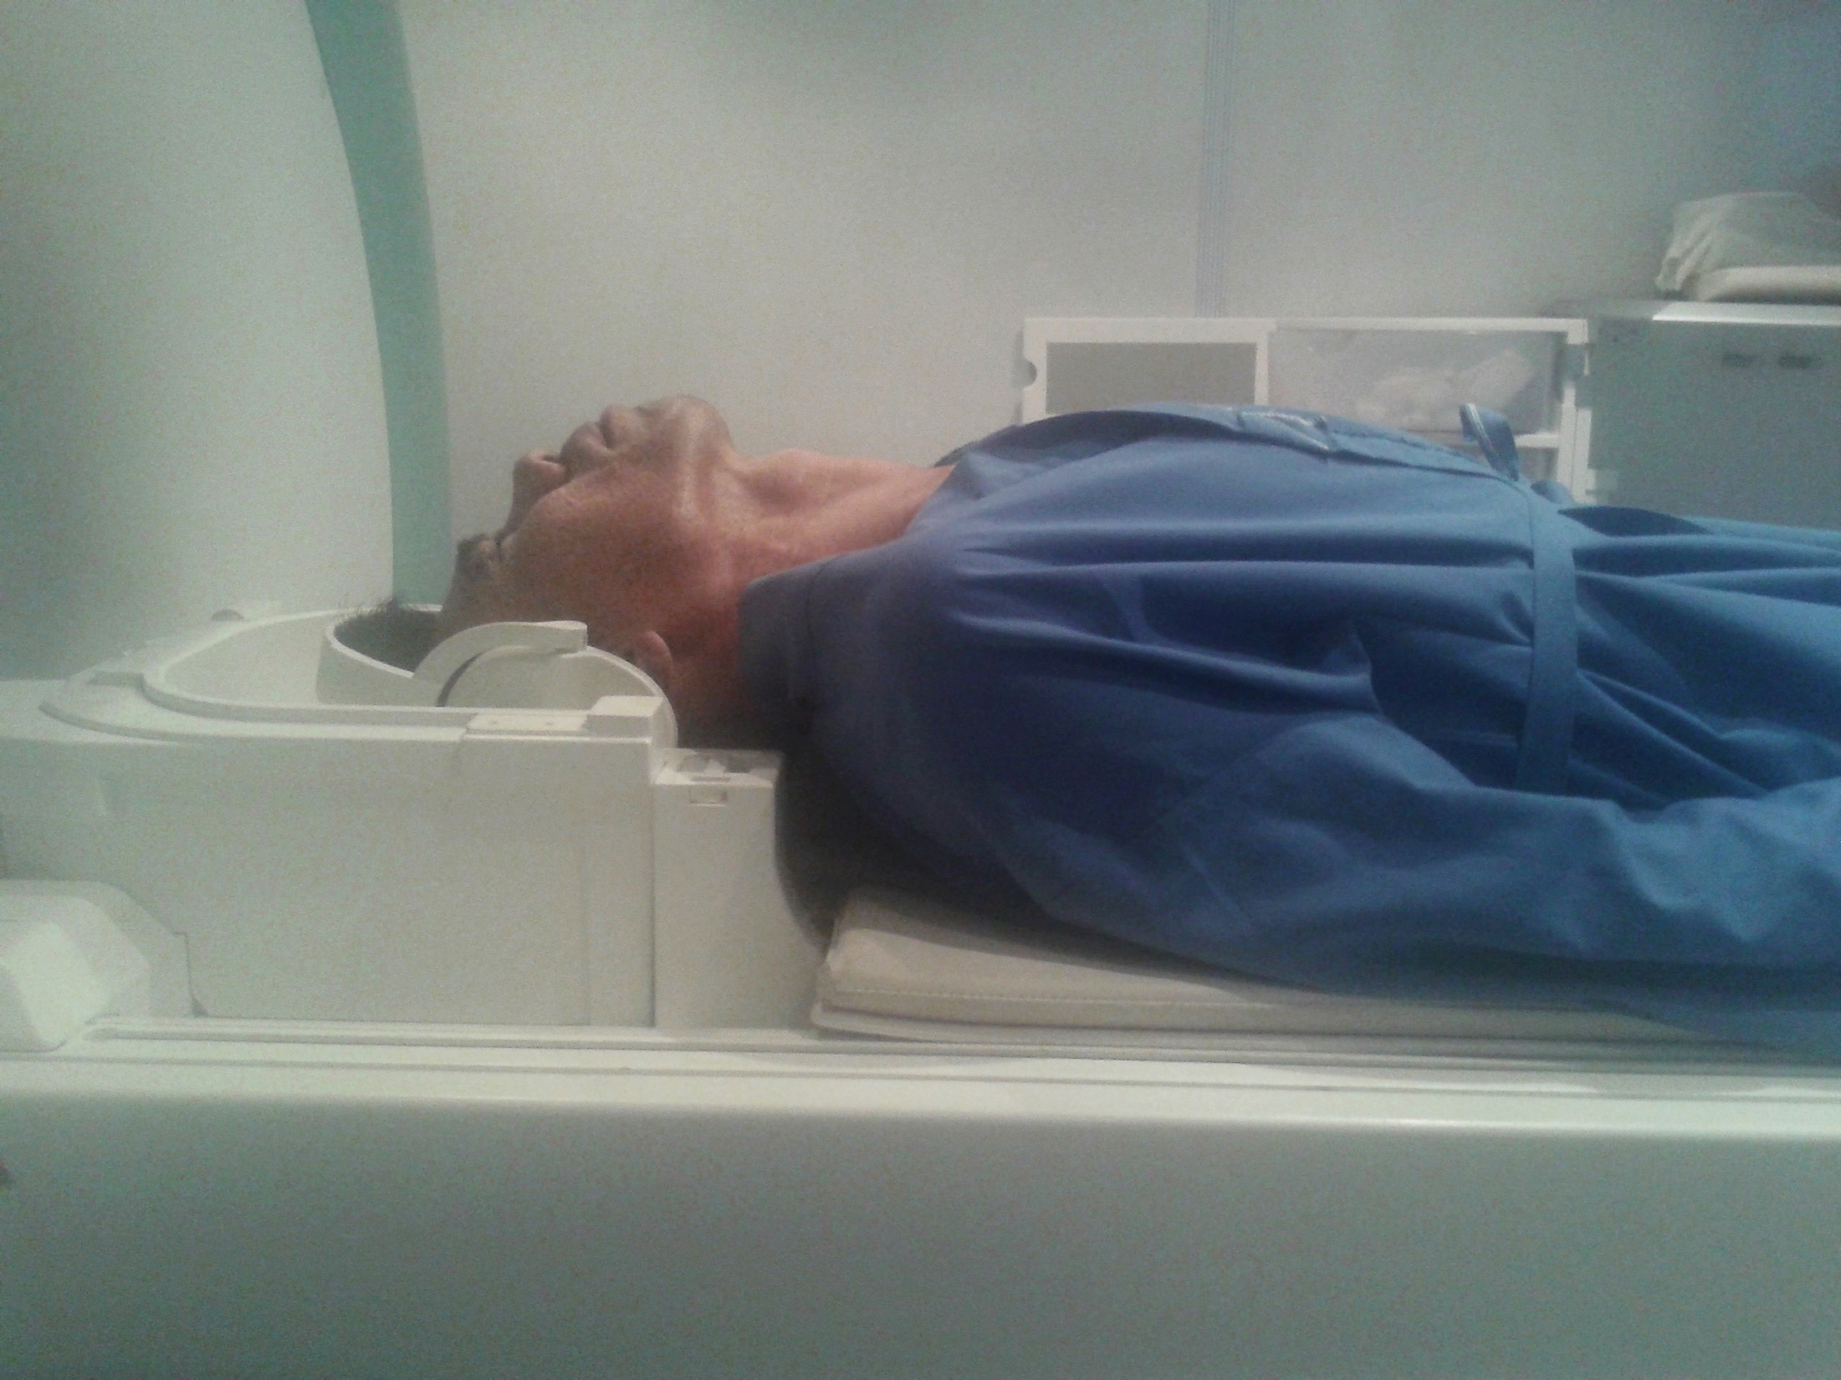
Flexion position
Neutral position
Extension position

Slide 6
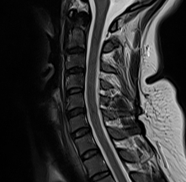
SAC: SPACE AVAILABLE for CORD
SAC flexion
SAC neutral
SAC extension
ΔSAC= SAC flexion – SAC extension

Slide 7
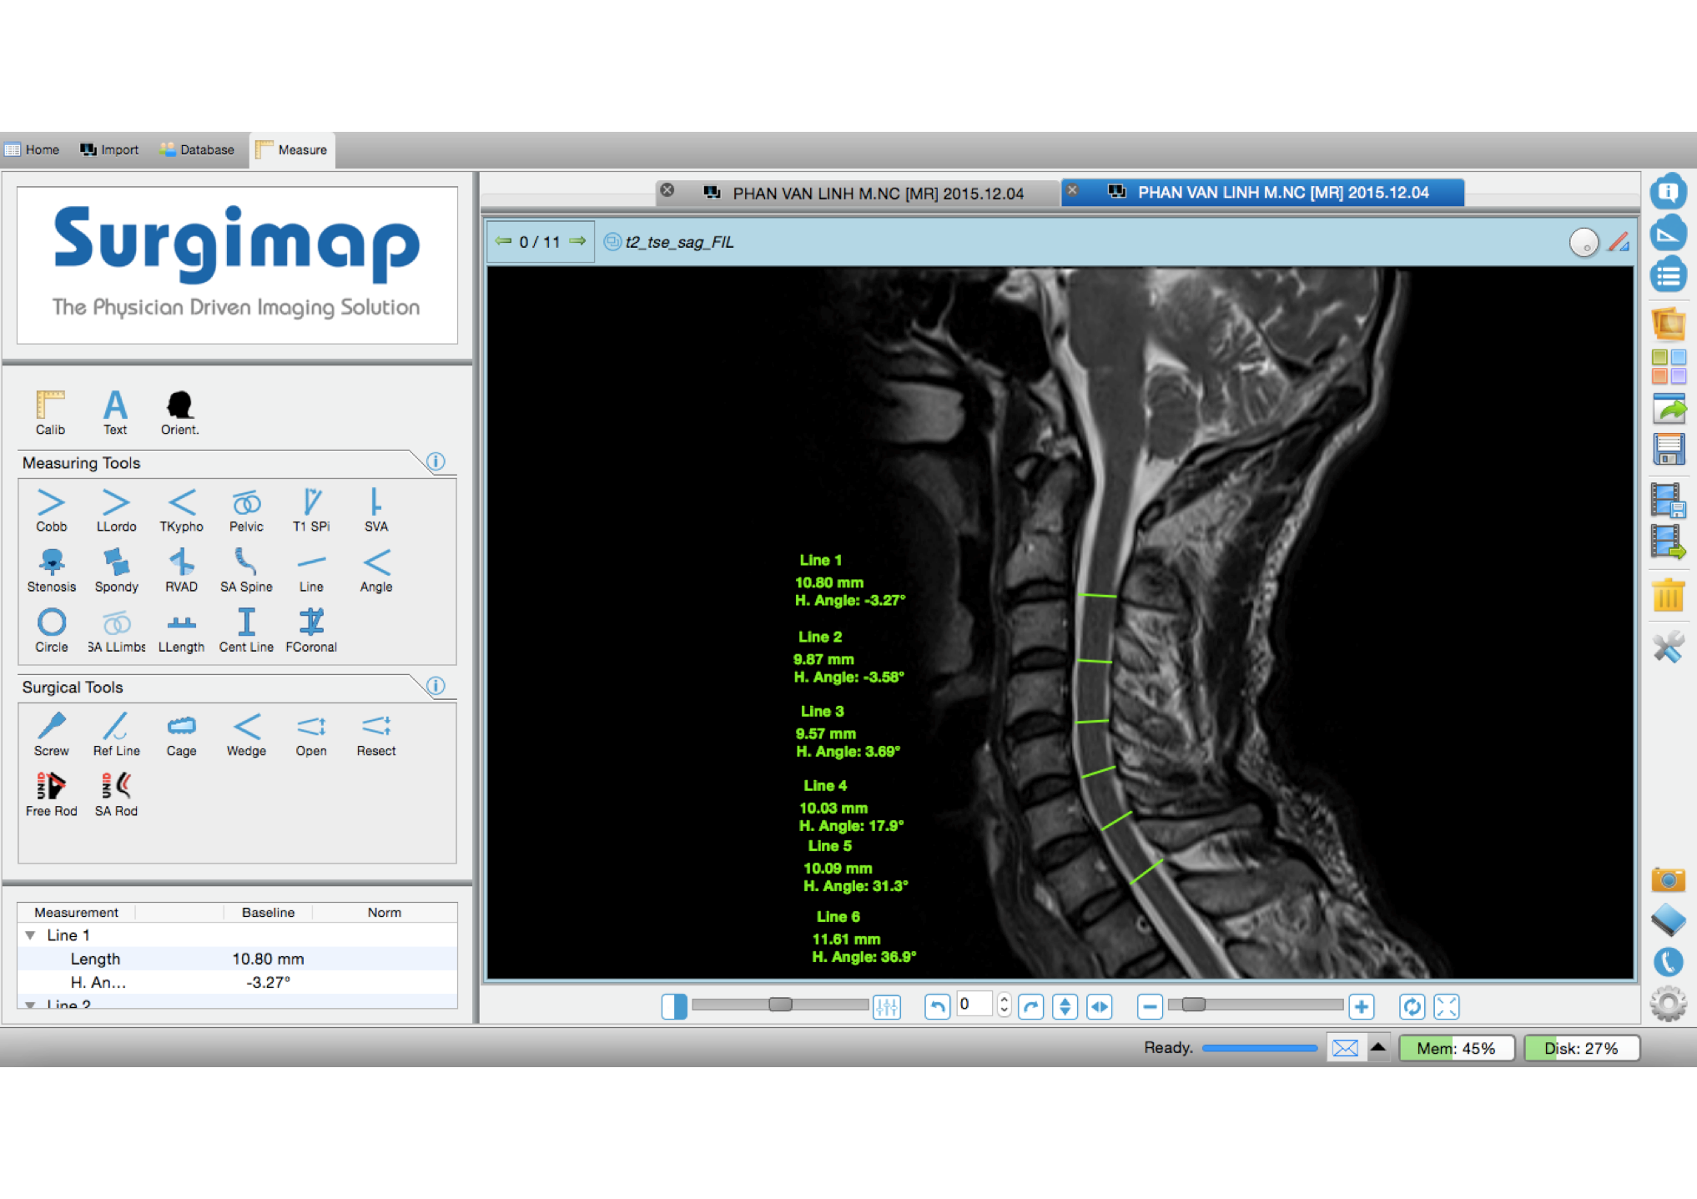

Slide 8
RESULTS
50 CSM patients : patient group
20 healthy volunteers : control group

Slide 9
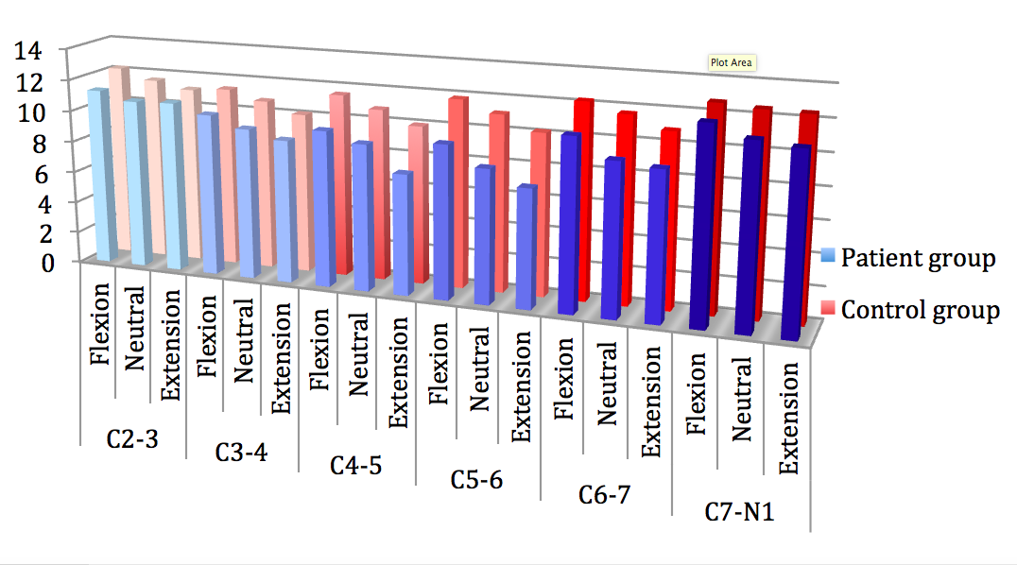

Slide 10
Remarks
Mean SAC decreases from C2-3 to C5-6 and increases again to C7-D1 (SAC is smallest at C5-6 level): both groups
SAC of control group at each level is greater than that of patient group (p<0.05).
SAC of each level decreases from flexion position to neutral and than to extension position: both groups

Slide 11
ΔSAC (FLEXION-EXTENSION) IN DIFFERENT LEVELS

Slide 12
Biomechanics of cervical spine:
C2-3, C3-4: low ROM → less dynamic effect
C4-5, C5-6: high ROM→ more dynamic effect
C6-7, C7-T1: flexion > extension (long spinous process → extension limited) → SAC flexion > neutral = extension

Slide 13
SAC flexion > neutral > extension:
Flexion mechanism: low risk of SCI
Extension mechanism: high risk of SCI
Patients with spinal stenosis (developmental or congenital) + extension injury = Central cord syndrom

Slide 14
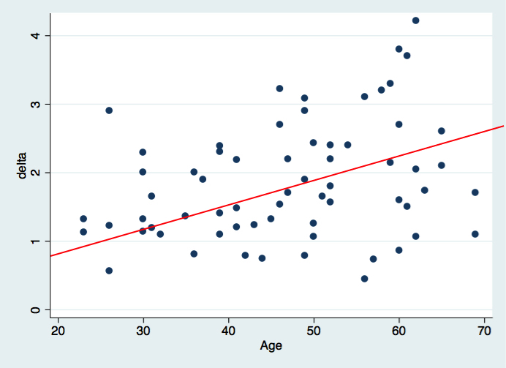
Pooled data

Slide 15
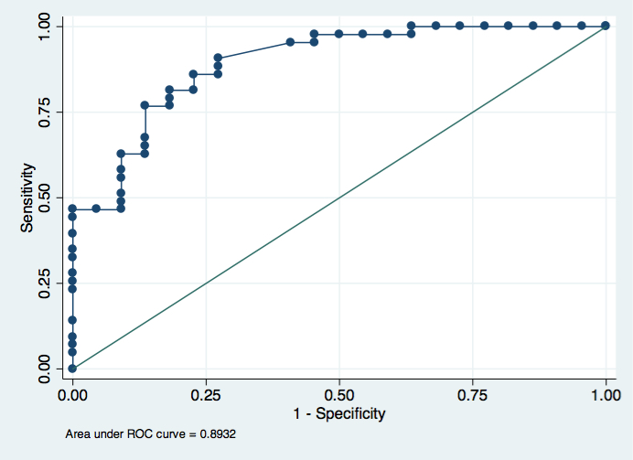
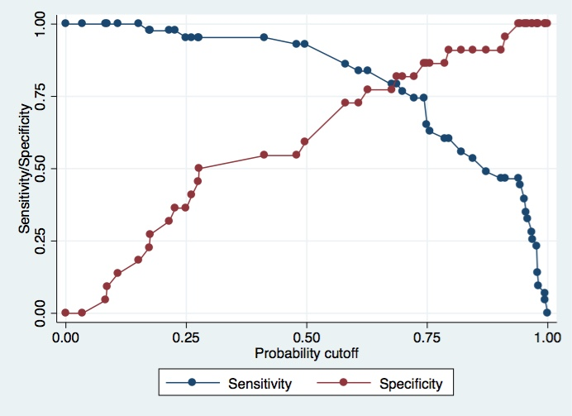
Receiver operating charcteristic curve method
Cutoff point differentiating the two groups: 10.8mm
Sensitivity: 90.7%
Specificity: 72.7%

Slide 16
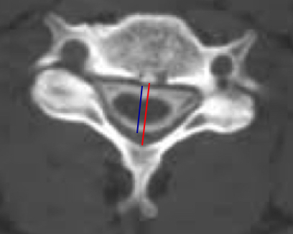
SAC < 11mm: Risk of dynamic compression of spinal cord
Consistent with litterature: Spinal stenosis when mid-vertebral osseous diameter < 13mm
With 1mm of thickness of epidural soft tissue (fat & venous plexus): 13-(1+1)= 11mm

Slide 17
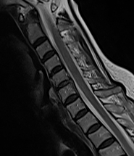
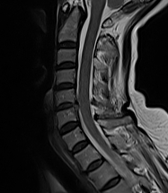
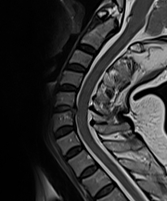
40 yo female, Herniation C5-6, hypertrophic ligamentum flavum C6-7
SAC: 11.6mm SAC: 9.9mm SAC: 8.7mm

Slide 18
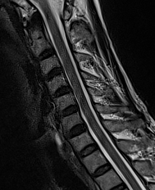
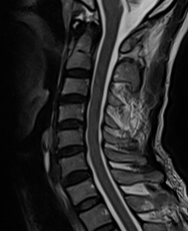
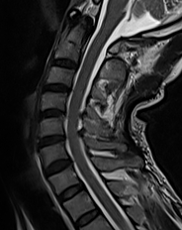
57 yo male patient. Degeneration of cervical spine. Hidden hypertrophic ligamentum flavum at C4-5, C5-6 (Arrow).
SAC: C4-5: 10.8mm SAC: C4-5: 10.3mm SAC: C4-5: 8.1mm
C5-6: 10.3mm C5-6: 9.2mm C5-6: 8.7mm

Slide 19
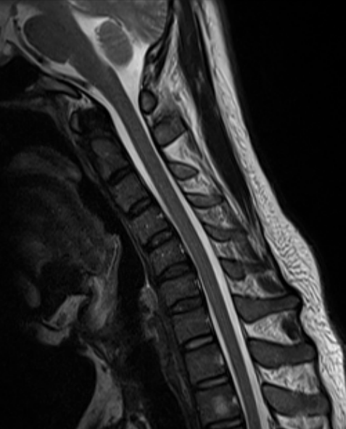
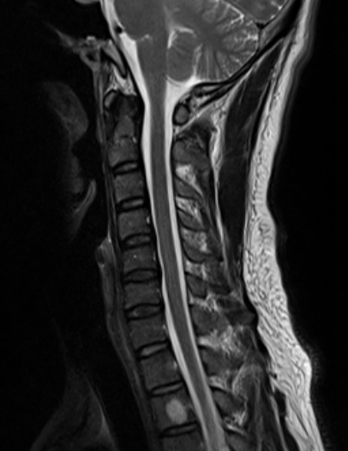
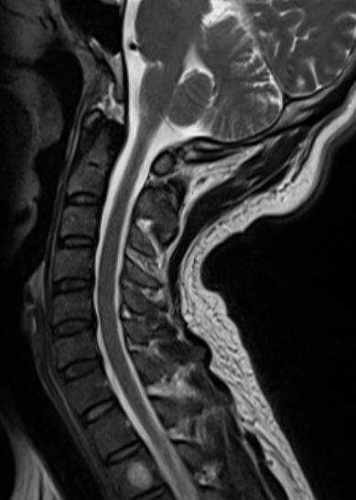
33 yo male healthy volunteer
SAC: C5-6: 13 mm SAC: C5-6: 11.4mm SAC: C5-6: 10 mm

Slide 20
TAKE HOME MESSAGES
Position of the neck is important when taking MRI → Risk of false negative
Avoid hyperextension position in long surgeries and when intubating: risk of dynamic compression of the spinal cord
CSM patients with symptoms unexplainable by MRI and SAC <11mm: MRI with the neck extended to reveal insidious compression site

Slide 21
CONCLUSION
kMRI is better than sMRI in:
Evaluating of dynamic compression
(disc & yellow ligament bulging)
Revealing “hidden hypertrophic ligametum flavum” unseen on conventional static MRI
→
Decision making
Help to predict adjacent segment syndrom after ACDF surgeries.

Slide 22
LIMITATIONS
Lack of weight bearing effect
Small number of patients and volunteers
→ No multivariate regression analysis
No pair-matching data
→ More elaborated study with bigger sample size in future is required

Slide 23
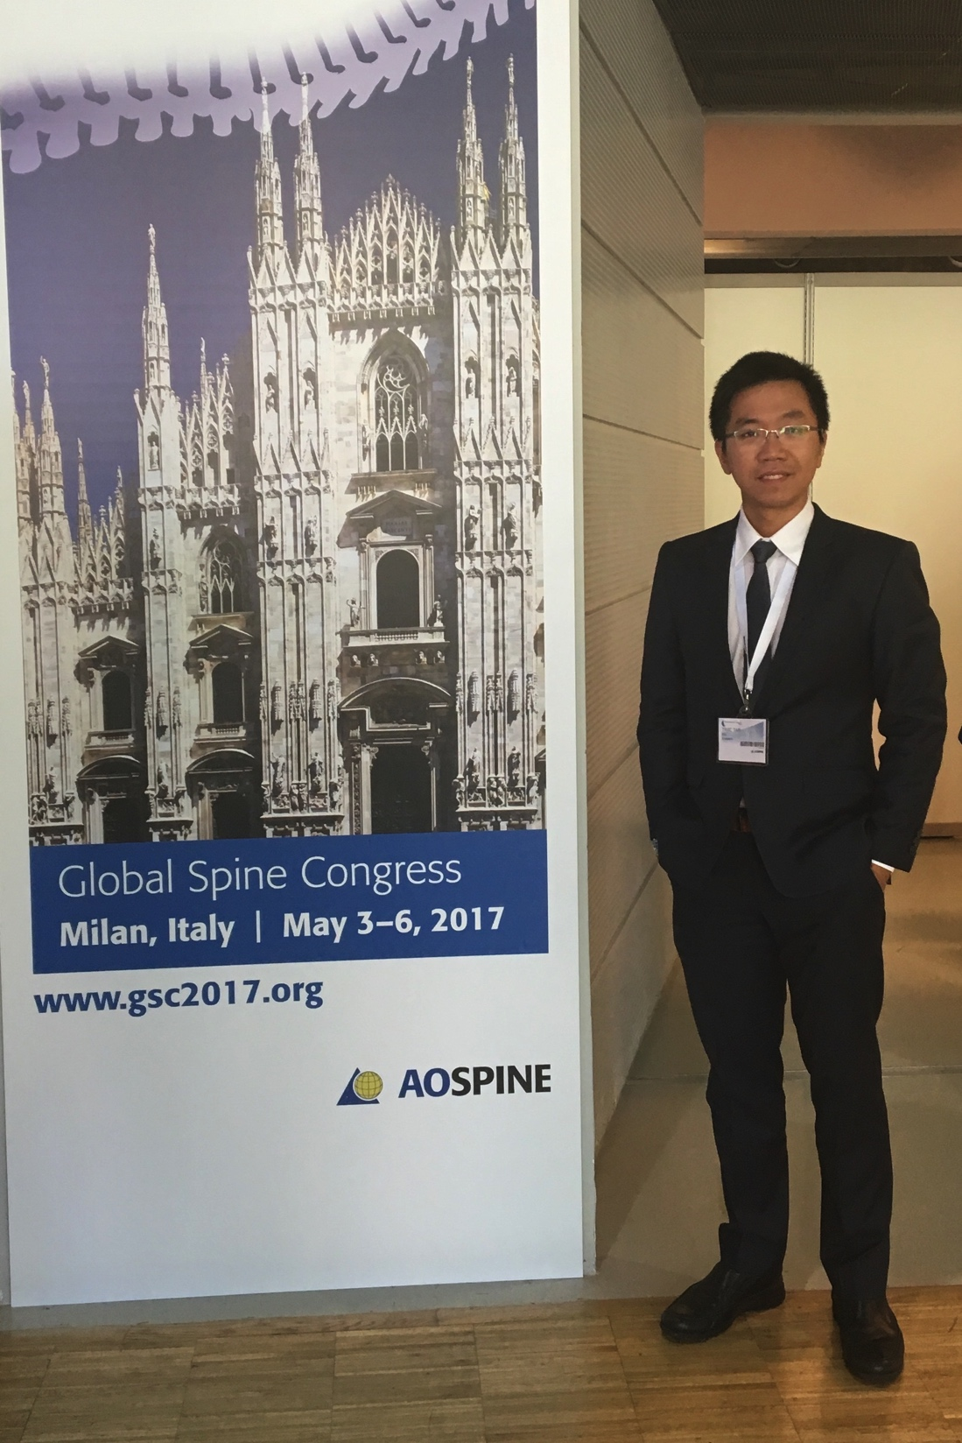
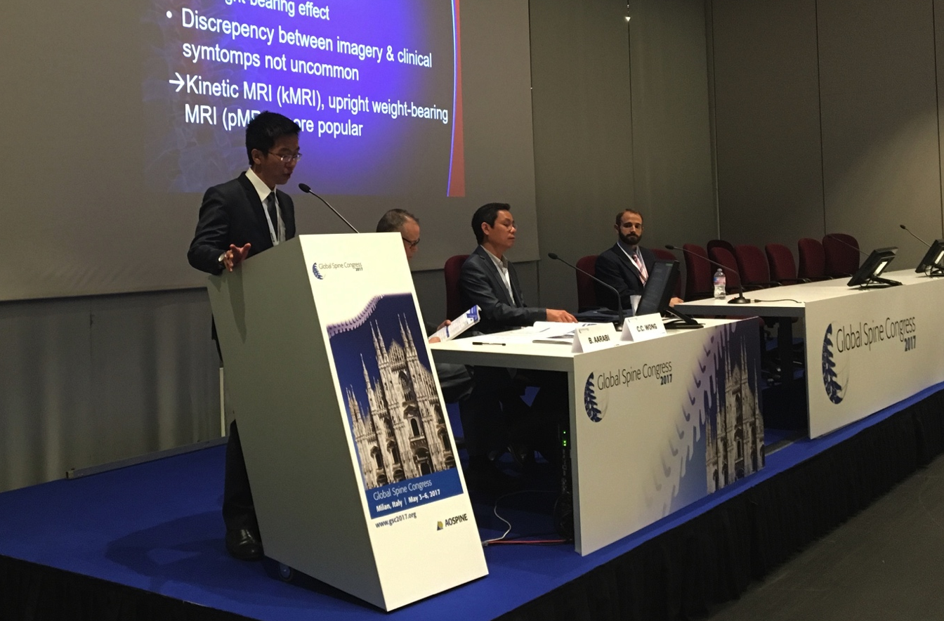

Slide 24
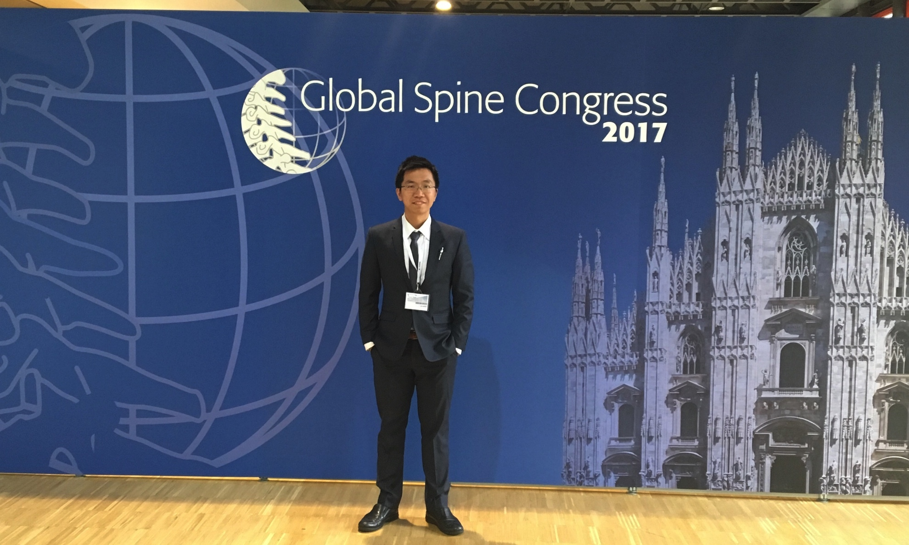
Thank you for your attention !

