Slide 1

ALLOGRAFT-PROSTHESIS COMPOSITES FOR RECONSTRUCTION AFTER BONE TUMOR RESECTION AT THE PROXIMAL FEMUR – A CASE REPORT
Le Van Tho, MD, PhD
Ngo Viet Nhuan, MD
2018

Slide 2

Case presentation
60 years old woman
Chief complaint: Left hip pain
History of present illness
  The patient had suffered from left hip pain 6 months ago, which had not improved with medications
  On the day before hospitalization, she fell → increasing pain
Physical examination
  Pain and swelling around the left hip
  Shortening of the left leg

Slide 3
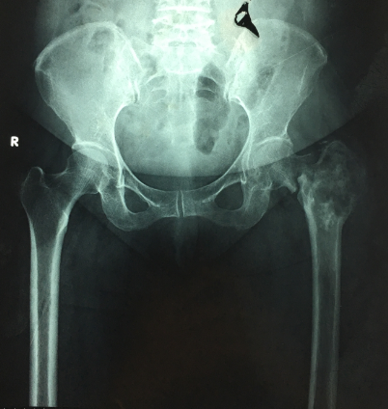
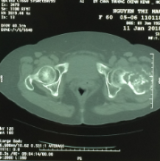
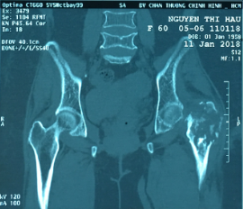
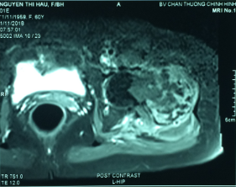
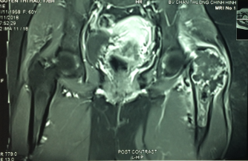
Imaging
Coronal -MRI
CTscan
Axial - MRI

Slide 4
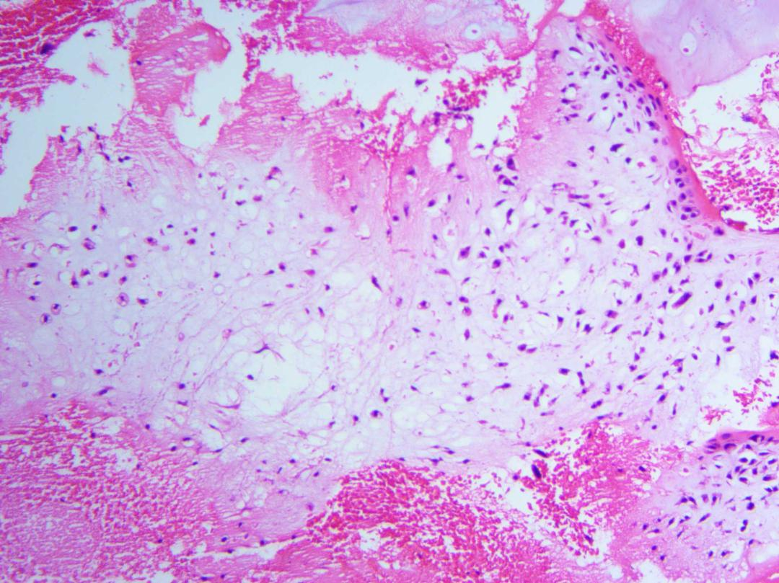
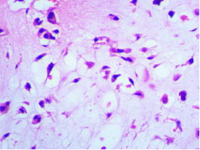
Pathology
Pathological diagnosis: Chondrosarcoma

Slide 5
Diagnosis
Pathological fracture of Left femoral neck - Chondrosarcoma
Treatment
Wide resection and reconstruction with Allograft – Prosthesis Composites (APC)

Slide 6
Preoperative planning
Tumor resection
Allograft – Prosthesis Composites reconstruction
Soft tissue reconstruction

Slide 7
Preoperative planning - Tumor resection
Gluteus Maximus and Medius Detachment
Vastus Lateralis Reflection
Detachment of Posterior Hip Musculature and Capsule
Distal Femur Osteotomy
Dislocation of the Femur
Release of Medial Structure
Notes:
Có khâu đánh dấu các gân cơ

Slide 8
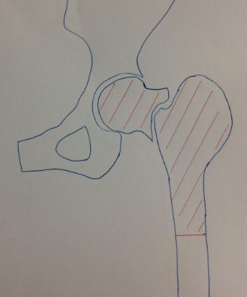
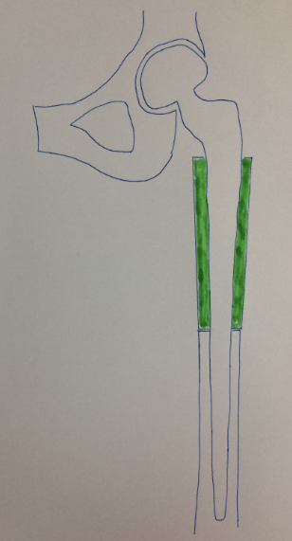
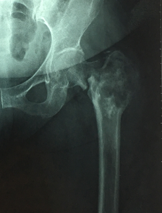
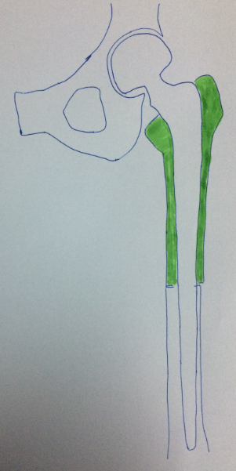
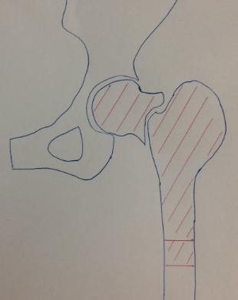
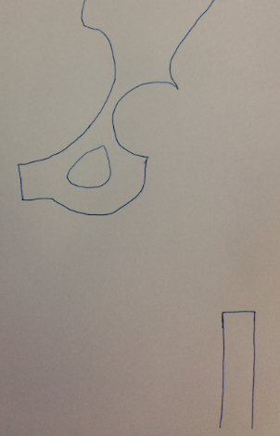
Preoperative planning – APC reconstruction
Notes:
Chiều dài stem: The femoral stem must be long enough to reach the distal femoral diaphyseal-metaphyseal junction, or else to achieve at least 6 cm of prosthesis-shaft contact bypassing the allograft-host junction.
Thêm hình ghép xương có mấu chuyển
Không có xương ghép mấu chuyển chỉ có thân xương đùi

Slide 9
Preoperative planning – Soft Tissue reconstruction
Reconstruction of the Hip Capsule
Reconstruction of the Abductor Mechanism and Iliopsoas
  Gluteus medius
  Vastus laterallis
  Iliopsoas

Slide 10
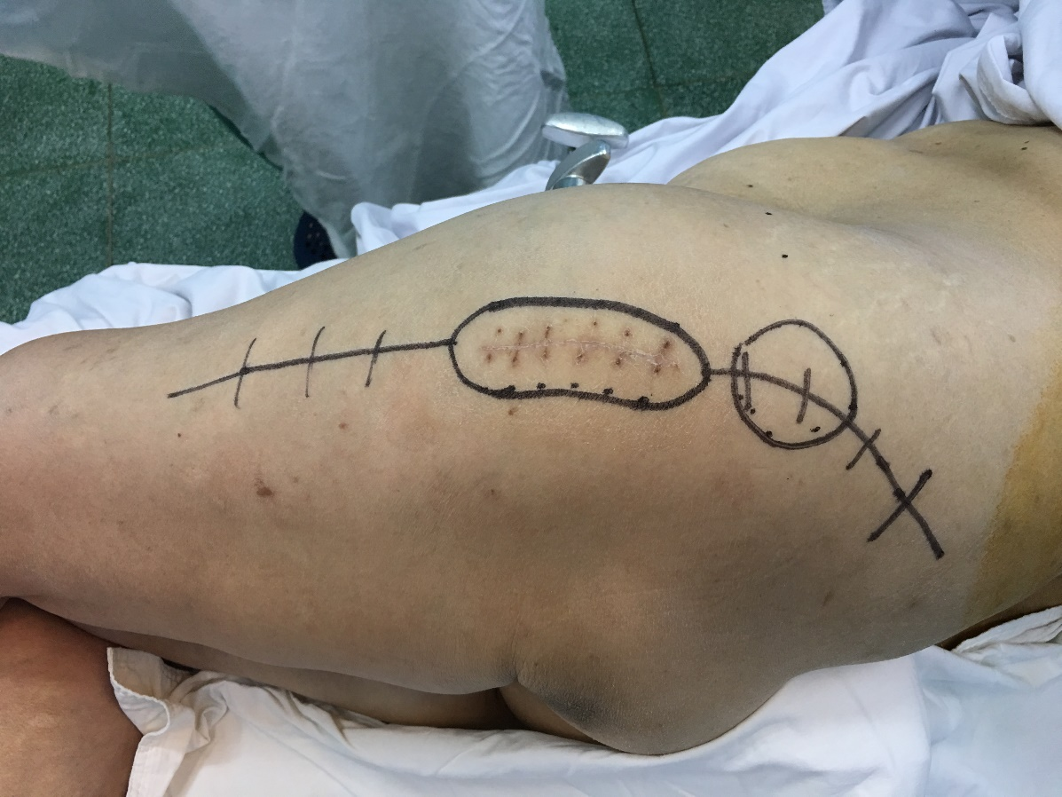
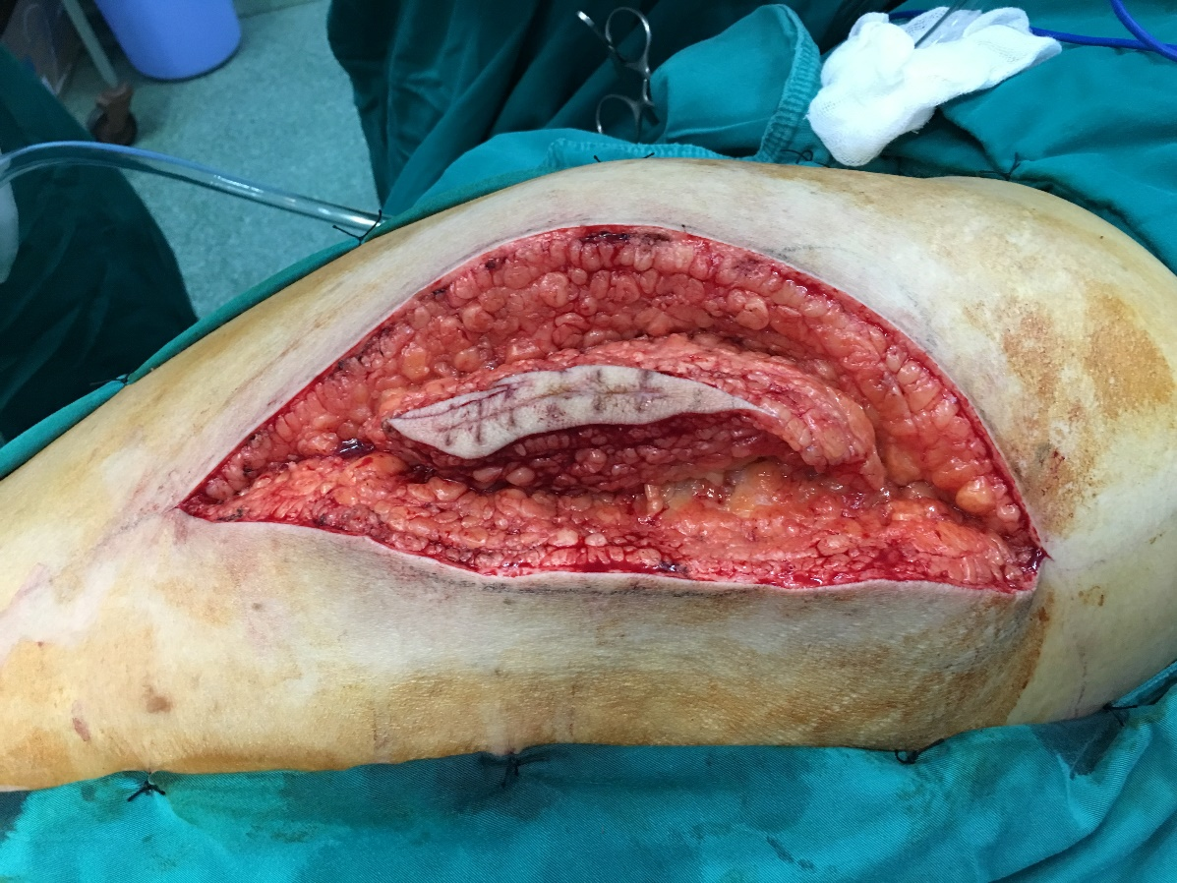
Intraoperative images

Slide 11
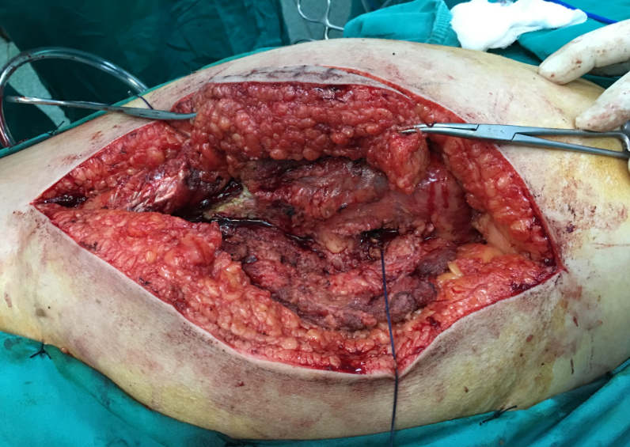
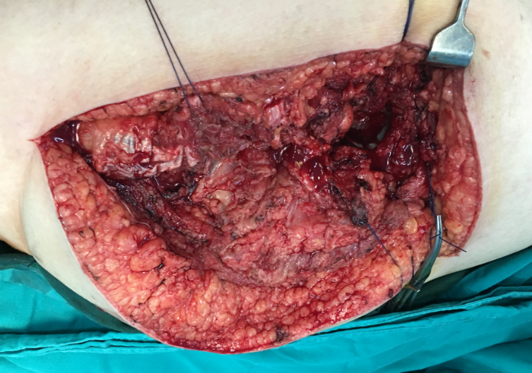
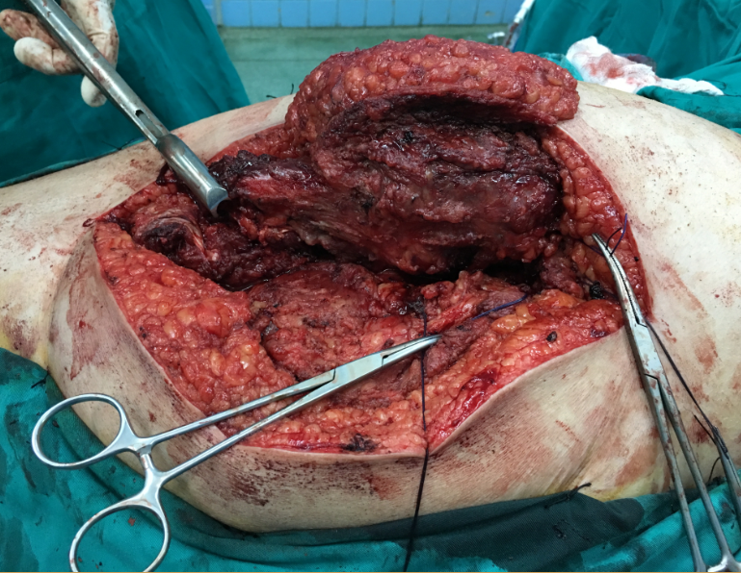
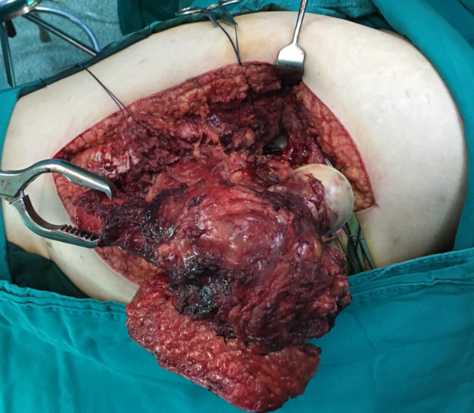
Intraoperative images

Slide 12
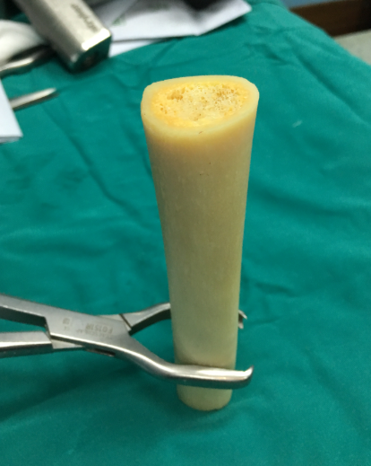
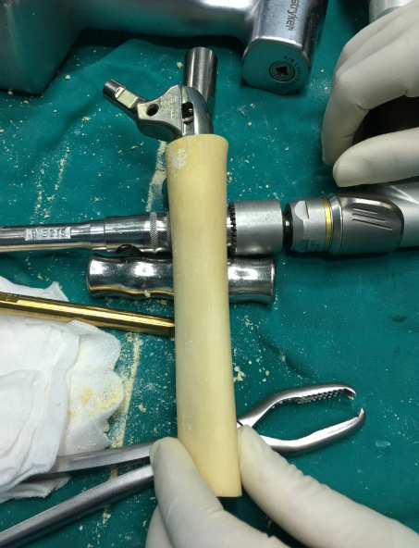
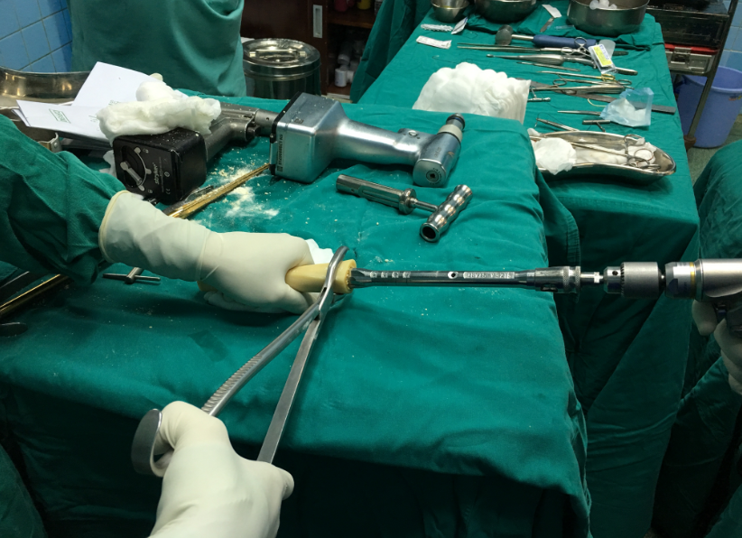
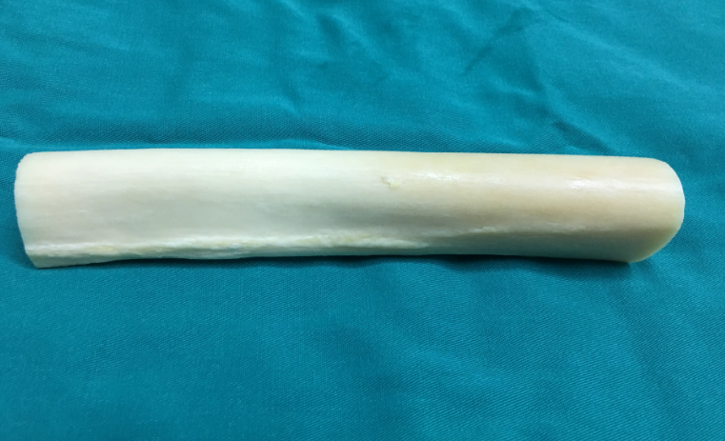
Intraoperative images

Slide 13
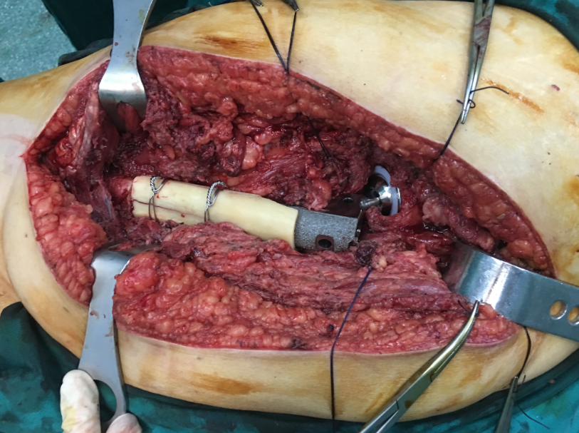
Intraoperative images

Slide 14
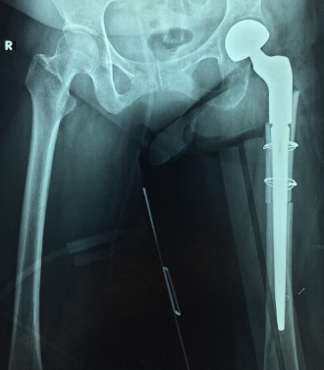
Postoperative imaging
Pre-Op
Post-Op

Slide 15
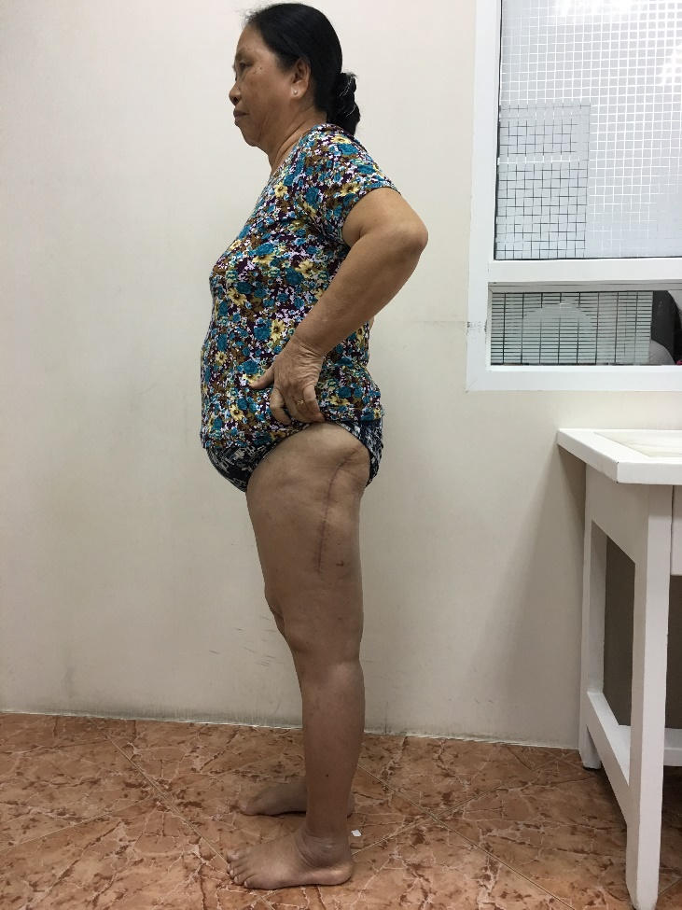
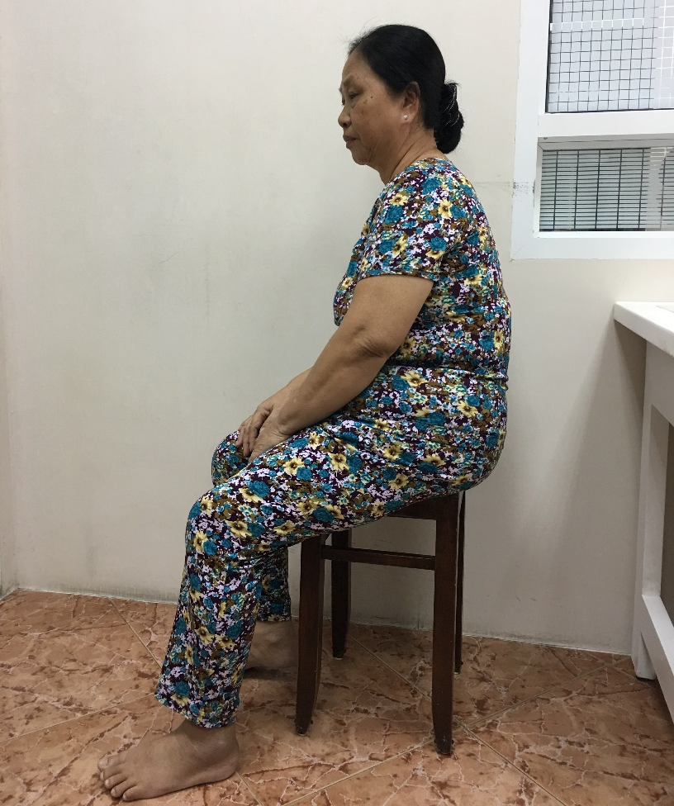
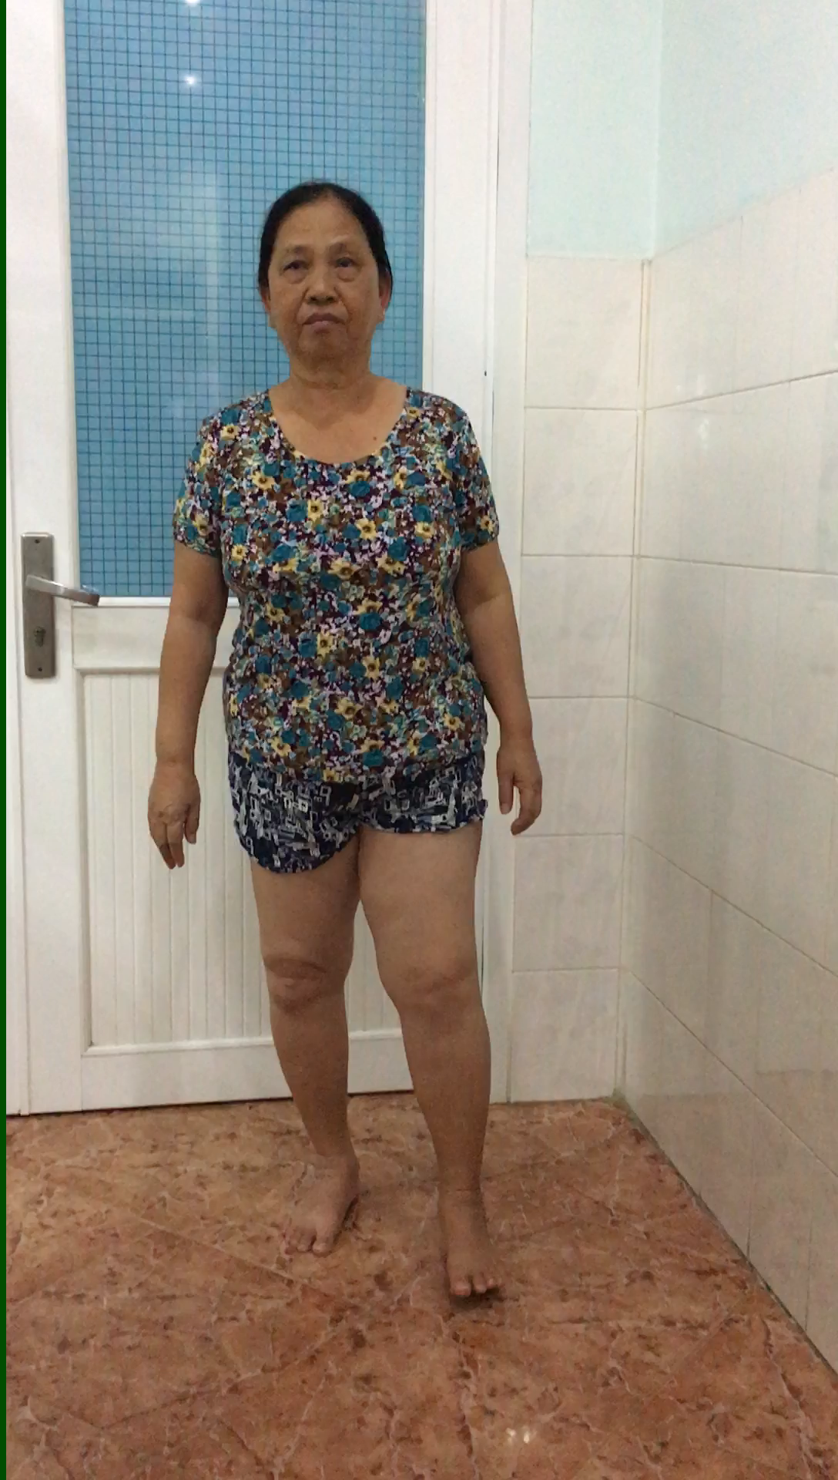
2,5 months FU

Slide 16
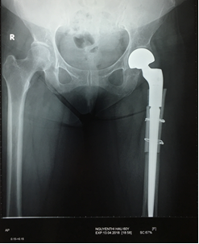
2,5 months FU
Post-Op
2.5 months FU

Slide 17
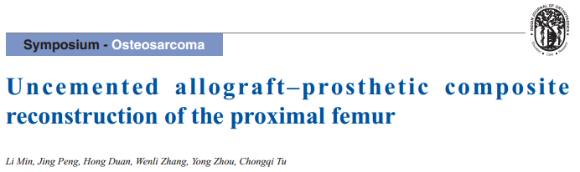
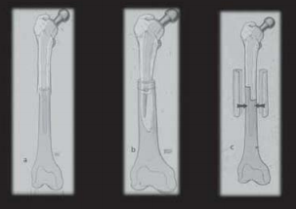
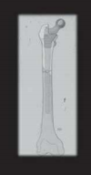
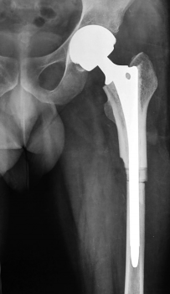
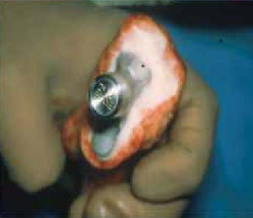
Discussion – Stability
Femoral Osteotomy
Cementing
Reaming
Stem length
Press fit is considered to be safe when there is at least
6 cm of prosthesis-shaft contact bypassing the allograft host junction ¹
1. The diameter of reaming can be a little smaller than that of the prosthetic stem
2.. The host bone should be reamed 2 cm shorter than the length of the distal prosthetic stem ²
A: Transverse. B: Intussuception. C: Step cut. D: Oblique ¹
A: Cemented
B: Partially cemented
C: Cementless
1. Sim, F. H., Choong, P. F., & Weber, K. L. (2011). Master Techniques in Orthopaedic Surgery: Orthopaedic Oncology and Complex Reconstruction. Lippincott Williams & Wilkins.
2. Min, L., Peng, J., Duan, H., Zhang, W., Zhou, Y., & Tu, C. (2014). Uncemented allograft–prosthetic composite reconstruction of the proximal femur. Indian journal of orthopaedics, 48(3), 289.
Notes:
Secondly, in order to gain a perfect distal fit, the diameter of reaming can be a little smaller than that of the prosthetic stem Thirdly, the host bone should be reamed 2 cm shorter than the length of the distal prosthetic stem, so that the distal part of the stem can be pressed directly into the host bone to increase stability.

Slide 18
Discussion – Soft tissue reconstruction
Soft tissue Reconstruction
Wide Resection
Instability
Impaired function
Malawer, M. M., & Sugarbaker, P. H. (2001). Musculoskeletal cancer surgery: treatment of sarcomas and allied diseases. Springer Science & Business Media..

Slide 19
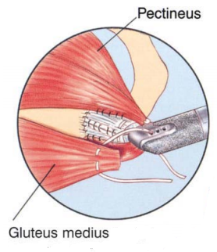
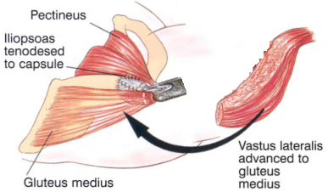
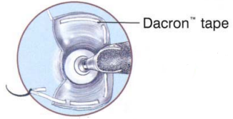
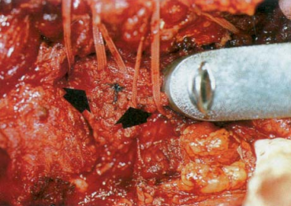
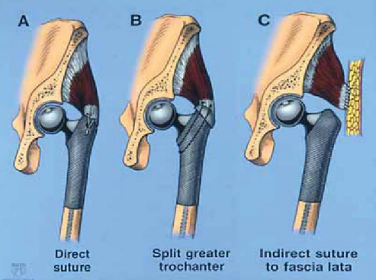
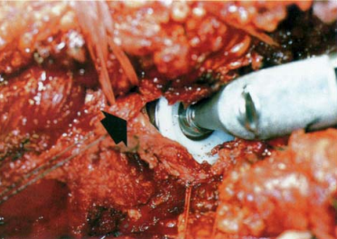
Discussion – Soft tissue reconstruction
Reconstruction of the Hip Capsule
Reconstruction of the Abductors & Iliopsoas
  Gluteus medius
  Vastus laterallis
  Iliopsoas
1. Sim, F. H., Choong, P. F., & Weber, K. L. (2011). Master Techniques in Orthopaedic Surgery: Orthopaedic Oncology and Complex Reconstruction. Lippincott Williams & Wilkins.
2. Malawer, M. M., & Sugarbaker, P. H. (2001). Musculoskeletal cancer surgery: treatment of sarcomas and allied diseases. Springer Science & Business Media..

Slide 20
Discussion – Megaprostheses VS APC
Resection Arthrodesis
Wide Resection
Reconstruction Bone Defect
Endoprosthesis
APC
Distraction Osteogenesis
Malawer, M. M., & Sugarbaker, P. H. (2001). Musculoskeletal cancer surgery: treatment of sarcomas and allied diseases. Springer Science & Business Media..

Slide 21
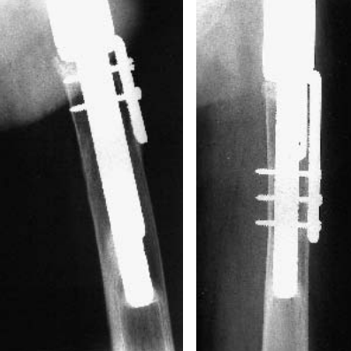
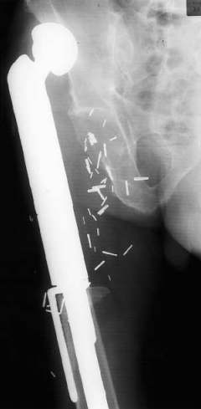
Discussion – Megaprostheses
 | No of patients | Average FU | Complications
Ilyas ¹ | 15 | 78 m | 2 infections, 3 dislocations
Ueda ² | 25 | 163 m | 8 infections, 4 dislocations
Donati ³ | 25 | 12 y | 1 infections, 17 stress shielding
Dislocation
Stress shielding
1.Ilyas I, Pant R, Kurar A, Moreau PG, Younge DA. Modular megaprosthesis for proximal femoral tumors. Int Orthop. 2002;26(3)170–173
2.Ueda T, Kakunaga S, Takenaka S, Araki N, Yoshikawa H. Constrained total hip megaprosthesis for primary periacetabular tumors. Clin Orthop Relat Res. 2013;471(3):741–74910.1007/s11999-012-2625-8.
3.Donati D, Zavatta M, Gozzi E, Giacomini S, Campanacci L, Mercuri M. Modular prosthetic replacement of the proximal femur after resection of a bone tumour a long-term follow-up. J Bone Joint Surg Br. 2001;83(8):1156–1160.

Slide 22
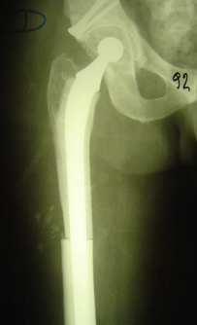
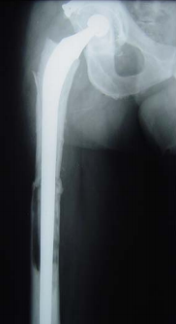
Discussion – APC
 | No of patients | Average FU | Complications
Biau ¹ | 18 | 83 m | 4 infections, 1 loosening
Eid ² | 18 | 93 m | 2 infections, 1 loosening
Langlias ³ | 21 | 10 y | 4 loosening
Loosening
1.Biau DJ, Davis A, Vastel L, Tomeno B, Anract P. Function, disability, and healthrelated quality of life after allograft-prosthesis composite reconstructions of the proximal femur. J Surg Oncol. 2008;97(3):210–215.
2.Eid AS, Jeon DG, Song WS, Lee SY, Cho WH. Pasteurized autograft–prosthesis composite for proximal femoral reconstruction: an alternative to allograft composite. Arch Orthop Trauma Surg. 2011;131(6):729–737.
3.Langlais F, Lambotte JC, Collin P, Thomazeau H. Long-term results of allograft composite total hip prostheses for tumors. Clin Orthop Relat Res. 2003;414:197–211.

Slide 23
Discussion – Megaprostheses VS APC
 | Megaprostheses | APC
Advantages | Easy to reconstruct | Restore bone stock
 | Immediate weight bearing
Disadvantages | Dislocation | Loosening
 | Revision difficulty | Nonunion

Slide 24
Take home messages
A stable allograft-host junction is essential
Soft tissue reconstruction is important for good functional outcome
Allograft Prosthesis Composites (APC) should be a limb salvage procedure of choice in cases with good life expectancy

