Slide 1
Total Hip Arthroplasty in Patient With proximal third of the Femoral Deformity: A case report.
Dr. Nguyễn Thái Thành, Đại Hoàng Ân, Nguyễn Quốc Thắng, Lê Trọng Hải

Slide 2
Patient Presents & Histories
64 yr old male
Complains of left hip pain for 2 years
Had a proximal third fracture of the left femur for 40 years & had a malunion of the proximal third of the left femur

Slide 3
Physical Exams
Vital signs: normal
His left lower limb was found to be shorter than the right
Passive range of motion of the left hip is limited and paiful

Slide 4
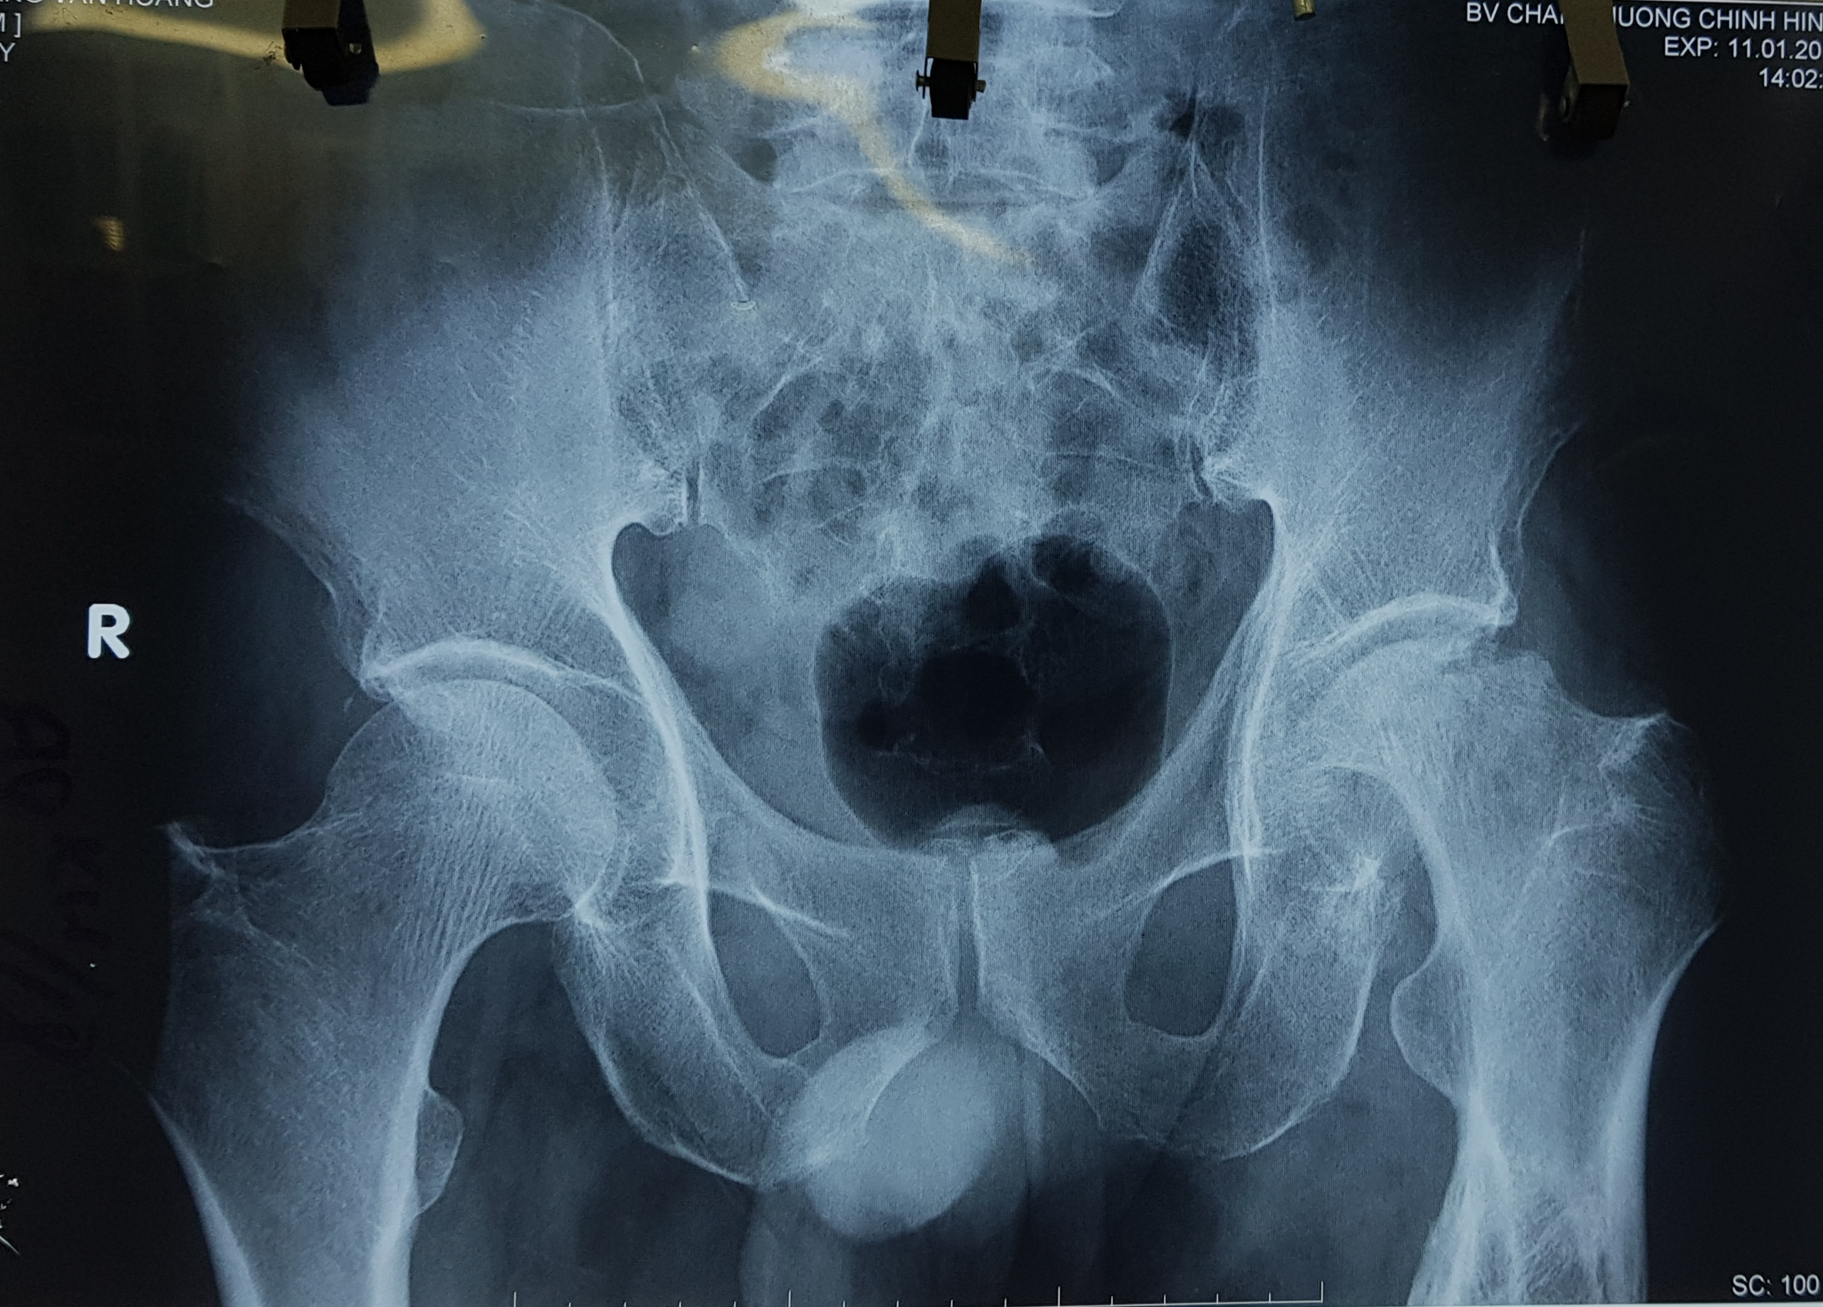
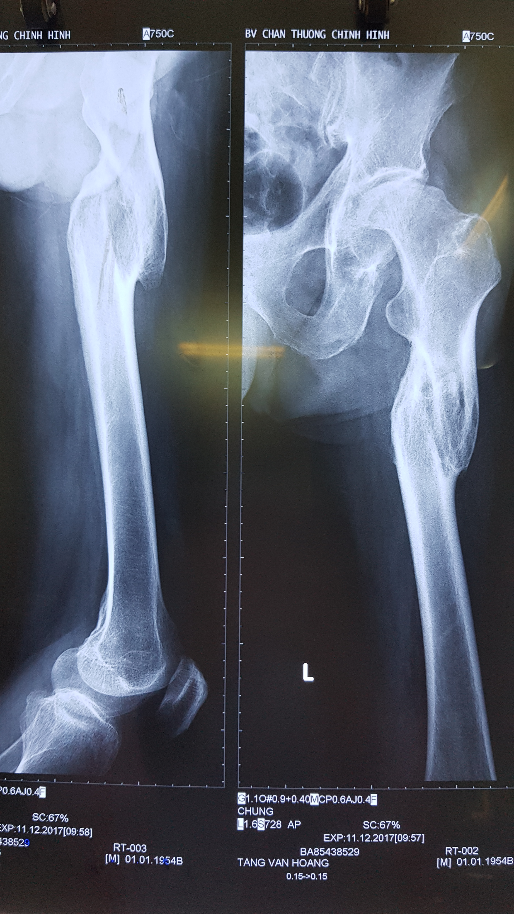
Labs/X-ray

Slide 5
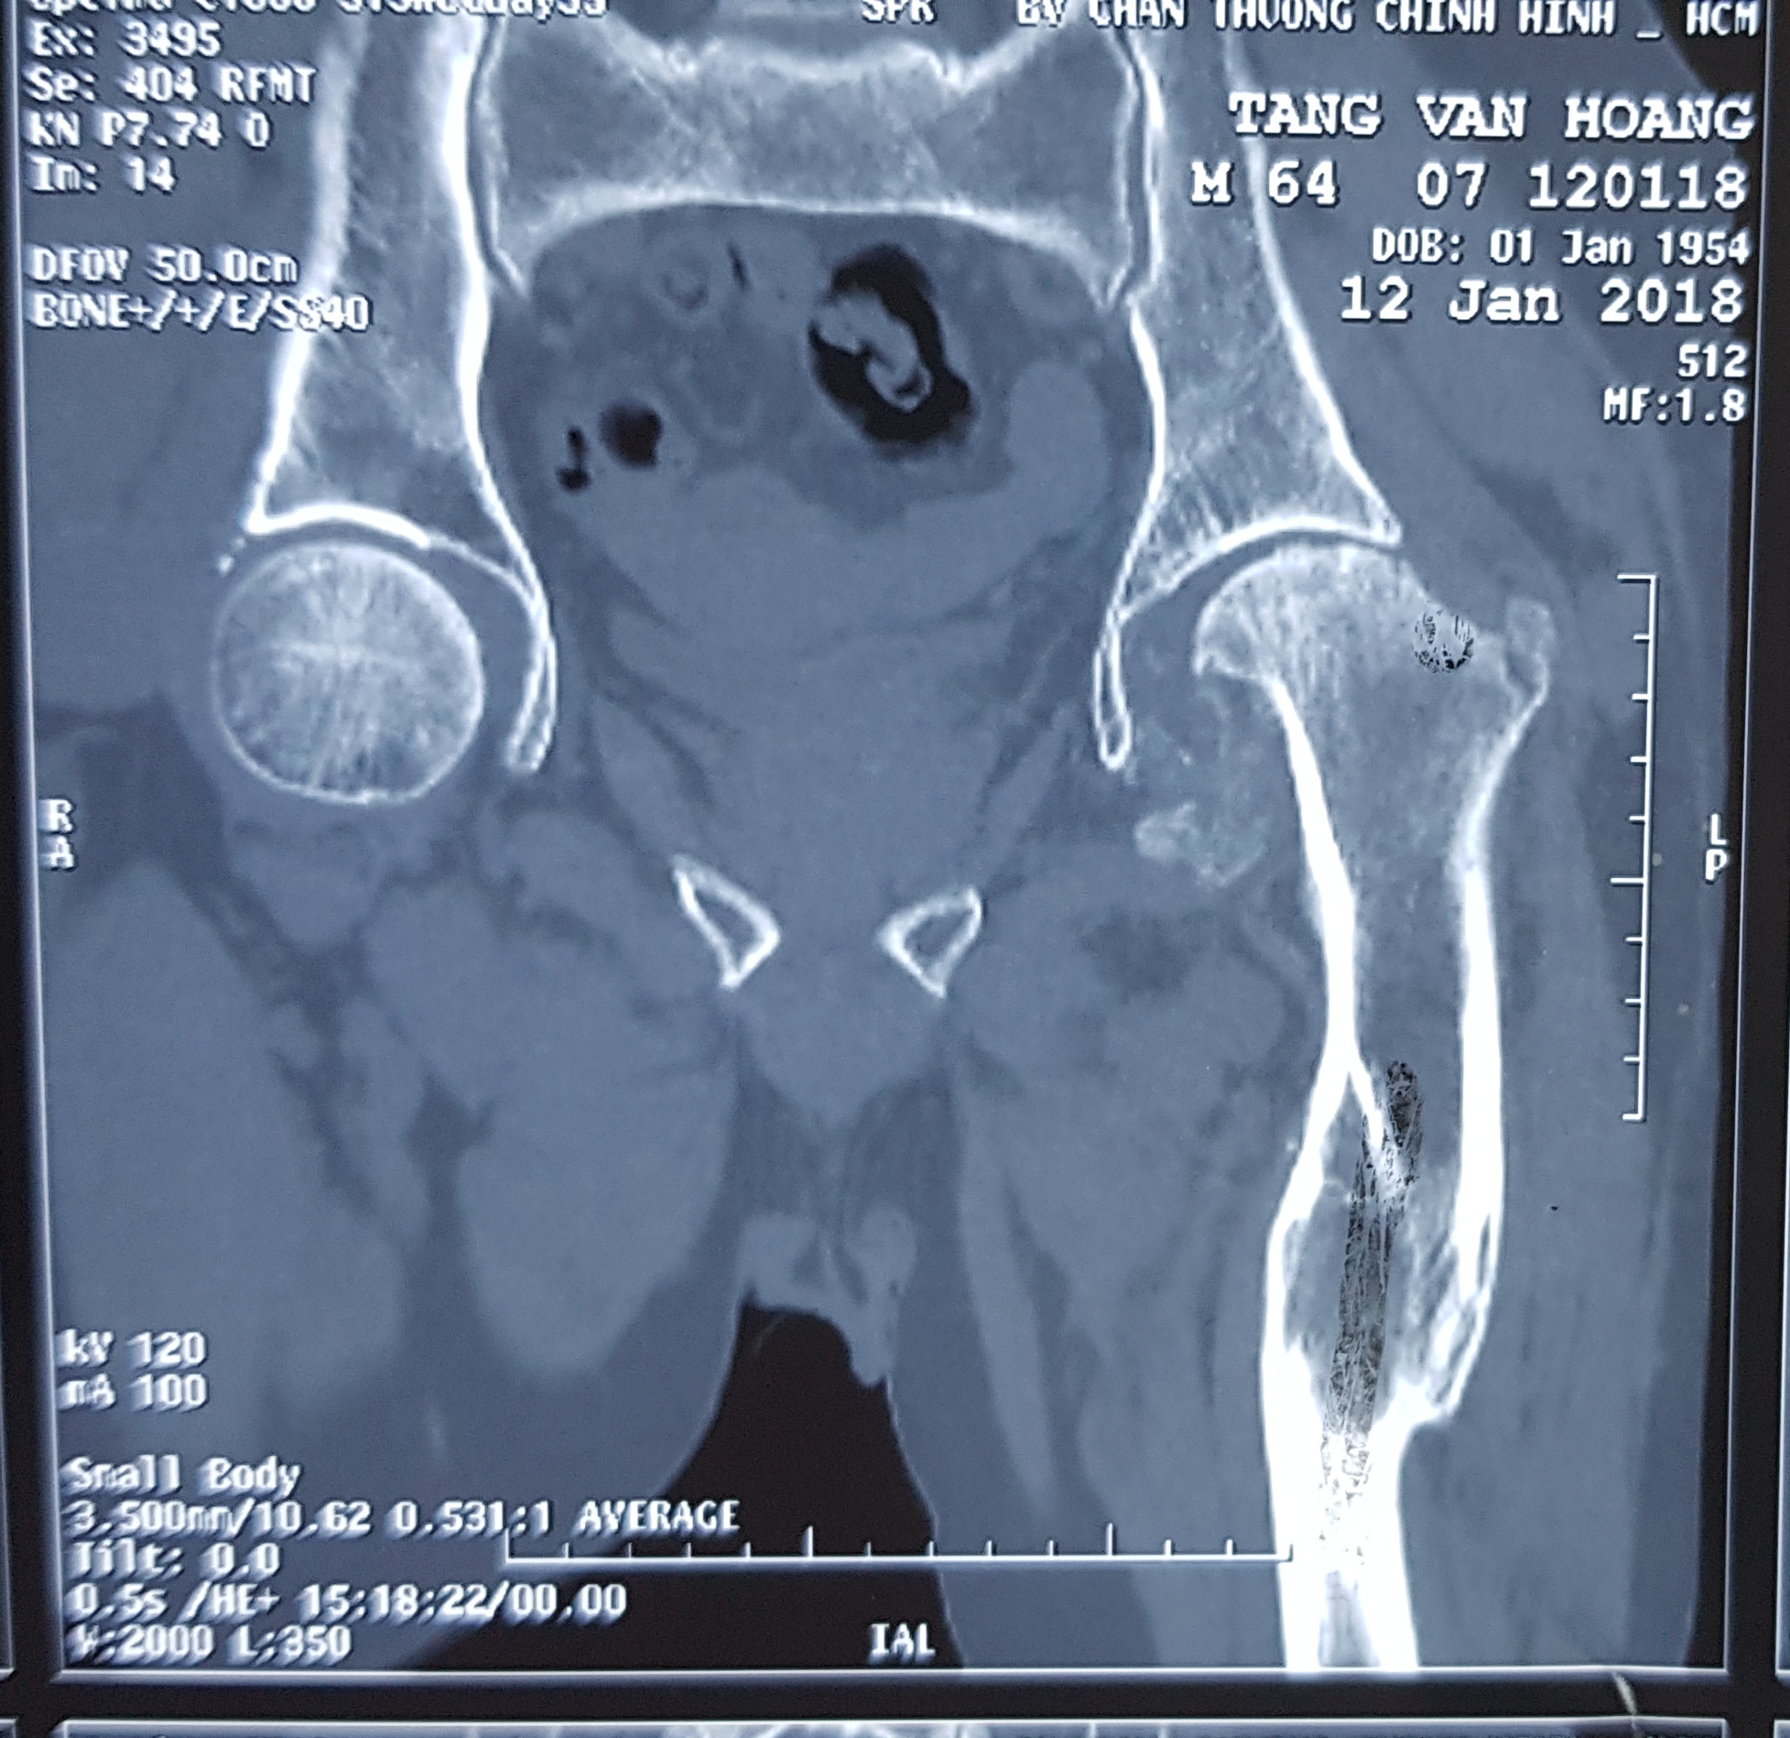
CT scan

Slide 6
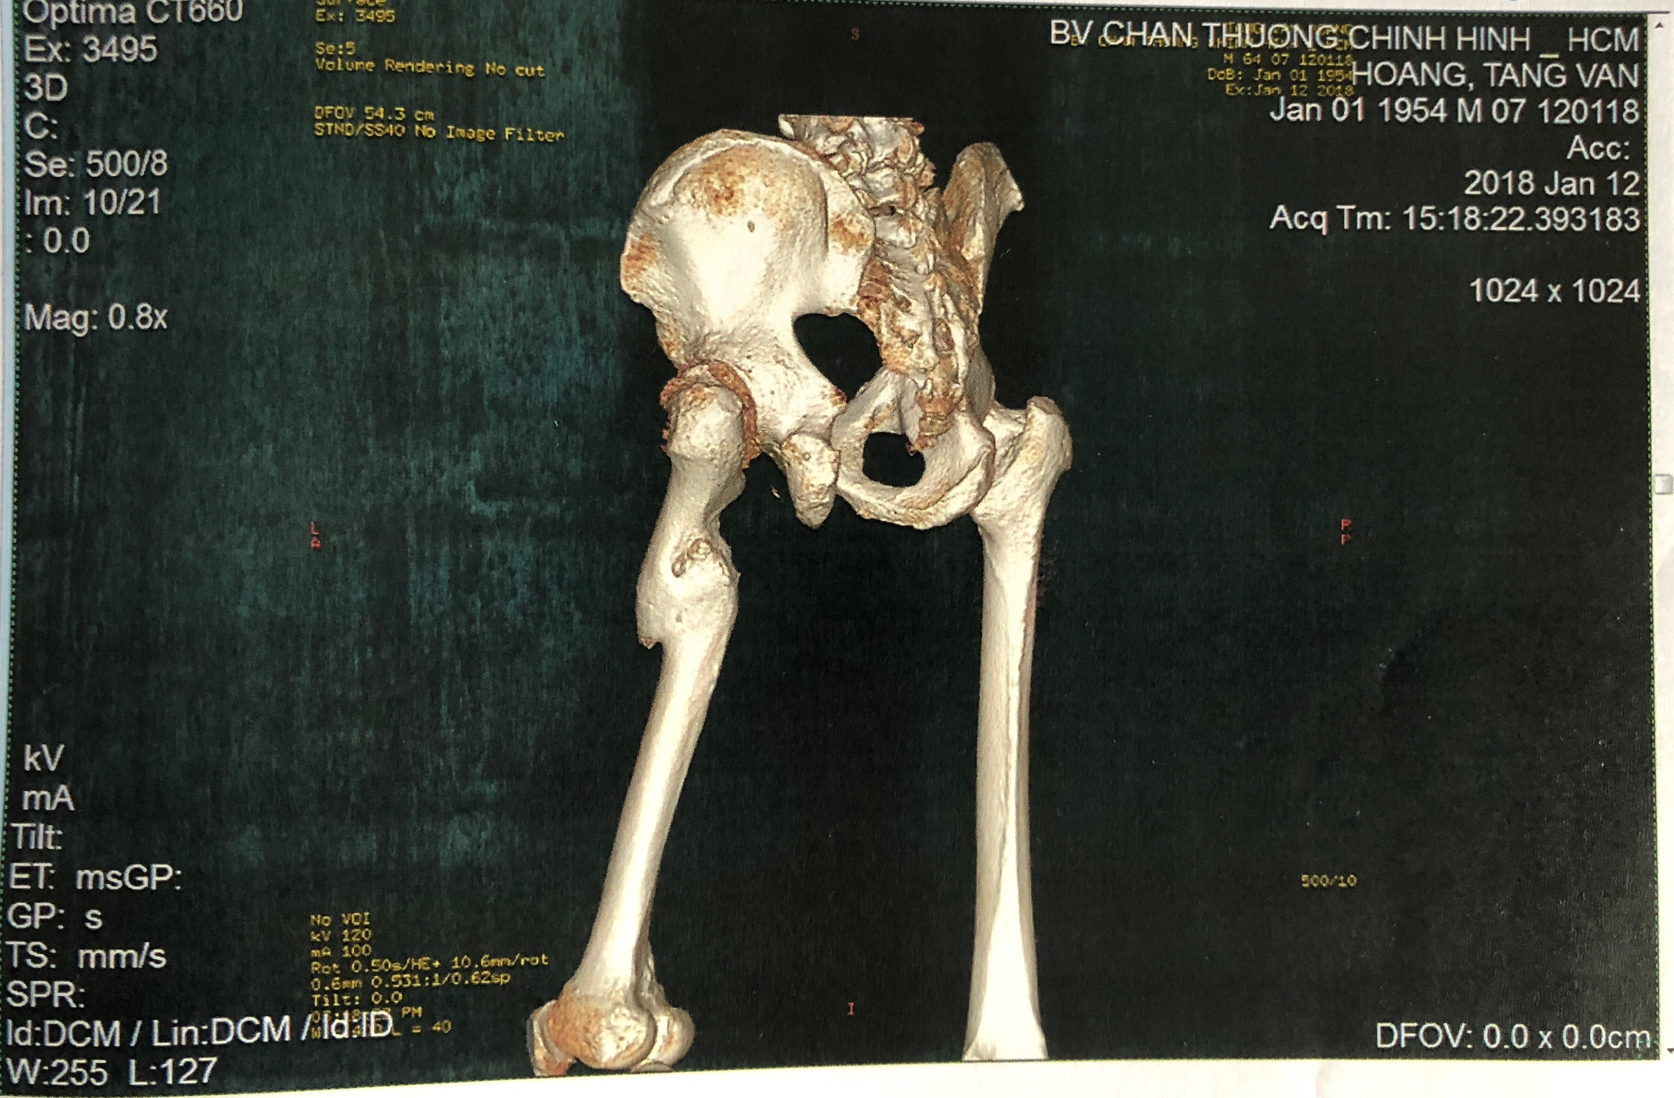
CT scan

Slide 7
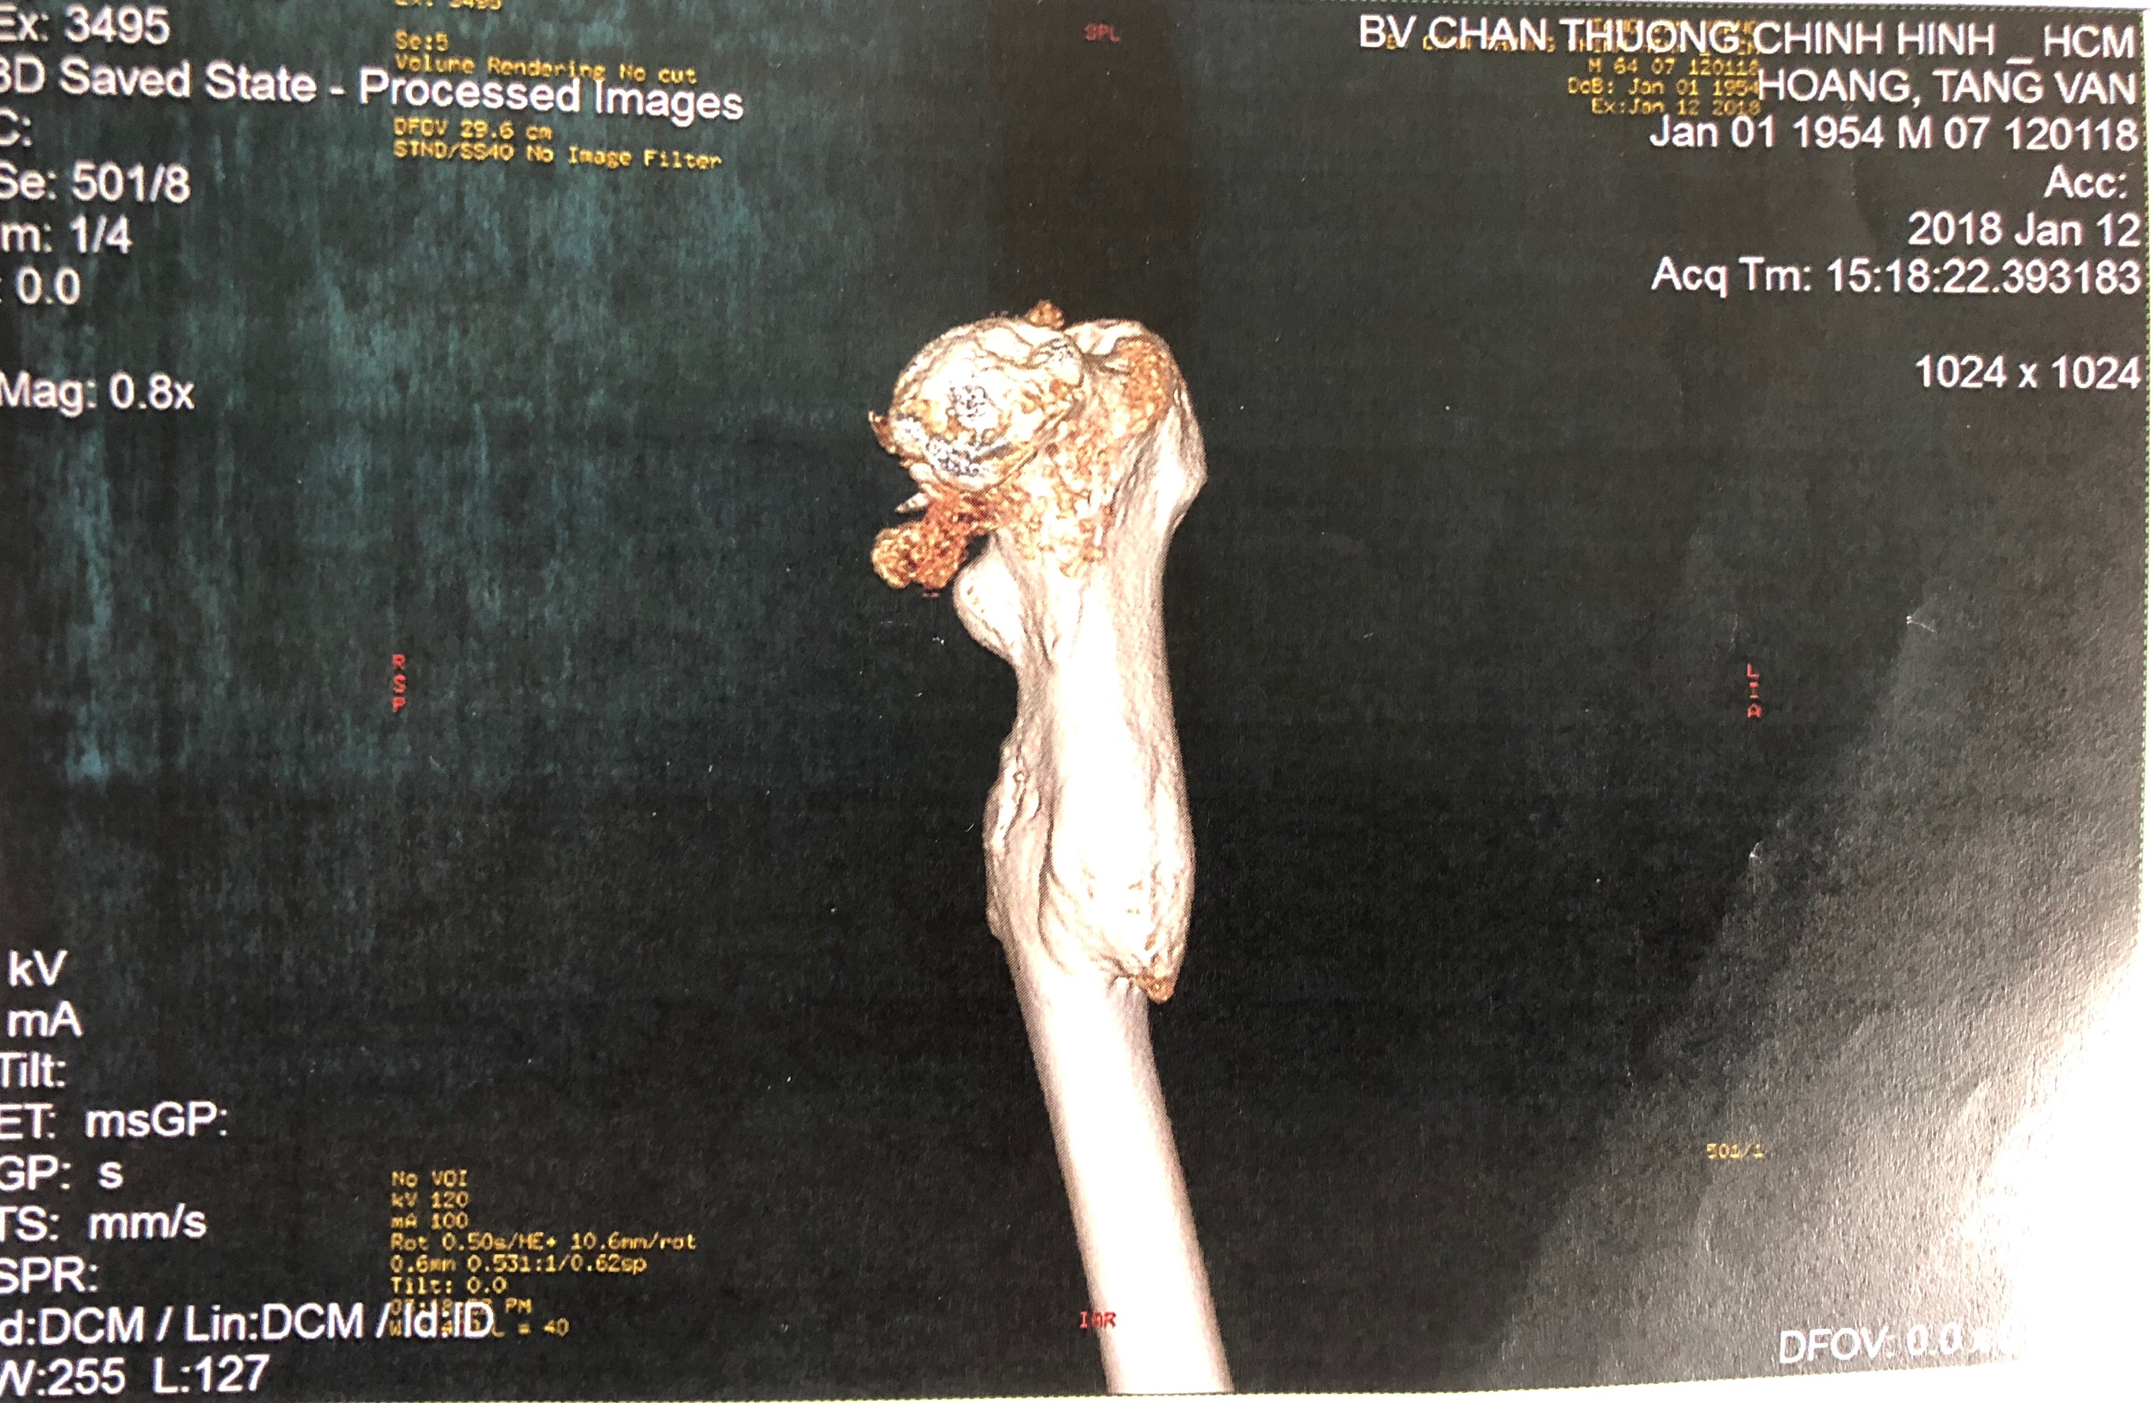
CT scan

Slide 8
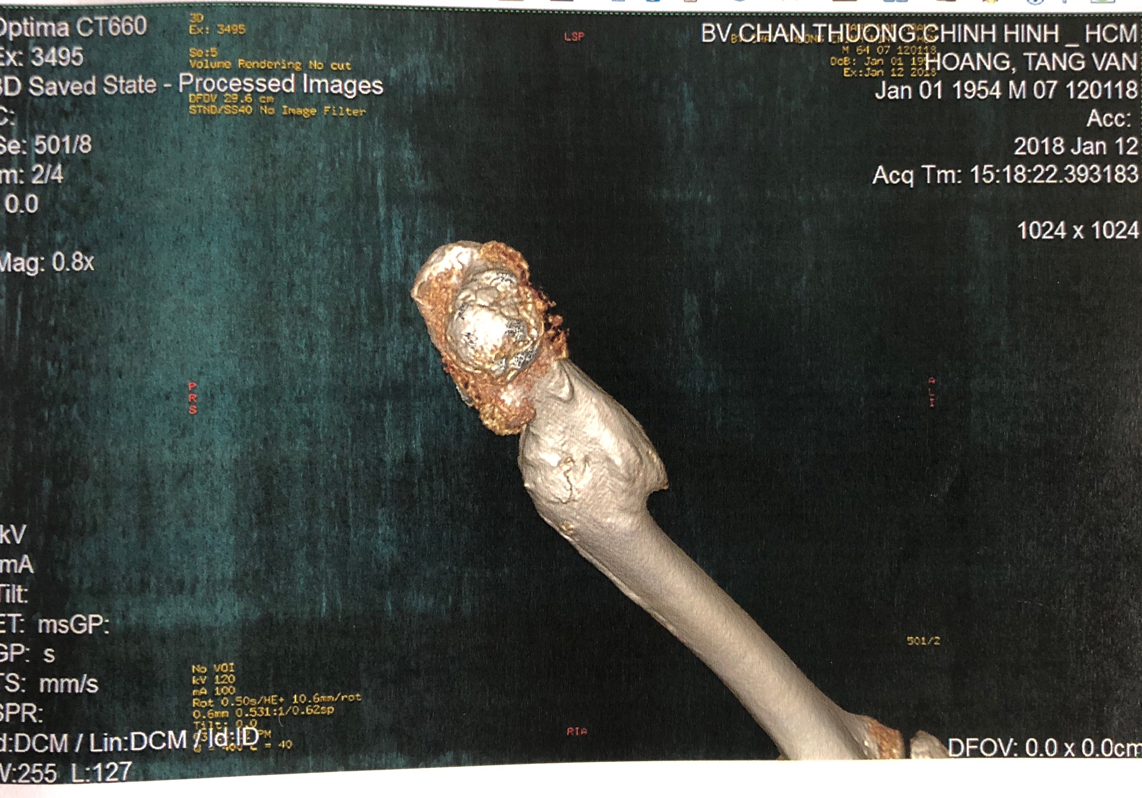
CT scan 3D

Slide 9
Diagnosis
Avascular Osteonecrosis of the left hip and malunion of the proximal third of the left femur.

Slide 10
What are the treatment plans?

Slide 11
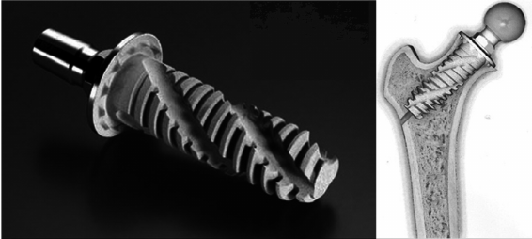
Option 1
Spiron prosthesis

Slide 12
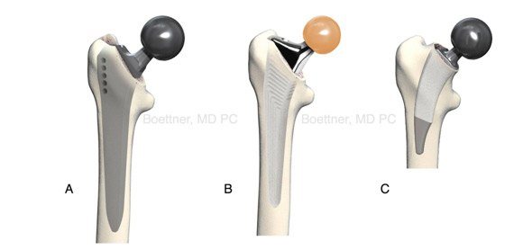
Option 2
Short stem prosthesis

Slide 13
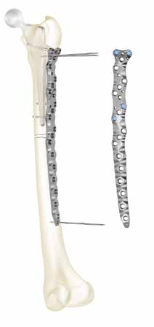
Option 3
Osteotomy and internal fixation

Slide 14
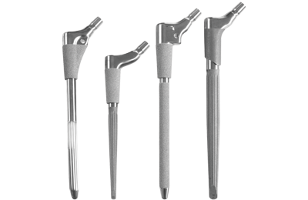
Option 4
Long stem prosthesis

Slide 15
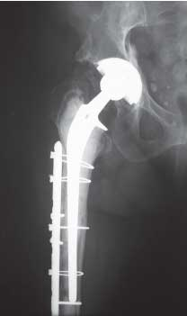
Option 5
Osteotomy and long stem prosthesis

Slide 16
Our Plan
THA with a Long stem
and internal fixation
Notes:
The milk-alkali syndrome, first reported as an adverse reaction to peptic ulcer therapy in the 1920s, may be increasing due to the growing use of calcium carbonate supplements to prevent osteoporosis.
In recent case reports of the syndrome, most patients had been taking only calcium carbonate, which provides both calcium and absorbable alkali. The pathophysiology of the syndrome remains unclear. Until the recent introduction of the immunoradiometric assay (IRMA), it was not possible to reliably distinguish the milk-alkali syndrome from
hyperparathyroidism with noninvasive studies.
Investigators reviewed the records of the 100 patients hospitalized for hypercalcemia between 1985 and 1993. Milk-alkali syndrome was diagnosed in seven of the 100 patients, based on a history of increased consumption of calcium and alkali, the presence of both hypercalcemia and metabolic acidosis, and the absence of any other explanations for these findings.
Six of the seven patients were women. All seven had been taking OTC antacids containing calcium carbonate in dosages of 4 to 12 g/day. Serum bicarbonate levels were elevated in three patients and high-normal in the rest. Serum parathyroid hormone levels, measured by IRMA in six patients at the time of admission, were low in all six.

Slide 17
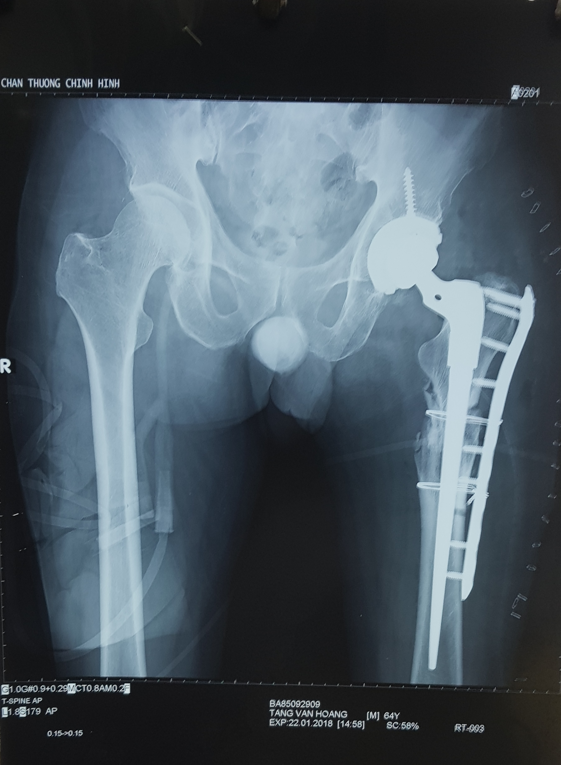
Result

Slide 18
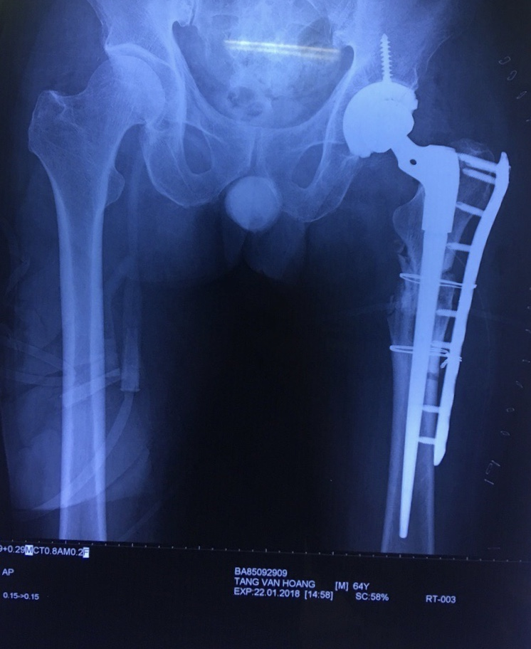

Slide 19
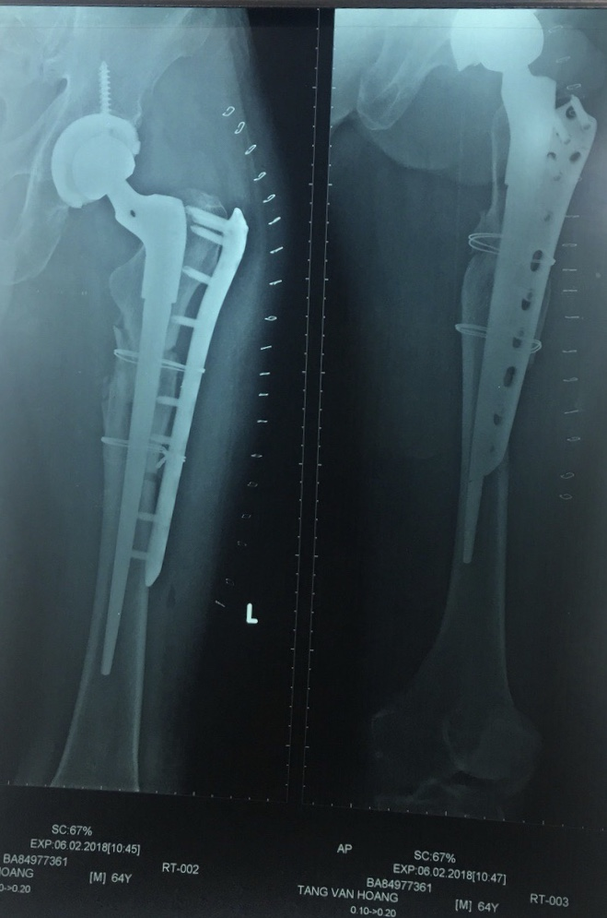
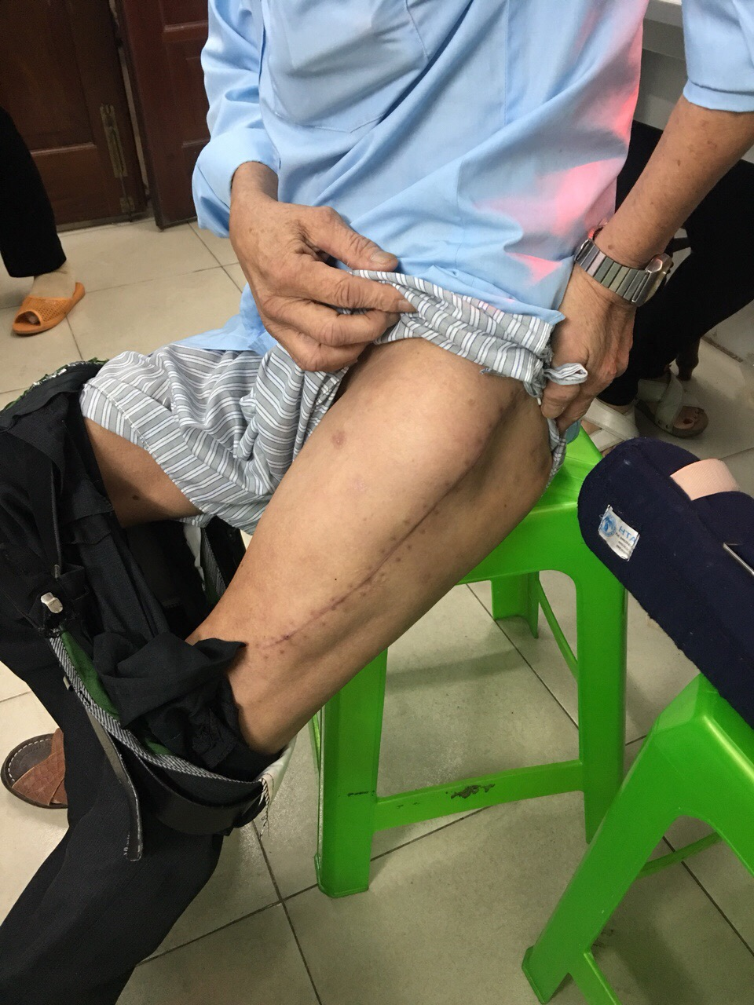

Slide 20
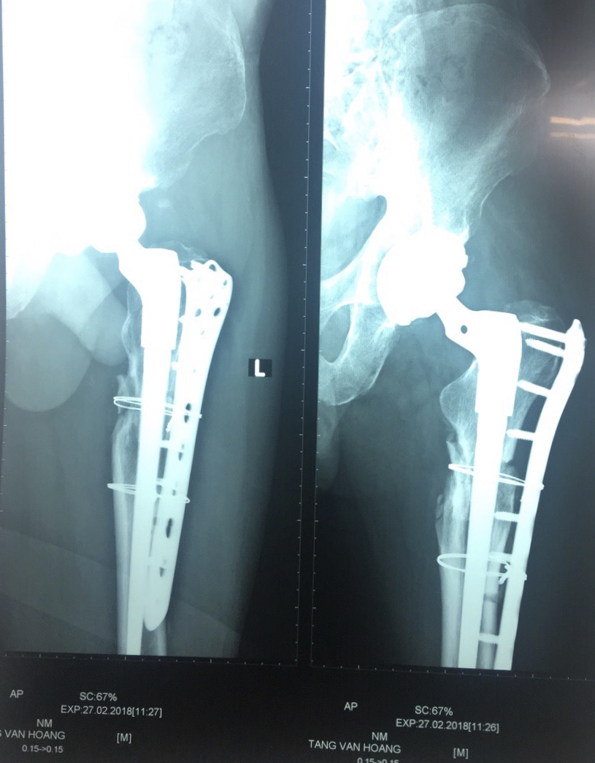

Slide 21

After 3 m

Slide 22

After 3 m

Slide 23

After 3m

Slide 24
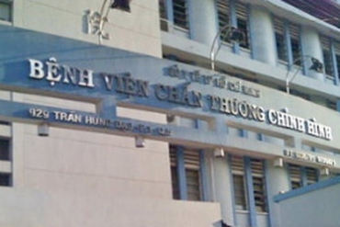
Thank you

