Slide 1
Knee Biomechanics
Todd Mason

Slide 2
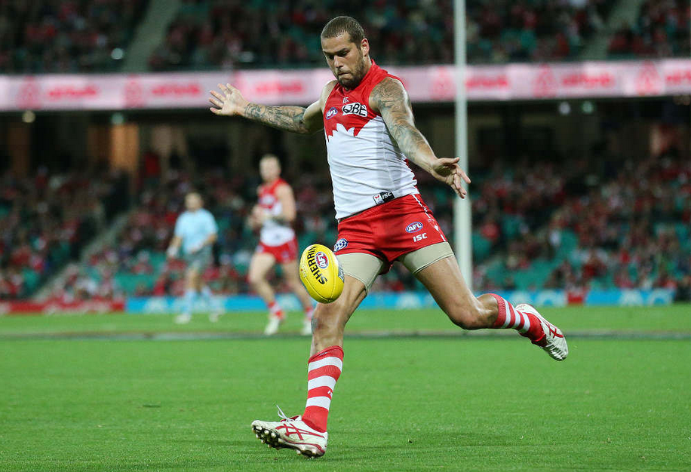
Knee Joint
Provides mobility and support during dynamic and static activities
Support during weight bearing
Mobility during non-weight bearing
Involved with almost any functional activity of the lower extremity

Slide 3
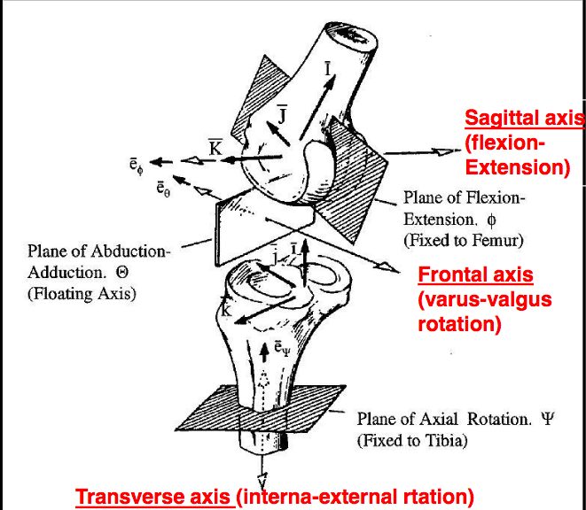
The Knee Joint
Complex hinge joint
  6 degrees of freedom
    3 rotations
    3 translations
Two functionally separate joints
  Tibiofemoral
  Patellofemoral

Slide 4
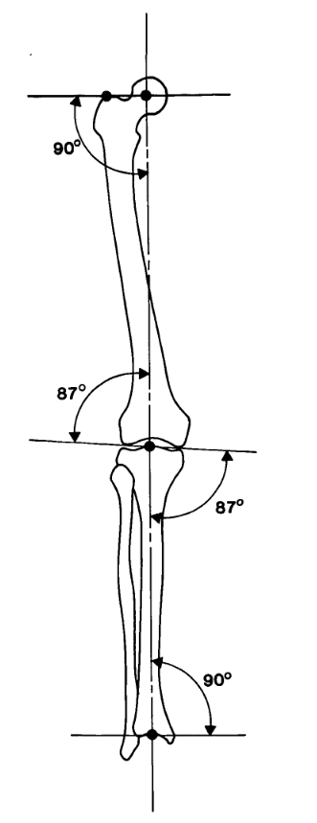
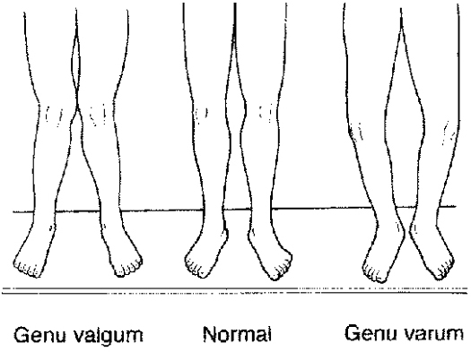
Alignment
Mechanical vs Anatomical axis
Physiological
  170-175°
Genu Valgum
  <165°
Genu Varum
  >180°

Slide 5
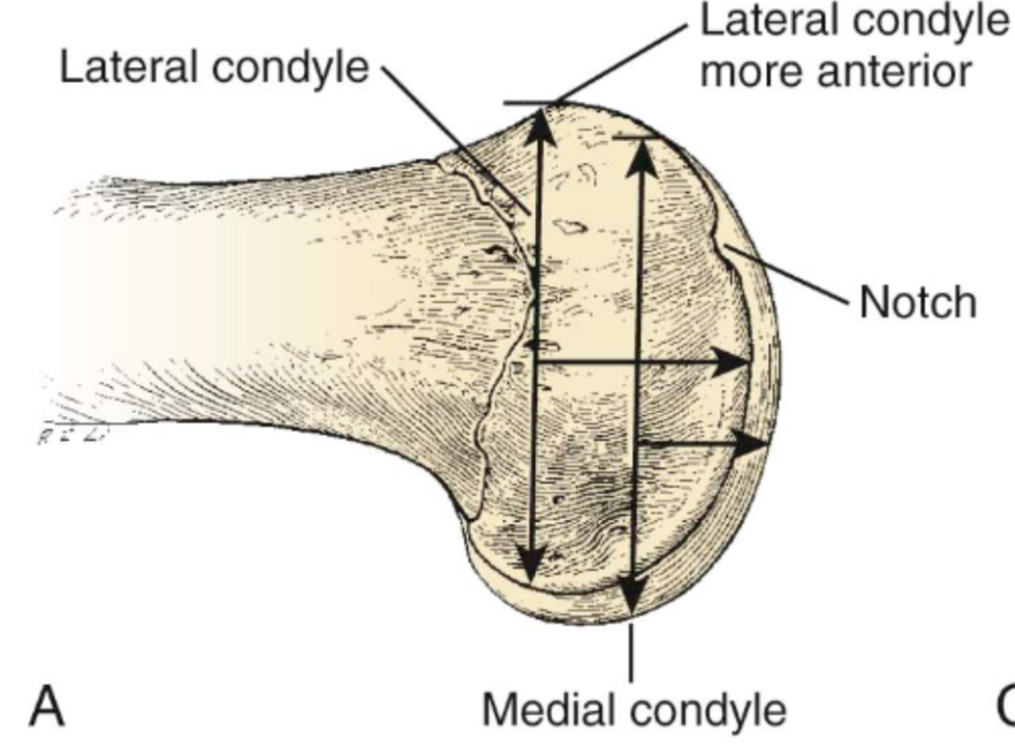
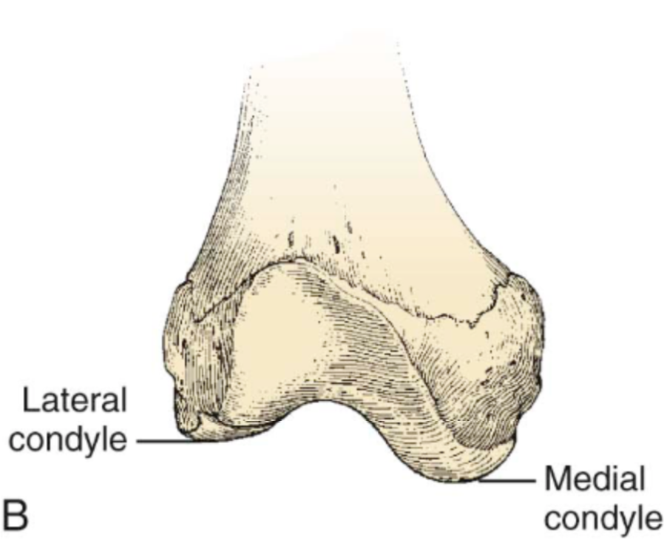
Anatomy
Femoral Condyles
  Cam-shaped
  LFC projects more anteriorly
    Relatively more flat – allows for sliding moment
  MFC projects more distally
    Relatively more curved – allows for increased rotation of screw home mechanism

Slide 6
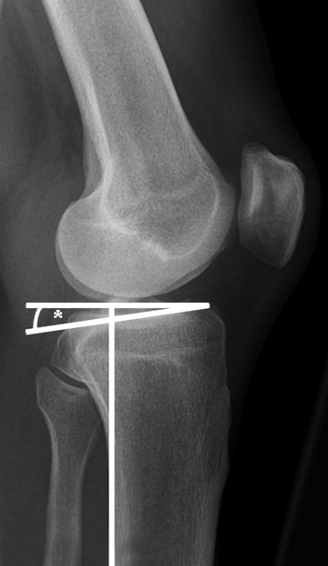
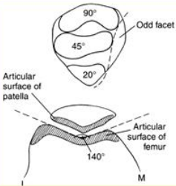
Anatomy
Tibial Plateau
  Posterior slope 7-10°
  Varus slope 3°
  Medial plateau concave
  Lateral plateau convex
Patella
  Function is to increase mechanical leverage of the quadriceps
  Engages trochlea at 20° flexion
  Moves 7cm caudally in full flexion

Slide 7
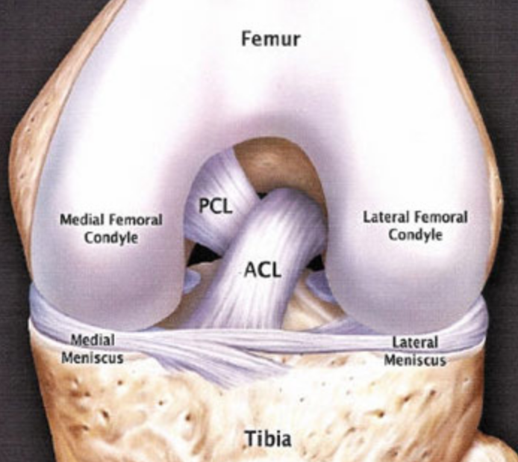
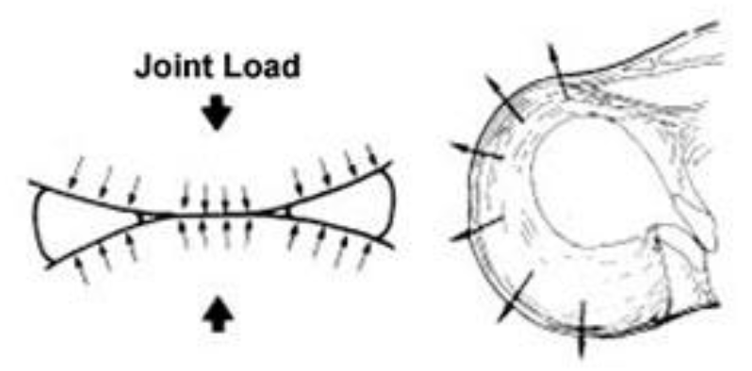
Anatomy
Ligaments
  ACL
    Limits anterior translation of tibia on femur
    Pivot point for screw-home mechanism
    Anteromedial and posterolateral bundles
  PCL
    Primary static restraint to posterior translation
    Anterolateral and posteromedial
  MCL
    Resists valgus stress
  LCL
    Resists varus stress
Menisci
  Shock absorption
  Increases surface area and congruity of joint

Slide 8
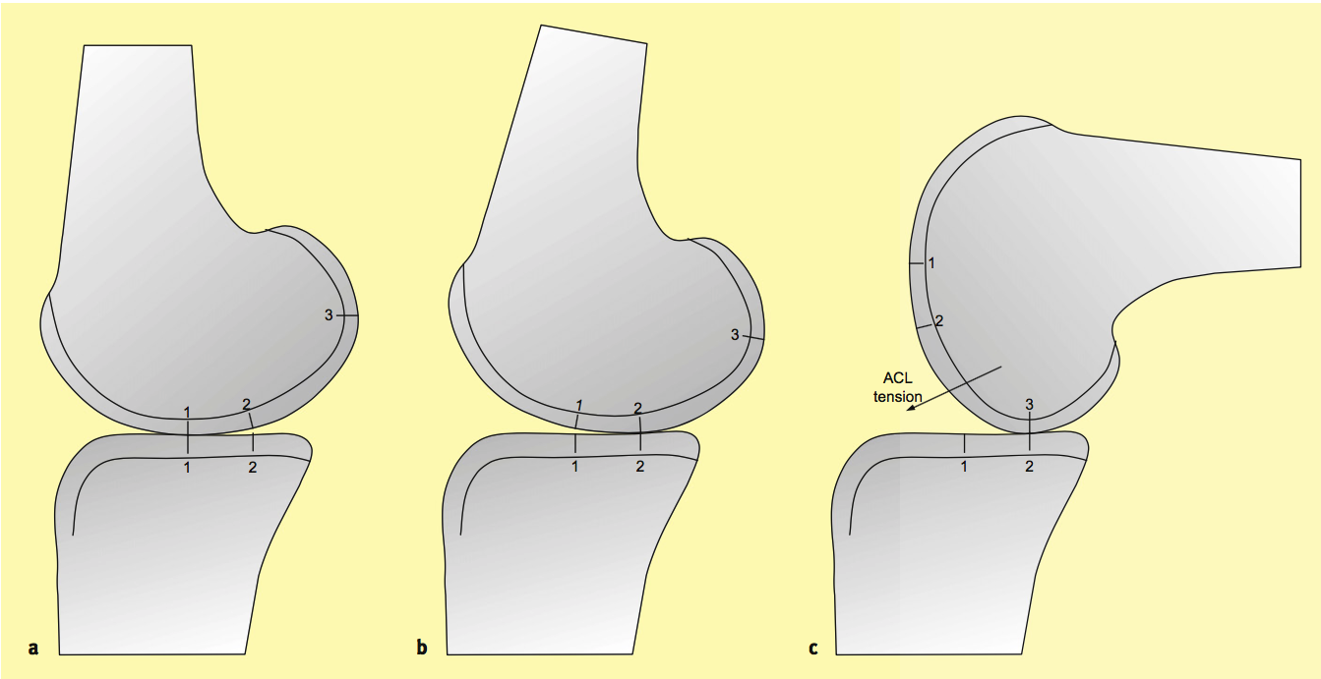
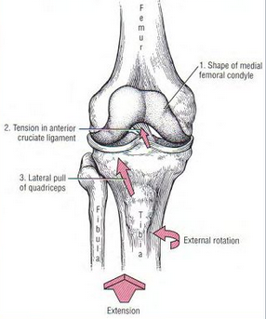
Tibiofemoral Articulation
Motion in Sagittal Plane
  3° of hyperextension to 140° of flexion
Femoral Rollback
  AP diameter of femur > than AP dimensions of tibia
Screw Home Mechanism

Slide 9
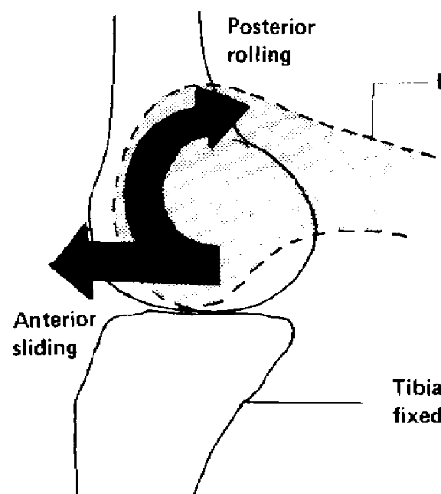
Rollback Mechanism
Allows full extension
AP diameter of femur > than AP dimensions of tibia
Posterior horn menisci
Point of contact moves forward on tibia

Slide 10
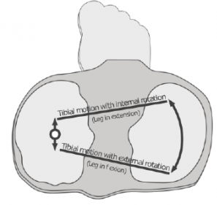
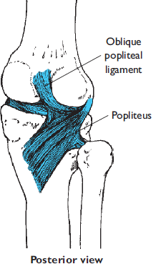
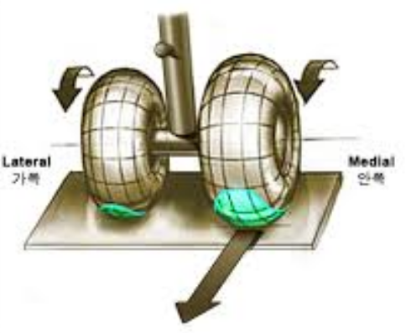
Screw-Home Mechanism
Terminal extension
  Functional advantage for conservation of energy
Soft tissues guide movement
  ACL becomes taut
    MFC pivots around ACL
  Greater arc of movement MFC (cf LFC)
  Oblique popliteal ligament / LCL / MCL tighten simultaneously
Locks knee to provide stability in weight bearing

Slide 11
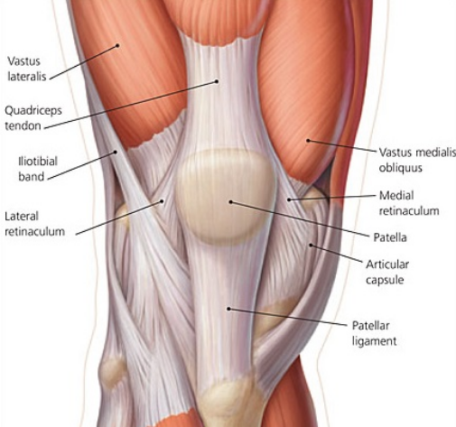
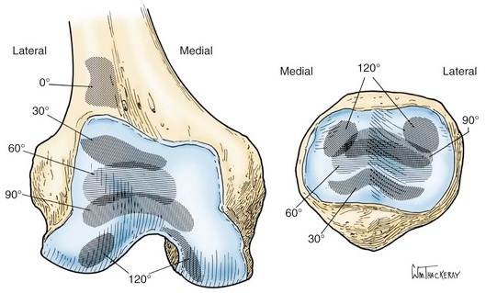
Patellofemoral Joint
Function of patella is to increase mechanical leverage of quadriceps
  Increases level arm of extensor mechanism
  Patellectomy decreases extension force by 30%
Static and dynamic constraint
Caudal movement during flexion
Large contact pressure
  Stress = force/area

Slide 12
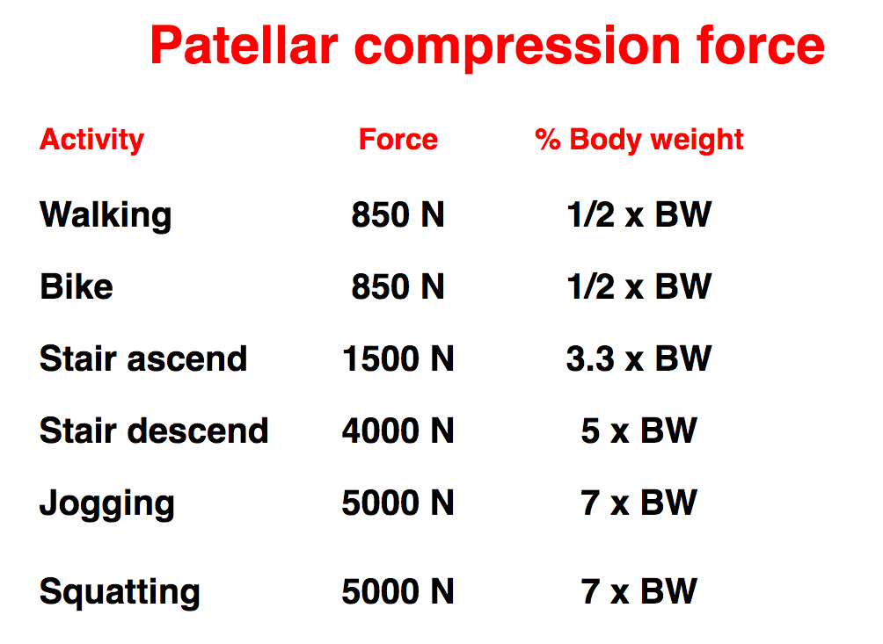
Patella Compression Force

Slide 13
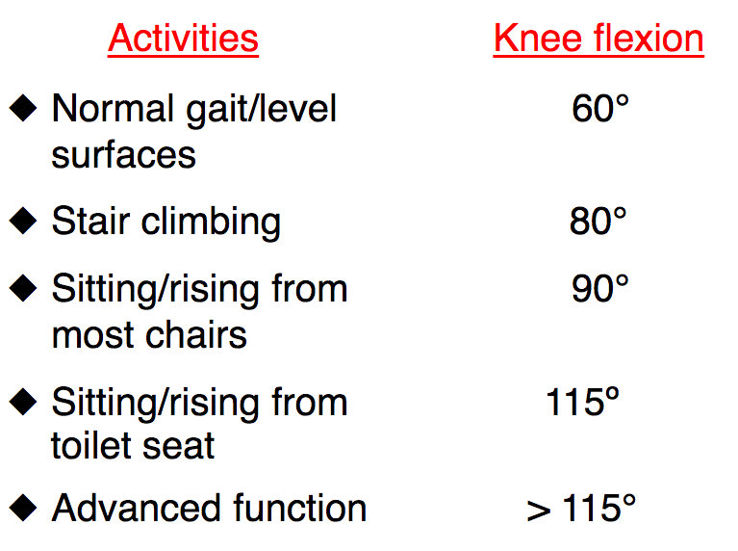
Functional Range of Motion

Slide 14
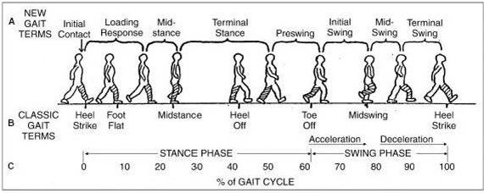
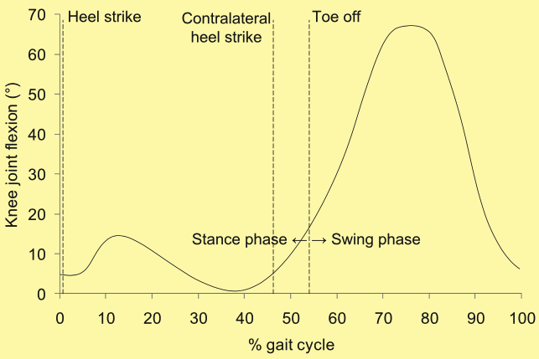
Knee Motion During Gait Cycle
Heel Strike
  Role of knee is to provide shock absorption
    Flexion to 15°
Midstance
  Knee extends
Swing Phase
  Flexion to 70°
    Clearance of foot

Slide 15
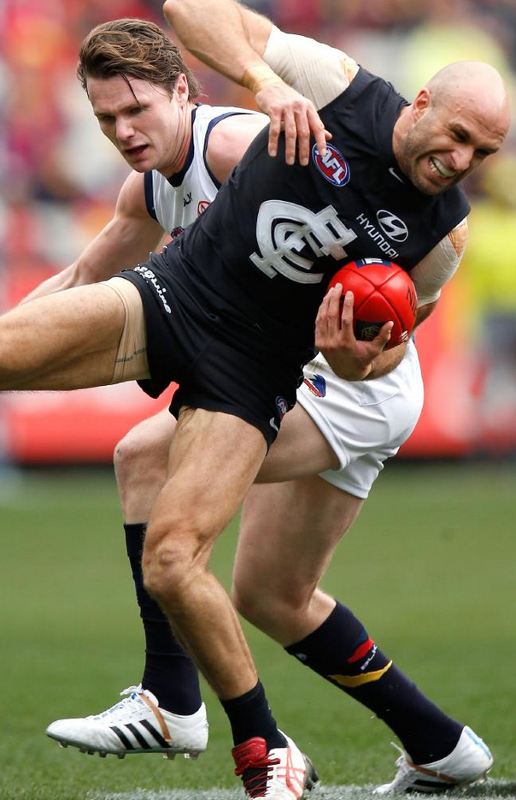
Conclusion
Complex joint
High loads/impact
Stability in range of positions
Implications for knee arthroplasty

