Slide 1
Pain Management following Total Knee Arthroplasty
A Das

Slide 2
FACT
70% of patients report moderate to extreme post-operative pain
PROSPECT – procedure specific postoperative pain management, evidence based, managed and developed by anaesthetists and surgeons
www.postoppain.org

Slide 3

Early Post operative Function
Patient Comfort

Slide 4

Patient
Anaesthetist
Surgeon
Pain Control

Slide 5
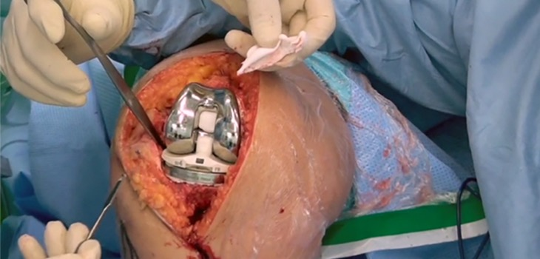
Pain Management
What do patients want?
• What do surgeons want?
• What do anaesthetists want?

Slide 6
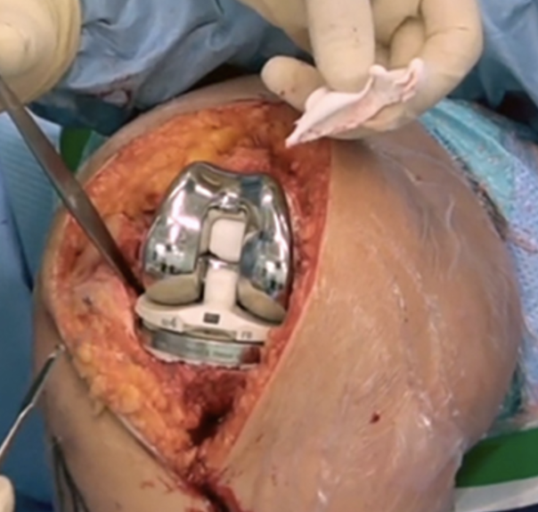
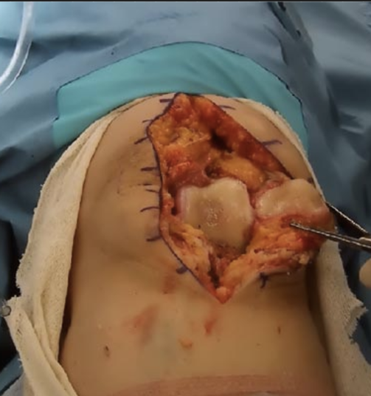
Incision and Surgery

Slide 7
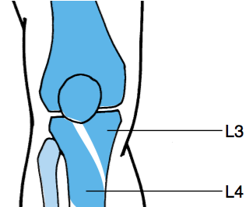
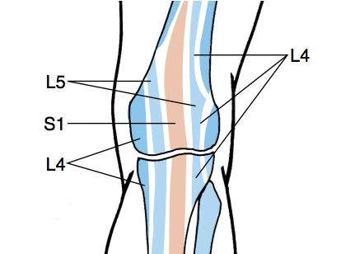
Osteotomes
Anterior
Posterior

Slide 8
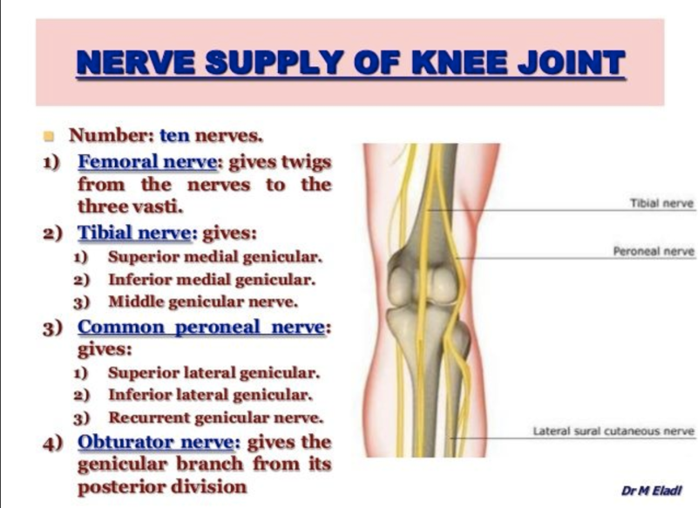

Slide 9
OPTIONS
• Spinal/Epidural/CSE : Single shot/ catheter
• Lumbar plexus / Psoas: Single shot/ catheter
• Local infiltration : Single shot +/- catheter
• Femoral/ 3 in 1: Single shot/ catheter
• Systemic: Opioids / NSAID / Paracetamol
• Adjuncts

Slide 10
Evidence Based
Recent trends have been “ Enhanced Recovery”
Most studies used nerve catheters.
Most studies single centre -not real world
Many older studies were pre USG
Most anaesthetist rarely see post op issues
Local Infiltration : No standards

Slide 11

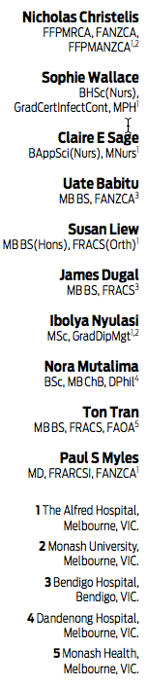
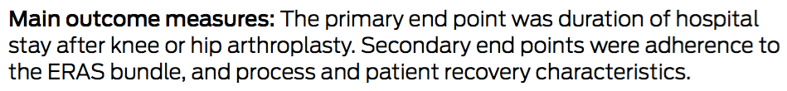
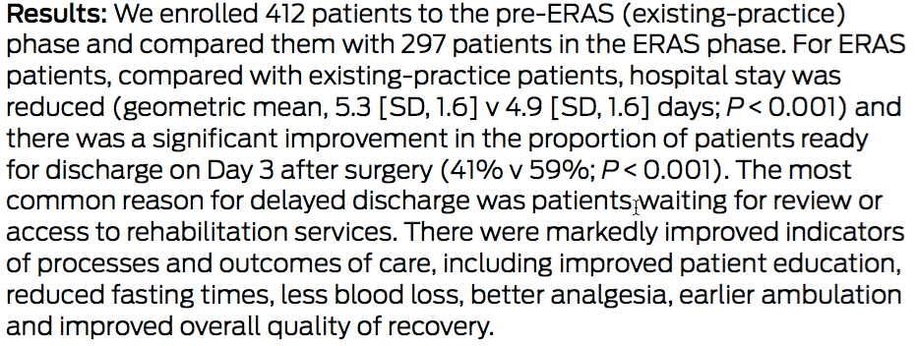

Slide 12
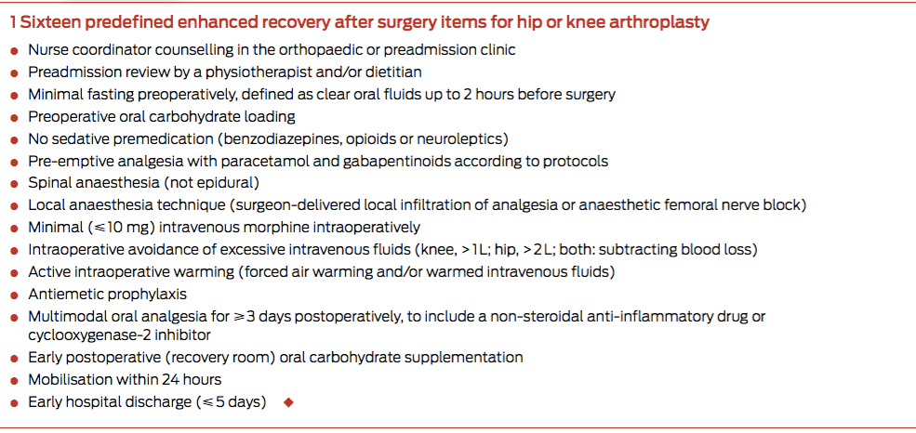

Slide 13
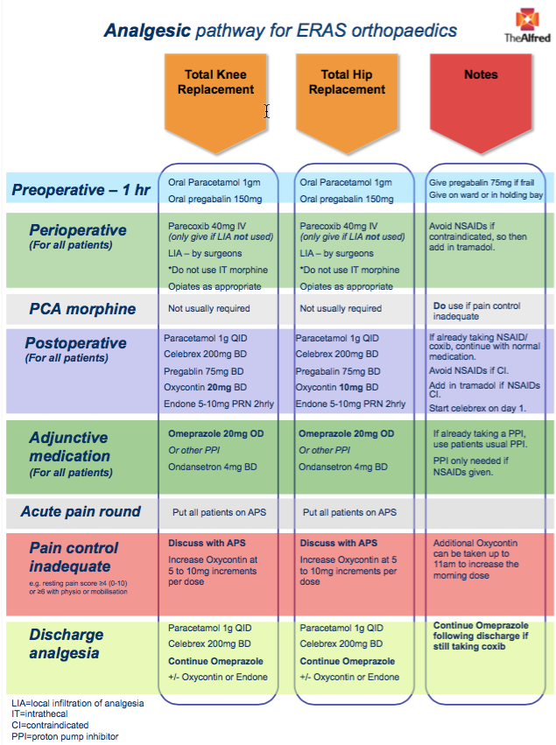

Slide 14
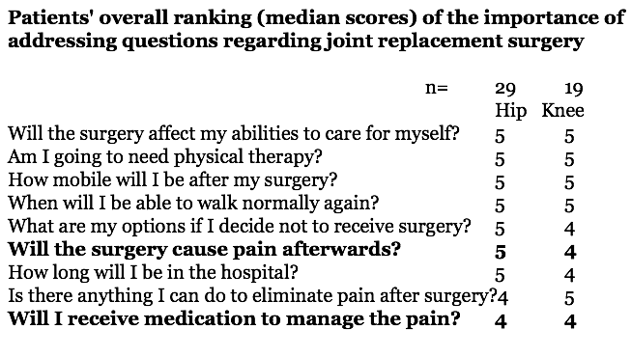
What Patients want
      Macario et al 2008 5 point 1 (least) to 5 (most important)

Slide 15
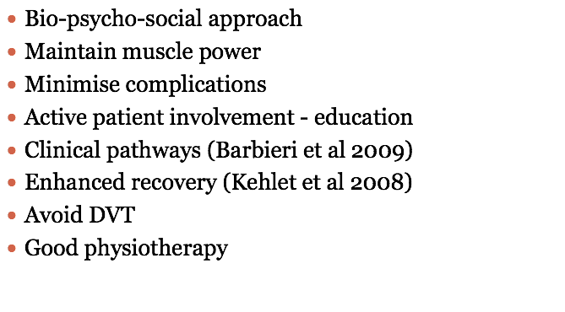

What do surgeons want

Slide 16

What do anaesthetist want
Good quality analgesia for patients.
Regional technique.
Provide good surgical field.
Optimise patient outcome.

Slide 17
Pain Management
Activation of nociceptive pathways leads to the experience of pain. The pathway can be stimulated or modified by endogenous and exogenous stressors.
Endogenous stressors include tissue damage and inflammation
Exogenous stressors include psychological and social factors.

Slide 18
Perioperative Pain Management
Critical for accelerated rehabilitation following Total Knee Arthroplasty

Slide 19
Pain Pathophysiology
Mediated Via Two Pathways
– Neurogenic
–Inflammatory
Direct tissue damage
Cytokines / Prostaglandins
Other chemical mediators

Slide 20
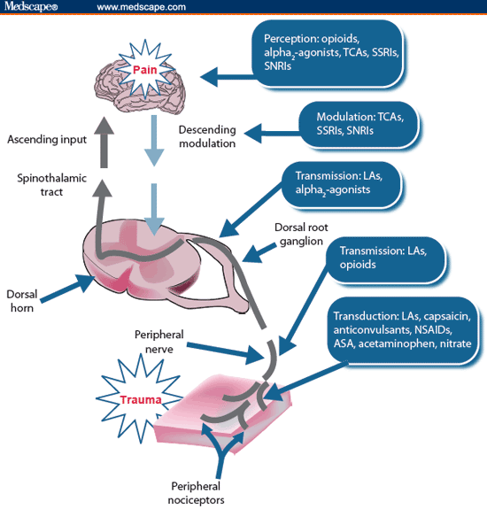

Pain Pathophysiology
Tissue Damage
  Direct neural damage & release of inflammatory mediators
  Sensitisation of peripheral nociceptors
  Increased afferent transmission of pain stimuli to dorsal horn cells resulting in CNS hypersensitivity

Slide 21
Preemptive Analgesia
Analgesia administered before tissue injury can lessen Neuronal Hyperexitability in CNS resulting in decreased Pain

Slide 22
Multimodal
Paracetamol
? Pregabalin
Preop
SAB with Fentanyl
LIA
Intraop
Paracetamol
Targin
COX2
?Pregabalin
Endone
Postop

Slide 23
Pre Op
Gabapentanoids
Reduction of physiological sensitisation induced by nociception & Inflammation.
? Reduces nerve hyperexcitability.
Pregabalin structurally related to gabapentin but 6X more binding affinity

Slide 24
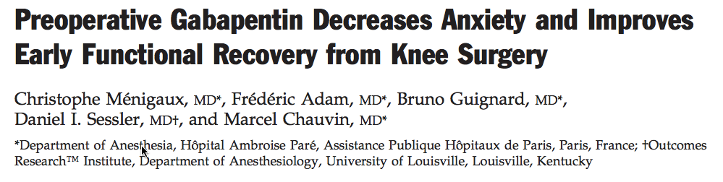
Central neural sensitisation
Gabapentanoids
  Reduction in postoperative pain and morphine consumption
  Reduction in anxiety and improvement in early functional recovery.

Slide 25
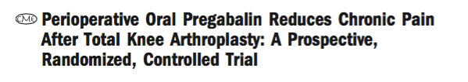
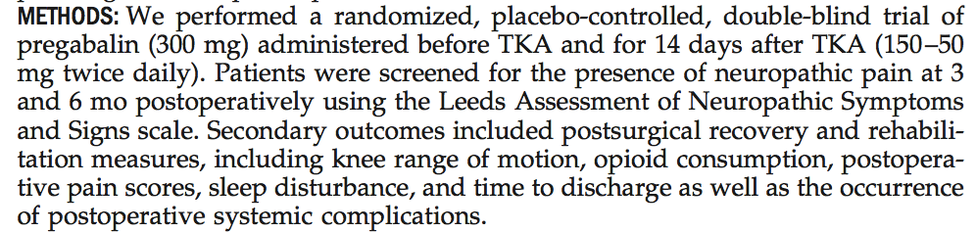
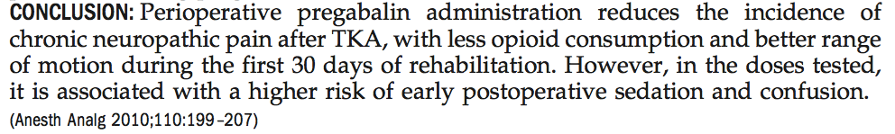

Slide 26

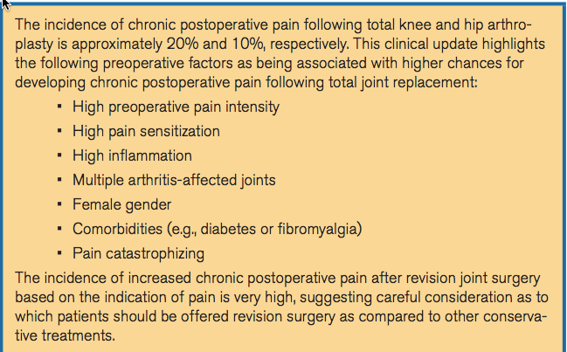

Slide 27
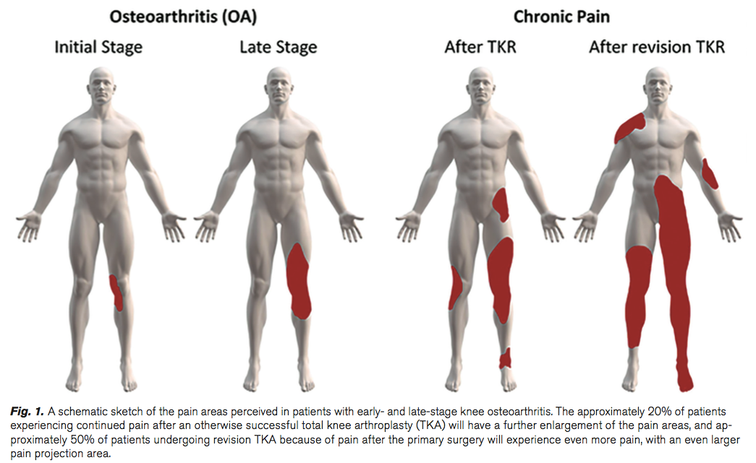

Slide 28
Intra operative
Neuraxial Block
Subarachnoid block is the preferred technique.
Excellent anaesthesia and analgesia.
Optimal operating conditions.
Analgesia extending to the post operative period.

Slide 29
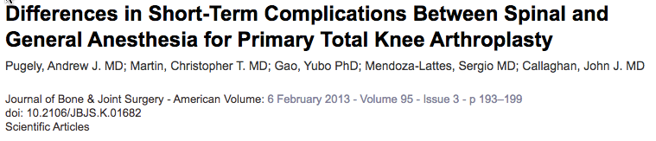
Other Advantages
Decreased blood loss.
Decreased incidence of DVT’s
Decreased incidence of PONV
Decreased complications.

Slide 30
Additives to SAB
Fentanyl : Rapid onset (10- 15 mins) but short duration of analgesia (2- 4hrs)
Morphine: Longer duration of analgesia (18-24hrs)

Slide 31
Peripheral nerve blocks
Advances is Ultrasound imaging and nerve localisation.
Increased interest in PNB.

Slide 32
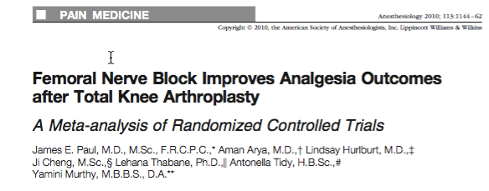
Meta analysis of 23 studies.
Comparing FNB with PCA & Epidural.
1016 Patients.
Only 153 single shot Vs PCA
SSFNB improves analgesia & reduced morphine consumption.
Continuous FNB no better than SSFNB.

Slide 33
Local Infiltration Analgesia
Alternative technique for post op analgesia for Hip & knee arthroplasty.
Multimodal wound infiltration analgesic Technique consisting of peri-and intraarticular infiltration of LA, NSAID, Vasoconstrictor
Catheter may be placed intraoperatively (Kerr and Kohan 2008)

Slide 34
Local Infiltration Analgesia
Several potential advantages
      Analgesia: Surgical area, no interference to muscle strength.
      Easier rehabilitation & earlier discharge.
      Reduced requirement for post op analgesia.

Slide 35
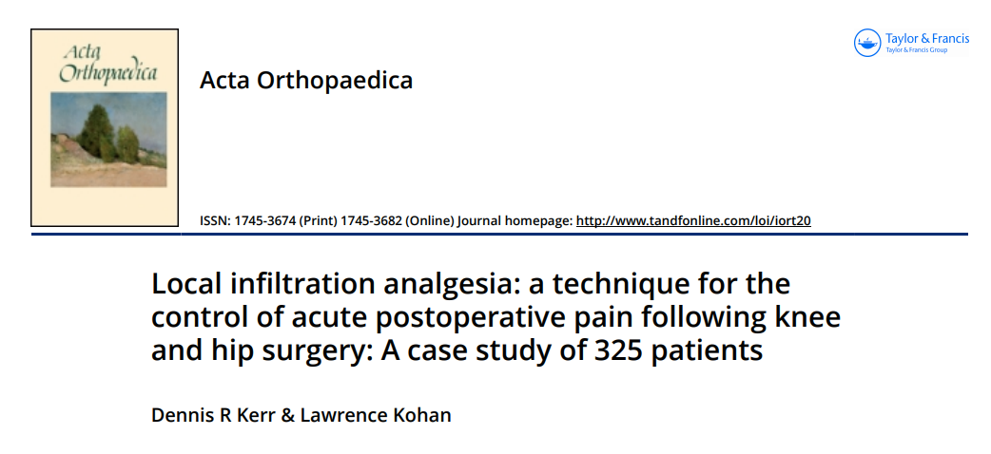

Slide 36
• 150–170 mL TKR; 150–200 mL THR
• 2.0 mg/mL Ropivacaine = total dose 250-300 mg
• 30 mg ketorolac
• 10 μg/mL adrenaline
• 50-mL syringes 10-cm-long 19-G spinal needles
• Over 1 hour during operation

Slide 37
  • Just before wound closure catheter placed through a 16-G Tuohy needle
  – 18-G epidural catheter
  – 0.22-μm antibacterial epidural filter
• 50ml reinjected at 15-20 hours
• NSAID + Codeine + Paracetamol

Slide 38
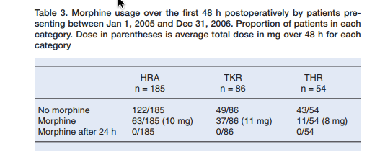

Slide 39
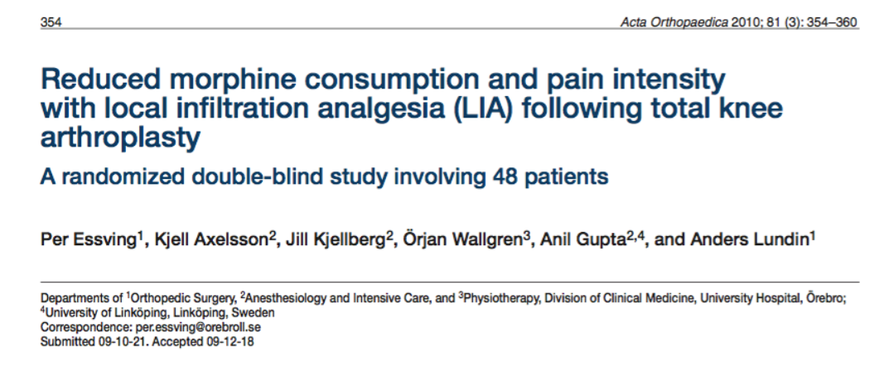

Slide 40
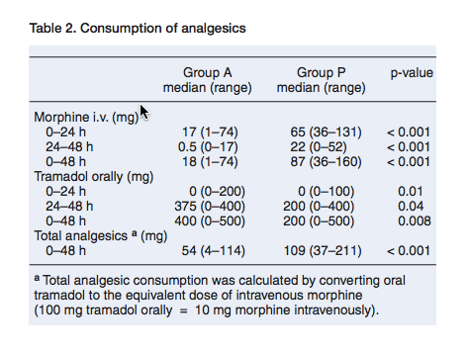

Slide 41
Local Infiltration technique
Comparison of LIA with techniques of proven analgesic effect like Femoral nerve blocks.

Slide 42
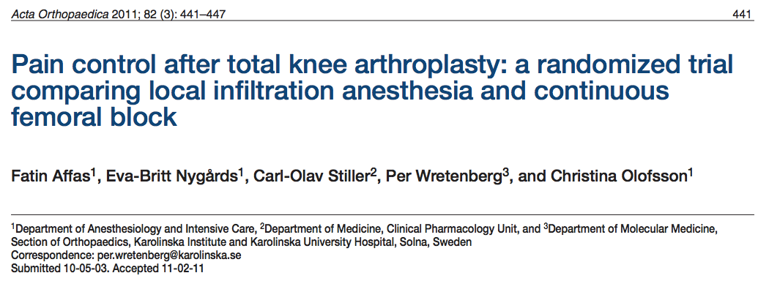

Slide 43
• Compared LIA with FNB
• 40 patients undergoing TKA under SAB
• Randomised to femoral nerve block or LIA (RKE)
• PCA Morphine

Slide 44
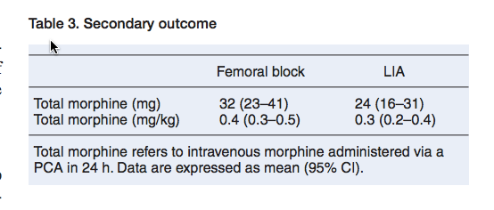
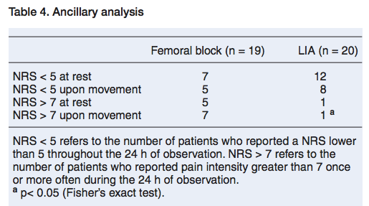

Slide 45
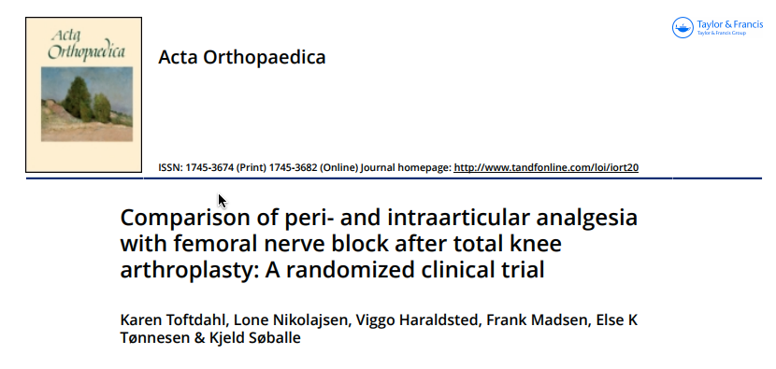

Slide 46
RCT, N=80, TKA with spinal anaesthetic.
Patients randomised to either receive LIA or CFNB.
LIA- Ropivacaine 300mg + Ketorolac 30mg & Adrenaline 0.5mg.
Less pain scores & morphine consumption on D1 in the LIA group.
Better ability to walk > 3 Mts on D1.
LOS : No difference.
S/E : No difference.

Slide 47
Post Op Analgesia
Must be Pre emptive and Multimodal.
Slow release opioid analgesia ( Targin) can be initiated in recovery room.
Regular adjuvants
        Paracetamol 1G QID.
        NSAID of choice.
        ? Pregabalin
        Consider PPI if using non selective NSAID
        Regular anti emetic
        PRN analgesia Endone / Tramadol.

Slide 48
Conclusion
Acute pain relief paramount to early rehabilitation.
Multimodal approach.
Attempt to prevent Persistent Post-operative Pain.

