Slide 1
Approaches In total knee replacement
Mr Kosta Calligeros
Mbbs fracs orth

Slide 2
Aims
Summarize approaches in primary and revision arthroplasty
Advantages and disadvantages of different approaches
Approaches in complex knee arthroplasty

Slide 3
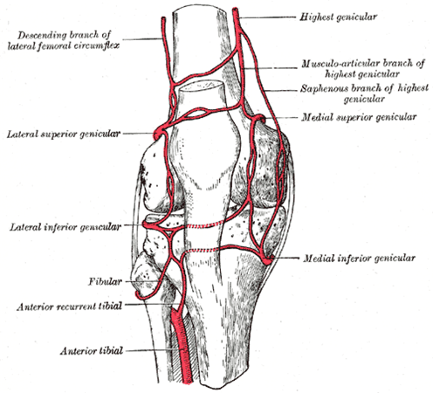
Vascular anatomy
Lateral inferior and superior geniculate arteries of vital importance to patella blood supply
Aim to utilise most lateral incision in revision situations
Avoid undermining and creating skin flaps as much as possible

Slide 4
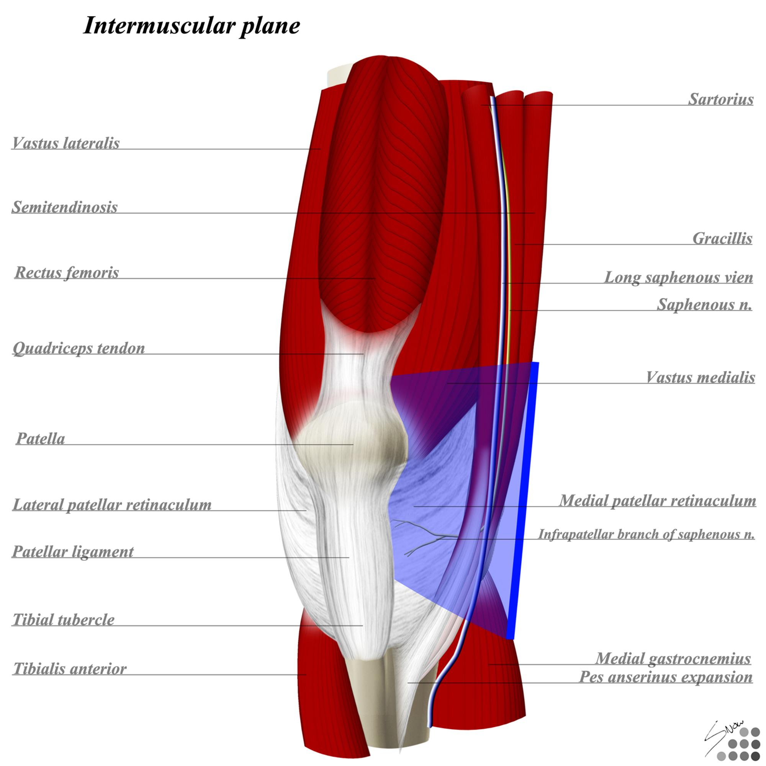
Intermuscular and inter nervous planes
Infra patellar branch of saphenous nerve usually sacrificed on approach

Slide 5
Medial para-patella approach
Most commonly used approach
  Advantages
    Expansile and versatile
    excellent exposure
    allows easy patella eversion
Disadvatages
  violates extensor mechanism
  Risk of tubercle avulsion
  May over release medial structures in valgus knee

Slide 6
Medial para-patella approach
Tips for this approach
  Do not raise flaps, expose what is required only
  Do not over release tissues on approach until attempting to balance the knee
  eversion of patella not necessary if not everting easily just slide it across

Slide 7
Lateral para-patella
Advantages
  good for valgus knee exposure
  May be more favorable for patella tracking
  Preserves main vessels to patella
Disadvantages
  difficult to move patella medially or evert patella
  May require Tubercle osteotomy
  prone to wound breakdown
  closure often difficult (thin retinaculum)

Slide 8
Sub-vastus and mid-vastus approaches

Slide 9
Sub-vastus and mid-vastus approaches
Advantages
  Spares VMO and quads tendon
  theoretically quicker rehabilitation
  may be less disruptive to patella tracking
  less likely to disrupt patella blood supply
  Disadvantages
    non-extensile
    contraindications in severe flexion or varus/valgus deformity
    may compromise component positioning
    Difficult exposure in large or obese patients

Slide 10
The complex or multiply operated knee
Post-traumatic
Difficult primary ie rheumatoid, severe deformity
Revision knee replacement

Slide 11
Extensile procedures
Quadriceps/Rectus Snip (Insall first Described 1988)
  Carry Medial para-patella arthrotomy laterally across Rectus fibres at apex of tendon
  Continue proximally splitting along vastus lateralis fibres
  Aim to isolate and preserve lateral superior geniculate vessels
  May also require inferior lateral retinacular release
  Normal post-op rehab protocol

Slide 12
Extensile procedures
Insall Quadriceps Turndown 1983
  At apex of medial arthrotomy make 45 distal incision
  Continue distally along VL and ITB
  Capsular incision should be broad based
  Mechanism may be lengthened at 30 degrees flexion using v-y limbs
  Quads mechanism must be protected for 6 weeks minimum
  often extensor lag which may take months to improve

Slide 13
Extensile procedures
Tibial tubercle osteotomy
  Used when PFJ contractures in knee are mostly distal
  Minimum 6cm surface with a laterally based soft tissue envelope, (whiteside says 8-10cm)
  Must be fixed with circlage wires if need to get around prosthesis (better results than screws)
  High complication rate (up to 23%)
Banana peel technique- tendon elevated in meticulous fashion with periosteal sleeve

Slide 14
Summary
Approach is usually dictated by deformity and previous surgery
Meticulous attention to detail and careful dissection and preservation of blood supply to patella
Medial approach is usually sufficient in most cases
Lateral approach should be used with caution
Extensor mechanism issues should be thought of and pre-planned
Extensive clearance of scar from gutters often aids patella clearance and avoids use of extensile measures which may compromise extensor mechanism

