Slide 1
PRIMARY TOTAL KNEE ARTHROPLASTY
The not so easy ones
Advanced Technologies in Hip & Knee arthroplasty
Hanoi, Vietnam
August, 2017

Slide 2
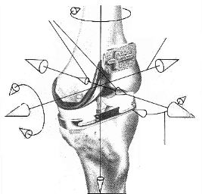
Challenge in TKA
- To control all 7 degrees of freedom
Reference for Implant Alignment
- Mechanical, rotational and AP-axes of the femur and tibia

Slide 3
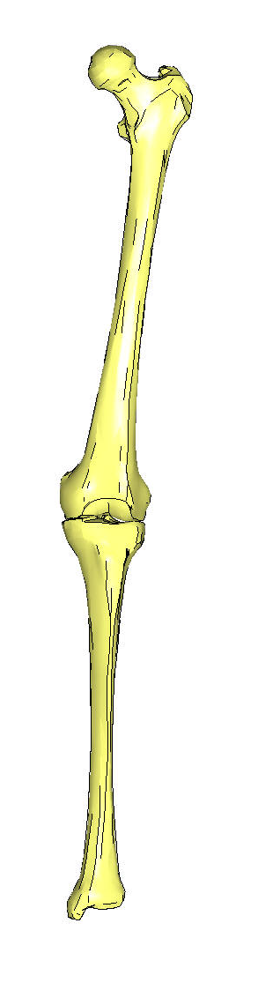
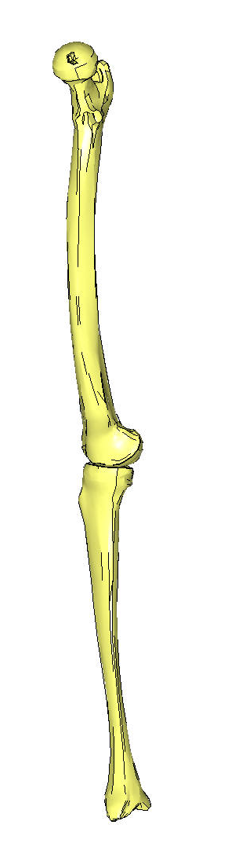
… TKA – Implant Alignment
Mechanical Axis of Femur and Tibia
A mechanical axis is a load bearing axis.
Describes the direction the load is being diverted to the ground
- Mechanical Femur Axis
Line passing through
- center of the femur head
- center of the knee
- Mechanical Tibia Axis
Line passing through
- center of the tibia plateau
- center of the ankle.
Mechanical femur axis
Mechanical tibia axis
Mechanical femur axis
Mechanical tibia axis

Slide 4
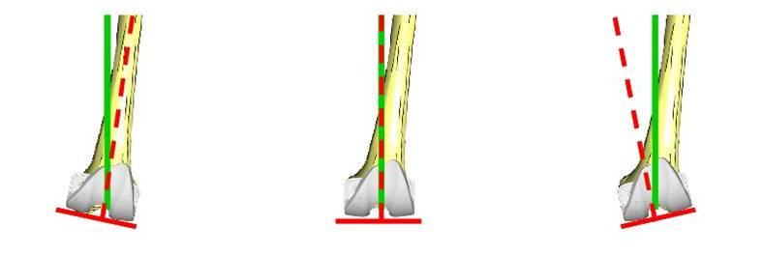
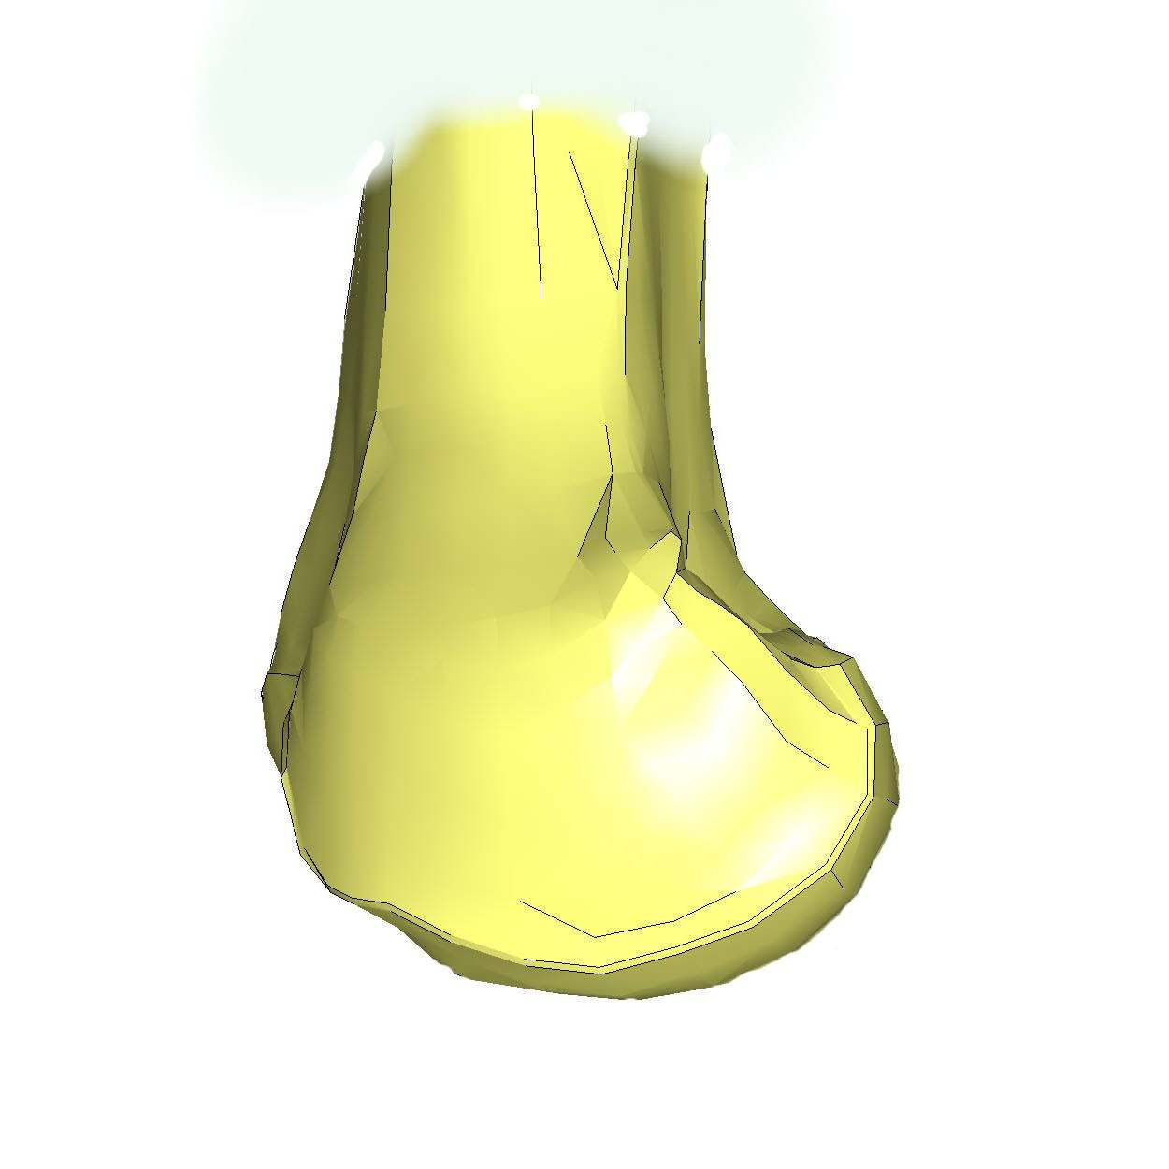
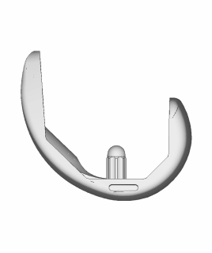
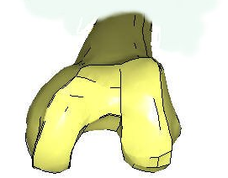
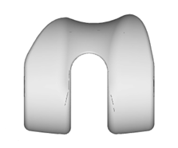
…TKA – Implant Alignment
Femoral Implant Alignment
Frontal view - Varus/ valgus alignment
Reference: Mechanical axis
Aim: Neutral varus/ valgus alignment
Lateral View - Flexion/ extension
Reference: Mechanical axis
Aim: Component in 0° Flex./ Ext.
Axial view - External/ internal rotation
Reference: Transepicondylar line
Aim: Neutral rotation
Femur Comp in Varus Femur Comp., neutral Var/Valg Femur comp. in Valgus
Femur comp. in Extension Femur comp in 0° Flex/ Ext Femur comp. in Flexion
Femrur component
internally rotated
Femrur component
In neutral rotation
Femrur component
Externally rotated

Slide 5
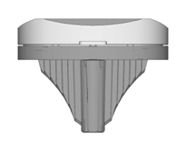
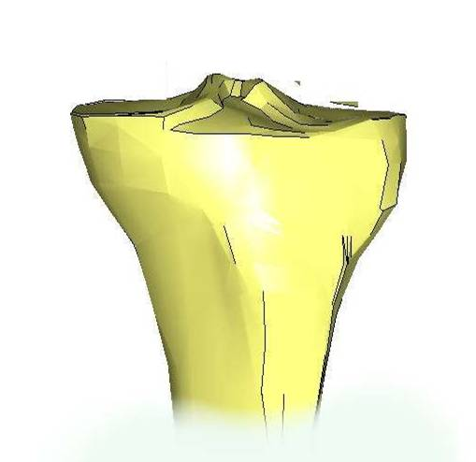
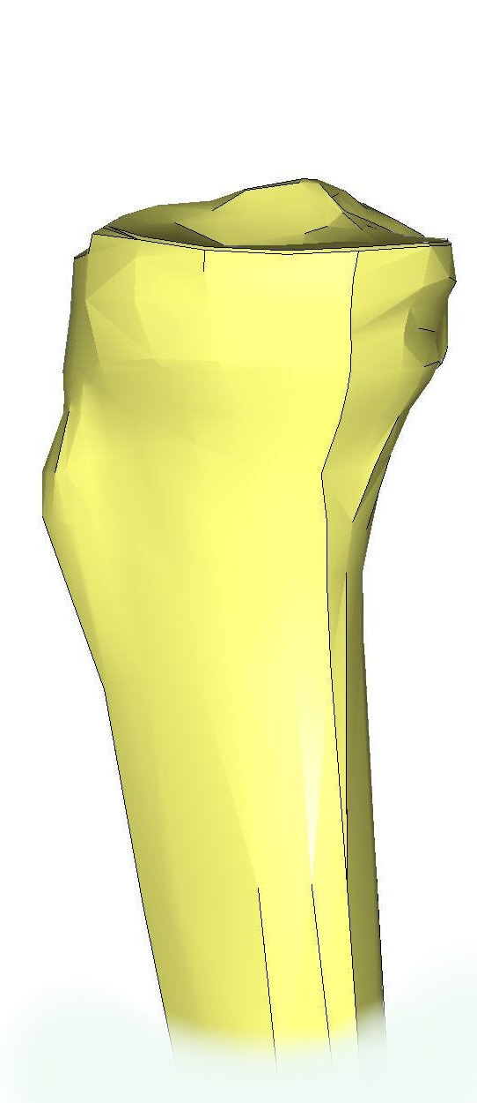
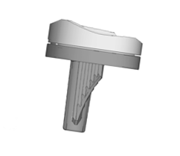
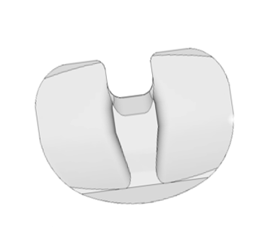
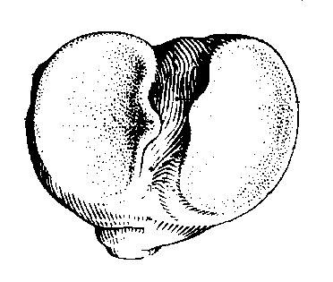
… TKA – Implant Alignment
Tibial Implant Alignment
Frontal view - Varus/ valgus alignment
Reference: Mechanical axis
Aim: Neutral varus/ valgus alignment
Lateral View - Slope
Reference: Mechanical axis
Aim: Depending on the implant design
Axial view - External/ internal rotation
Reference: Neutral AP-axis
Aim: Tibia component in neutral rotation
Tibia component
in
valgus
Tibia component
in neutral
varus/ valgus
Tibia component
in
varus
Tibia component
Posterior slope
Tibia component
No slope
Tibia component
Anterior slope
Internally rotated
tibia insert
Neutral rotated
tibia insert
Externally rotated
tibia insert

Slide 6
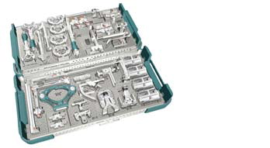
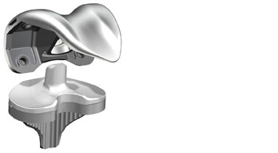
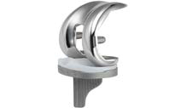
The first knee
Know your instrument
Know your implant

Slide 7
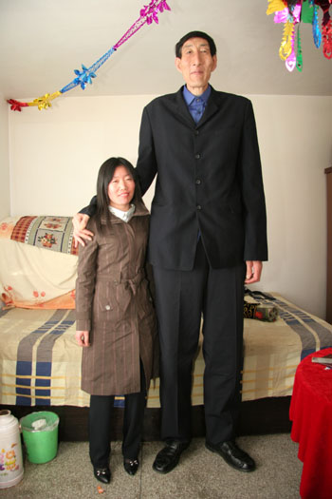
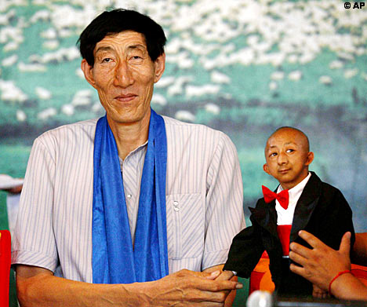
“Size does matter”
The short one
  Implant size
  More femoral valgus
  Tibial internal torsion
  BEWARE THE Young RHEUMATOID or Haemophiliac
The tall one
  Implant size
  Less femoral valgus

Slide 8
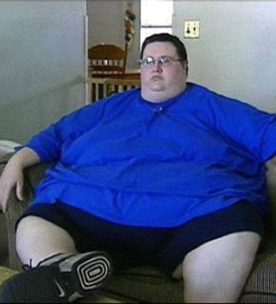
“Size does matter”
The Fat one
  Implant size
  Instrument issue
  Landmark issue
  Operating theatre issue
Consider:
  Bariatric surgery
  Computer Navigation

Slide 9
‘”Size does matter”
Beware digital XR’s
Ensure appropriate alignment of limbs
Femoral bowing vs femoral valgus
Beware the short asian patient

Slide 10
The Joint line
Important to restore
Reference from femur
  27mm from Medial epicondyle

Slide 11
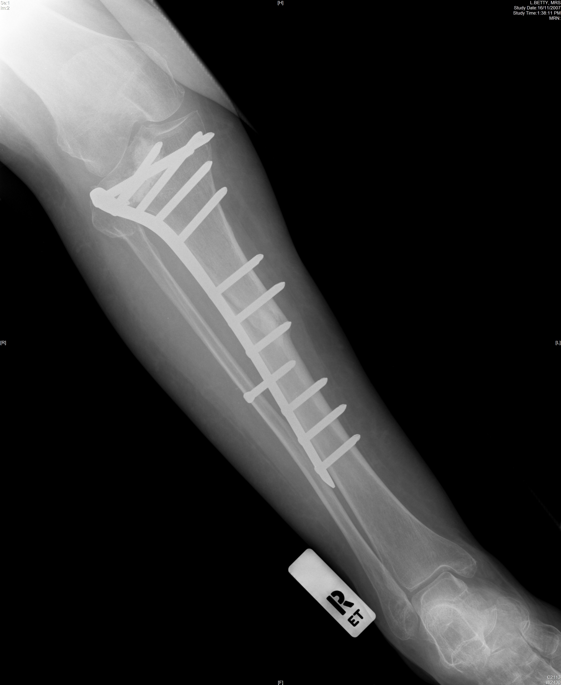
The joint line
Bone defect
  Post traumatic
  Inflammatory
  Degenerative
  Neoplasia
Options:
  Cement
  Metal augment
  Bone
    Autologous
    allograft

Slide 12
The joint line
Resect low and build up tibial tray
    BEWARE LIGAMENT ATTACHMENT
      PCL 7 +/- 2mm below joint line
Resect high and build up bone
    SAFE FOR LIGAMENT ATTACHMENT
Be prepared to go to more constrained and stemmed implants

Slide 13
The deformed femur
Consider a supracondylar osteotomy if
  >10 deg CORONAL
  >20 deg SAGGITTAL
Recommendation:
  Plate with long stem implant

Slide 14
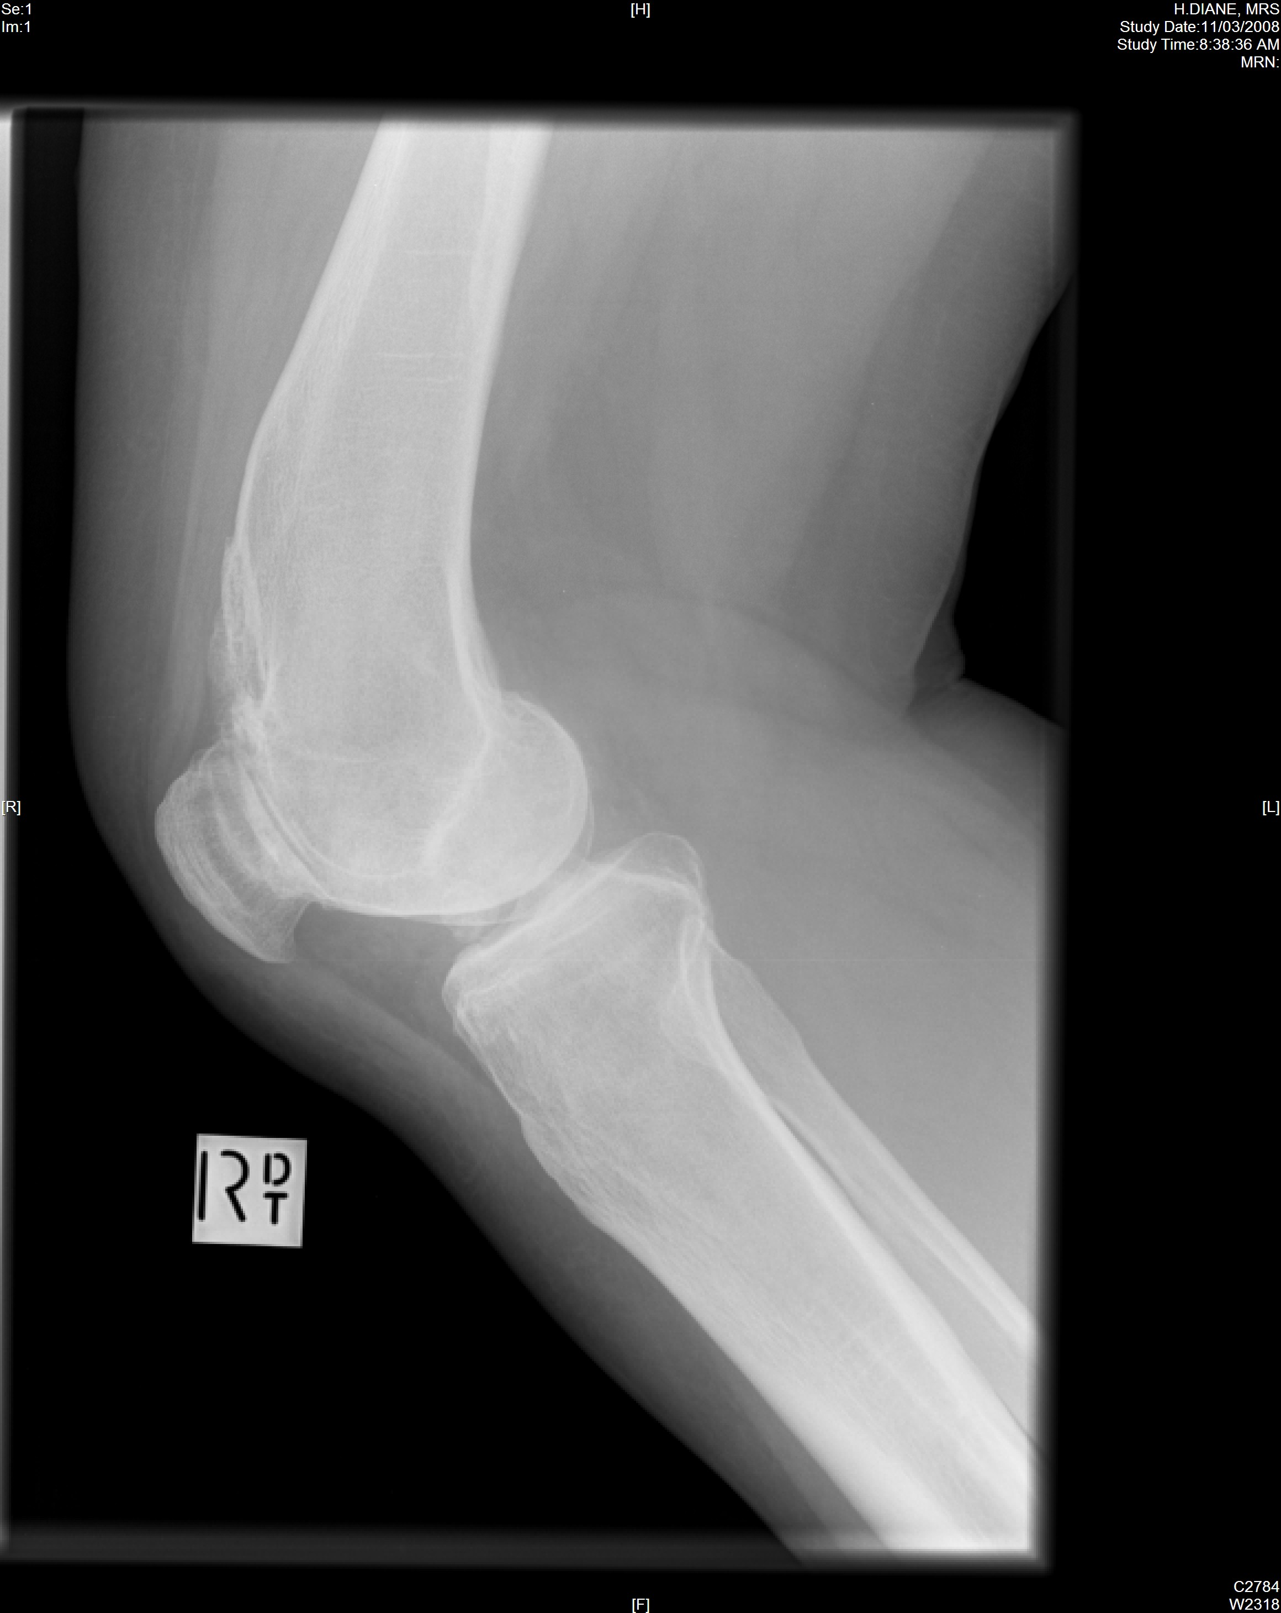
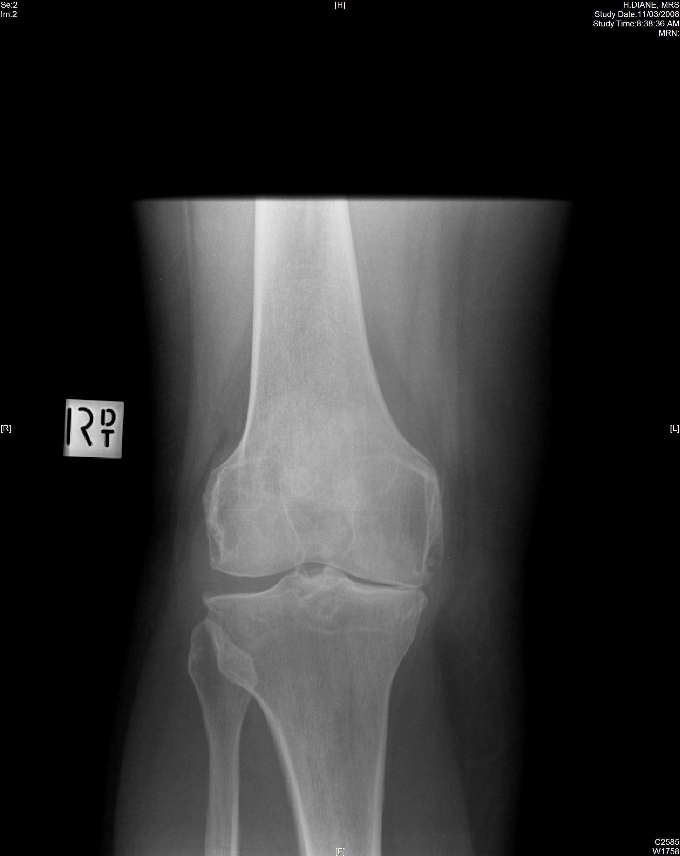
How to do this one?

Slide 15
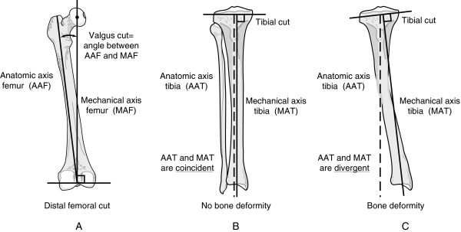
The deformed tibia
Post HTO
Post trauma
Paget’s
Rickets
Consider:
  Long tibia XR
  Long leg XR
Options:
  Resect with MAT
  Computer Navigation
  Avoid I.M. guide

Slide 16
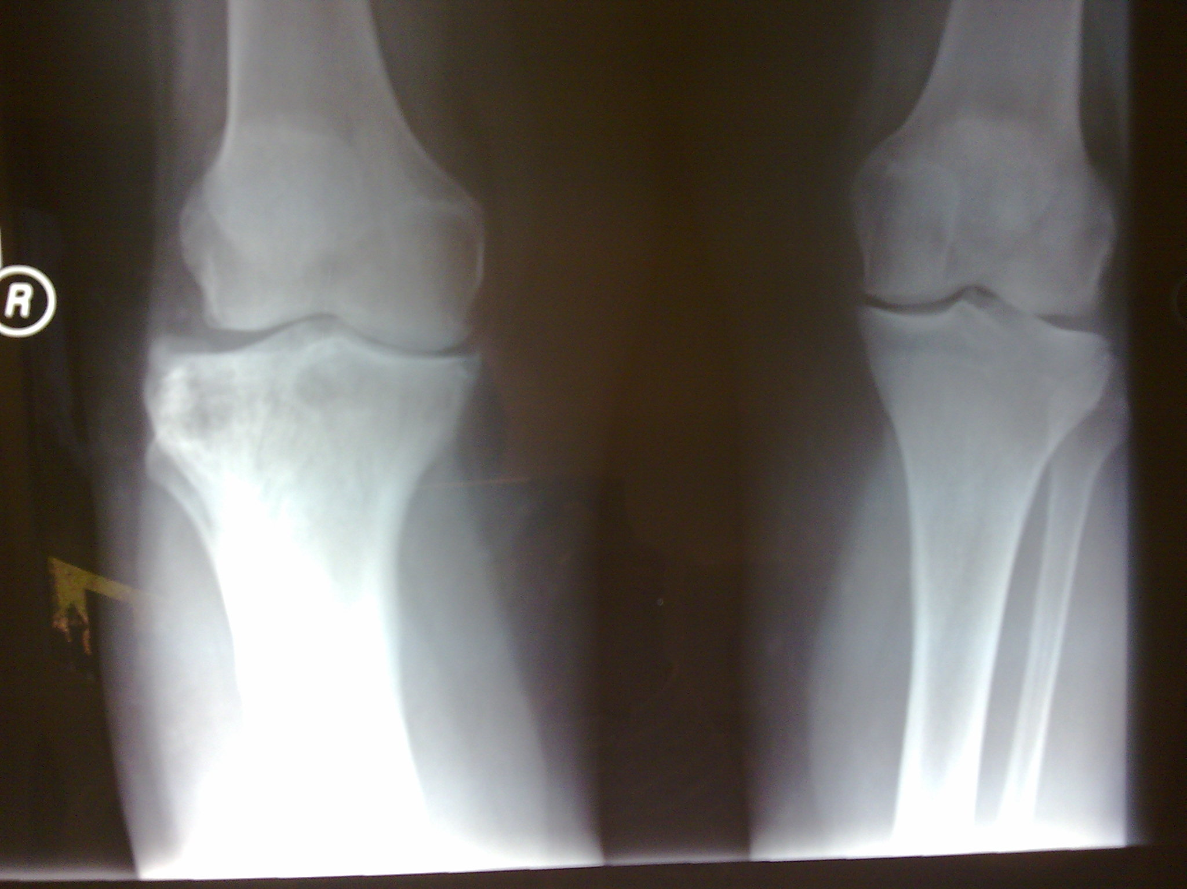
The deformed tibia

Slide 17
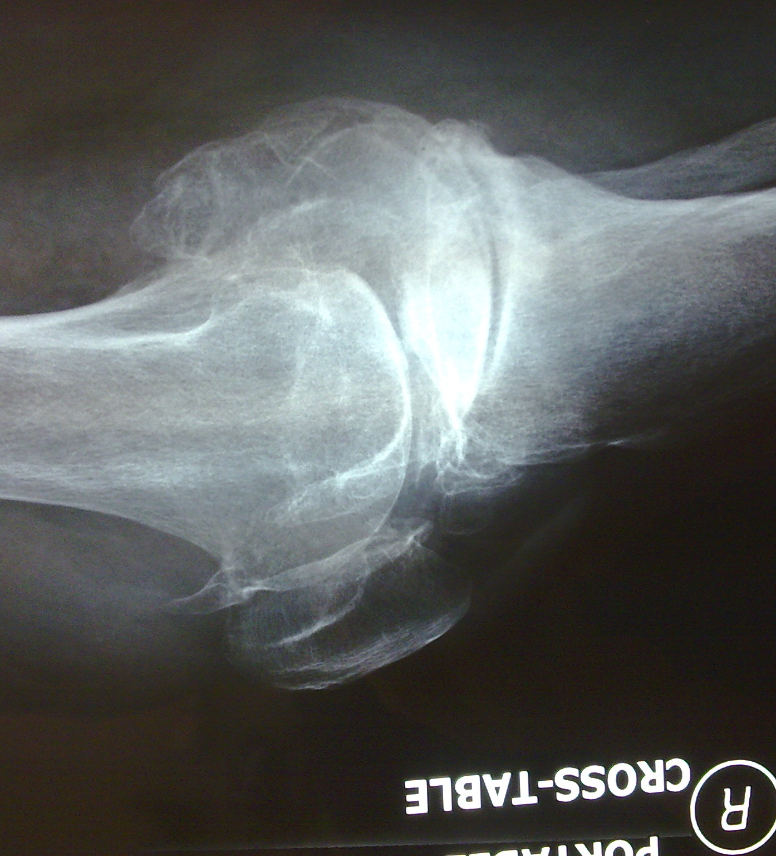
The deformed joint
Coronal contracture
  Varus/ Valgus
Saggittal contracture
  Flexion
Combined
  Valgus + Flexion
    BEWARE CPN Palsy
  Varus + Flexion
    BEWARE – tibial torsion

Slide 18
Principles of releases
Release concave side
  Ligaments
  Capsule
  Osteophytes
Replace BONE loss FIRST
Avoid Premature OVER-RELEASE
DON’T FORGET POSTERIOR structures

Slide 19
The unstable knee
Ligament integrity– critical
Ligament balancing – MORE critical

Slide 20
Principle of ligament balancing
Replace bone loss
Restore joint line
Coronal balancing
Saggittal balancing
  Symmetrical = Tibia
  Asymmetrical = Femur
  If you can’t work it out, try to make it symmetrical

Slide 21
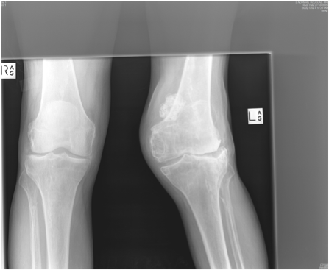
The unstable knee
PCL- substitute TKR
  Patellectomy
  Imflammatory
  PCL loss
  Over release

Slide 22
The unstable knee
Pitfalls:
  Know your implant
  Ligament balancing critical
  Mobile bearing implant
A PS implant will NOT save a poorly balanced knee

Slide 23
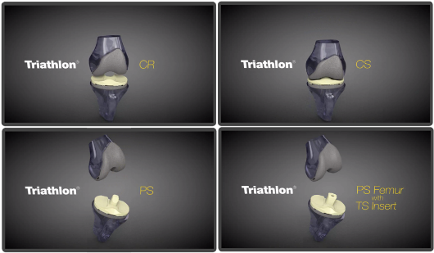
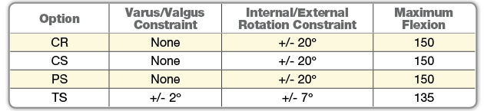
Various options of constraint

Slide 24
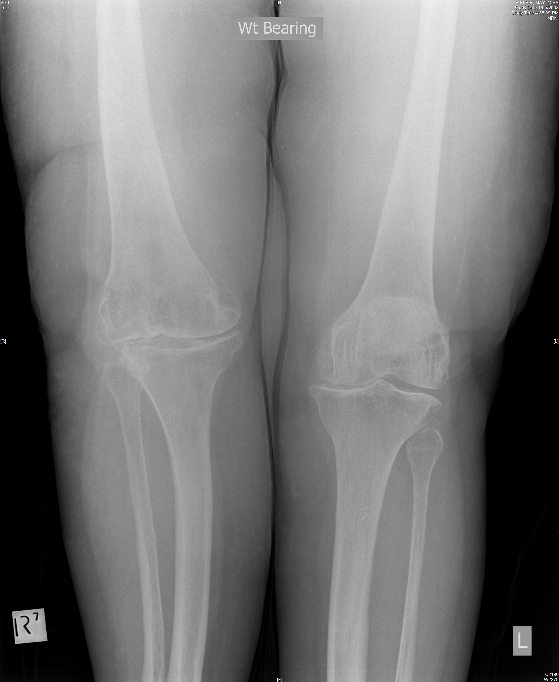

Slide 25
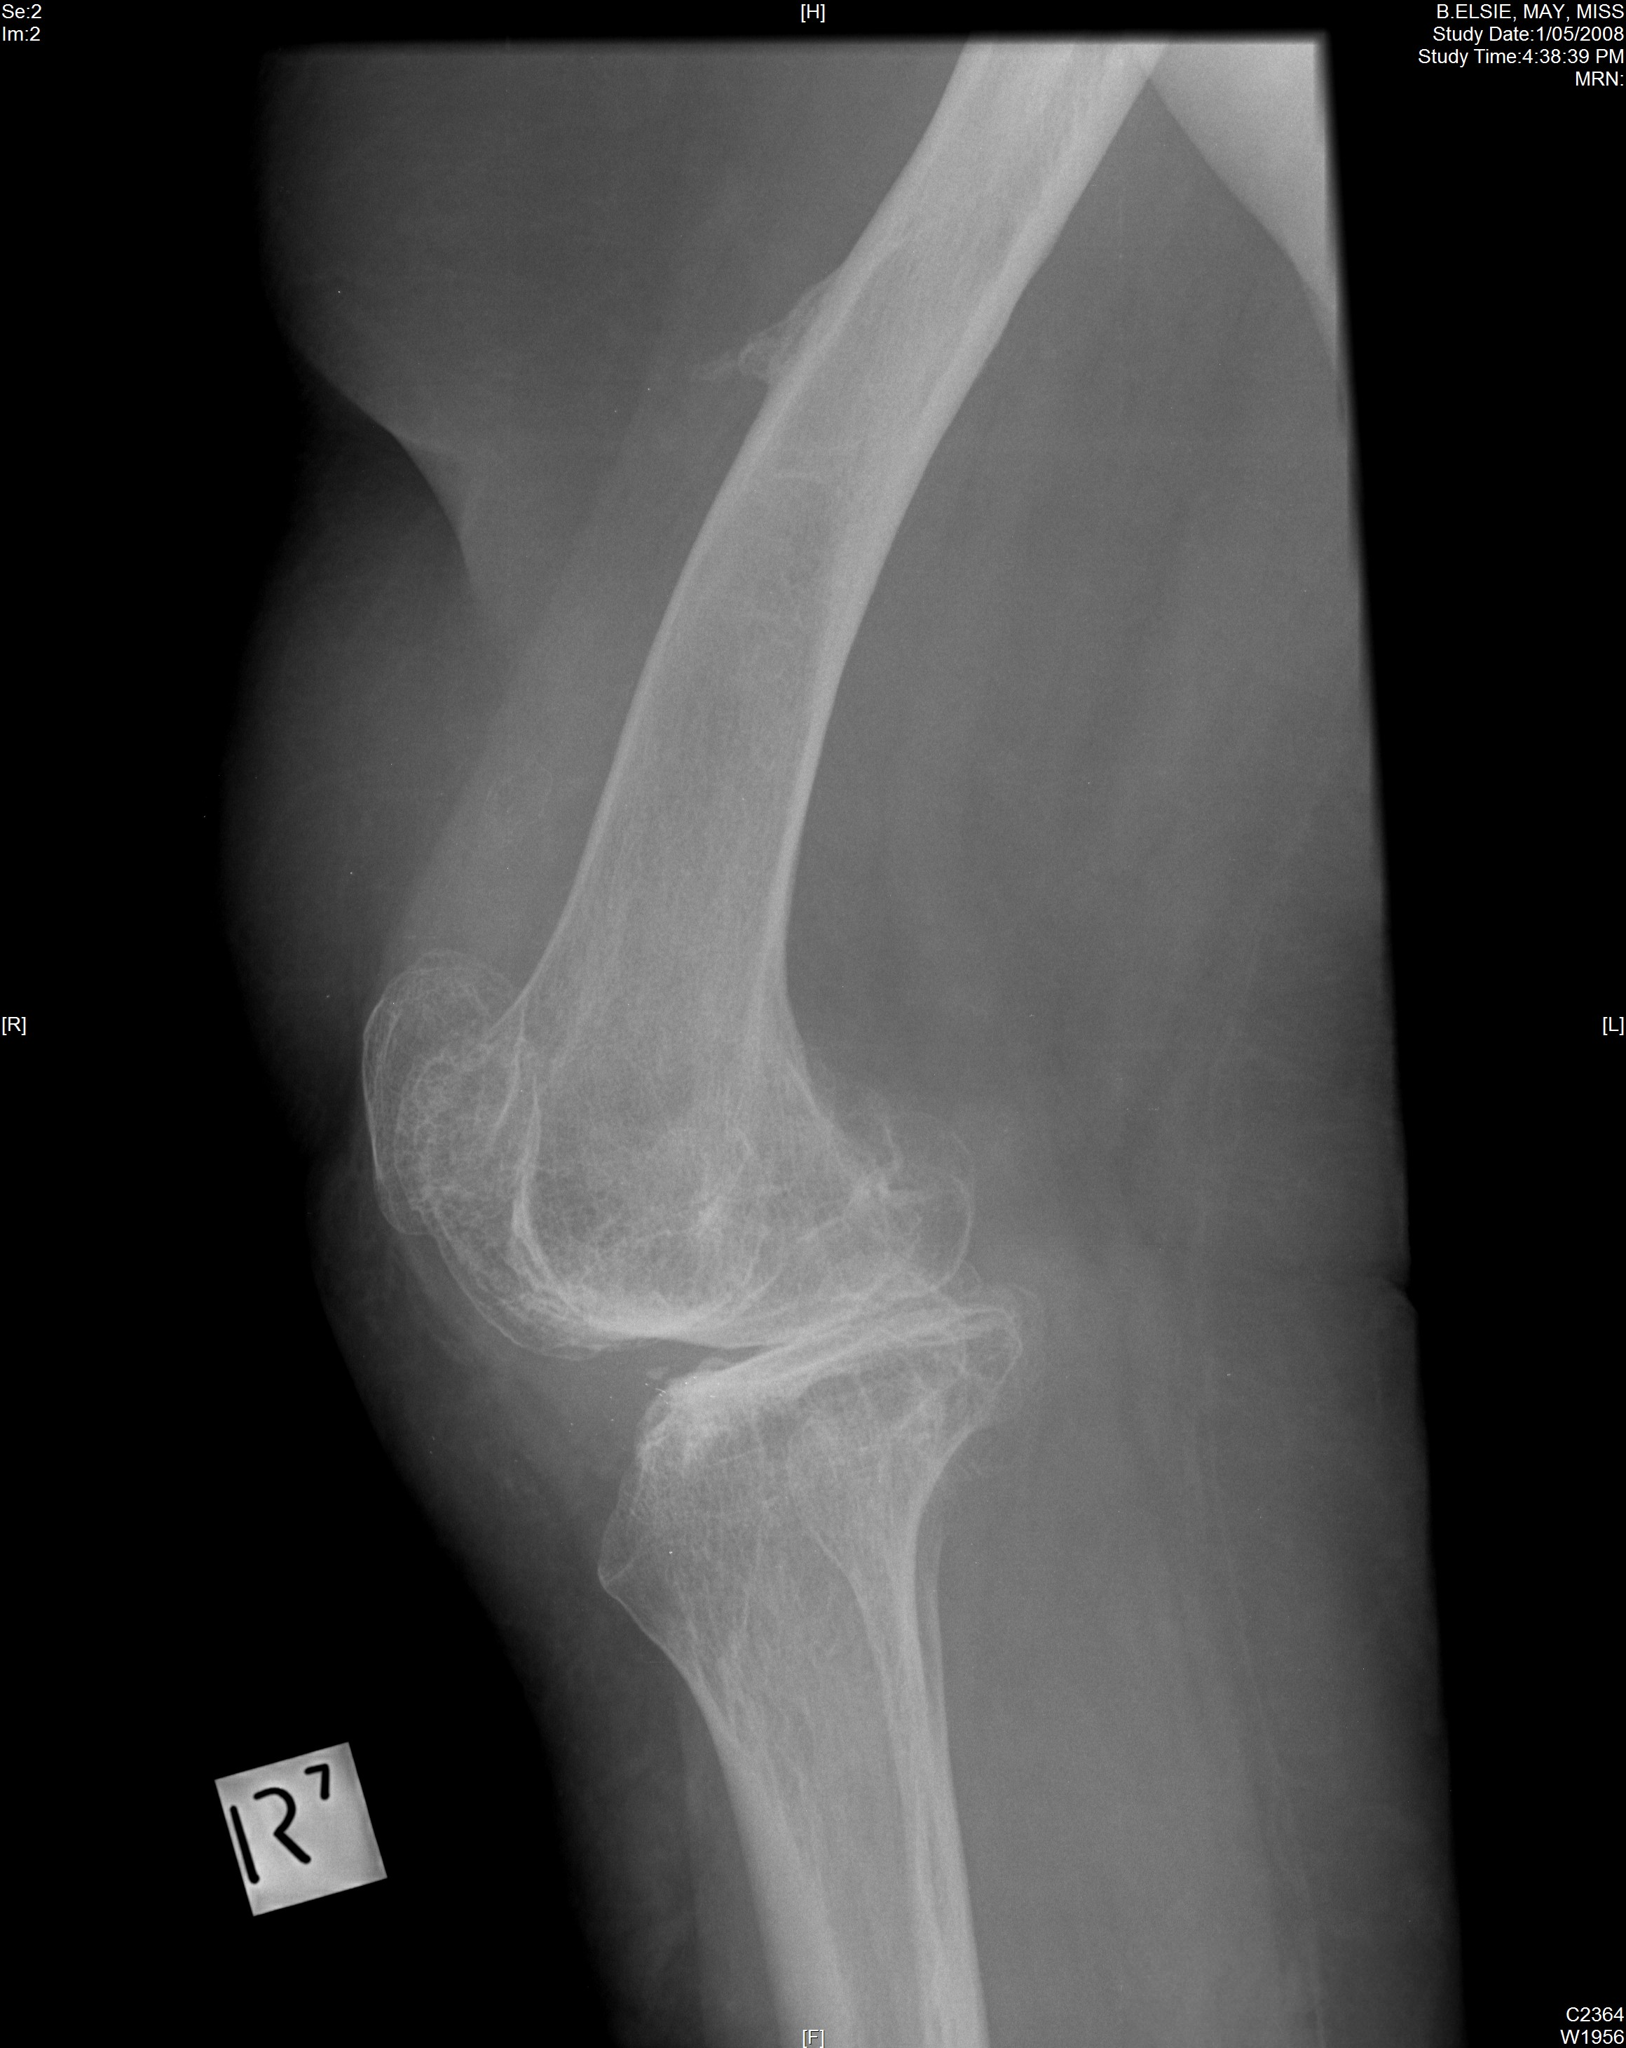

Slide 26
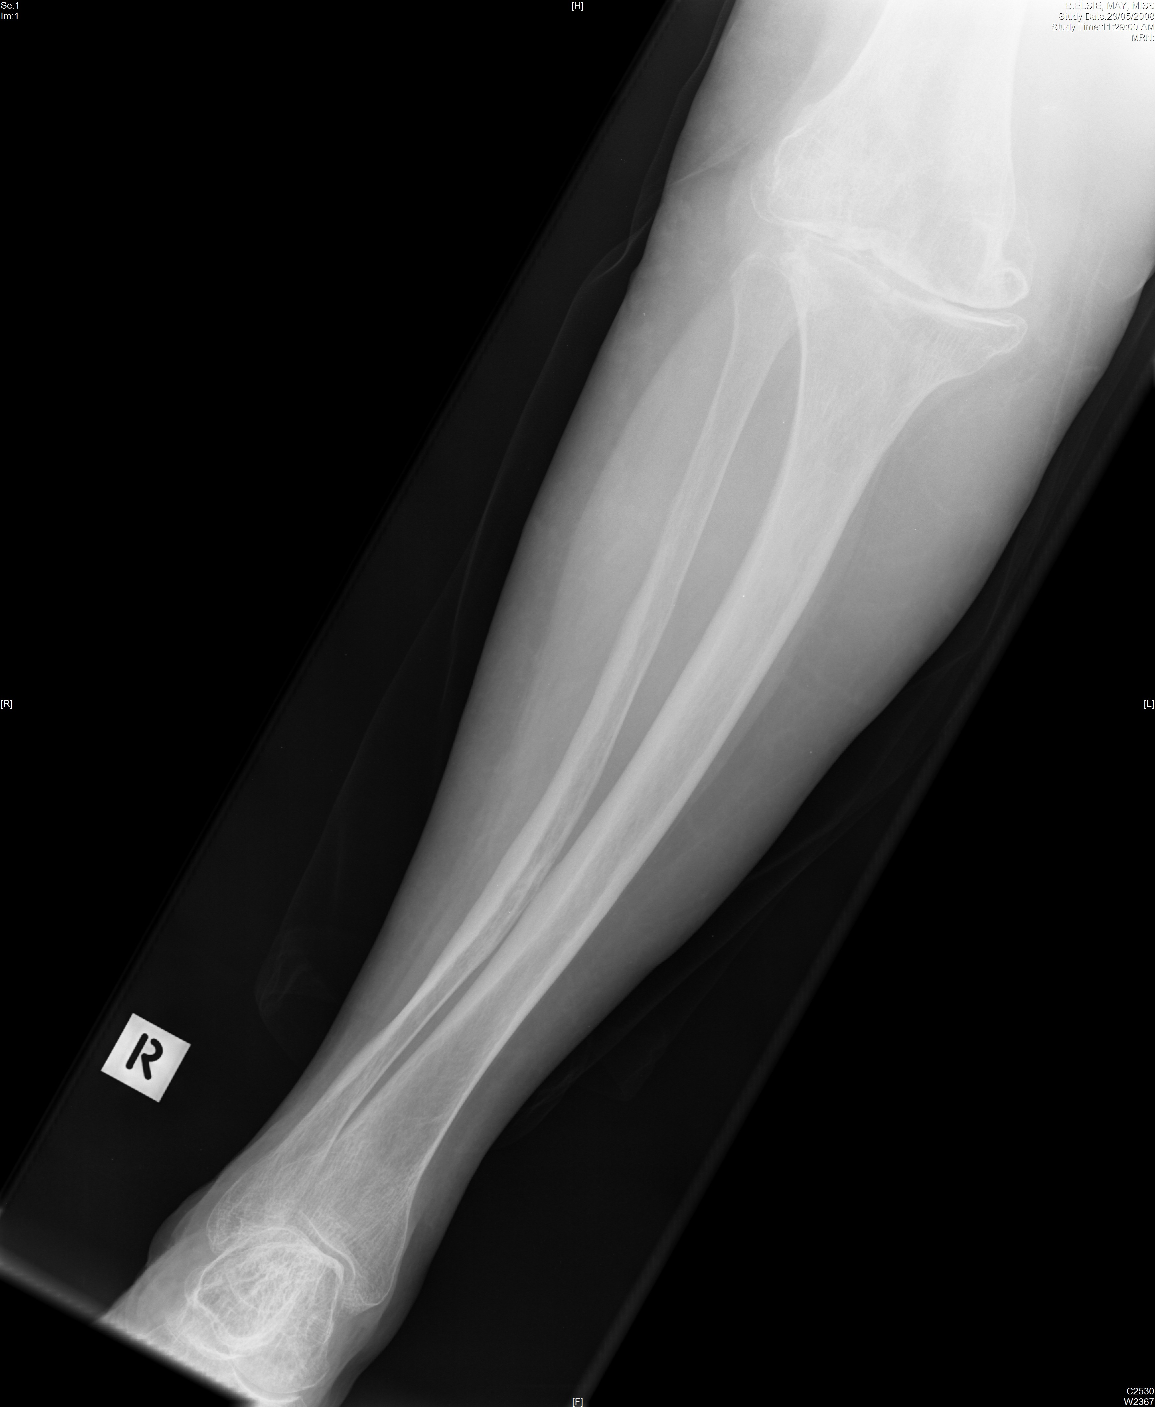

Slide 27
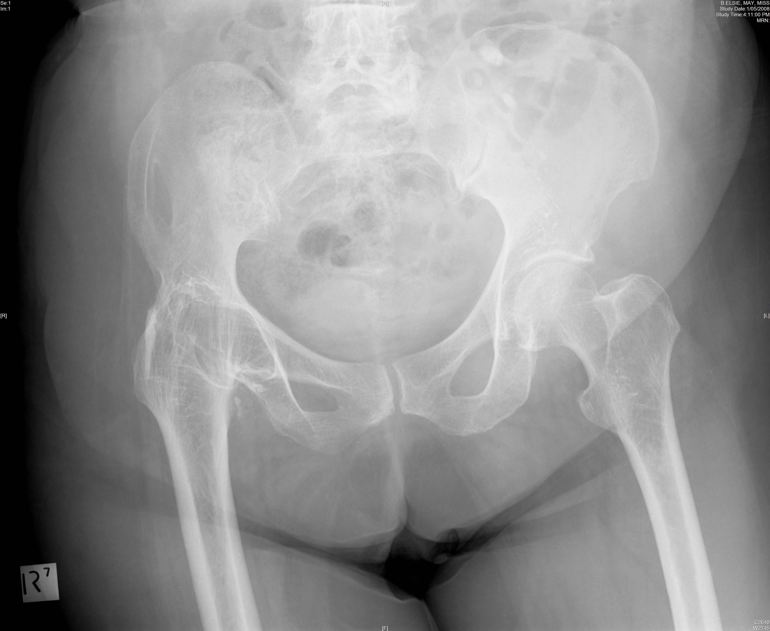

Slide 28
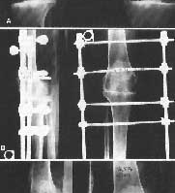
The fused knee
Beware:
  Extensor mechanism
  Joint line
  Popliteal artery
  Ligaments

Slide 29
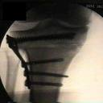
The touched one
Closed wedged HTO
  Soft tissue scar
  Patella baja
  Implant
  Subacute infection
  Translation of shaft
  Altered tibial slope

Slide 30
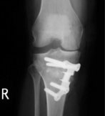
The touched one
Open wedge HTO
  Less tibial translation
  More patellar descent
  More tibial slope
  Implant removal

Slide 31
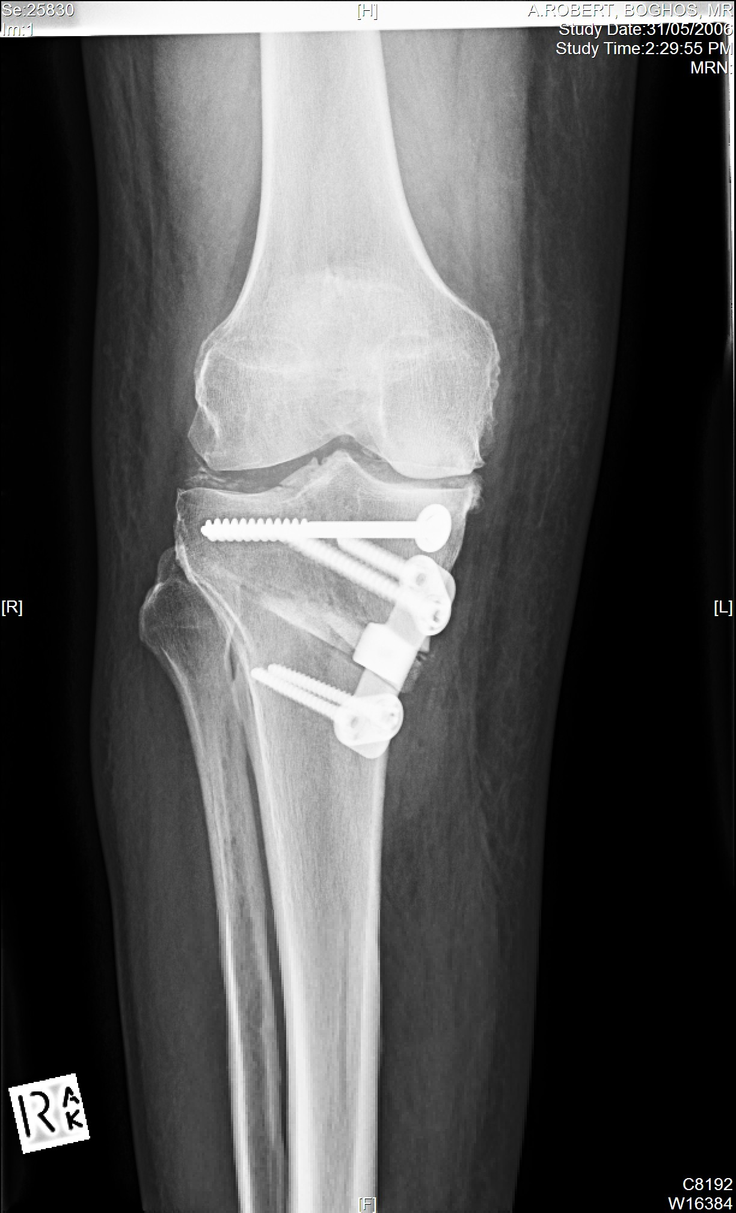
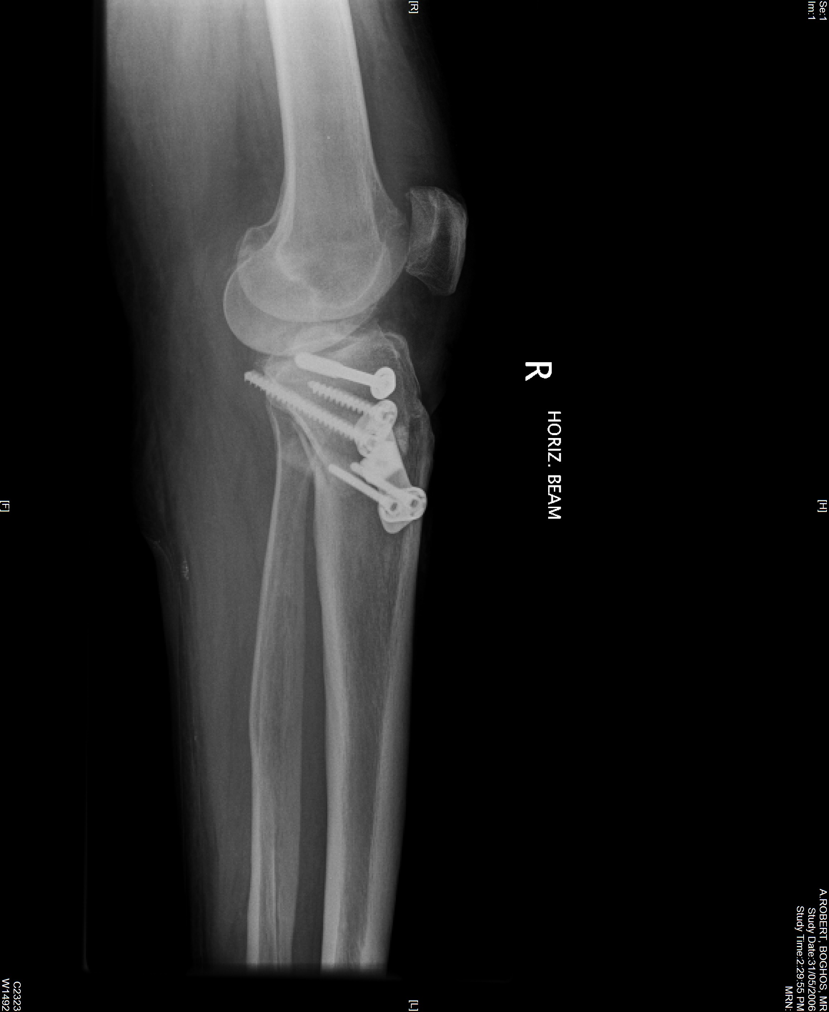
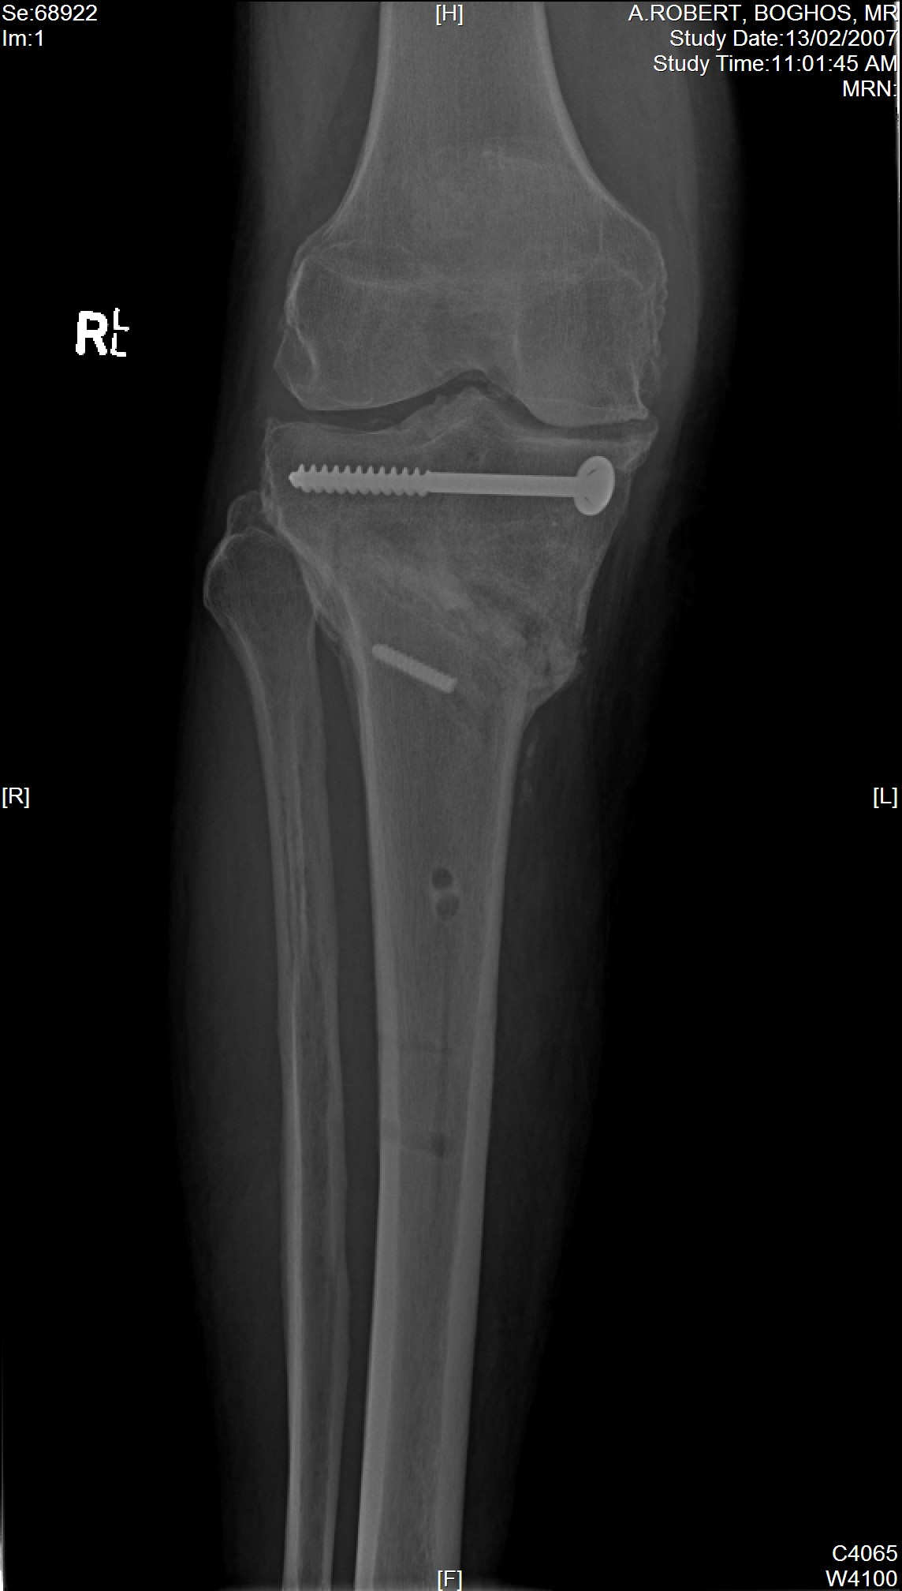
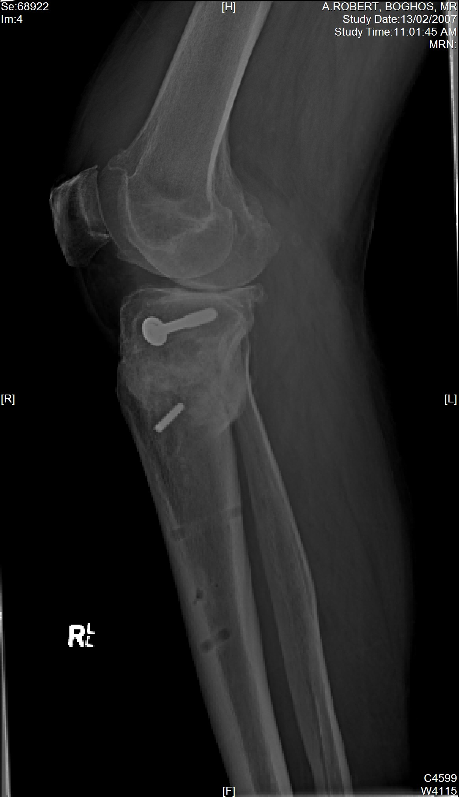
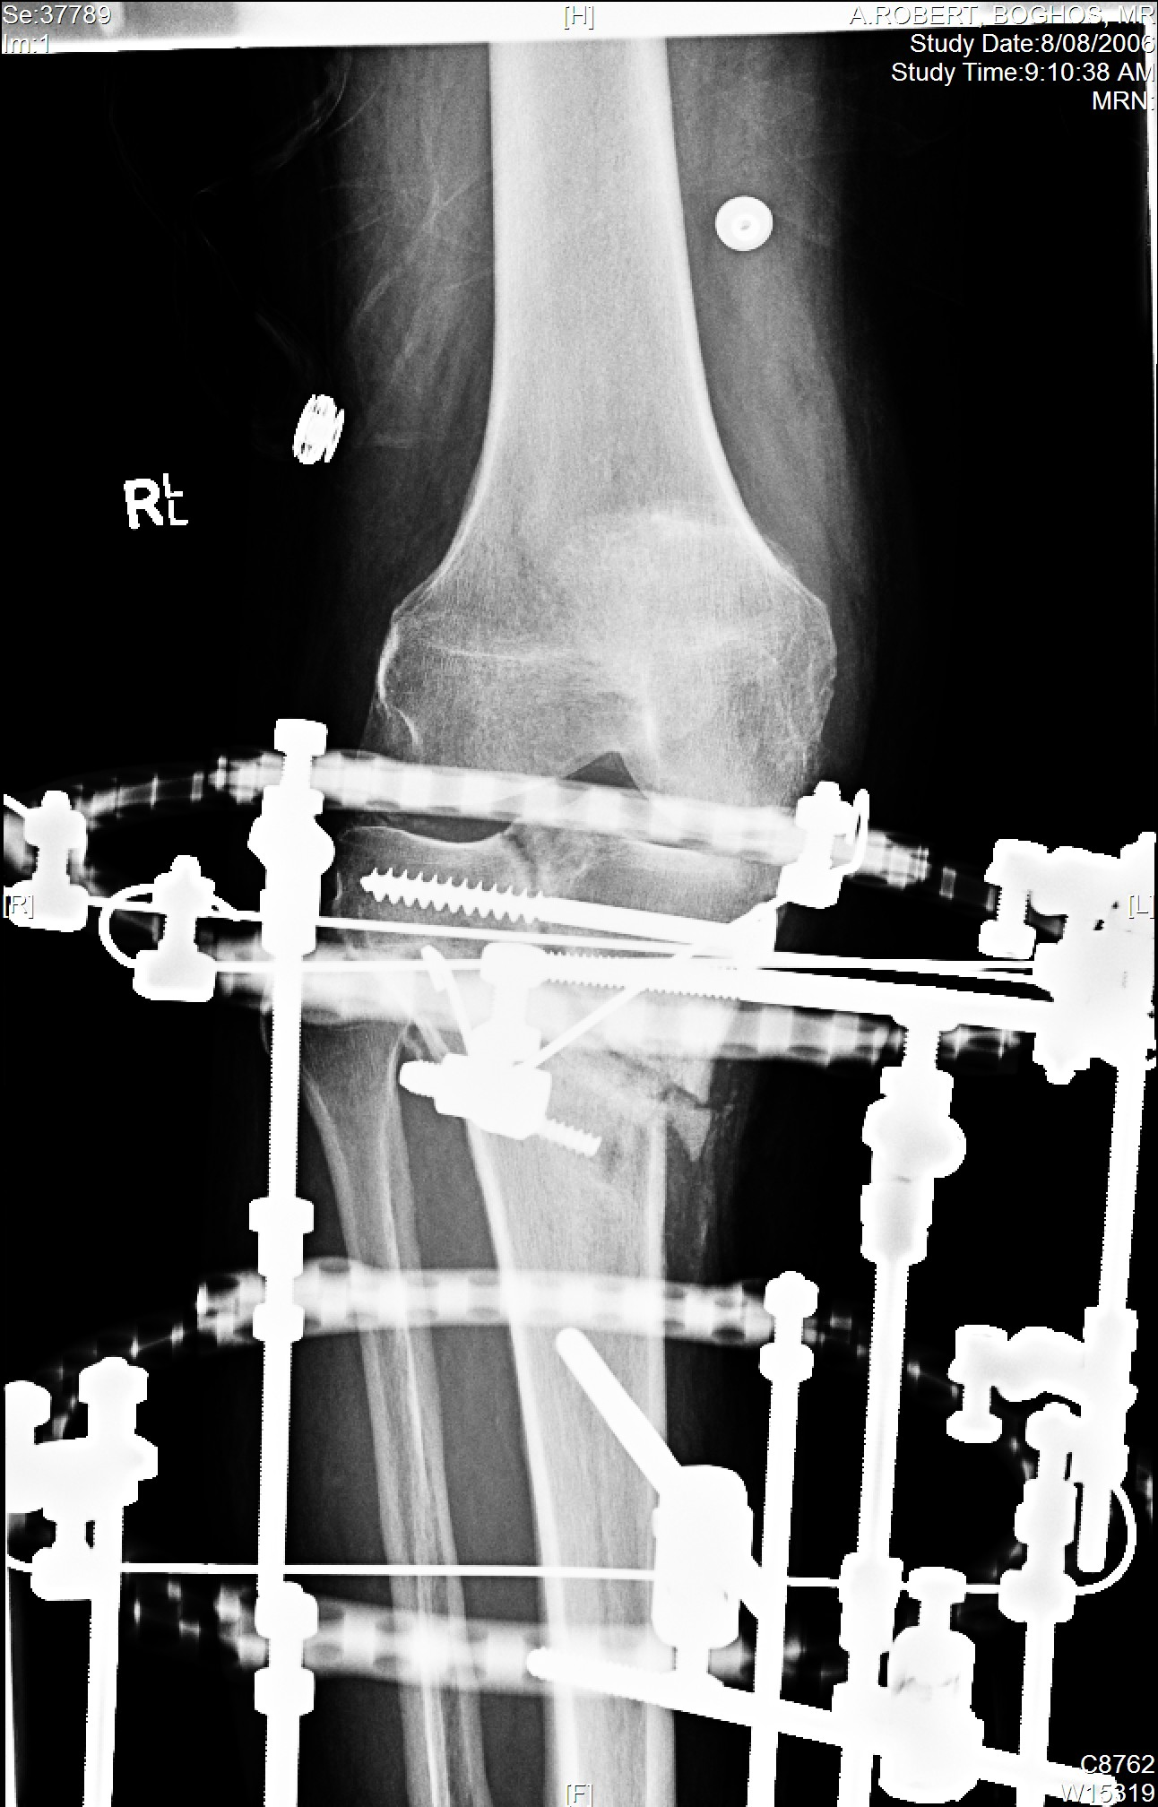

Slide 32
Conversion Post HTO
Tubercle osteotomy/ Patellar tendon scarring
Stiff range (esp FFD)
Tibial slope
PCL integrity
i.m guide
Staged implant removal
Beware infection

Slide 33
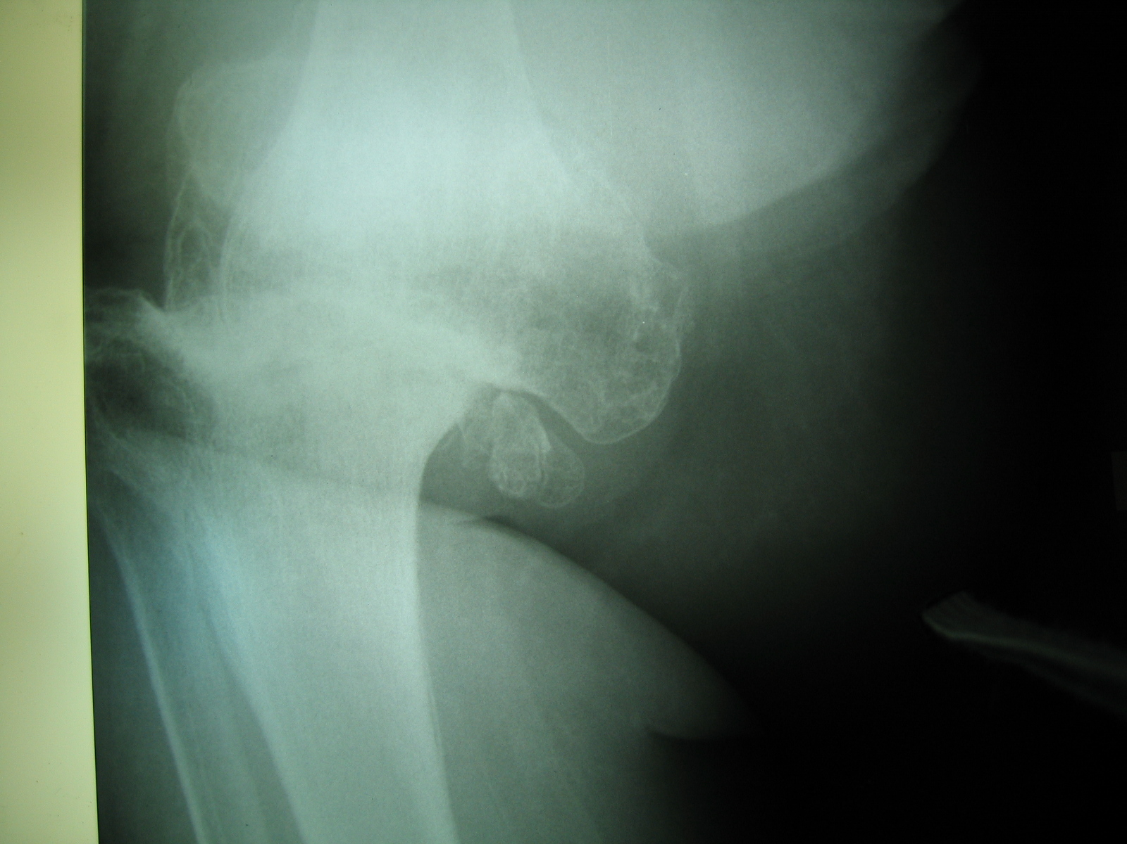
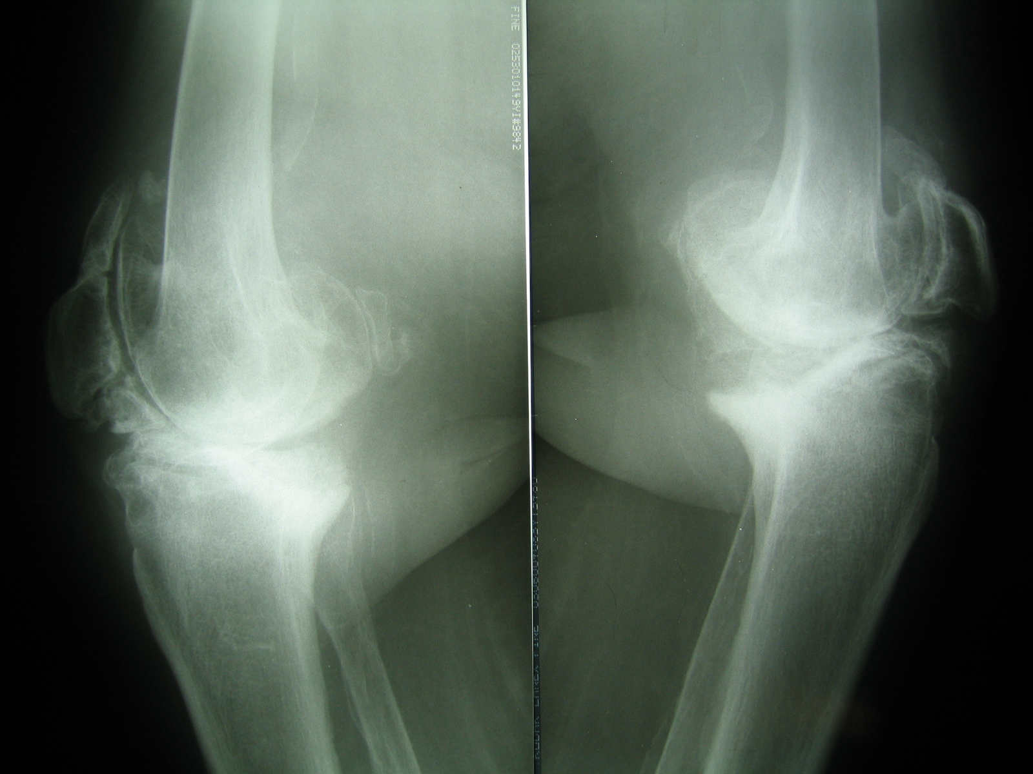
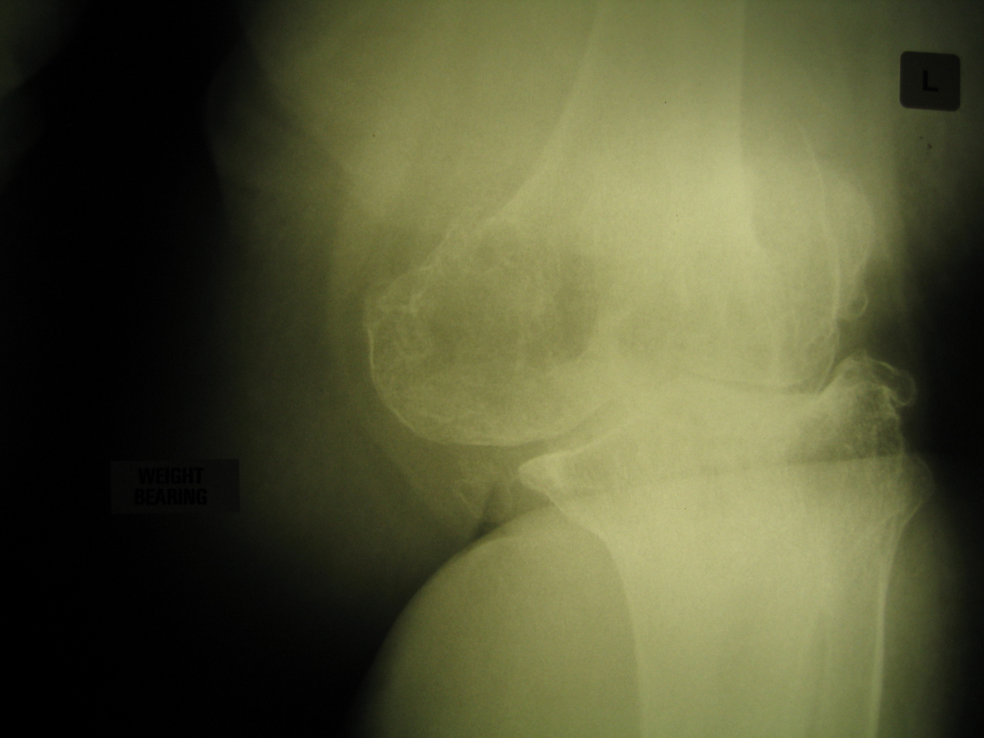
The impossible one

Slide 34
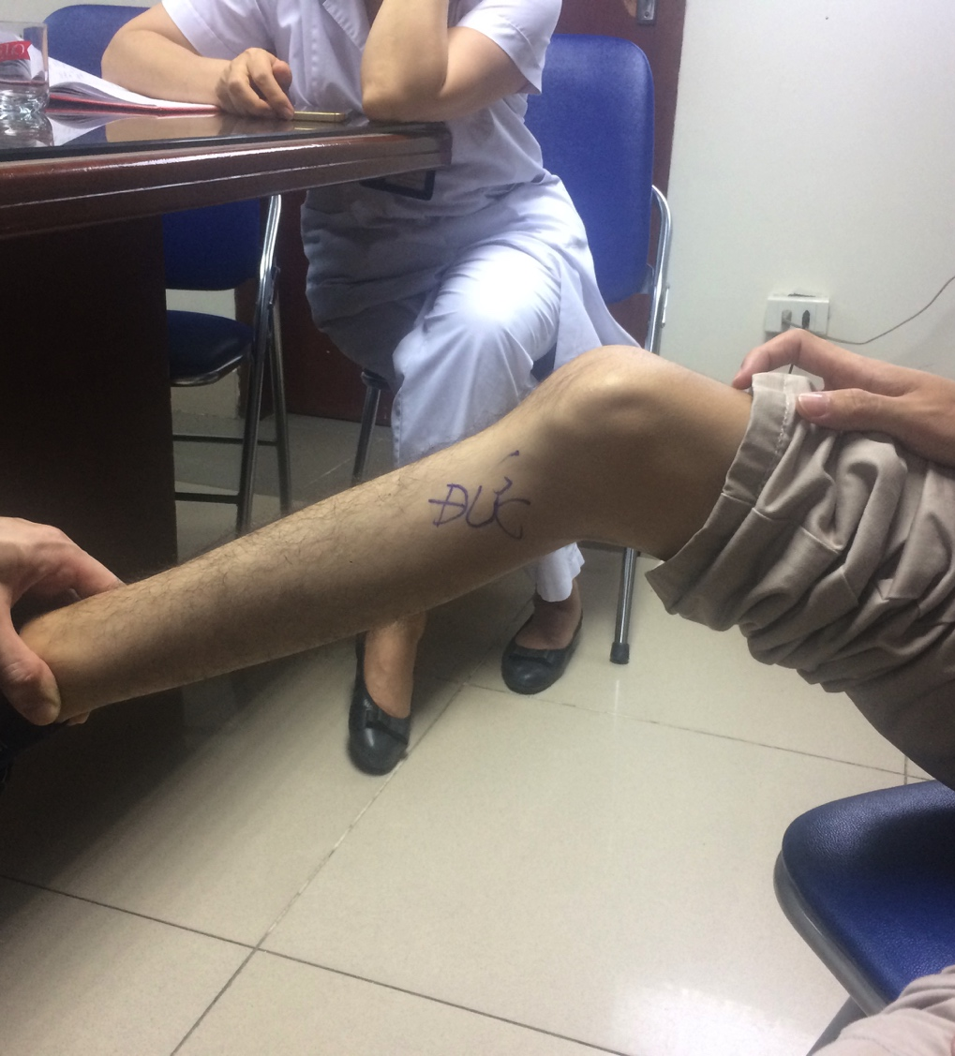
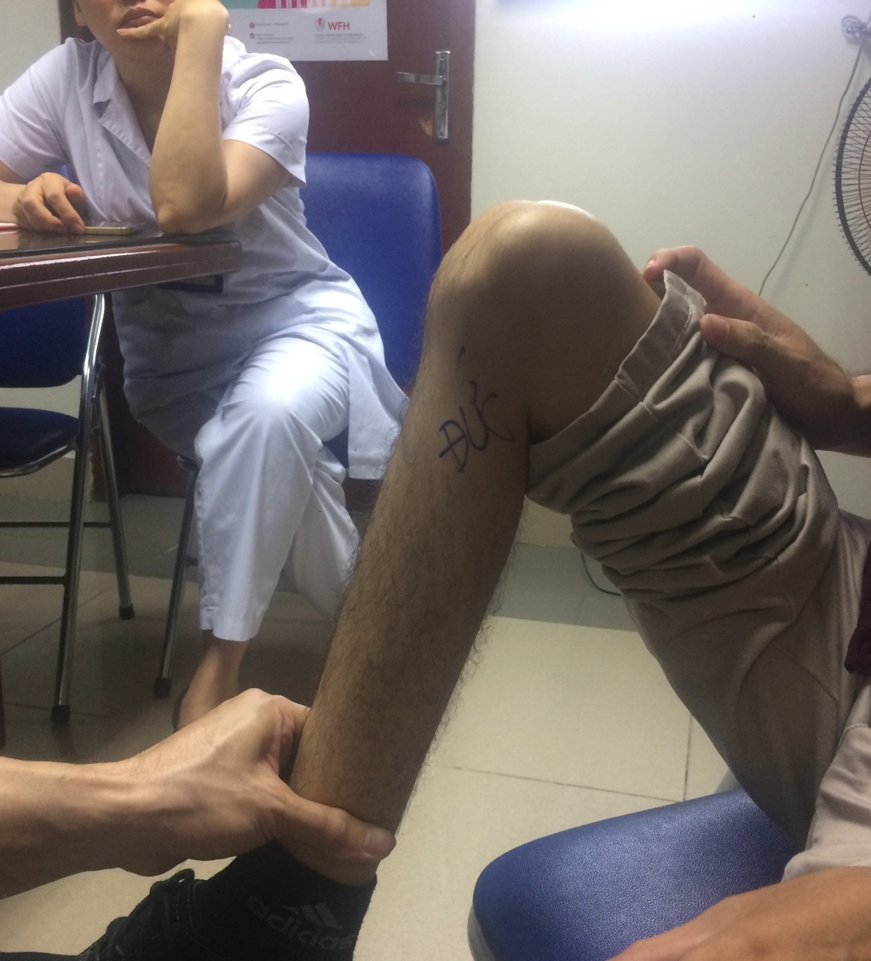

Slide 35
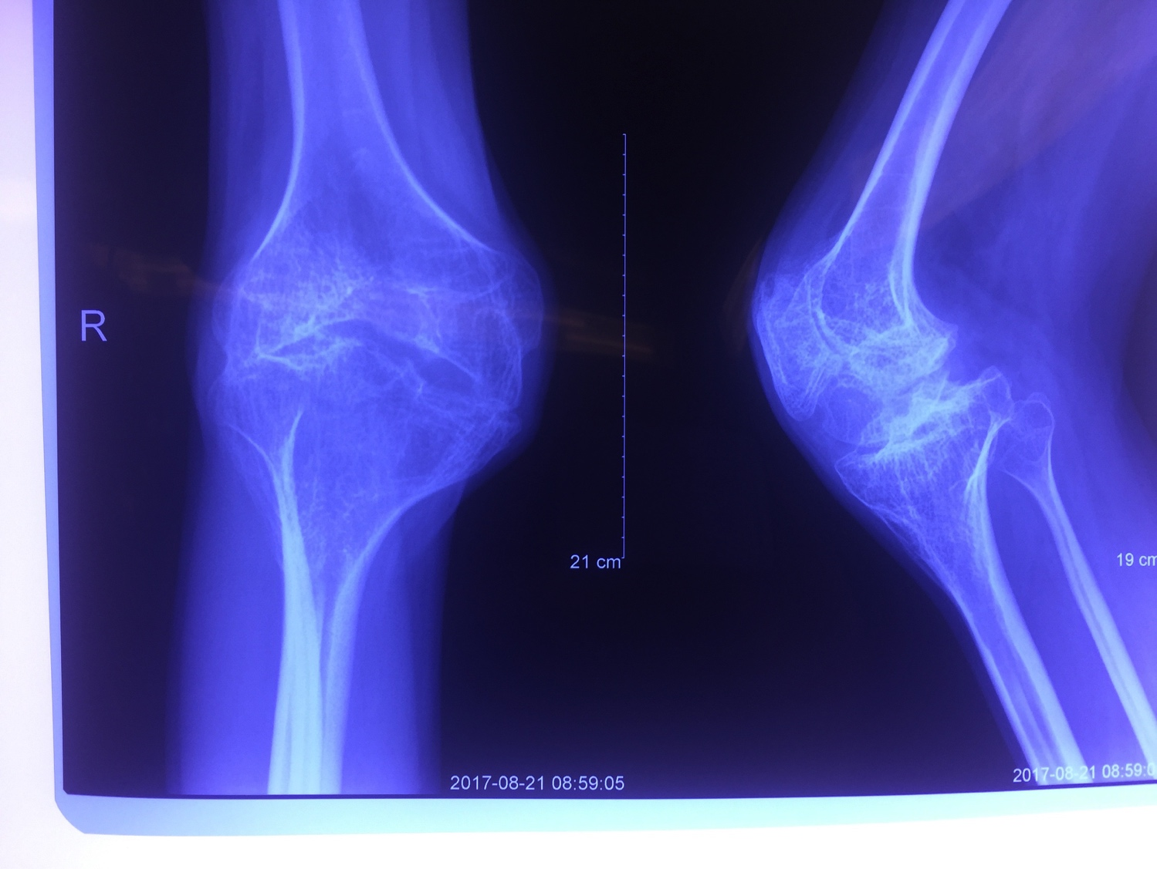

Slide 36
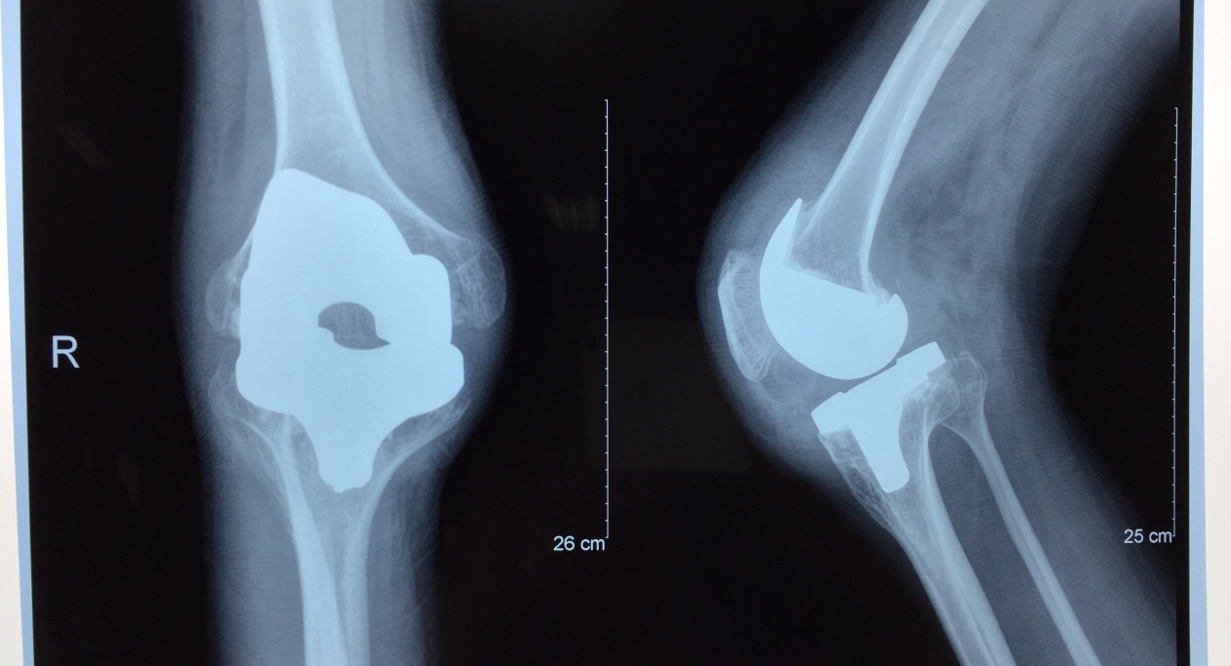

Slide 37
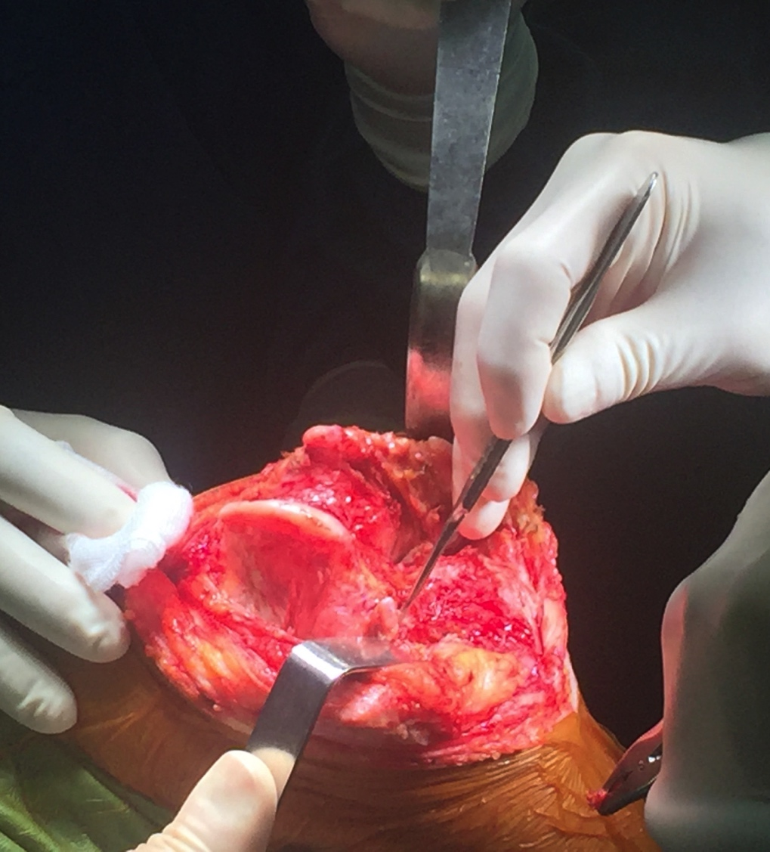
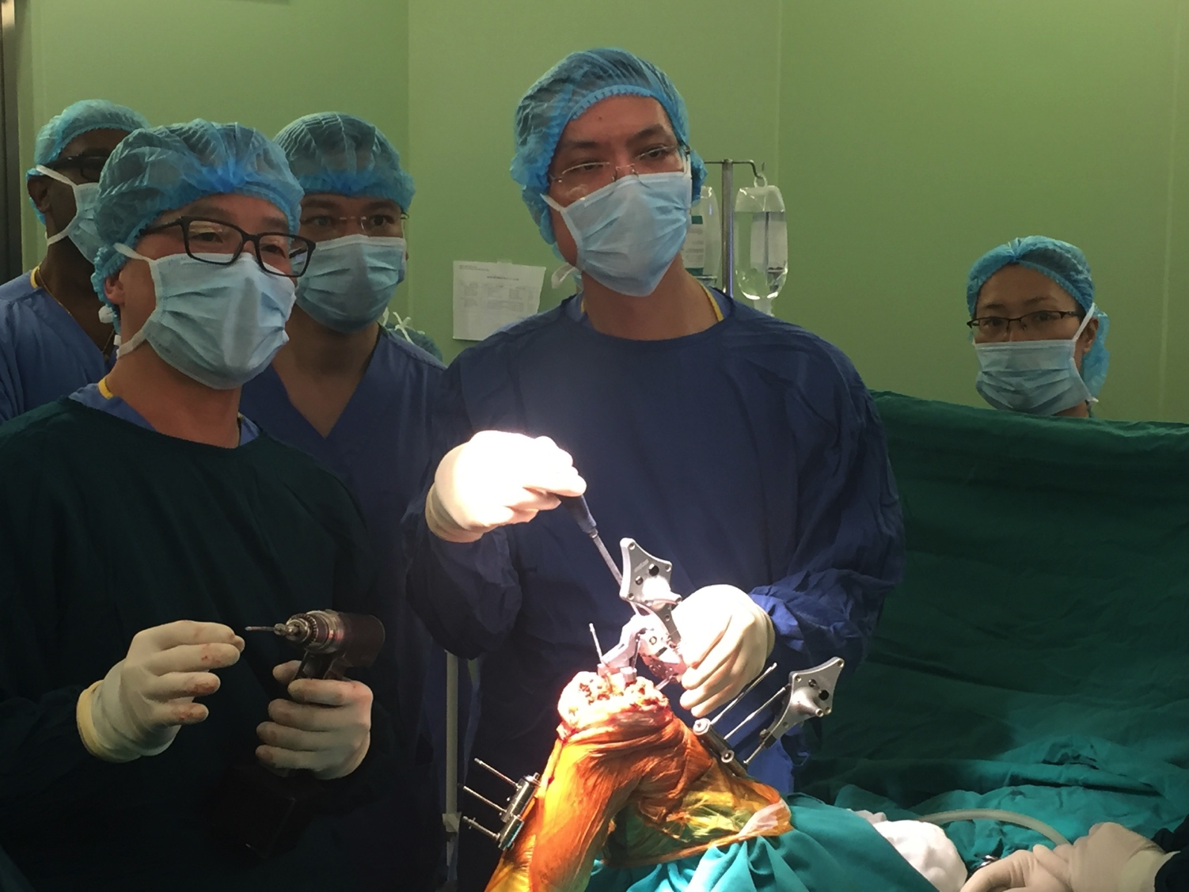

Slide 38


Slide 39
Conclusions
More technical
Less forgiving
Alignment and stability critical
Know your implant and instruments

Slide 40


