Slide 1


Rehabilitation Post TKR
Physiotherapy

Slide 2
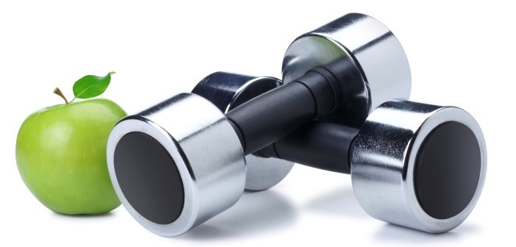
Pre-operative Assessment
Setting Patient Expectations
  Post-op
  Outcomes
Pre-conditioning
Notes:
Pre-operative assessment prepares patients for what lies ahead. Patients are often unaware of the extent of rehabilitation required to restore muscle function and this is better dealt with in the pre-operative phase. Its also about preparing the patients condition pre-op as well as practicable to firstly cope with the surgery and secondly to get the best possible result post-op. As I discussed in the earlier talk, these patients often come with multiple co-morbidities. Improving a patient’s underlying strength, cardiovascular conditioning, as well as their understanding of lifestyle factors such as diet and smoking can contribute to an improved surgical outcome. For example, in a pre-op setting we could teach patients how to use the different walking aides they might encounter post-op. It’s going to mean they won’t be overwhelmed when we try to show them a walking frame or crutches day 2 post-op. They could start using an exercise bike to develop quads strength, or we could show them some simple quads activation exercises to practice. Most likely they will have poor quads mechanisms anyway given that they need to have a TKR.

Slide 3
Early Mobilisation
Reduces post-op complications
  DVT
Reduces stiffness and pain
Restores muscle function
Develops confidence
Prepares for early discharge
Notes:
Early mobilisation is a critical part of post-op management. There is moderate to strong research evidence showing rehabilitation begun within the first 24 hours reduces pain, reduces swelling, improves physical function and joint ROM. It also develops confidence and decreases the length of hospital stay.

Slide 4
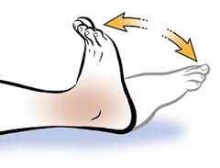
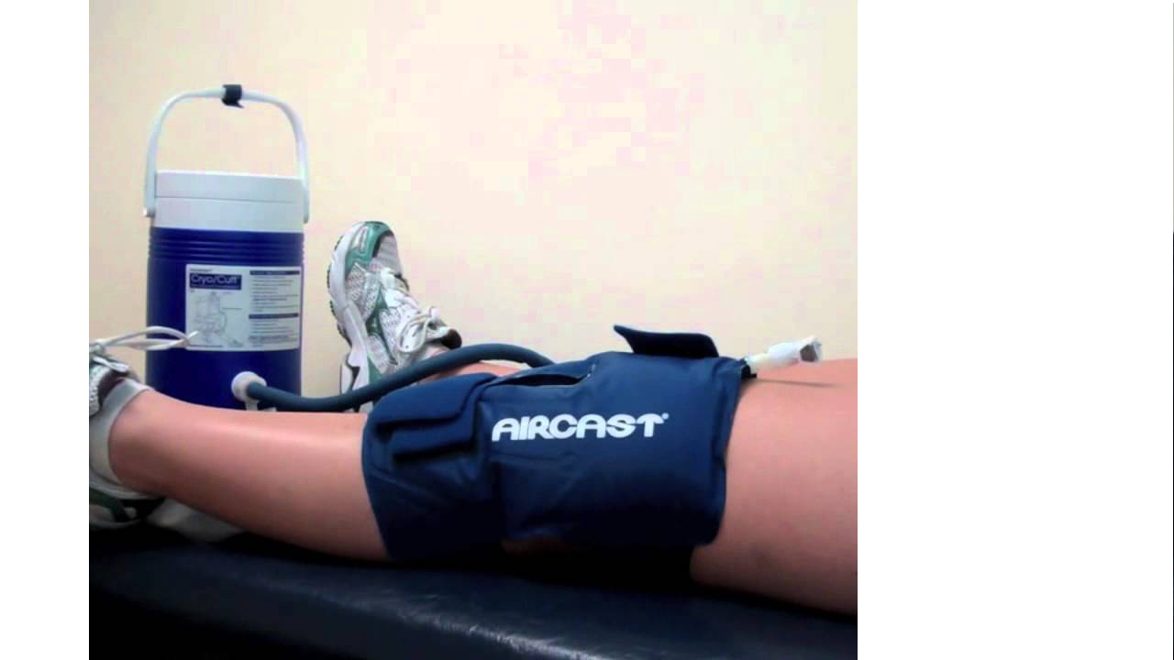
Post –op and Day 1
Circulation
  Foot & ankle exercises
  TED Stockings
Cryotherapy (ice)
Wound Care
Notes:
So what do we do? We manage DVT risk, we manage pain, we manage the wound. Post –op we start circulation exercises to prevent DVTs. Ice in some form as well as compression helps manage the pain and swelling.

Slide 5
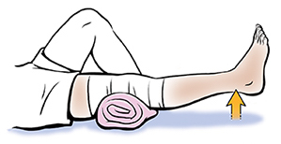
Post-op and Day 1 (cont.)
Bed Mobility
  Sit out of Bed
Quads Activation
  Static Quads in Terminal Extension (2hrly)
  Active-assisted Knee flexion
  Assisted SLR
CPM?
Notes:
We encourage early bed mobility. Sitting out of bed prevents bed sores; improves patient’s breathing patterns, and improves mood and appetite. Terminal knee extension is very important for regaining knee control in stance and gait. Lack of terminal extension perpetuates quads and hamstring imbalances, leads to a bent knee gait, increases the risk of FFD, and patellofemoral tracking issues. CPM is used by some surgeons though the data on CPM is that it doesn’t seem to contribute significantly to outcomes over current practices.

Slide 6
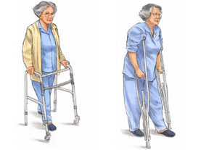
Day 2-4 Post-Op
Ambulate
  +/- Zimmer Splint and WB as prescribed
  Gait Aides as required
Notes:
We get patients walking in whatever capacity they are able to mobilise, whether that is crutches or a walking frame, most likely with their splint. Patients can be very apprehensive and nervous about doing this so early, which is why if we have an opportunity pre-op to educate them on aide use, its one less thing to worry about. Early walking improves muscle function and tone, and improves blood flow. It develops the patients confidence in the effectiveness of surgery and their knee replacement. It also starts us on the road for safe discharge.

Slide 7
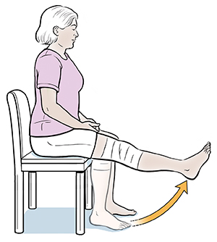
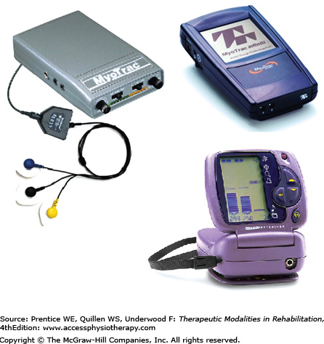
Day 2-4 Post-Op (cont.)
Progress Quads
  Sitting on edge of bed
  +/- biofeedback/muscle stim
Notes:
We do quads, and then more quads, and then more quads. There are many different exercises and positions but at the end of the day its all about quads activation. Often an EMG biofeedback device can be a great way to provide another source of external feedback for the patient regarding the quality of their muscle recruitment. These devices here are examples of portable devices that give the patient feedback in the form of flashing lights of changing colours, or sounds, or moving bars.

Slide 8
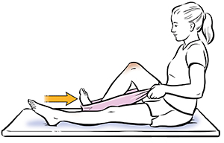
Day 2-4 Post-Op (cont.)
Hip Exercises
  Gluteal activation
Range of motion
  PNF techniques
  Active or self-assisted
Stretching
  Hamstrings and calf
Notes:
Hip exercises are added to restore core control and provide proximal stability for gait. Examples might be hip abduction exercises in side ly in bed or in standing. ROM exercises like active and active self-assisted as in this picture. PNF or Proprioceptive Neuromuscular Facilitation is another method of stretching that has been shown to improve range of motion. There are some varying theoretical mechanisms identified as to how this works but clinically I find it a good method help improve range of motion. Static stretching is also important to incorporate into the program, particularly the posterior structures of the hamstrings and calf.

Slide 9
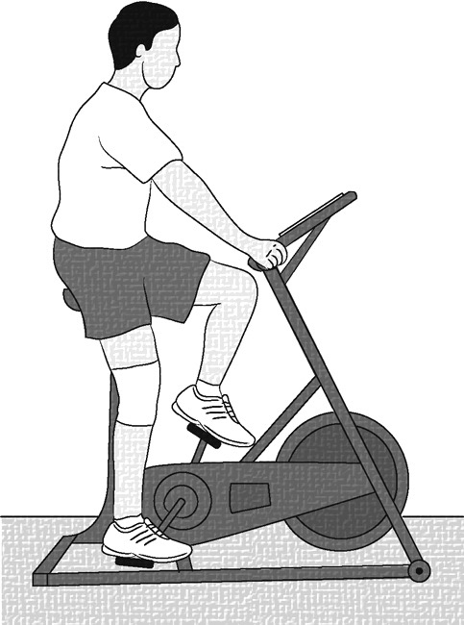
To Discharge
Continue to Progress
  Knee Flex/Ext
  Hip strength
  Proprioception
  Bike
Notes:
From then to discharge we look to progress all the relevant parameters: ROM, strength, proprioception/balance, cardiovascular endurance. Our focus obviously depends on the individual patient’s progress to date, taking into account the setting they are returning to at home. For example, whether they have home help or are independent in a house with stairs, will dictate how much time you spend on stair practice.

Slide 10
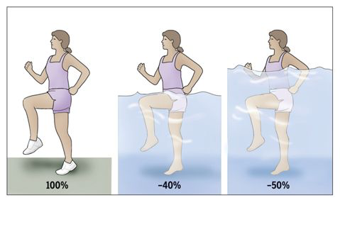
To Discharge (cont.)
Planning for home environment
  Stairs
  Ambulation with/without aides
Notes:
If the patient has access to pools, at home or in some rehab setting, water can be a useful medium. Along with the benefits of hydrostatic pressure to help manage swelling, the buoyancy provided, depending on the water depth, can reduce joint load and allow more effective exercise. On discharge, patients should ideally be safe ambulating with or without an aide.

Slide 11
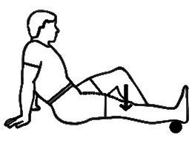
Ongoing Rehabilitation
Ongoing Post-op Pain Management
  Surgical pain
  Joint mechanics - PFJ
Stiffness
  Due to pain inhibition/surgery
  Aggressively manage with physiotherapy
    Manual Therapy and exercise
Weakness
  Home exercise program
    Compliance monitoring
Notes:
Anecdotally the first 6-8 weeks post-op there is often considerable surgical pain. Pain management is important at this stage so as to not inhibit muscle activation, or mobility or the exercise program. So its critical we get that under control. Patient’s are often in the community at this stage, therefore its important for whoever their follow-up care provider is to have an understanding of this – whether it’s the GP, physio or outpatient review. This pain tends to naturally subside and stiffness becomes the primary concern. Explain image. Supervised exercise programs that extend two to three if not six months post TKR have been shown to improve function as opposed to no or minimal exercise post surgery. More intense programs in the early stages also tend to produce better results, again when measured in terms of pain relief, ROM, and physical function.
This is why we tend to be aggressive with early intervention. If they need more pain relief to handle the program (within reason) then we try to facilitate that.
So the key at this point is to be able to provide patients with a home exercise program of stretching and strengthening that they have ownership of and have had input into. They will have a greater likelihood of being compliant, they will be more comfortable self-managing, and long term have a better chance of a positive outcome.

Slide 12
References
Harvey LA, Brosseau L, Herbert RD 2014, ‘Continuous passive motion following total knee arthroplasty in people with arthritis’, Cochrane Database of Systematic Reviews, issue 2.
Hindle KB, Whitcomb TJ, Briggs WO, Hong J 2012, ‘Proprioceptive neuromuscular facilitation (pnf): its mechanisms and effects on range of motion and muscle function’, Journal of Human Kinetics vol.31, p.105-113.
Oldmeadow L & Kimmel L, 2008, Clinical protocols in acute orthopaedic physiotherapy.
Surgical management of osteoarthritis of the knee, American Academy of Orthopaedic Surgeons, 2015 www.orthoguidelines.org

