Slide 1
TKR Complications
Rabi Solaiman
MBBS, FRACS, FAOrthA
Orthopaedic Surgeon
Monash Health

Slide 2
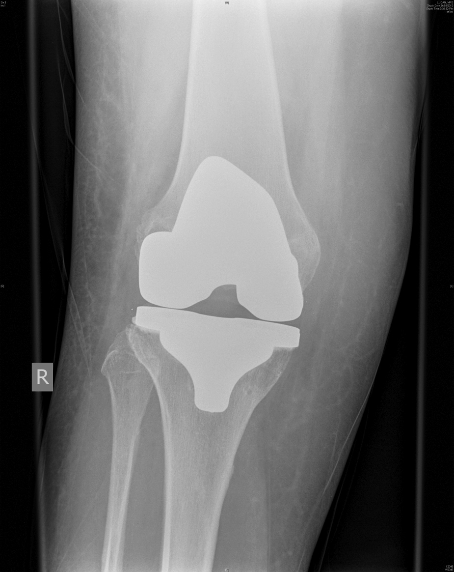
Post Operative Care
Multi Disciplinary Team Approach
Goal
  Pain free
  ROM
  Stable prosthesis
  Longevity
  Avoid complications
Notes:
Management of a patient post TKR does not end with surgery. post op care requires diligence and a multi disciplinary approach in order to minimize the risk of post operative complications

Slide 3
Complications Post TKR
Vascular
Common Peroneal Palsy
Infection
Wound Dehiscence
DVT & PE
Stiffness
CRPS
Medical Complications
  Atelectasis, UTI, Urinary Retention

Slide 4
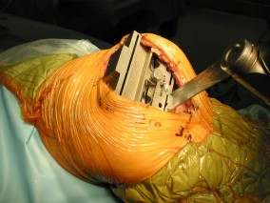
Vascular Complications
0.03 – 0.17%
Arterial severance
Arterial Thrombosis
Arterio-Venous Fistula
Aneurysm
High rate of infection and stiffness

Slide 5
Vascular Complications
Prevention
  Always place Retractor behind tibia before cutting
  Measure tibial AP diameter and match with saw
  Flexion of knee helps
  Minimal Soft tissue handling
  Always deflate the tourniquet prior to closure
  Always check the pulse and capillary return before commencement of surgery and at the end.

Slide 6
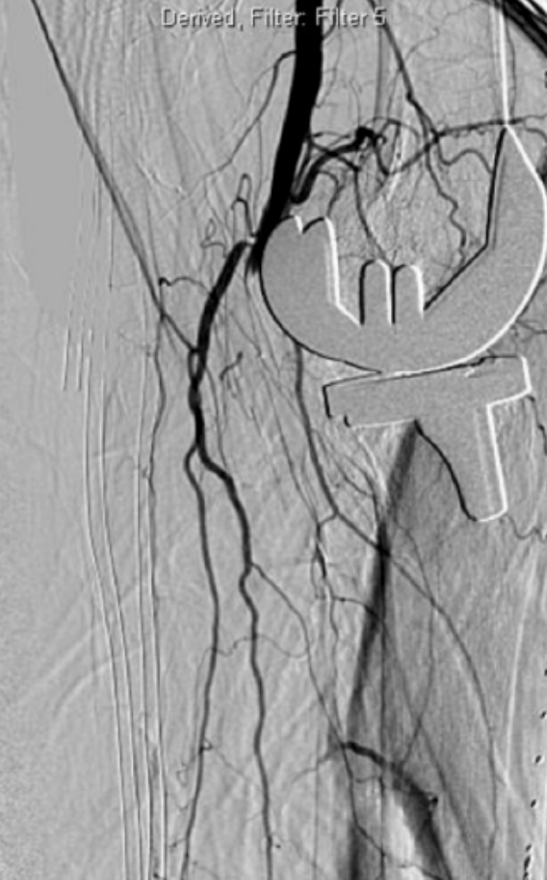
Vascular Complications
  Intra operative Recognition
  Call a Vascular Surgeon
  Complete the Surgery & close the wound
  Angiogram +/- stent
  Bypass Surgery
Notes:
Severing of popliteal vessels is a rare intra operative complication. It is usually identified intra operatively and can be repaired by our vascular colleagues at the end of the procedure. However, occasionally it may not be recognized intra operatively due to inflated tourniquet. Delay in Diagnosis is detrimental and can lead to loss of affected limb.

Slide 7
Vascular Complications
  Post Surgery
    Educate Nursing Staff
    Temperature & capillary return
    Compare to normal foot
    Pulseless, paralysis, paraesthesia, pain
  Early Recognition is vital

Slide 8
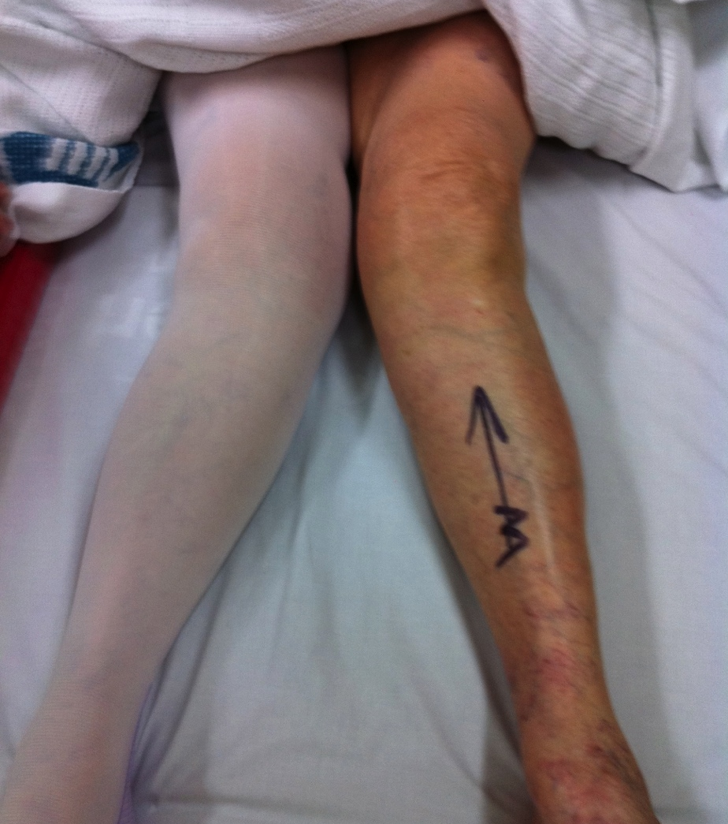
Common Peroneal Nerve Palsy
Valgus Knee
Flexion contracture
Foot drop
Non operative treatment
Orthotics & Physio
Prevent Equinus
Tendon Transfer
Notes:
CPN palsy should not get on the way of physiotherapy and rehabilitation post TKR. Most CPN plasies will recover spontanously. If there is no sign of recovery within 3 months, there may a be a role for exploration and decompression of the nerve. it can take up to 12 months. If the nerve does not recover, we usually consider tendon transfer after 12 months.

Slide 9
Atelactasis
Post op fever is NOT due to infection in the wound!
Avoid antibiotics
Physical Examination
Chest Physiotherapy
Mobilization
Notes:
Mild fever day 1-3 post op is usually due to atelectasis.

Slide 10
DVT
Pharmacological
  Clexane, Rivaroxiban, Aspirin
Early Mobilization
Mechanical Device
  Foot pump, Calf compressor
Need to review and alter if necessary
Notes:
All patients post TKR should be on some form of pharmacological DVT prophylaxis. The type and dose of the pharcomological therapy is determined based on the risk stratification of the patient. Multiple studies have shown that a combination of early mobilization, pharco, and mechanical device significantly reduced the risk of symptomatic DVT and PEs. It is also important to review the DVT prophylaxis on daily basis. If the patient remains completely immobilized and bed bound due to pneumonia, the dose may have to be increased. In contrast, if the patient has constant ooze and a large haematoma, then you need consider reducing the dose or changing to aspirin.

Slide 11
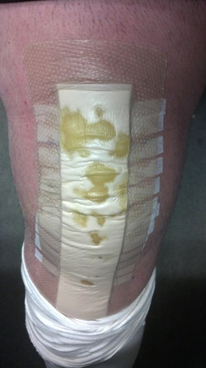
Wound Drainage
Slight Ooze (up to 25%)
  No change in post-op care
Profuse Drainage
  Immobilize the knee
  Review DVT prophylaxis
Persistent Drainage
  Lavage, debridement
Avoid giving antibiotics
Avoid wound swab

Slide 12
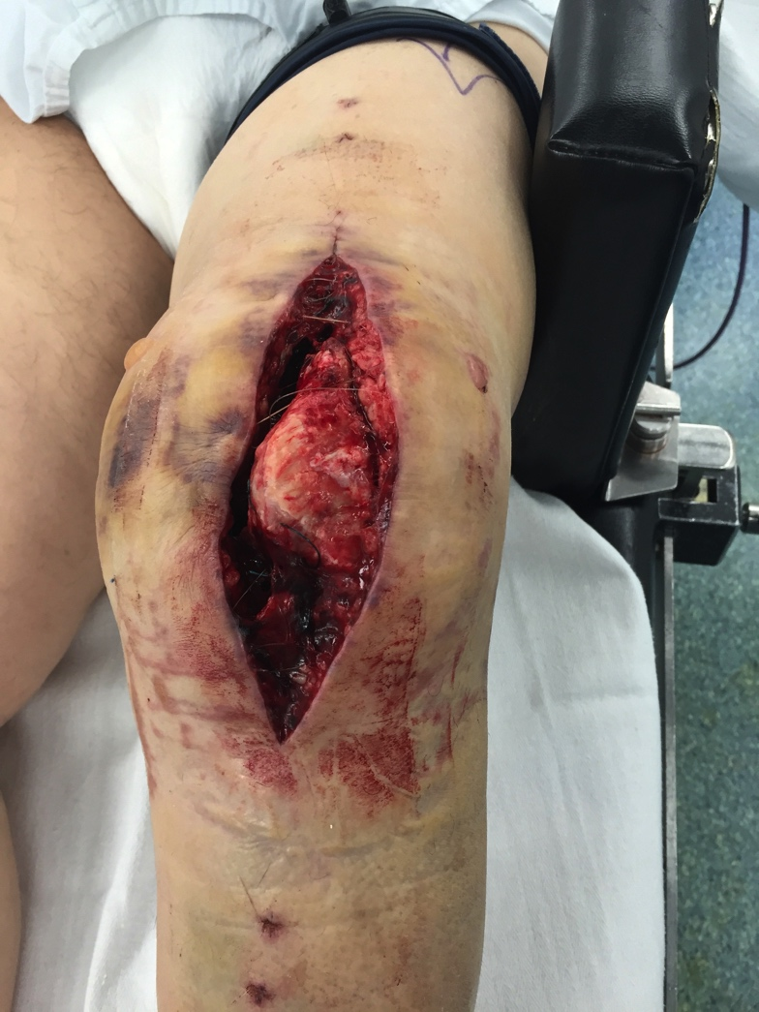
Wound Dehiscence
Wound Dehiscence
  Easy diagnosis
  Underlying Cause
Capsular Repair Dehiscence
  Difficult to diagnose
  Sudden increase in flexion ROM
  Large effusion
  Warm knee
  Patient systemically well
  Debridement and Repair

Slide 13
Infection
2% post primary TKR
5.6% post Revision TKR
Notes:
Deep Infection is a devastating complication post THR

Slide 14
Infection
Host Factors
  RA, Diabetes, Poor Nutrition, psoriasis, obesity, smoking, malignancy, prior hx of septic arthritis
Environmental Factors
  Antiobiotics
  Traffic in theatre
  Prolonged hospital stay
Increased Operating Time

Slide 15
Infection
Early Post-op < 4 weeks
Delayed Post-op > 4 weeks
  6 months
  Low virulence organisms
  Gradual decrease in function
Acute Haematogenous >2 years
  Spread from UTI, infected teeth, URTI, etc

Slide 16
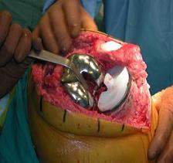
Infection
Early Post-op < 4 Weeks
  Acute presentation
  Inoculation at the time of surgery
  Spread from infected haematoma or superficial infection
Notes:
The challenge is differentiating superficial from deep infection.

Slide 17
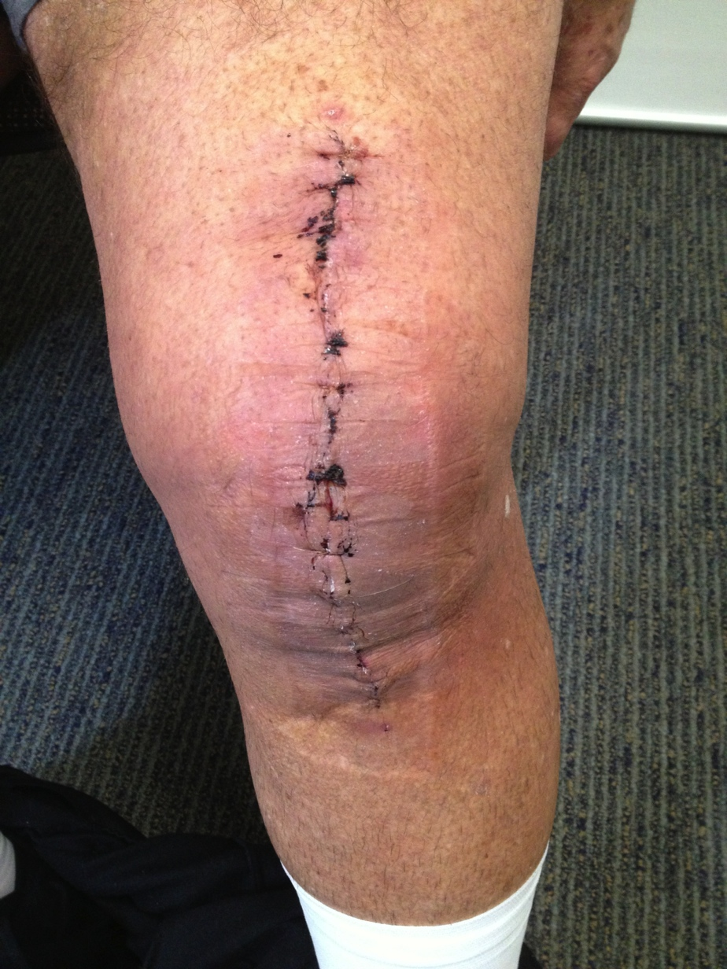
Acute Infection
Persistent pain, swelling & wound drainage
ESR/CRP high
Delay Antibiotics until intra-op sample is taken
Blood cultures
Notes:
Acute deep infection which occurs in the first 4 weeks post surgery is relatively easier to diagnose. The patient has either never made it home from hospital or represent usually at 2-4 weeks post op with persistent fever, wound ooze. There is a large effusion and the knee is generally very stiff. The inflammatory markers are high. Try to resist giving iv antibiotics unless the patient is septic. Aspiration is positive only about 60% of cases. Pus is dead neutrophil cells. The best chance of growing the responsible organism is to take a tissue sample. Don’t forget to do blood cultures.

Slide 18
Treatment
Emergent debridement & change of poly liner
i.v. Antibiotics
2 stage Revision

Slide 19
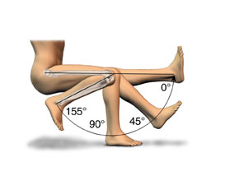
Stiffness
Aim >95-100 degrees of flexion
65° during swing phase
80° during climbing stairs
90-100° during descending stairs
90-95° to rise from standard chair
Notes:
There is no universally accepted criteria for diagnosis of stiffness. However, we aim for minimum flexion of 95-100. Biomechanical studies and gait analysis have showed we require

Slide 20
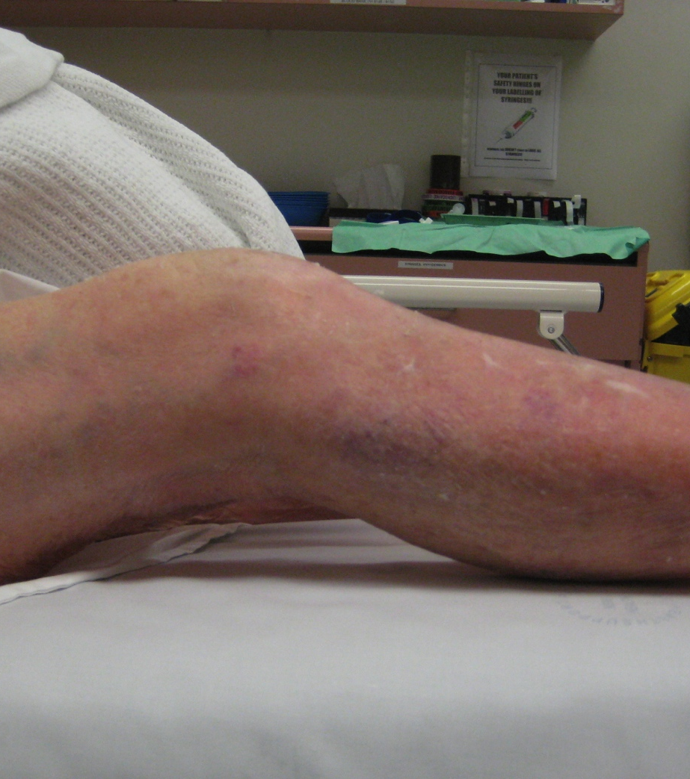
Stiffness
Pre Operative Factors
  Pre-op ROM
  Underlying diagnosis
  History of prior surgery
Notes:
Postoperative stiffness is a debilitating complication of total knee arthroplasty. Pre- operative risk factors include limited range of motion, underlying diagnosis, and history of prior surgery.

Slide 21
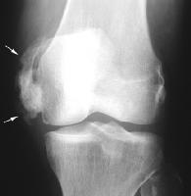
Stiffness
Pre Operative Factors
  Pre-op ROM
  Underlying diagnosis
  History of prior surgery
Notes:
Postoperative stiffness is a debilitating complication of total knee arthroplasty. Pre- operative risk factors include limited range of motion, underlying diagnosis, and history of prior surgery.

Slide 22
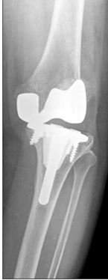
Stiffness
Intra operative Factors
  Unbalanced knee
  oversizing or malpositioning of components

Slide 23
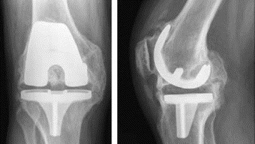
Stiffness
Post operative Factors
  Patient Motivation
  Arthrofibrosis
  Heterotopic Ossification
  CRPS
  Infection
Notes:
Arthrofibrosis-excessive scaring in the the knee joint

Slide 24
Stiffness
Prevention
  Patient and component selection
  Patient education
  HO
    NSAID/Radiotherapy
  Structured physiotherapy program up to 6 weeks

Slide 25
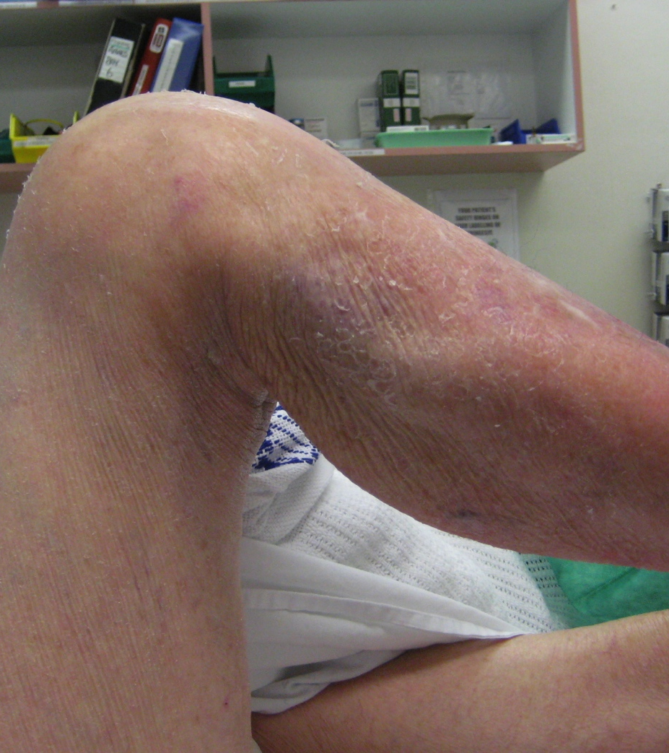
Stiffness
Treatment
  Physiotherapy
  Manipulation under anaesthesia → 8 week
  Open or Arthroscopic release > 3 months
  Revision Surgery

Slide 26
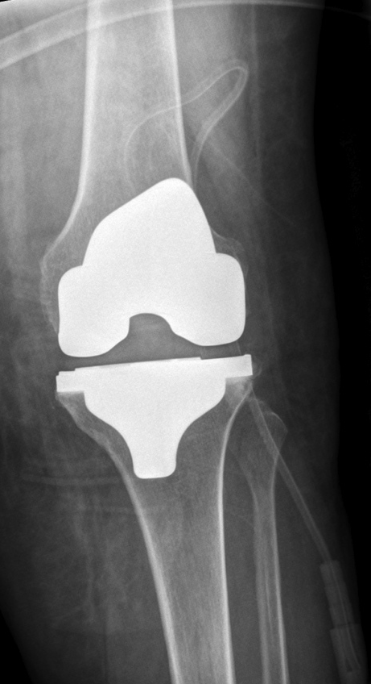
Periprosthetic Fracture
Posterior Stabilized (PS) Knee
Small size femoral component
Uncemented prosthesis
Change in weightbearing status
Notes:
Condylar fracture of femur is a unique complication of PS knees. Although it can happen with CR knee.

Slide 27
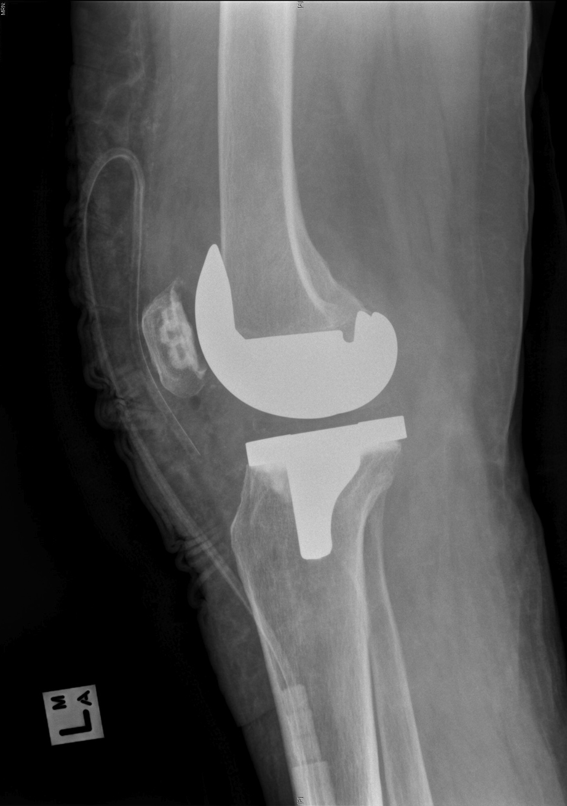
Periprosthetic Fracture
Posterior Stabilized (PS) Knee
Small size femoral component
Uncemented prosthesis
Change in weightbearing status
Notes:
Condylar fracture of femur is a unique complication of PS knees. Although it can happen with CR knee.

Slide 28
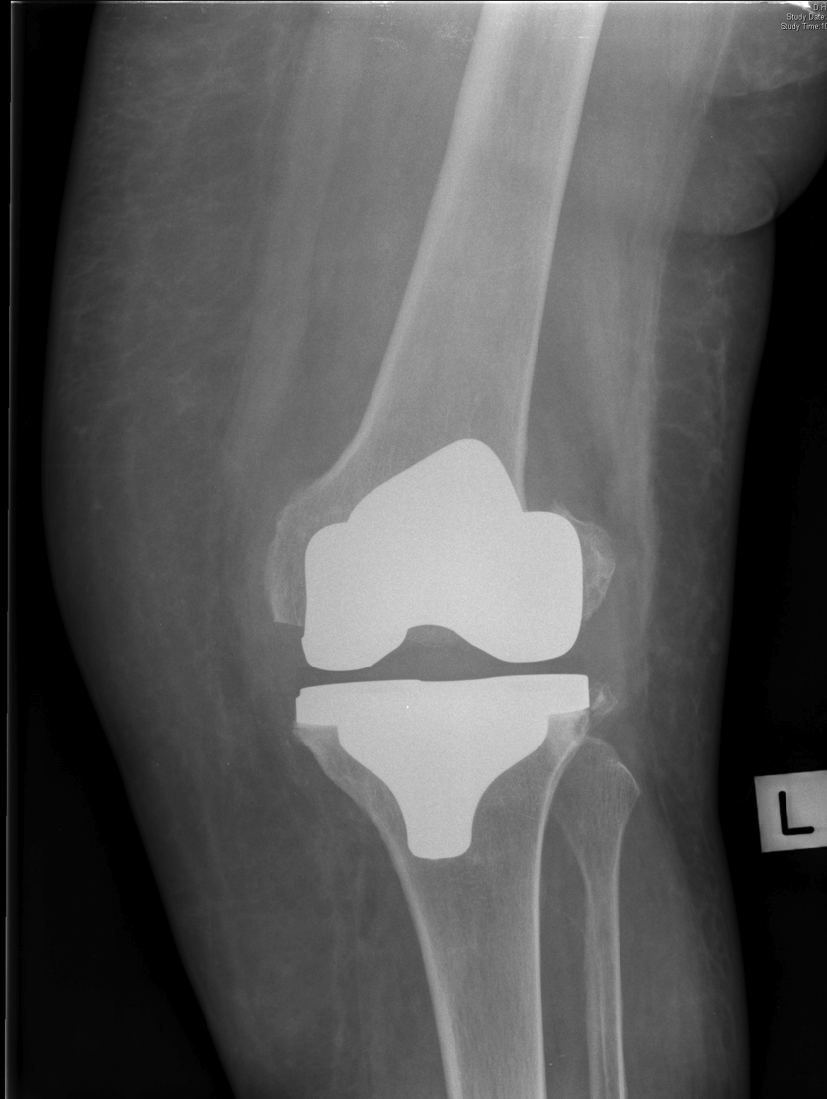
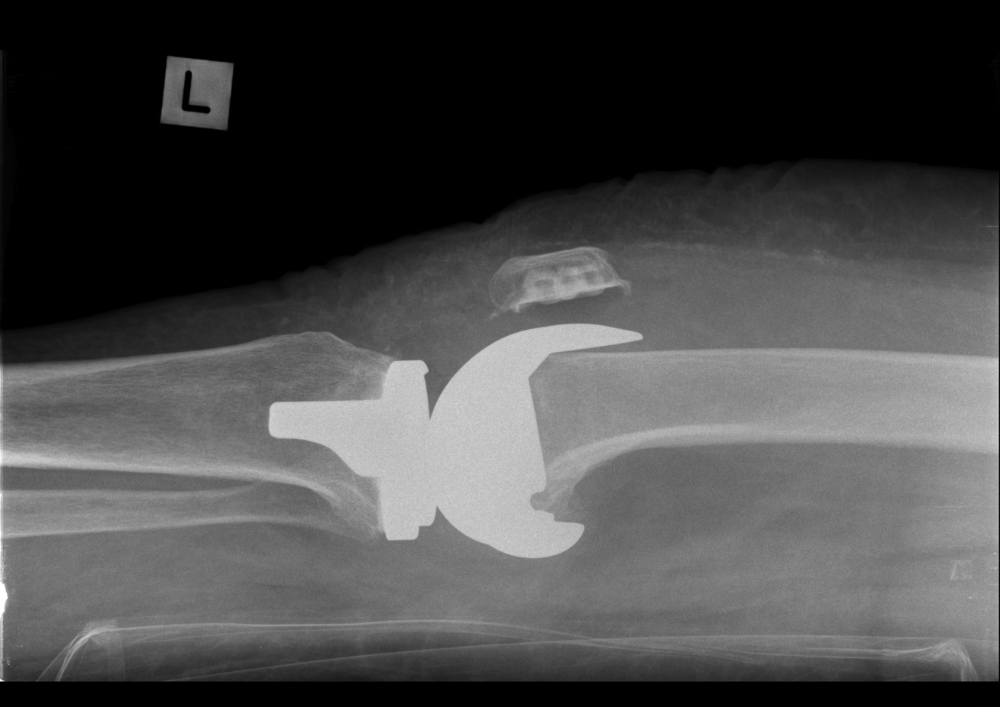

Slide 29
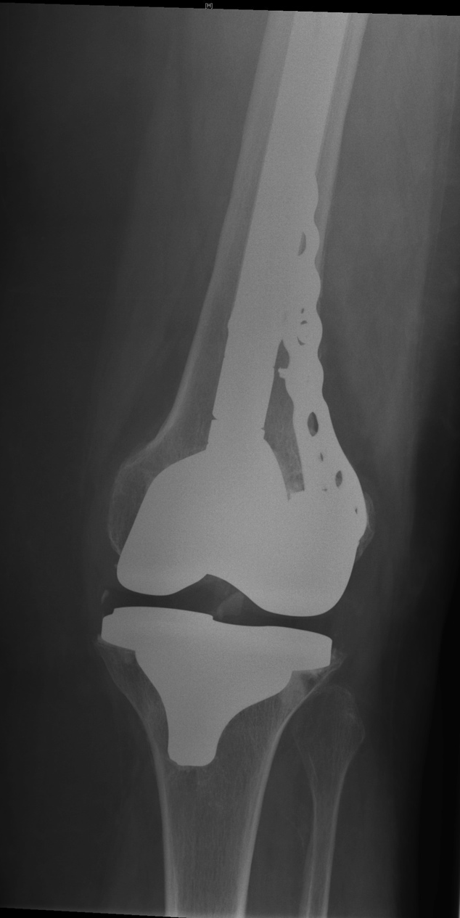
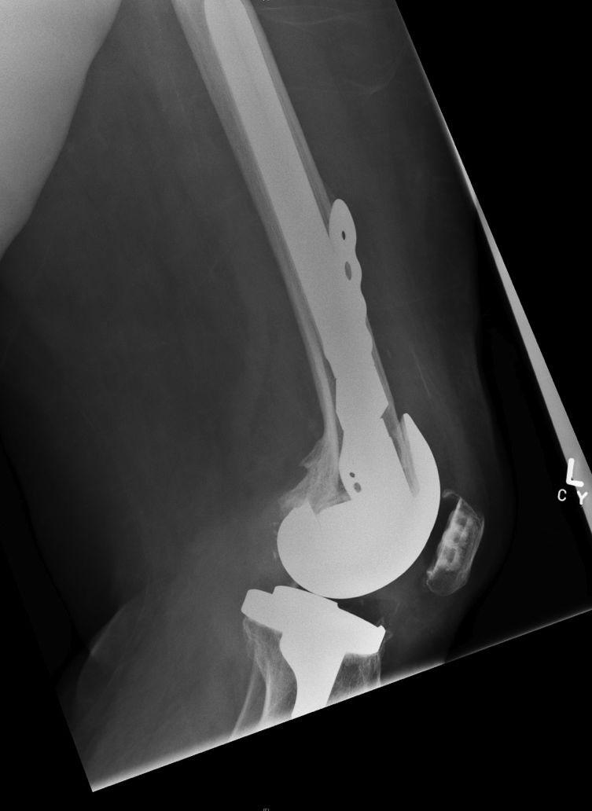

Slide 30
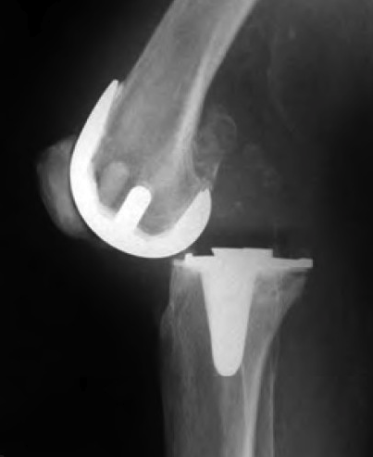
Knee Dislocation
0.2%
Severe valgus knee
  Extensive lateral release
Vascular Injury
Notes:
Dislocation post TKR is a rare but dreaded complication. The incidence is about 0.2%. It can occur in a primary or revision TKR. There will be an obvious deformity, pain, inability to move the knee.

Slide 31
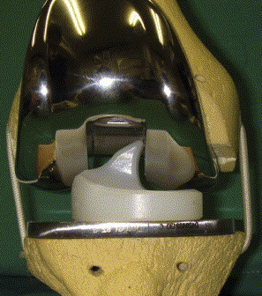
Knee Dislocation
0.2%
Severe valgus knee
  Extensive lateral release
Mobile Bearing Knee
  Liner spin out
Notes:
Dislocation post TKR is a rare but dreaded complication. The incidence is about 0.2%. It can occur with CR, PS, MB, and semiconstrained knees.

Slide 32
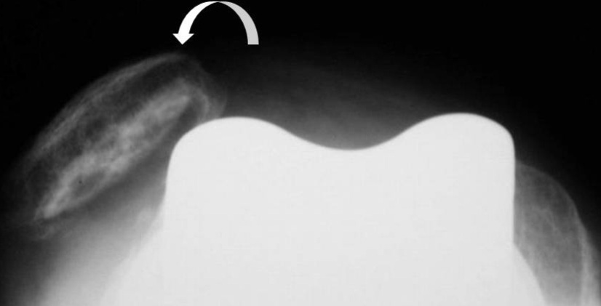
Knee Dislocation
0.2%
Severe valgus knee
  Extensive lateral release
Mobile Bearing Knee
  Dislocation of poly
Patella Dislocation
Notes:
Dislocation post TKR is a rare but dreaded complication. The incidence is about 0.2%. It can occur with CR, PS, MB, and semiconstrained knees.

Slide 33
Treatment
Surgical
Treat the underlying cause
  Unbalanced knee
  Extensive release
  Wrong components
Notes:
Management of TKR dislocation requires emergent surgical reduction and examination under anaesthesia to determine the underlying cause of instability. The definitive treatment will involved identifying and treating the underlying cause which may be

Slide 34
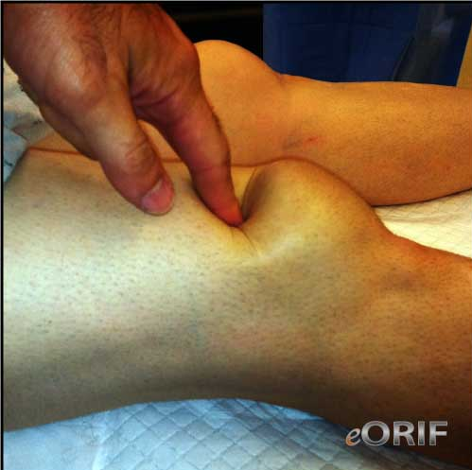
Quadriceps Rupture
Uncommon
Extension Lag
Palpable defect

Slide 35
Quadriceps Rupture
Mayo Clinic JBJS 2005 study of 23,800 patients
  0.1% of TKR
  2 year follow up
  11 complete and 21 partial tear
Results:
  Partial tear treated non operative had good outcome
  Complete tears had poor outcome

Slide 36
Summary
Serious complications post TKR are rare.
Most Complications are preventable
Early and Accurate diagnosis can lead to better outcome
Notes:
Most patients do well following TKR. Fortunately serious complications are rare. Most complications are preventable by choosing the right patient, the right prosthesis and performing the correct operation. When patients develop surgical complications, early and accurate dx can lead to better outcome.

Slide 37
Thank You.

