Slide 1
The Stiff TKR
HTO visit
HCMC, Vietnam 2017

Slide 2
Functional range
Walking 60 deg
Sitting 90 deg
Ascending/ descending stairs 110 deg
Tie shoes 110 deg
Squatting 120 deg

Slide 3
Knee during gait

Slide 4
Knee functional range

Slide 5
Definition
Difficult and variable
Usually <90 deg flexion

Slide 6
Definition
Beware of Fixed flexion deformity!!!

Slide 7
Causes
Patients
Surgeons
Complications

Slide 8
Patients
Pre-op range (ankylosis/ fusion)
Extreme varus deformity
Pre-op diagnosis
  Sepsis
  Trauma
  JCA/ Erosive arthropathy
Ipsilateral painful joints
Female
Young age
Body habitus
Psychological factors

Slide 9
Surgeon
Malalignment of components
  Coronal Femur
  Axial Tibia
  Saggittal Patella
Poor soft tissue balance
Poor closure
Post op rehabilitation

Slide 10
Complications
Arthrofibrosis
Haemarthrosis
Delayed wound healing
Infection
Peri-prosthetic fracture
Intra-articular Loose bodies
Unstable components
CRPS
Severe heterotopic ossification

Slide 11
Assessment
Bloods
XR’s
CT

Slide 12
Approach
Painful
Painless
Infection
Fracture
Instability
  Soft tissue
  subsidence
Malalignment
Heterotopic ossification
CRPS
Poor pain management
Psychological
Adhesions
Muscle contractures
Body habitus
Implant malalignment
Heterotopic ossification

Slide 13
Assessments
Painful
Painfree
Wound
Soft tissue
Tenderness
Stability
CRPS signs
Soft end point
Soft tissue
Hard end point

Slide 14
Radiology
Good quality
AP
Lateral
Skyline
Fracture
Subsidence
Heterotopic bone
Asymmetrical gap
Malalignment

Slide 15
X rays

Slide 16
XRays

Slide 17
XRays

Slide 19
Imbalance

Slide 20
Other investigations
CRP
ESR
Bone scan
CT scan

Slide 21
Management
Pain management
Treat primary cause
Manipulation
  Early better
  Not after 3 months
Arthrolysis – open vs arthroscopic
Quadricepsplasty
Revision TKR
  Careful evaluation

Slide 22
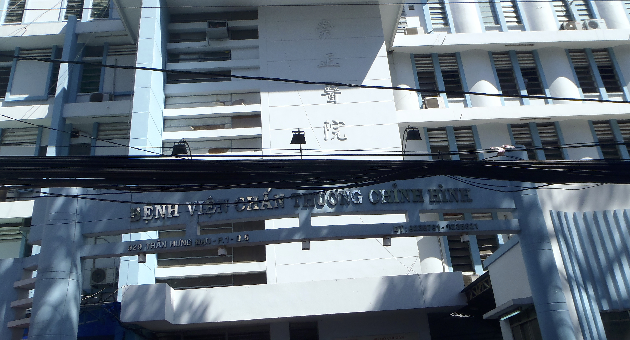
Thank you

