Slide 1
The Unstable Knee
De Juan Ng

Slide 2
Reasons for instability
Native knee
Ligament deficiency
  incompetent medial collateral ligament (MCL), eg, valgus deformity
  poliomyelitis (ligamentous / capsular laxity)
Bony deficiency
  severe deformities
  post-traumatic arthritis
  Charcot arthropathy
Combined bony and ligament deficiency

Slide 3
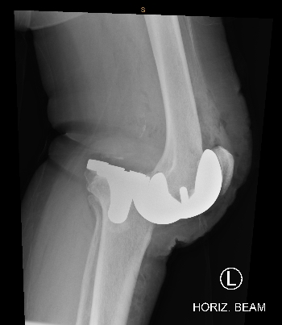
Reasons for instability
Knee replacement
Ligament deficiency
  excessive release
  transection
Improper gap balancing
  undersized femoral component (loose flexion gap)
  excessive bony resection
  inadequate thickness of polyethylene liner
Malalignment of components

Slide 4
Reasons for instability
Native knee
Ligament deficiency
  incompetent medial collateral ligament (MCL), eg, valgus deformity
  poliomyelitis (ligamentous / capsular laxity)
Bony deficiency
  severe deformities
  post-traumatic arthritis
  Charcot arthropathy
Combined bony and ligament deficiency

Slide 5
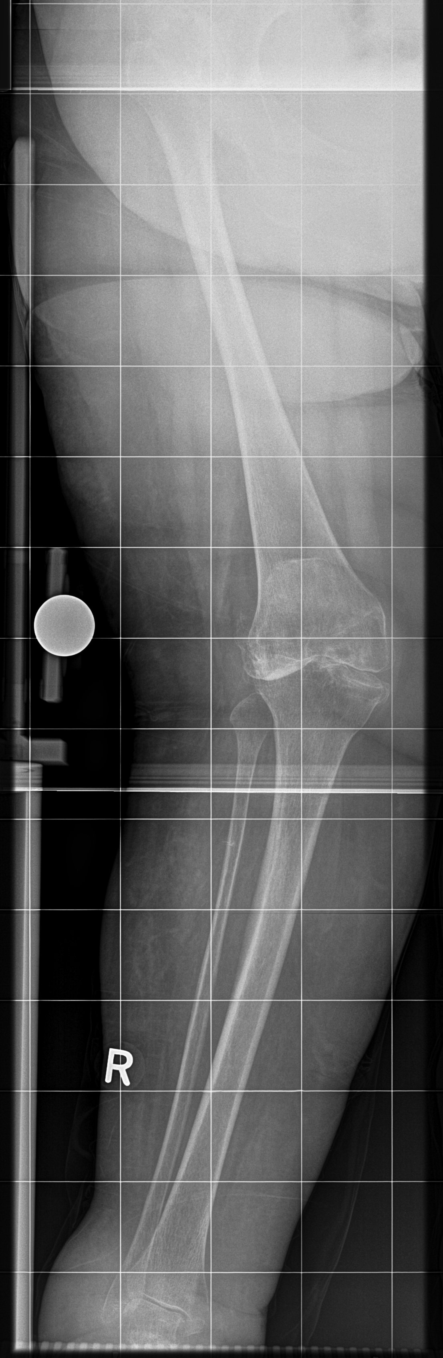
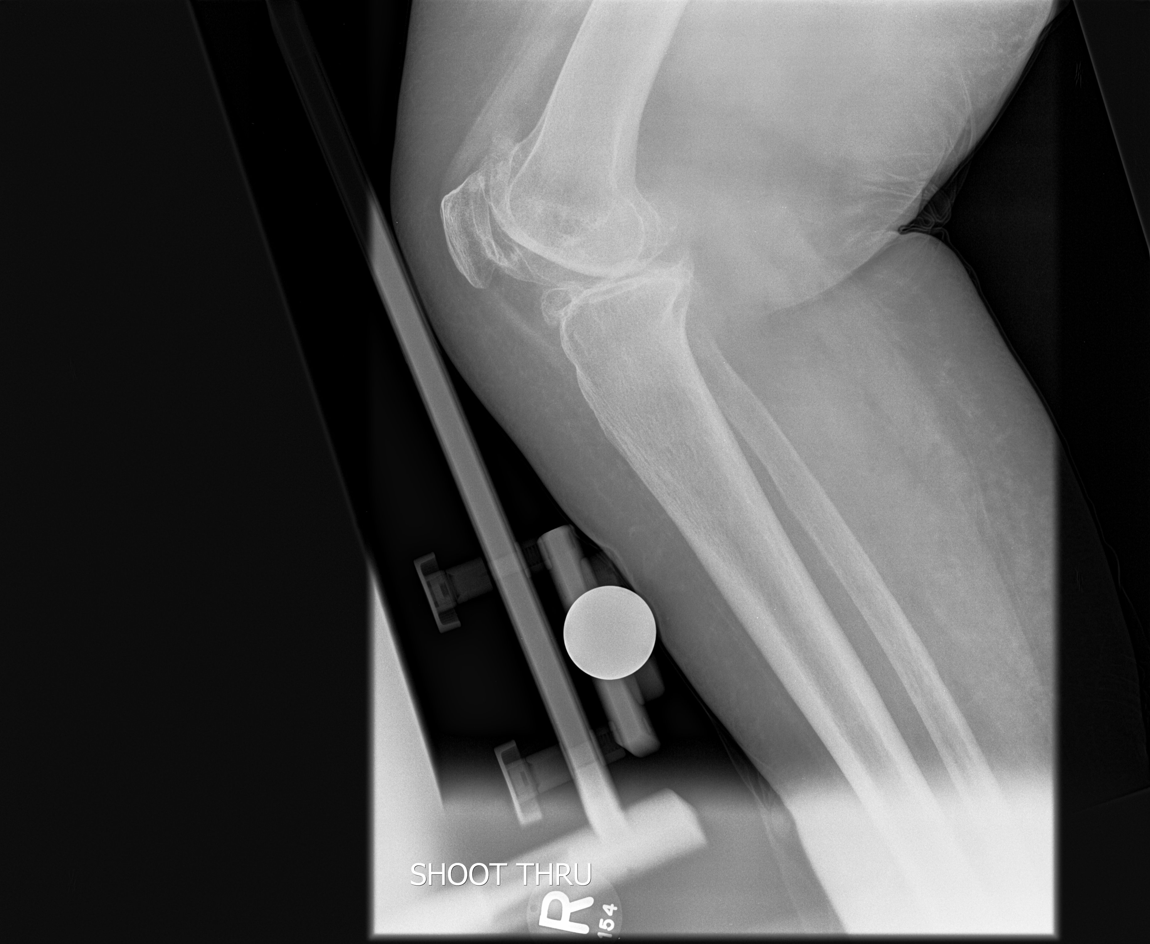
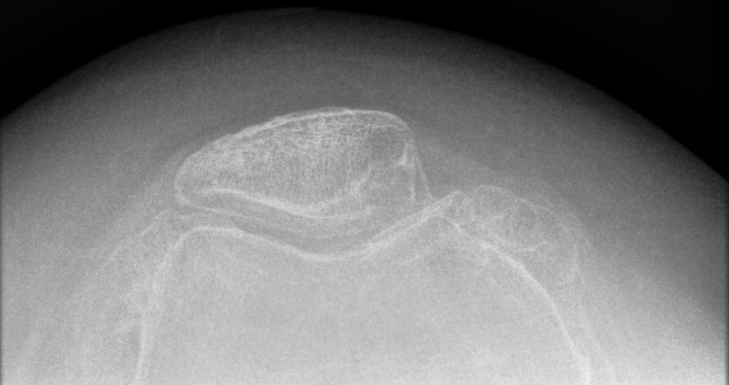
Ligament deficiency
Mechanical (weight bearing) axis
line from centre of femoral head to centre of ankle
in a normal lower limb, axis passes through centre of knee

Slide 6
Reasons for instability
Native knee
Ligament deficiency
  incompetent medial collateral ligament (MCL), eg, valgus deformity
  poliomyelitis (ligamentous / capsular laxity)
Bony deficiency
  severe deformities
  post-traumatic arthritis
  Charcot arthropathy
Combined bony and ligament deficiency

Slide 7
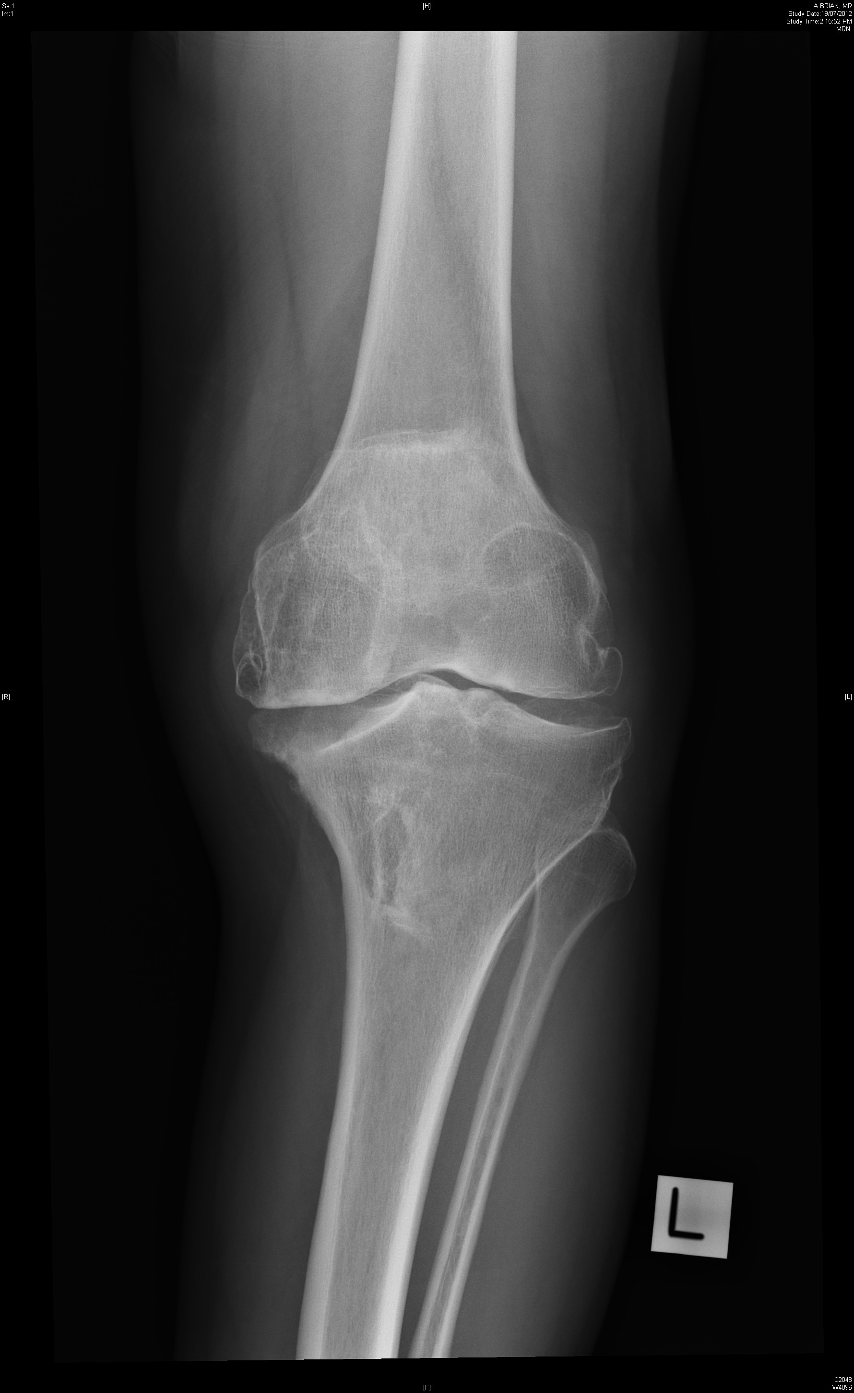
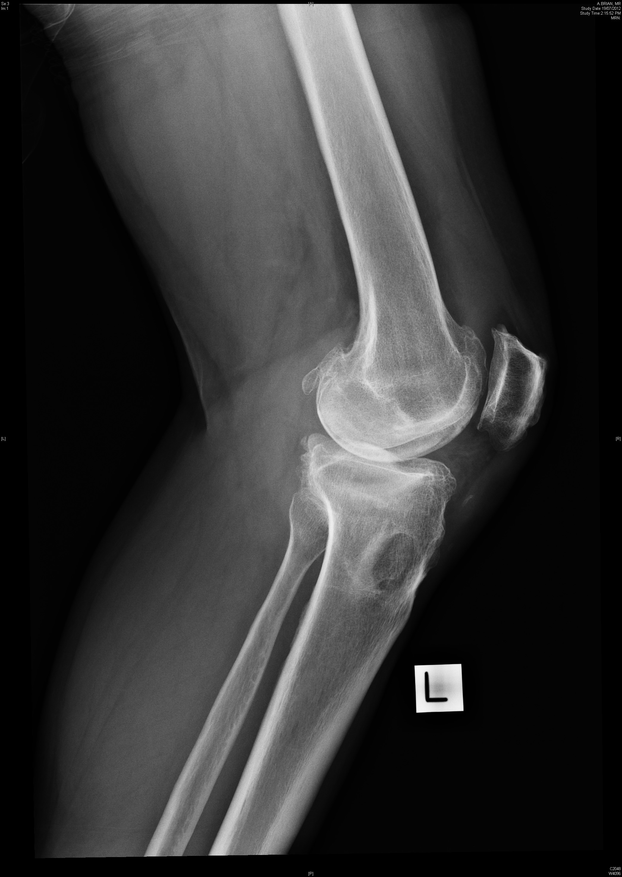
Bony deficiency

Slide 8
Reasons for instability
Knee replacement
Ligament deficiency
  excessive release
  transection
Improper gap balancing
  undersized femoral component (loose flexion gap)
  excessive bony resection
  inadequate thickness of polyethylene liner

Slide 9
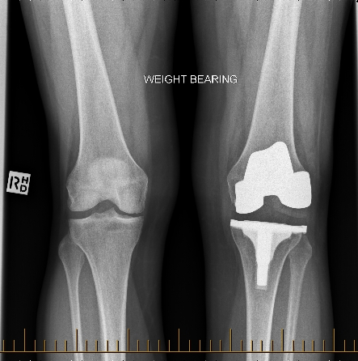
Incorrect bony resection

Slide 10
Knee replacement stability
Factors contributing to stability in a knee replacement
  ligaments
  soft tissue structures
  prosthesis design
  limb alignment
Instability occurs when these factors are not able to provide stability for stresses transmitted across the joint

Slide 11
Knee replacement stability
Factors contributing to stability in a knee replacement
  ligaments
  soft tissue structures
  prosthesis design
  limb alignment

Slide 12
Constraint in a prosthesis
The elements of knee implant design that provides the stability needed in the presence of a deficient soft-tissue envelope

Slide 13
Degrees of constraint
Cruciate-retaining (CR; preserve PCL)
PCL substituting / posterior stabilized (PS)
Unlinked constrained / varus-valgus constrained (VVC)
Rotating-hinge knee

Slide 14
Degrees of constraint
↑ amount of constraint
↑ stress transmitted
prosthesis-bone
interface
FAILURE
↑ backside polyethylene
wear or
early implant loosening

Slide 15
Degrees of constraint
Therefore, use least amount of implant constraint necessary to achieve a satisfactory result

Slide 16
Types of implants
Cruciate retaining (CR)
Posterior stabilized (PS)
Varus-valgus constrained
Rotating hinge knee

Slide 17
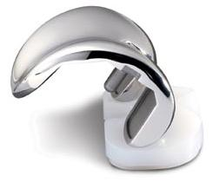
Cruciate-retaining implants
Minimally constrained prostheses
Depend on intact PCL and collateral ligaments
Potential advantages (over posterior-stabilized)
lower forces at tibial component-bone interface
bone-stock preservation on femoral side
more nearly normal knee kinematics
avoids post-cam problems (impingement or dislocation) in PS implants

Slide 18
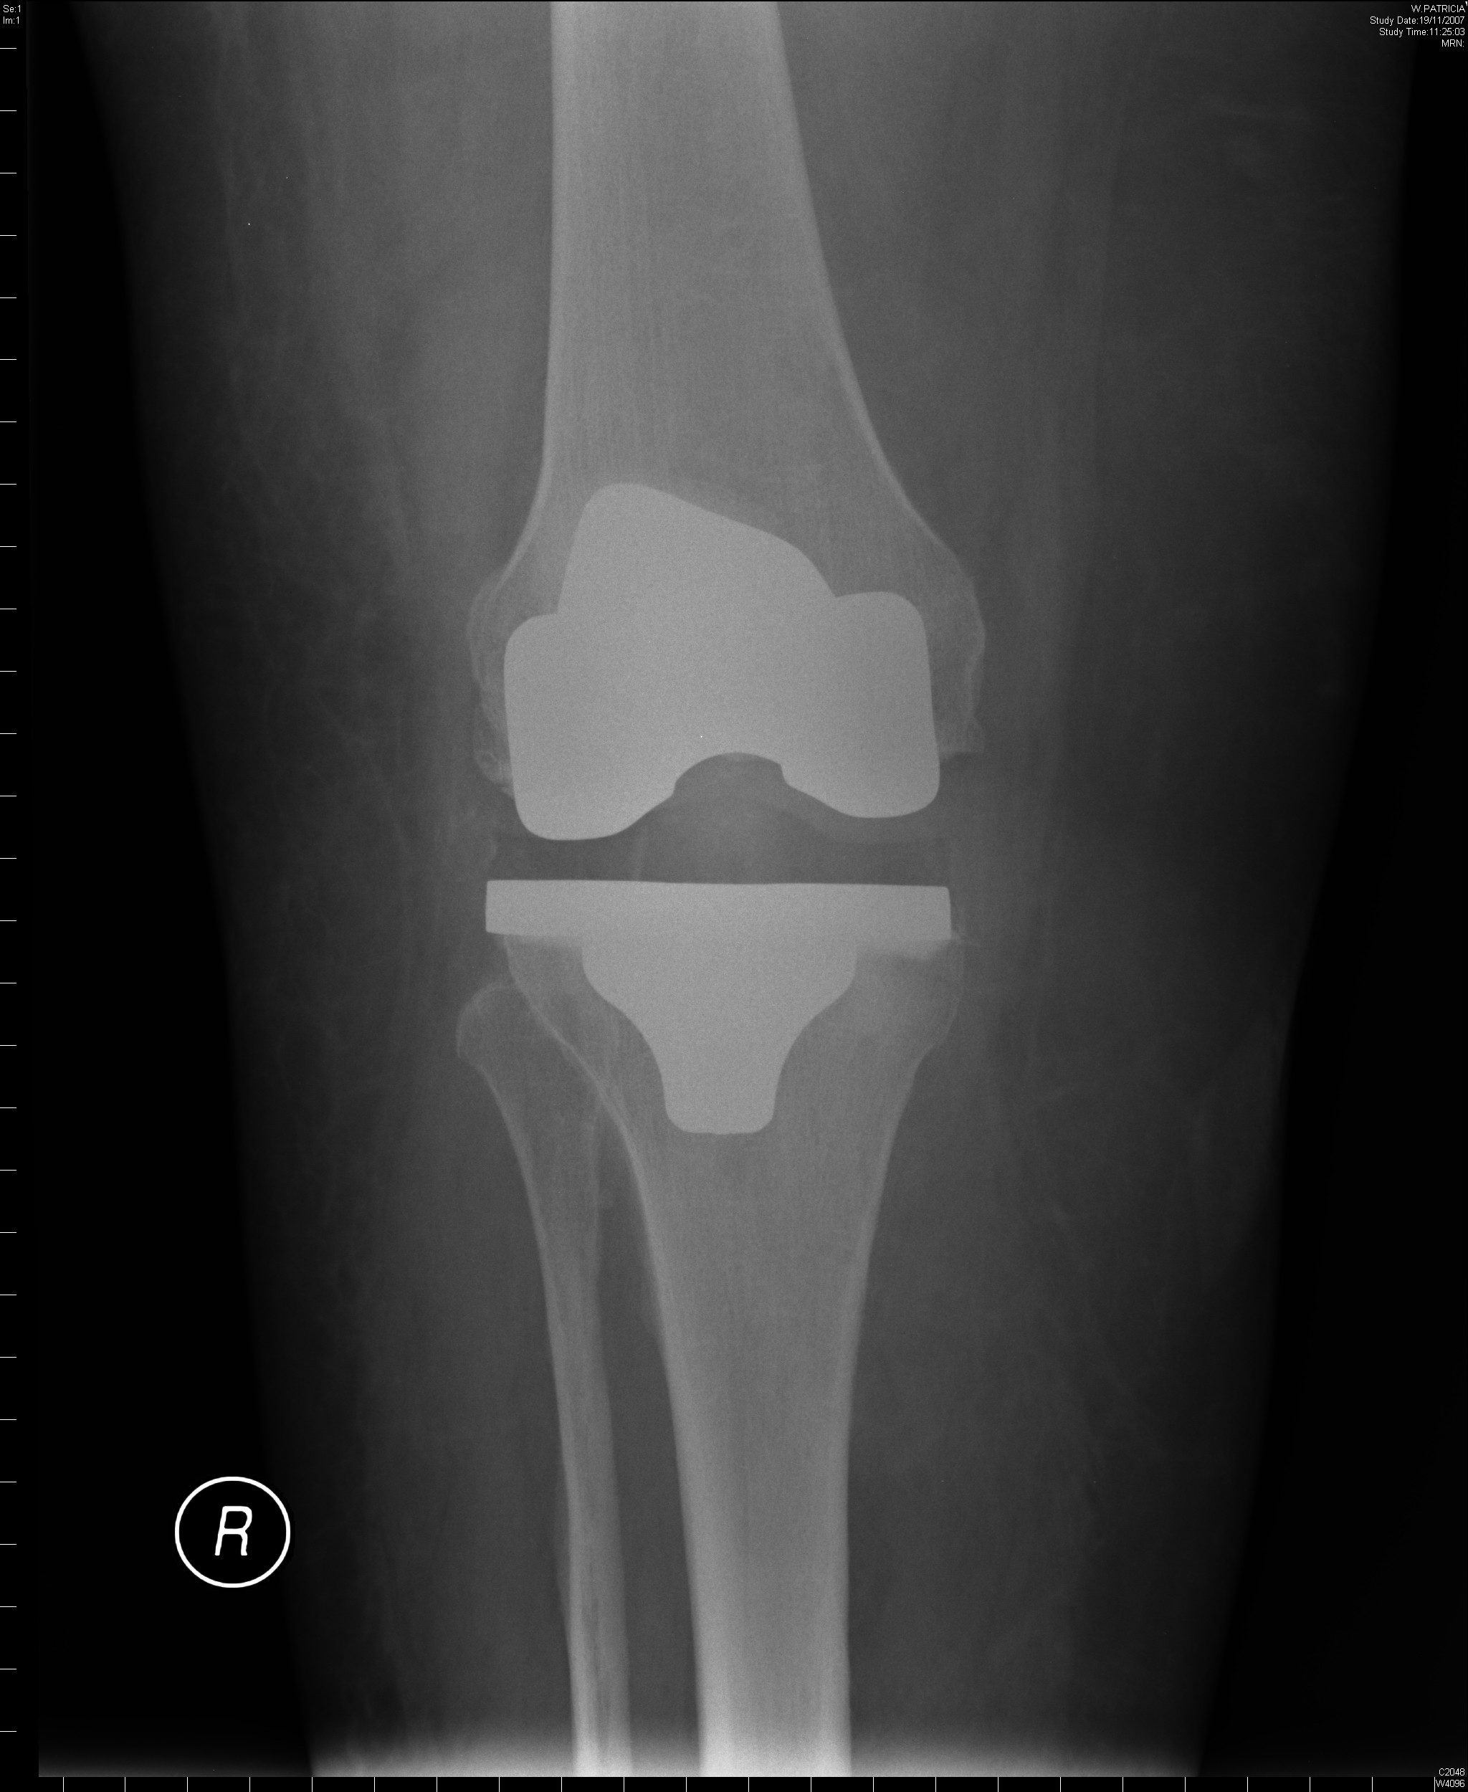
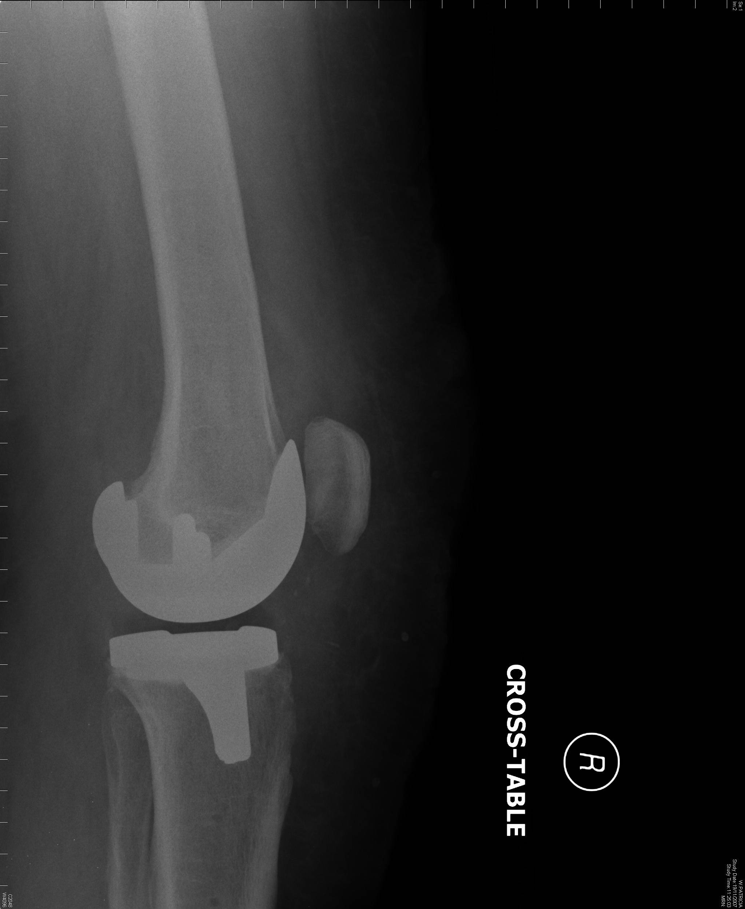
Cruciate-retaining implants

Slide 19
Types of implants
Cruciate retaining (CR)
Posterior stabilized (PS)
Varus-valgus constrained
Rotating hinge knee

Slide 20
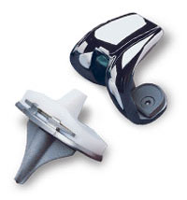
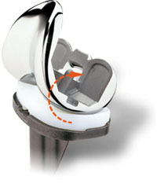
Posterior-stabilized implants
Improves anterior-posterior and translational stability
  tibial post
  femoral cam
Depends on intact collateral ligaments
Can be used routinely for uncomplicated knee replacement

Slide 21
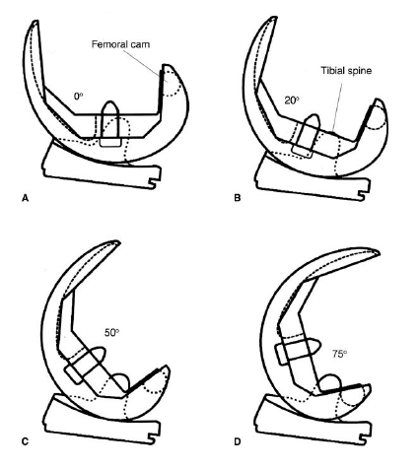
Posterior-stabilized implants

Slide 22
Posterior-stabilized implants
Potential advantages (over cruciate-retaining)
  relative ease of ligament balancing
  easier correction of severe deformity by eliminating tight PCL
  increased predictability in restoration of knee kinematics
  PCL can rupture post-operatively which would result in failure in CR implants

Slide 23
Posterior-stabilized implants
Potential disadvantages
(compared with cruciate-retaining)
  tibial post polyethylene wear from cam-post mechanism
  soft-tissue impingement into intra-condylar notch during flexion
  additional bone resection of femur
  risk of dislocation

Slide 24
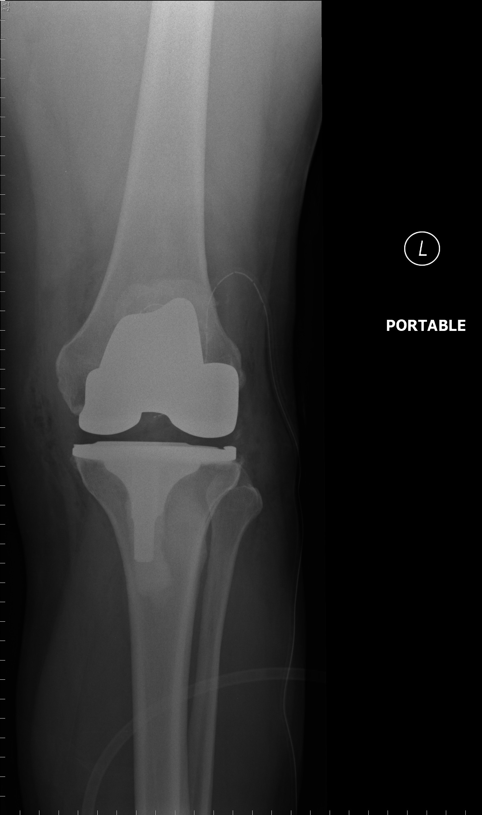
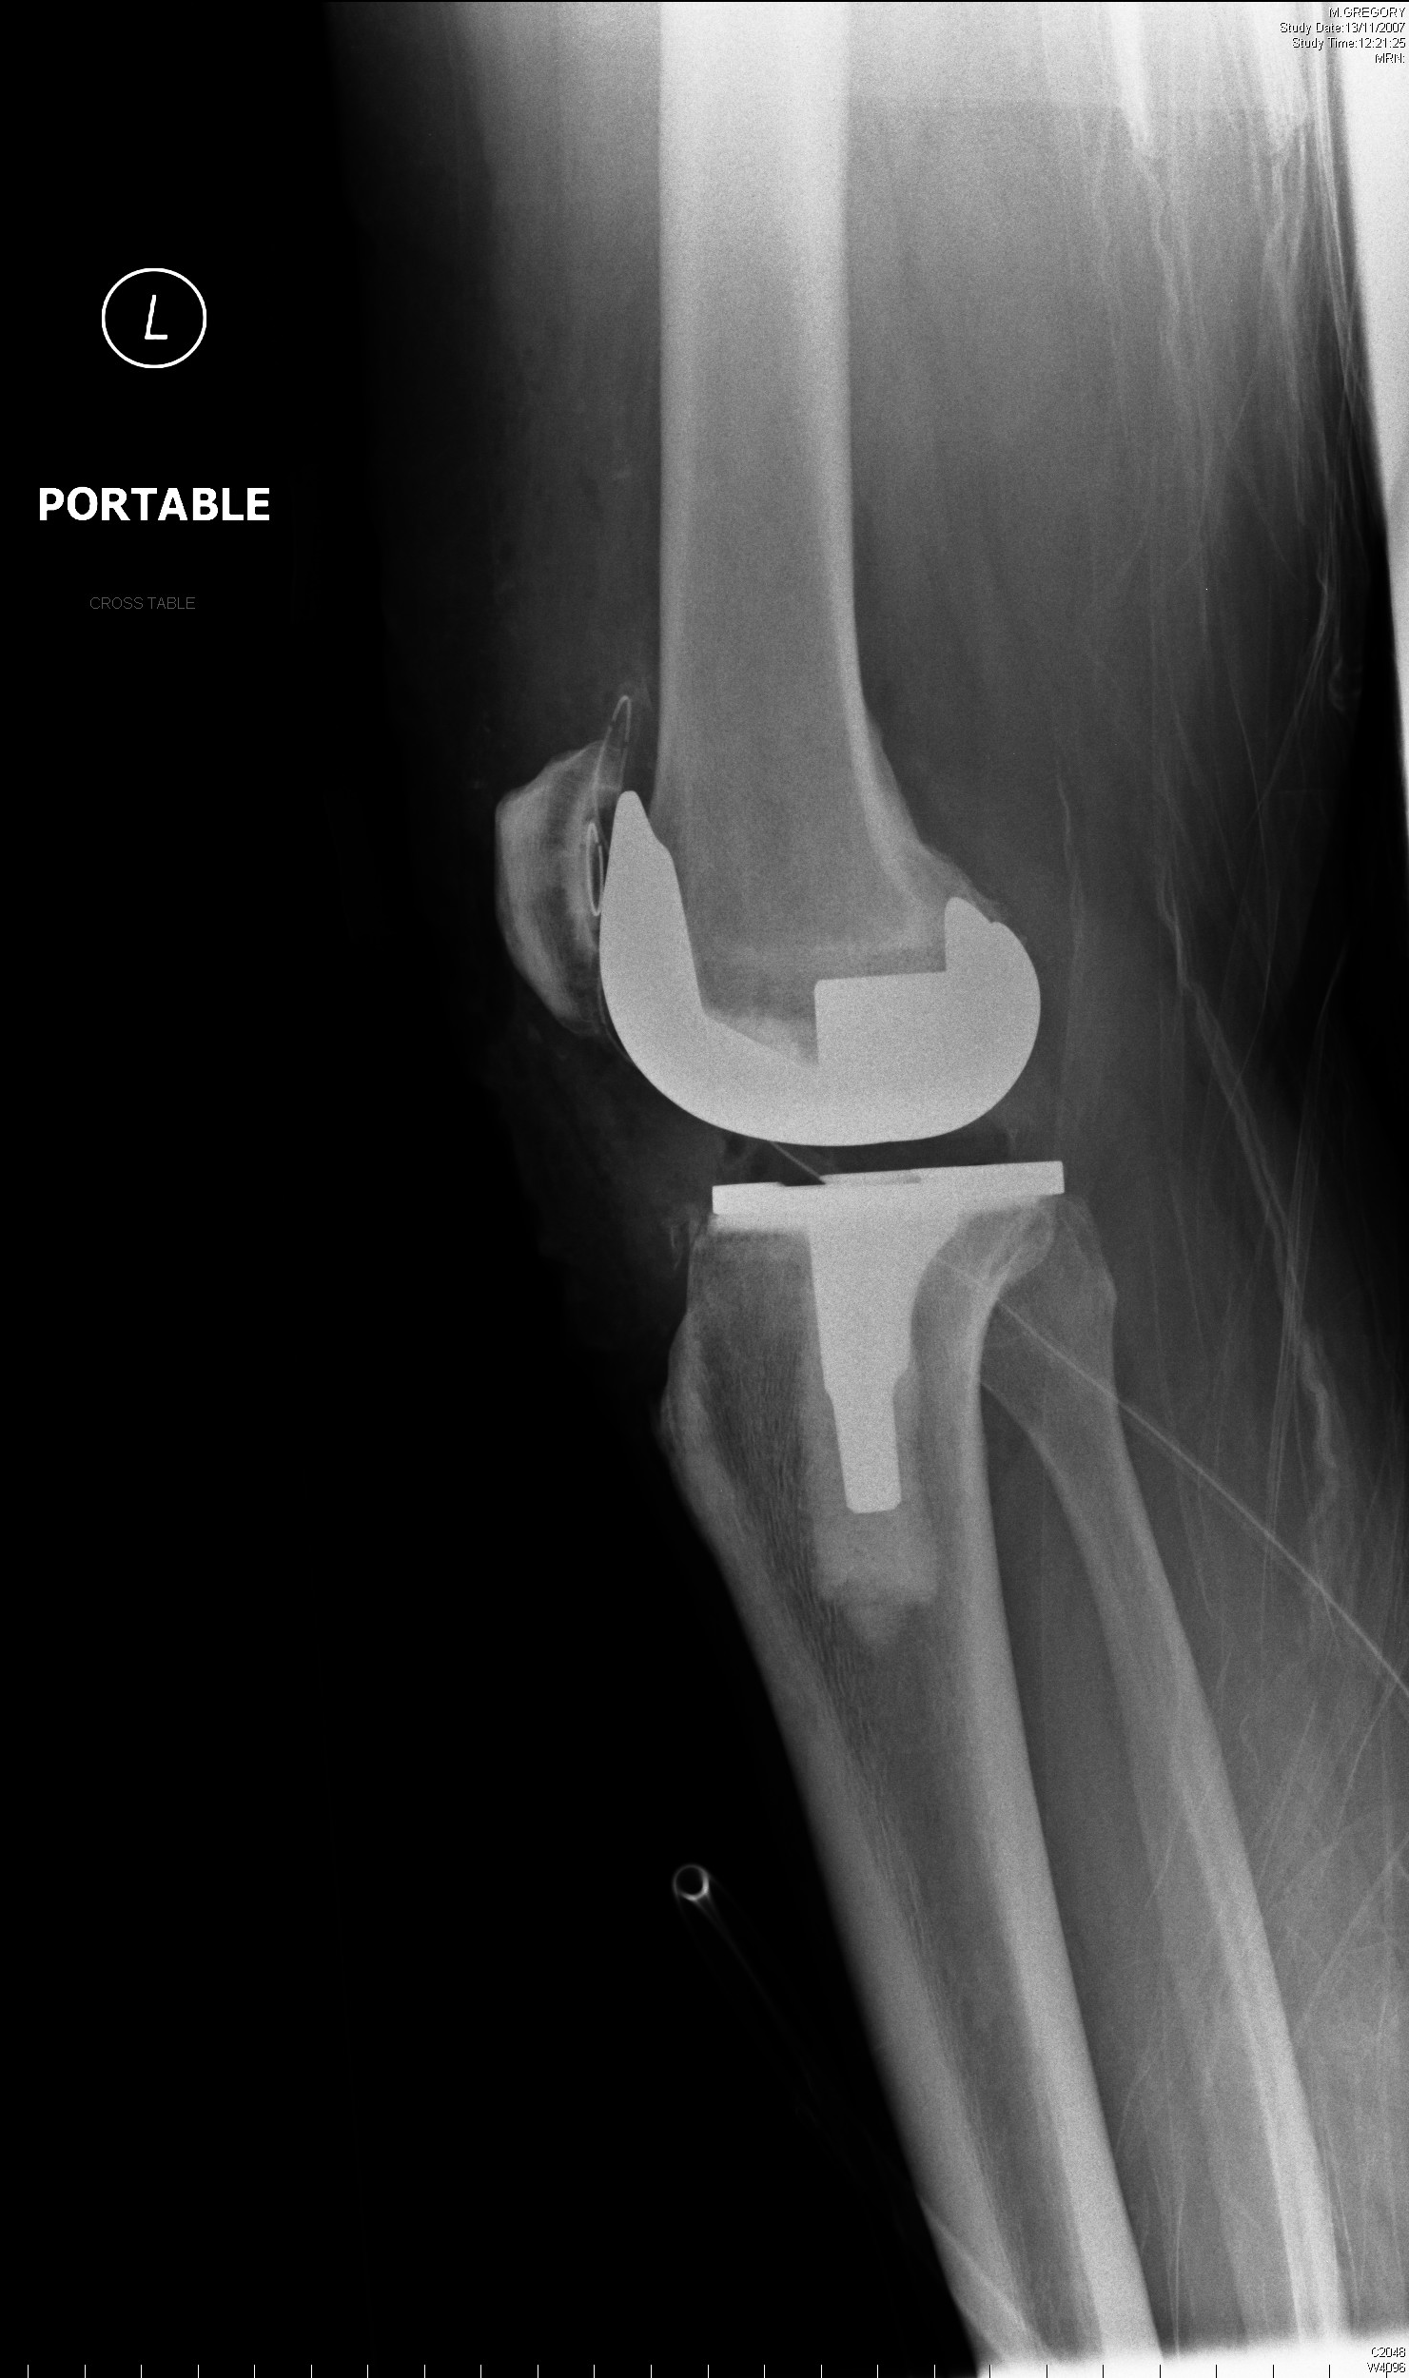
Posterior-stabilized implants

Slide 25
Types of implants
Cruciate retaining (CR)
Posterior stabilized (PS)
Varus-valgus constrained
Rotating hinge knee

Slide 26
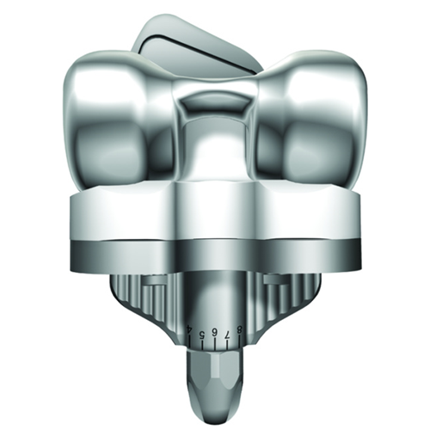
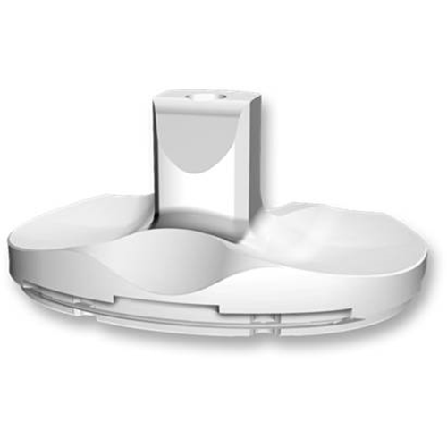
Varus-valgus constrained implants
Tall tibial post
Deep femoral box
Stemmed components
More inherent coronal plane stability than PS implants

Slide 27
Varus-valgus constrained implants
For primary and revision arthroplasty
  severe valgus deformities
  collateral ligament deficiency
  bone defects
  flexion-extension imbalances after PS implants

Slide 28
Varus-valgus constrained implants
Potential disadvantages
need to remove femoral intercondylar bone
higher rates of aseptic loosening
fracture or failure of tibial post

Slide 29
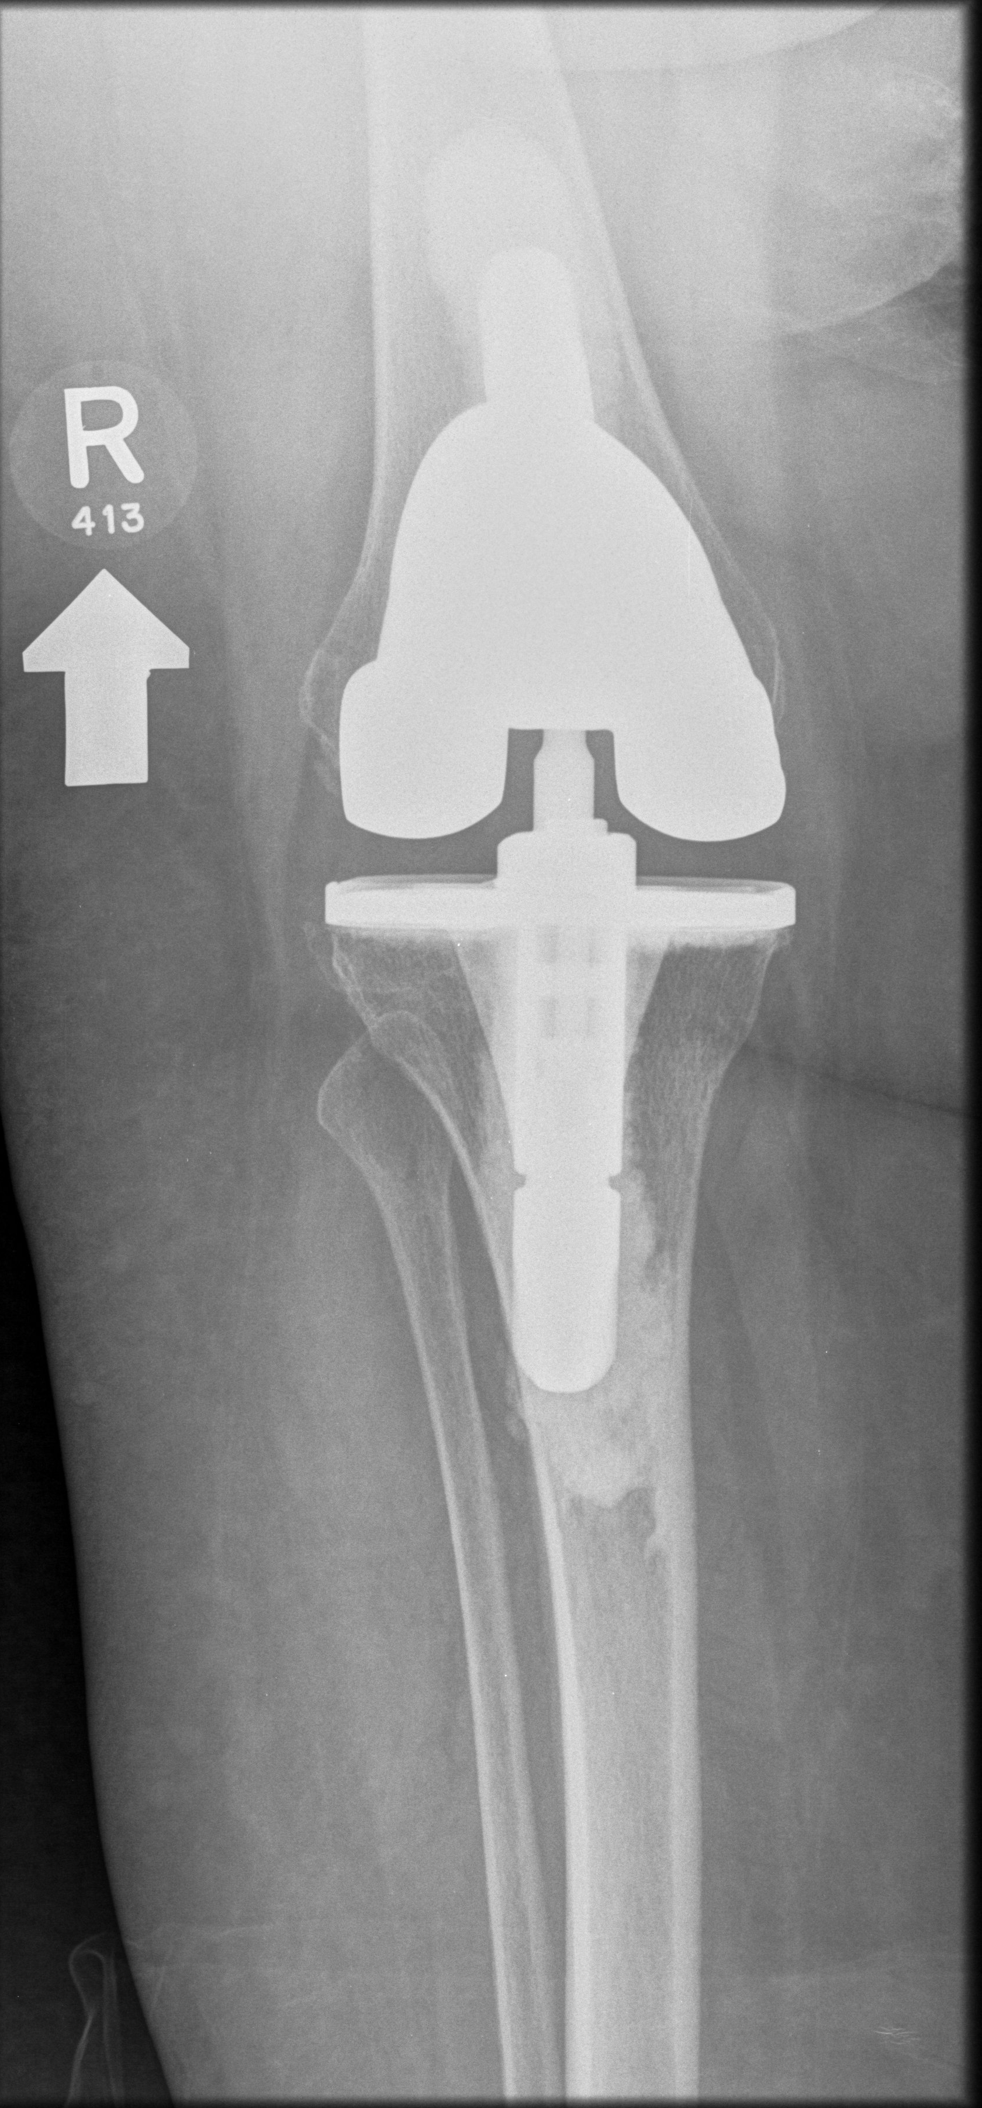
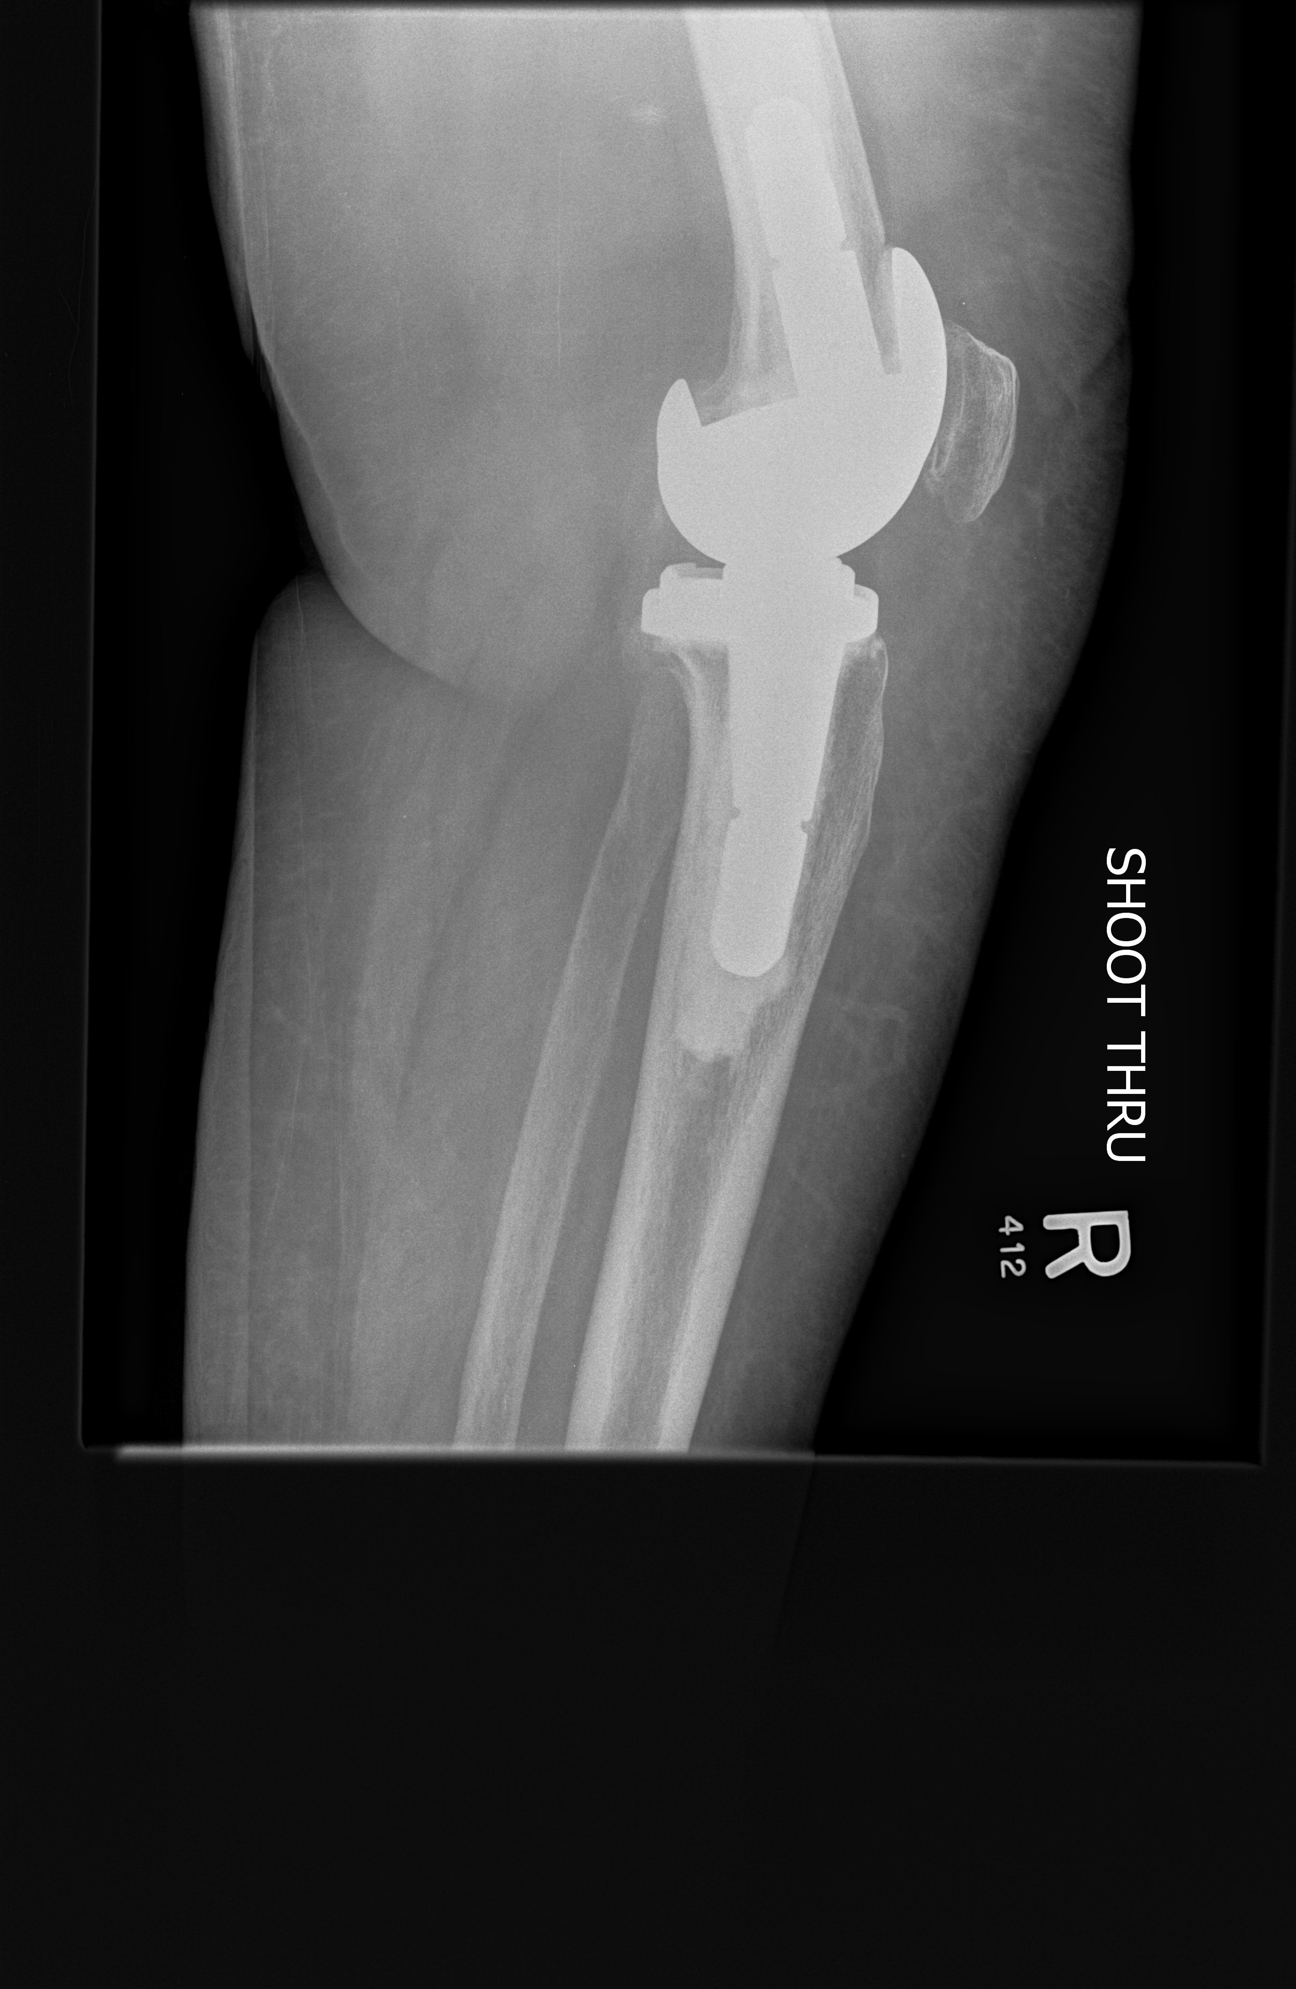
Varus-valgus constrained implants

Slide 30
Types of implants
Cruciate retaining (CR)
Posterior stabilized (PS)
Varus-valgus constrained
Rotating hinge knee

Slide 31
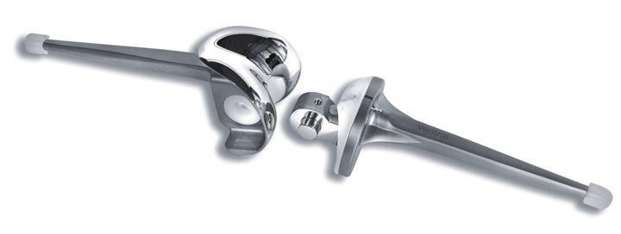
Rotating hinge knee implants
Tibial and femoral components linked with axle that restricts varus-valgus and translational stresses
Rotating tibial bearing on platform (decreases overall amount of constraint)

Slide 32
Rotating hinge knee implants
For:
  severe deformities
  significant bone loss
  complex revision arthroplasty
  tumour surgery

Slide 33
Rotating hinge knee implants
Potential disadvantages
aseptic loosening of implant-bone interfaces
larger bone resection

Slide 34
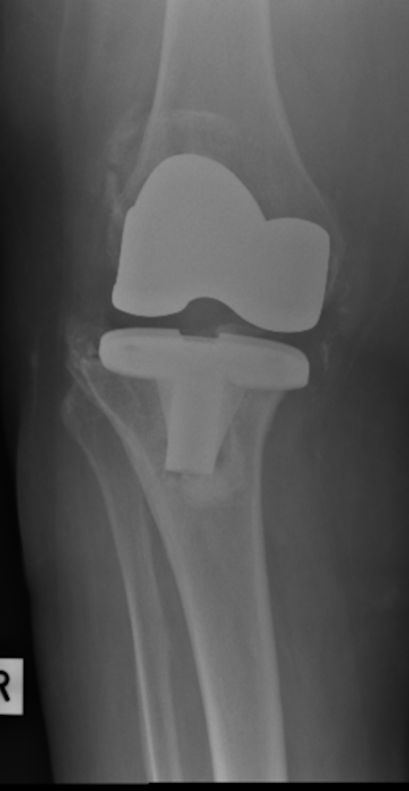
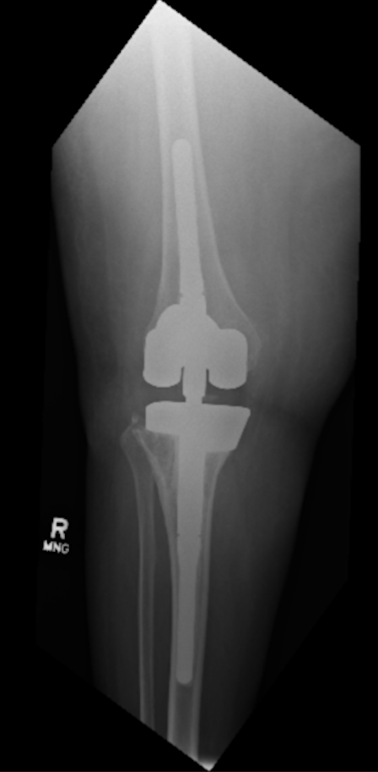
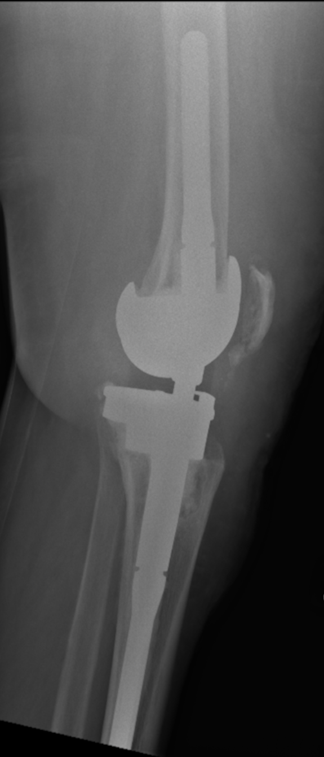
Rotating-hinge knee implants

Slide 35
Summary
Knee instability can be caused by several factors
  ligament and bony deficiency
  improper gap balancing and malalignment
Use constrained prosthesis if ligament and soft tissues are unable to provide stability
Use the least amount of constraint necessary which will provide adequate stability

