Slide 1
Knee Assessment
Clinical & Radiological
Dr. Rabi Solaiman
Orthopaedic Surgeon
Monash Health, Melbourne, Australia

Slide 2
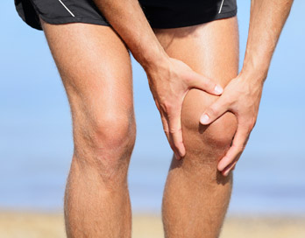
History
Pain Profile
  Site
  Radiation
  Severity
  Aggravating Factors
  Relieving factors
  Analgesics

Slide 3
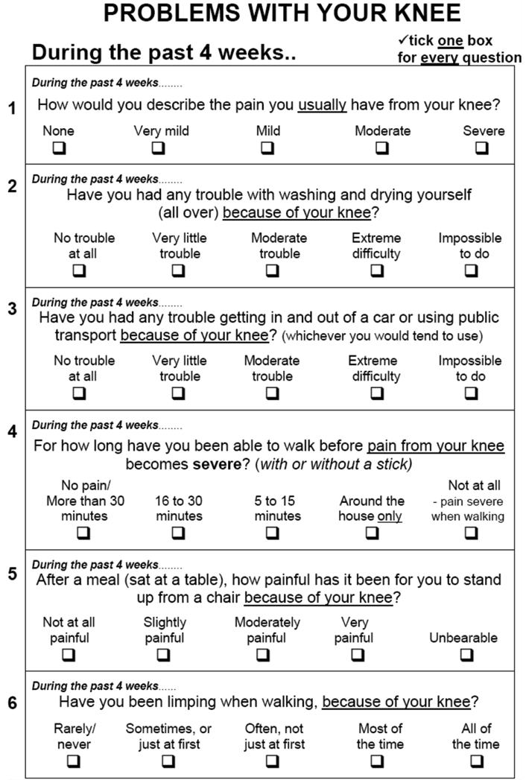
History
Functional Profile
  Oxford Knee Score
  Walking tolerance
Medical Comorbidities
  Diabetes
  Obesity
  IHD
  PVD
Social History

Slide 4
Examination
Look
Feel
Move
Measure

Slide 5
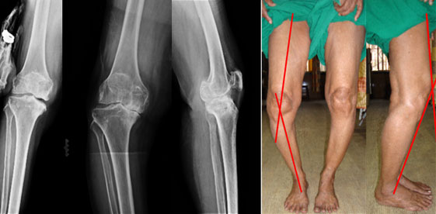
Examination
LOOK
  Coronal Plane
    Quadriceps Atrophy
    Varus/Valgus
    Position of Patella
    scars
    skin condition
    Feet

Slide 6
Examination
LOOK
  Sagittal Plane
    Fixed Flexion
    Hyperextension
  Gait
    Antalgic
    valgus/varus thrust
    foot drop
    etc.

Slide 7
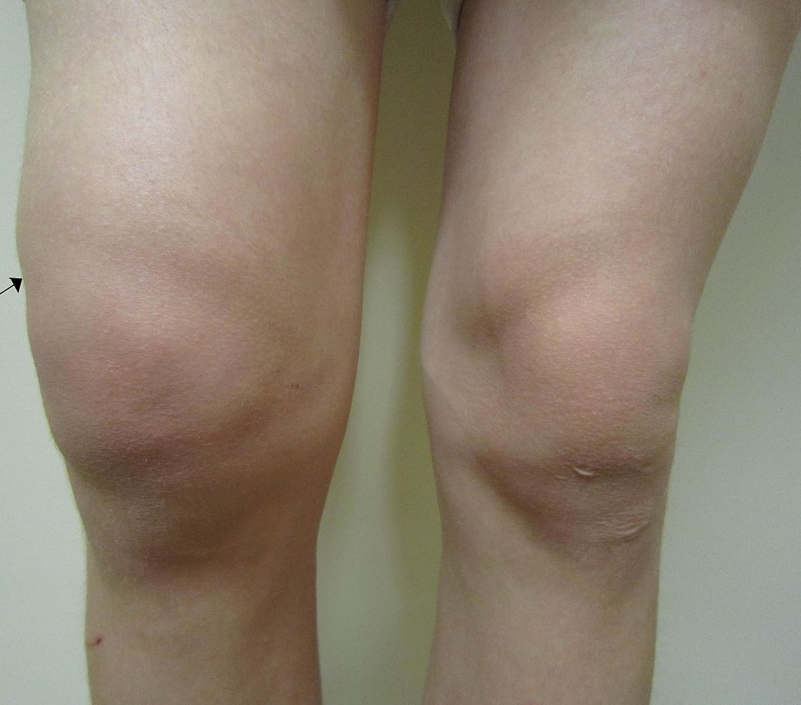
Examination
FEEL
  Effusion
    swipe test
    Ballottement
    Patella Tap Test

Slide 8
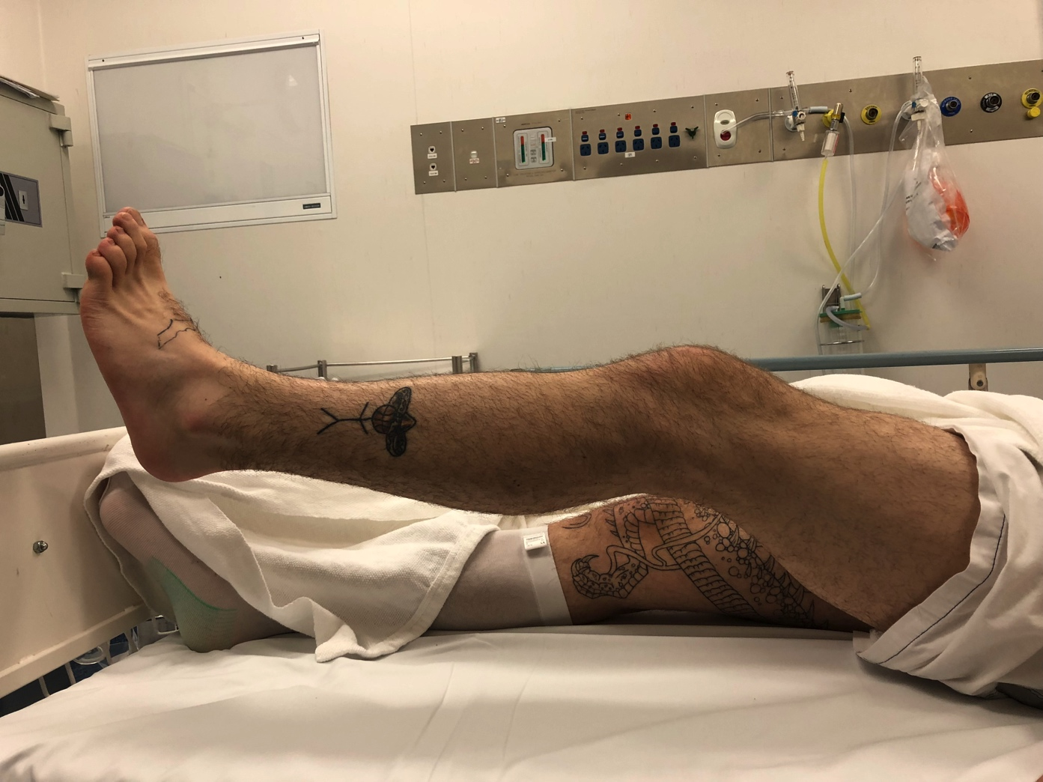
Examination
  Quad power
  Quadriceps Lag
  Range of Motion
  Patella tracking
  Patella grind test

Slide 9
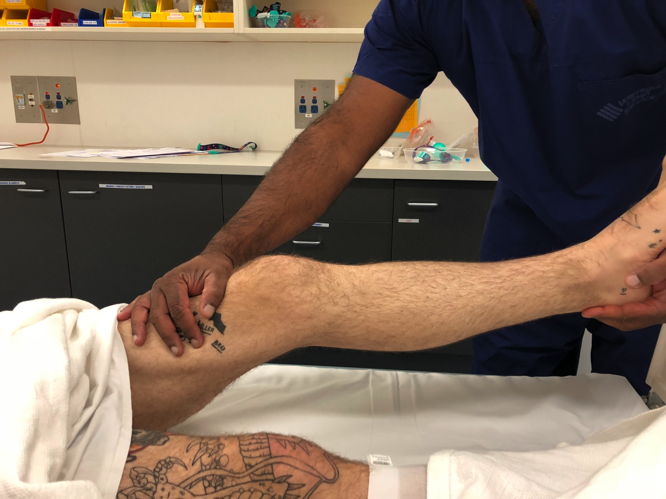
Examination
  Quad power
  Quadriceps Lag
  Range of Motion
  Patella tracking
  Patella grind test

Slide 10
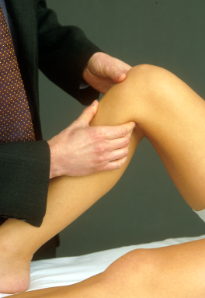
FEEL
  Systematic palpation
    Femoral condyles
    Joint line
    Patella tendon
    Hamstring insertion
    Popliteal fossa

Slide 11
FEEL
  Stability
  Load the individual compartments
  Examination of the hip joint
  Distal neurovascular examination

Slide 12
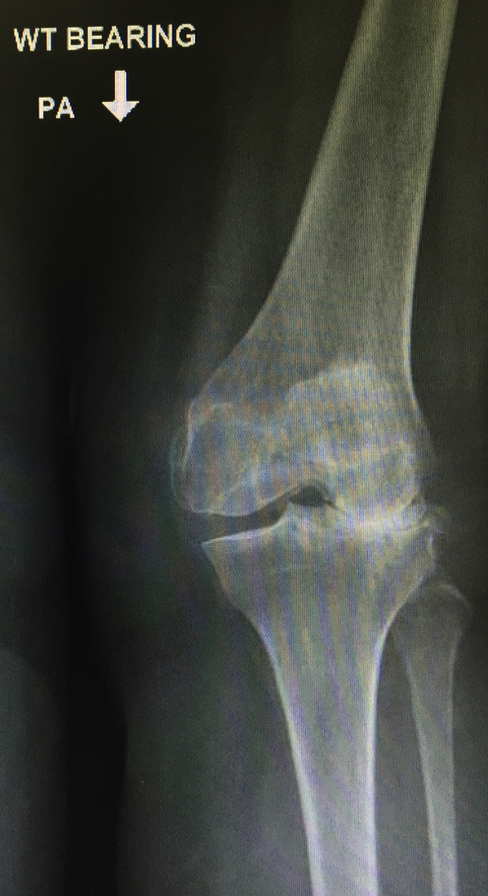
Radiological Assessment
Weightbearing
  AP
  Rosenberg
  Lateral
  Patella Sky View

Slide 13
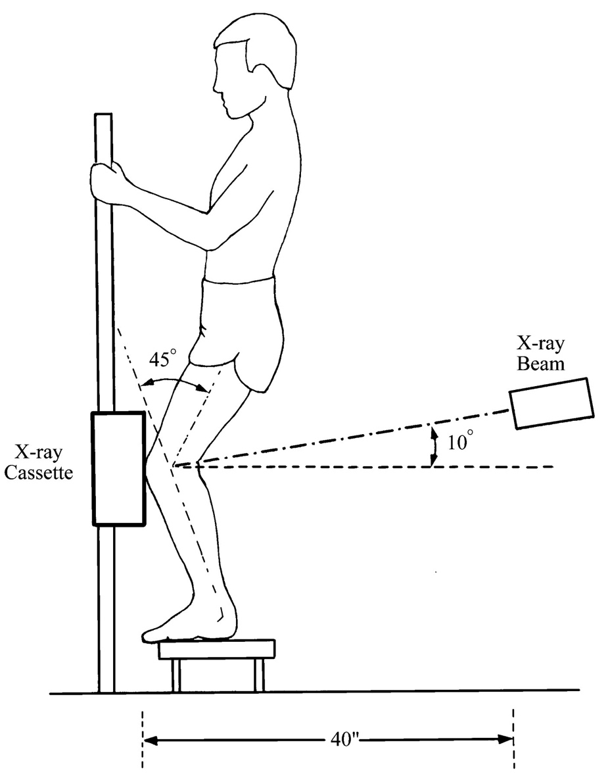
Radiological Assessment
Weightbearing
  AP
  Rosenberg
  Lateral
  Patella Sky View

Slide 14
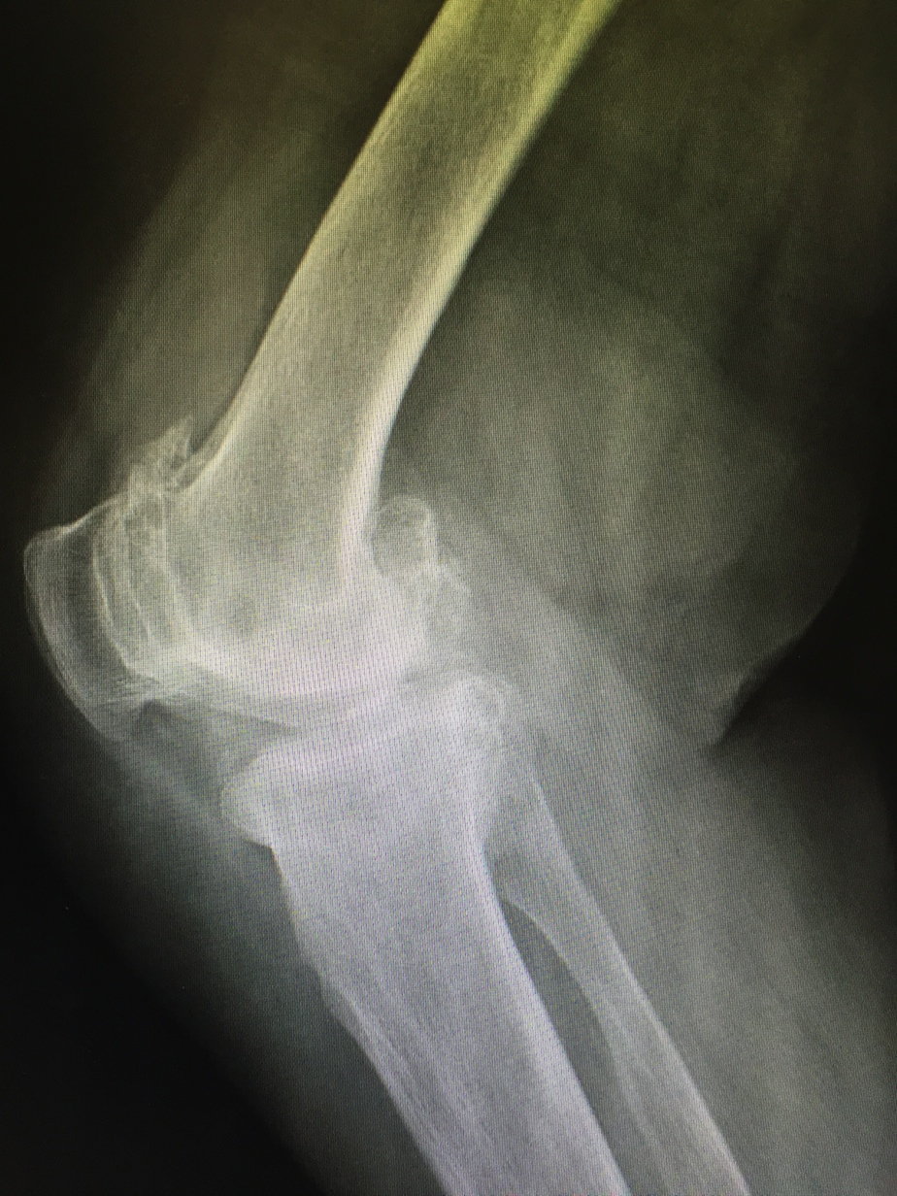
Radiological Assessment
Weightbearing
  AP
  Rosenberg
  Lateral
  Patella Sky View

Slide 15
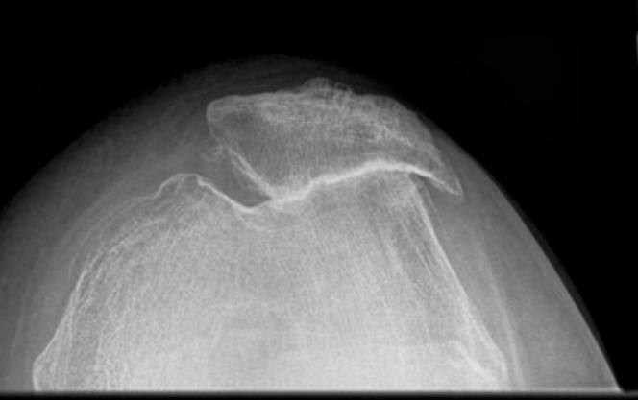
Radiological Assessment
Weightbearing
  AP
  Rosenberg
  Lateral
  Patella Axial View
    (Merchant, Sunrise)
Notes:
Various methods described for patella axial views

Slide 16
Radiological Assessment
Ultrasound → No role
CT scan → Rarely required
MRI → Osteonecrosis, OCD
Bone Scan → Rarely required

Slide 17
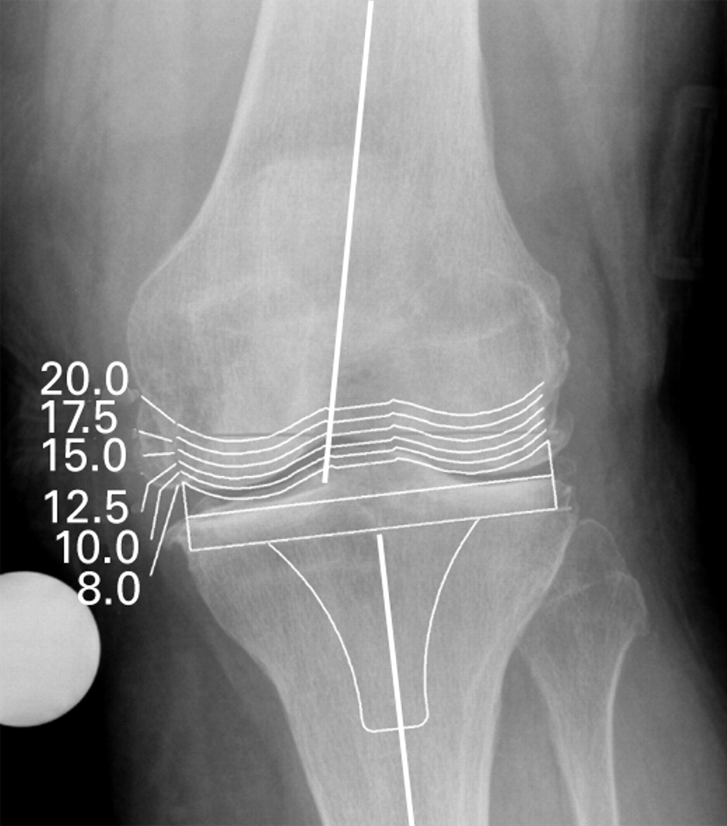
Preop Templating
  Sizing the implant
  Degree of varus/valgus malalignment
  Dysplastic condyles
  Bone deficiency
  Extra Articular Deformity

Slide 18
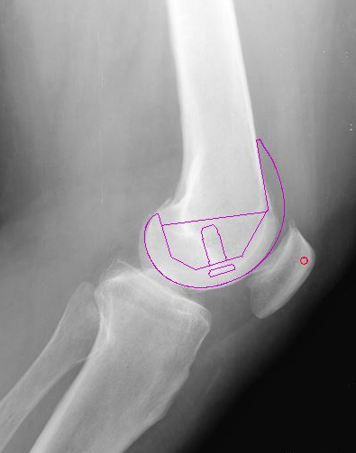
Preoperative Templating
Sizing implant
Distal femoral flexion
Posterior Condylar Offset
Tibial slope

Slide 19
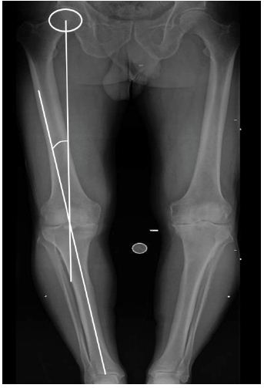
Preop Templating
Long limb alignment view
  Sizing the implant
  Degree of varus/valgus malalignment
  Dysplastic condyles
  Bone deficiency
  Extra Articular Deformity

Slide 20
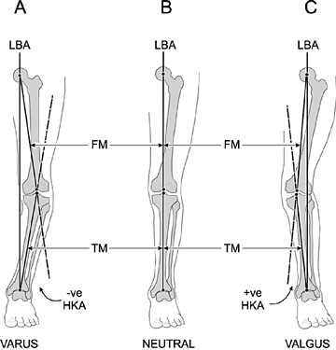

Slide 21
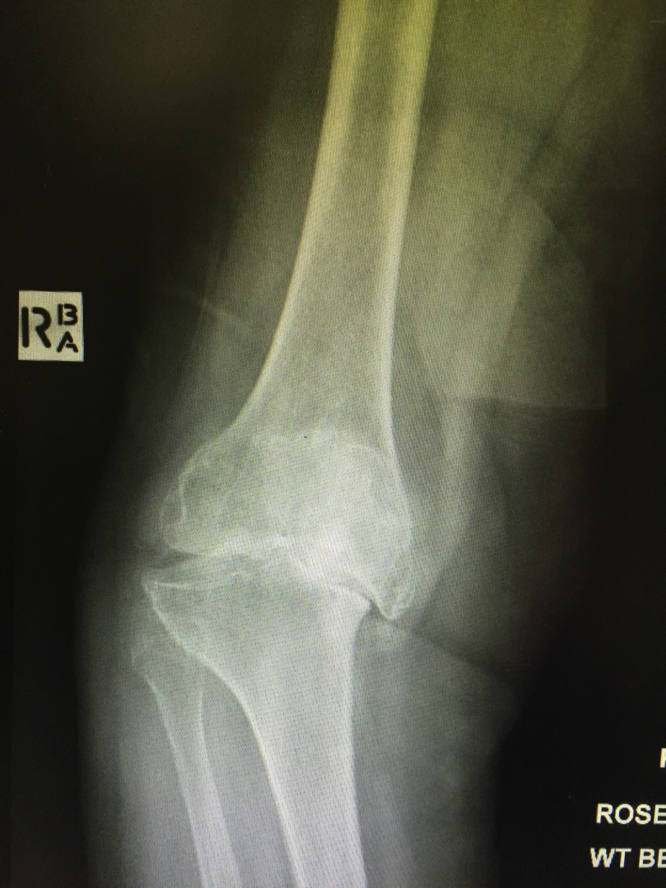
Notes:
Bony deficiency

Slide 23
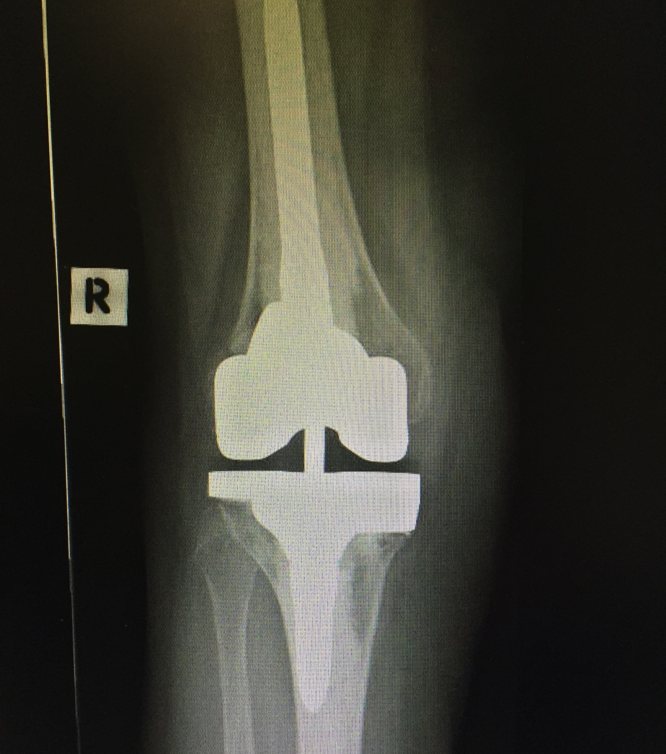
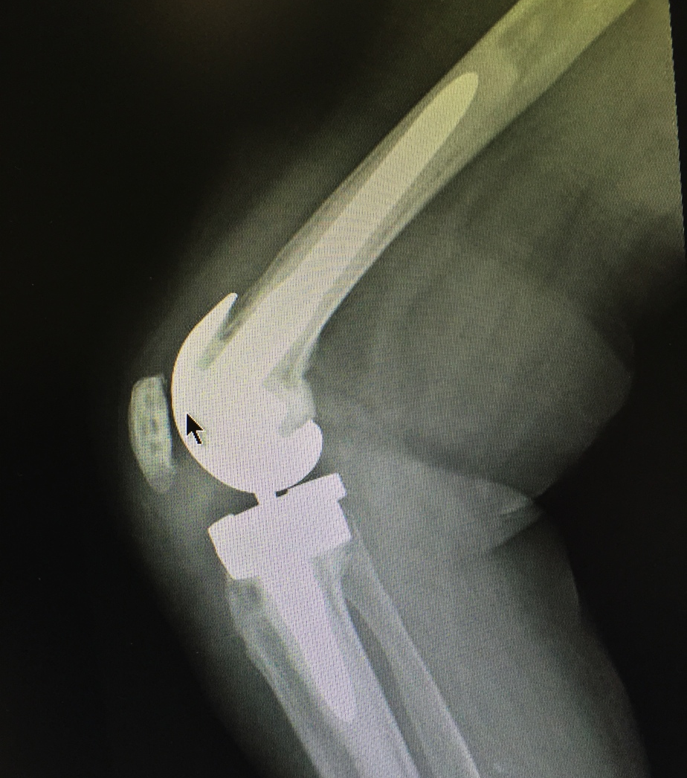

Slide 24
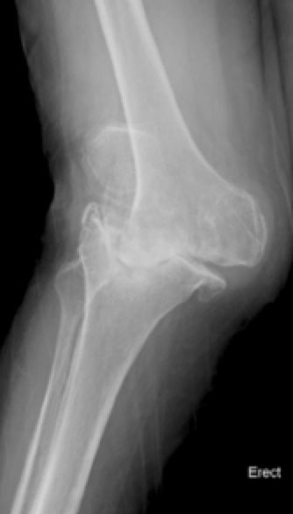
Preoperative Templating
Long limb alignment view
  Degree of varus/valgus malalignment
  Dysplastic condyles
  Bone deficiency
  Extra Articular Deformity

Slide 25
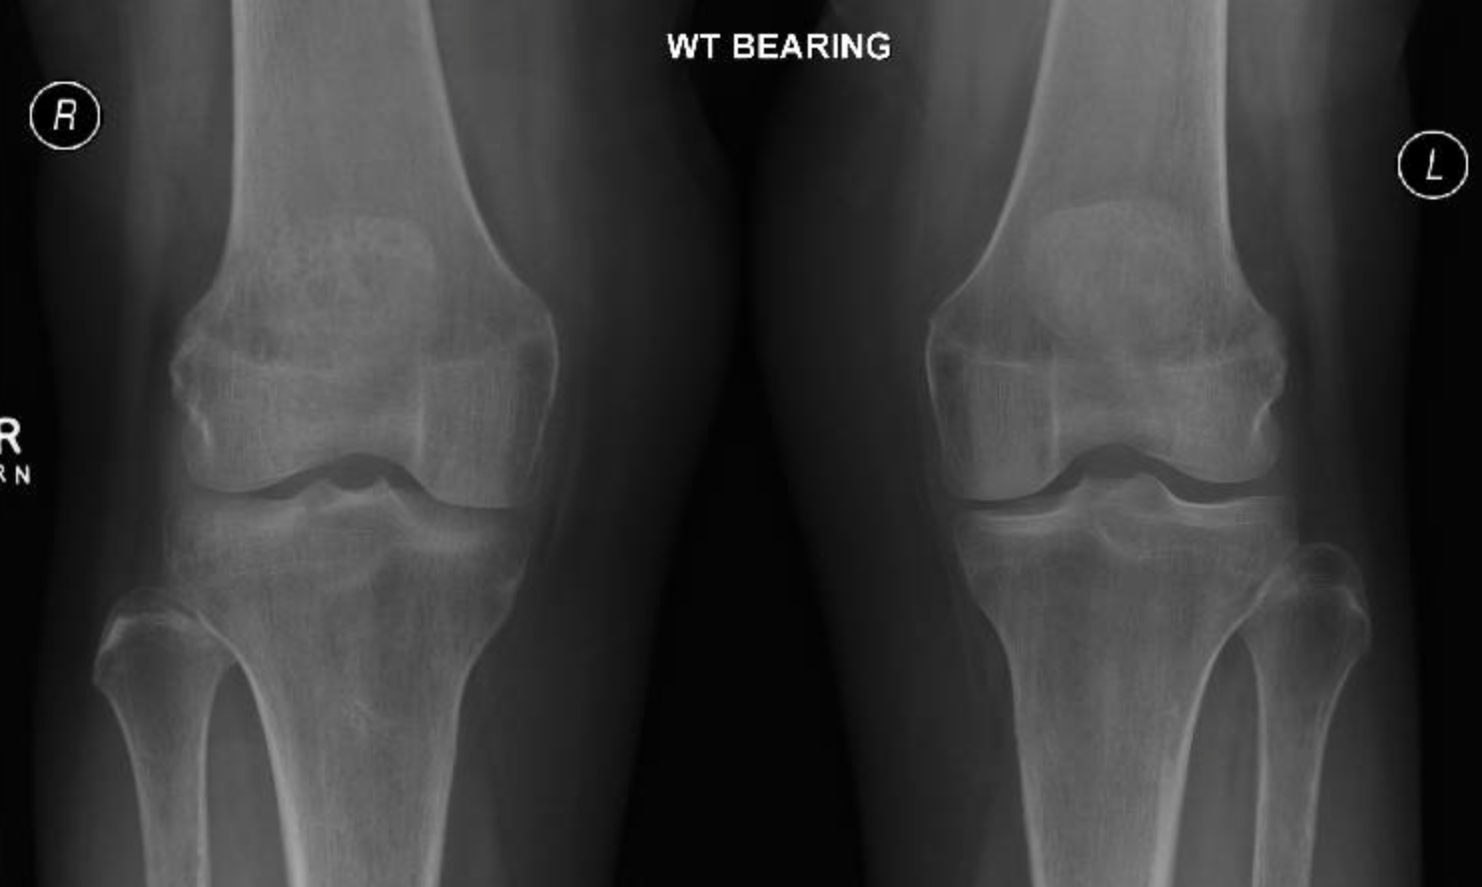

Slide 26
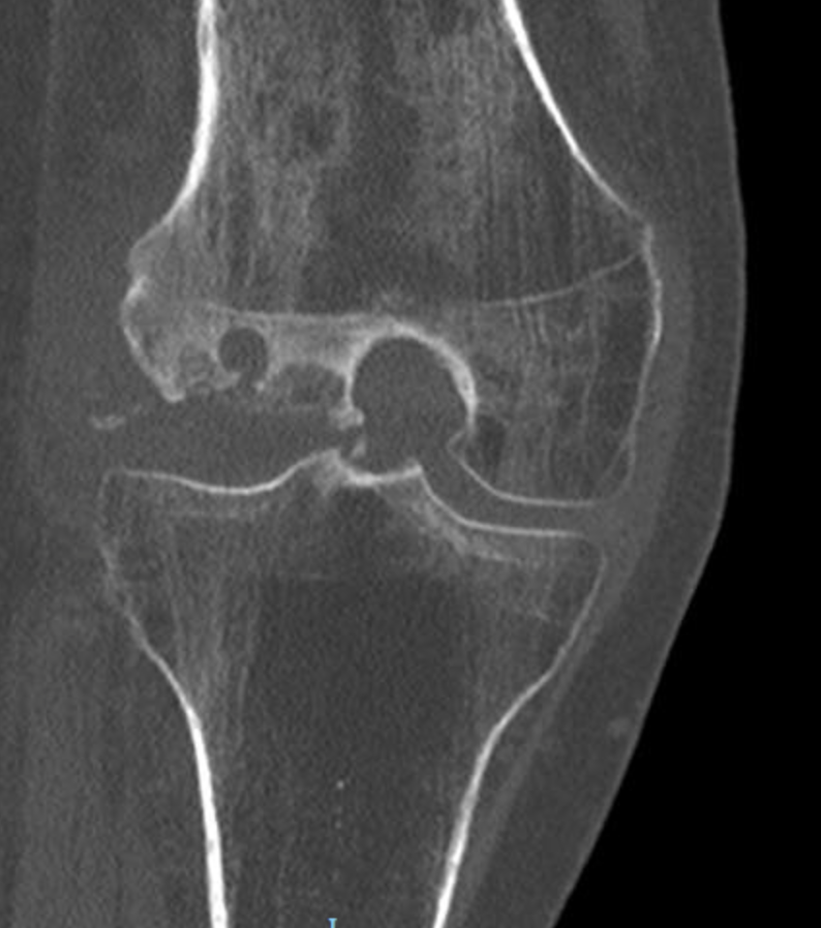
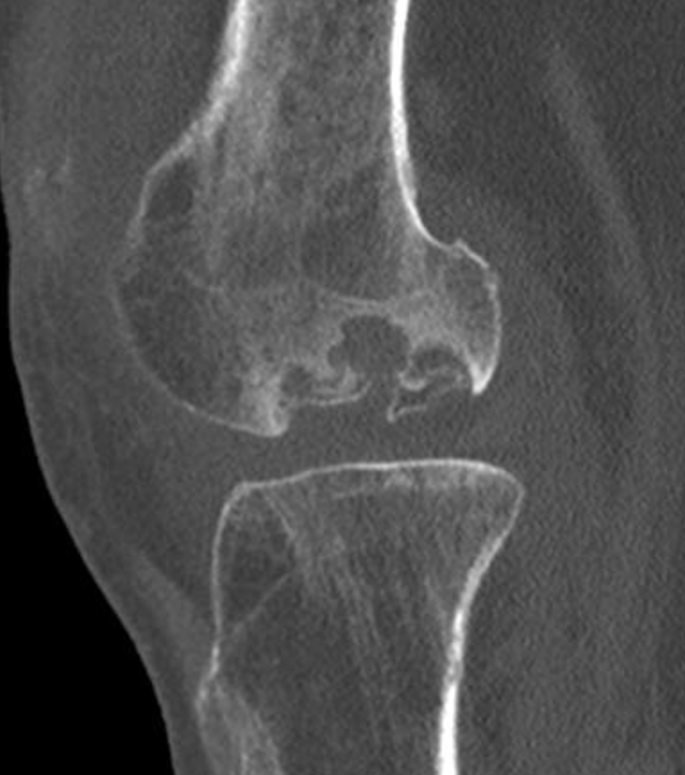

Slide 27
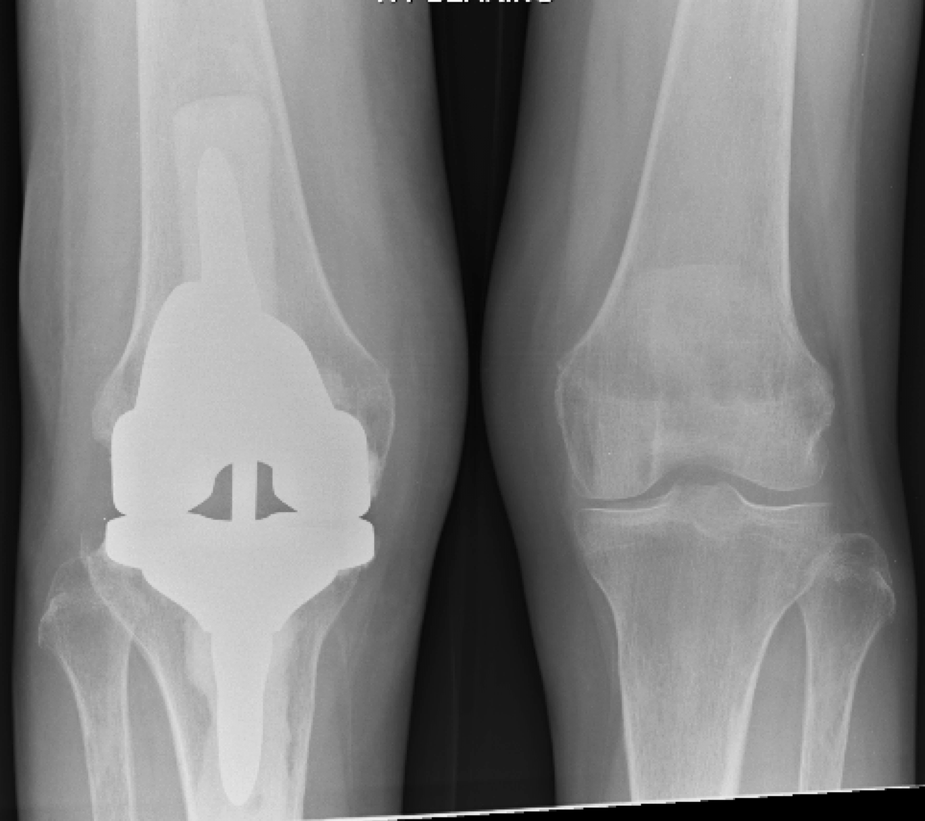
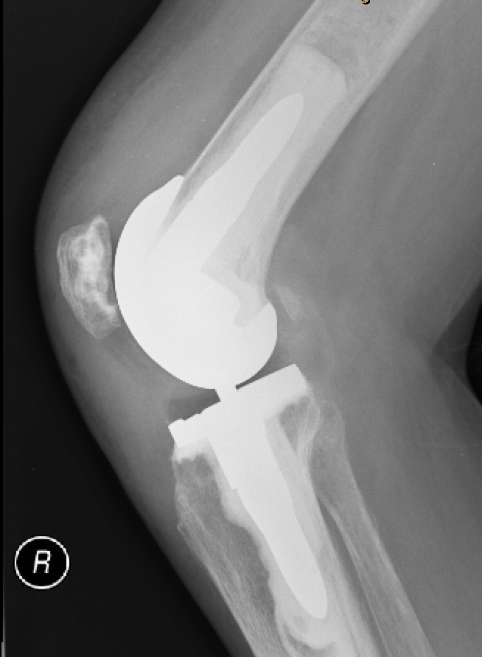

Slide 28
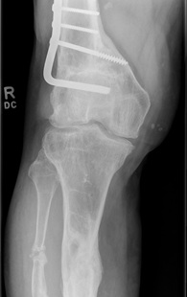
Preoperative Templating
Long limb alignment view
  Degree of varus/valgus malalignment
  Dysplastic condyles
  Bone deficiency
  Extra Articular Deformity
Notes:
Prior to the knee replacement procedure lower limb should be in a reasonable alignment. Mechanical axis of femur and tibia should fall inside the joint level. Otherwise joint replacement with soft tissue balancing to accommodate for bone deformity is technically demanding if not impossible.

Slide 29
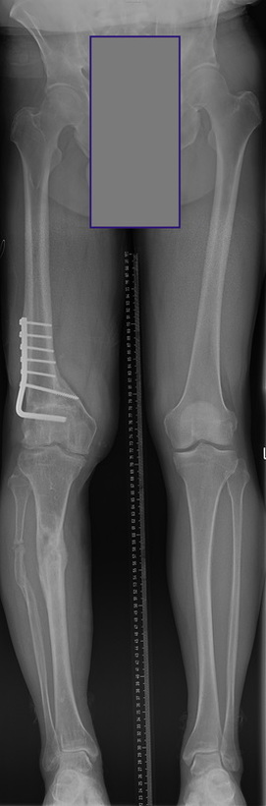

Slide 30
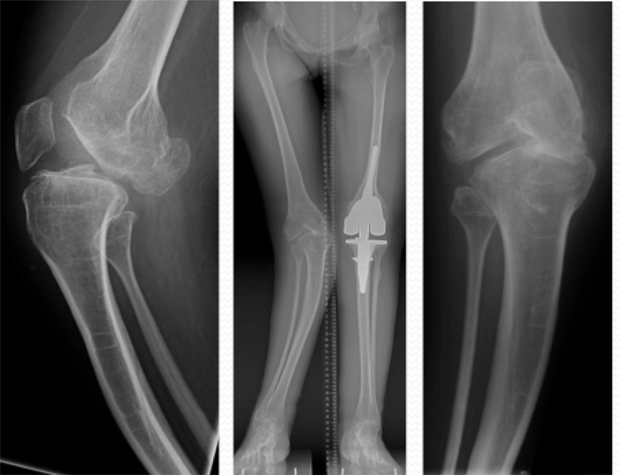

Slide 31
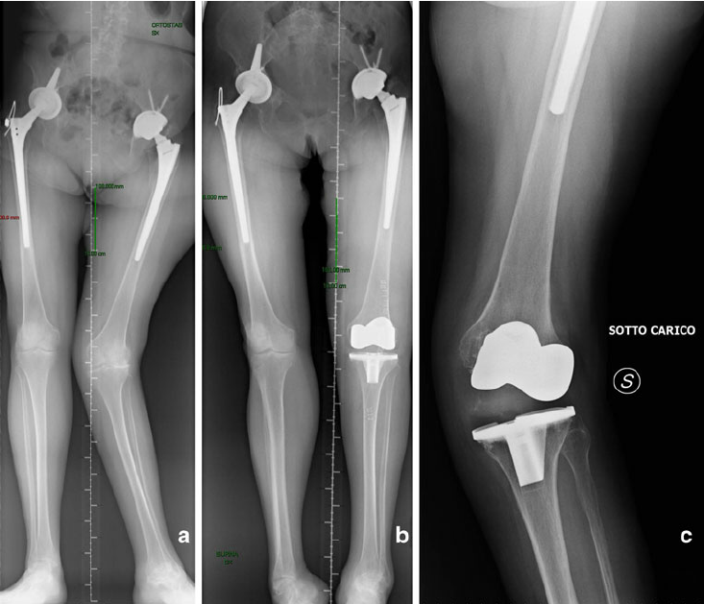
Notes:
What do you think of the left TKR?

Slide 33
Summary
Thorough History
Focused Examination
Weightbearing Xrays

Slide 34
Thank You

