Slide 1
AAOS evidence based treatment recommendations of Knee Osteoarthritis
Tran Dang Khoa, MD.
HTO

Slide 2

RECOMMENDATION 1
Strong:
recommend that patients with symptomatic osteoarthritis of the knee participate in self- management programs, strengthening, low-impact aerobic exercises, and neuromuscular education; and engage in physical activity consistent with national guidelines

Slide 3
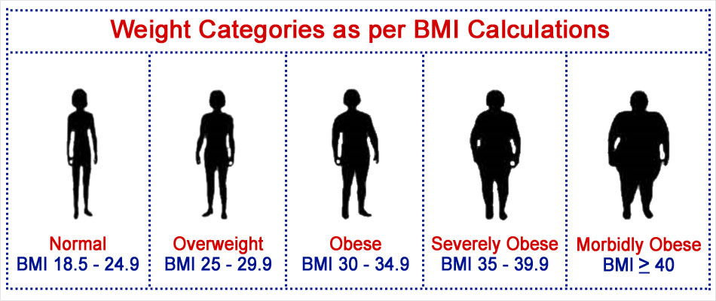
RECOMMENDATION 2
Moderate:
suggest weight loss for patients with symptomatic osteoarthritis of the knee and a BMI ≥ 25

Slide 4
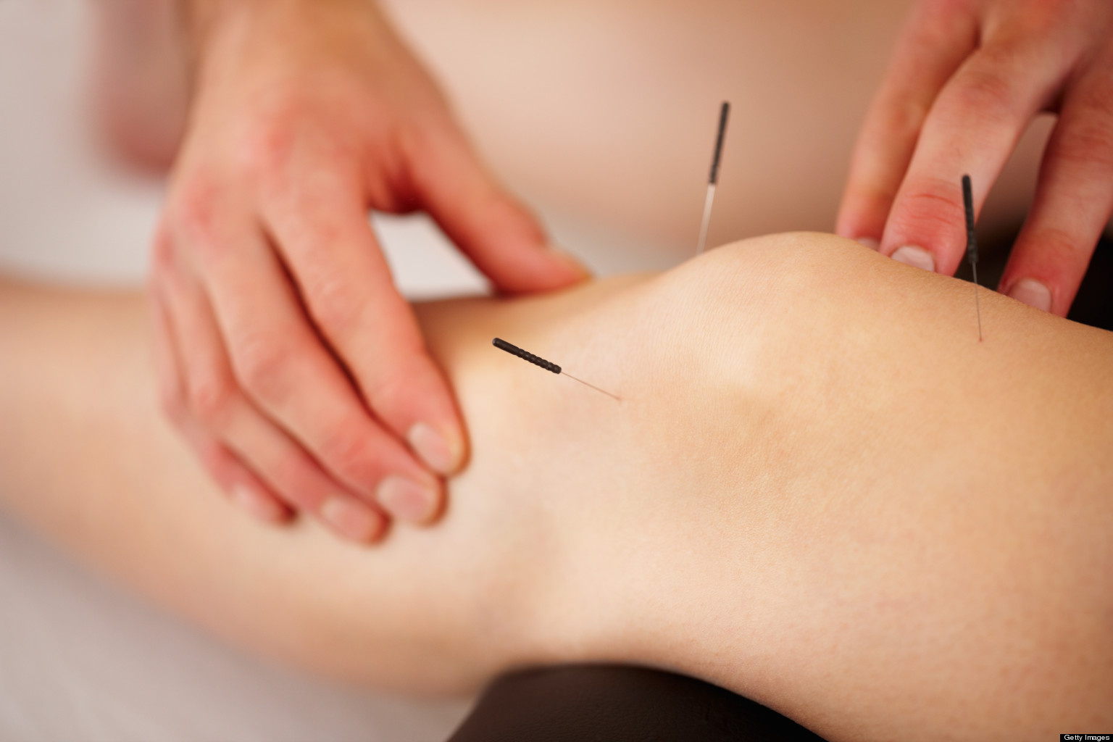
RECOMMENDATION 3A
Strong:
CANNOT recommend using acupuncture in patients with symptomatic osteoarthritis of the knee

Slide 5
RECOMMENDATION 3B, 3C
Inconclusive:
UNABLE to recommend for or against the use of physical agents (including electrotherapeutic modalities) in patients with symptomatic osteoarthritis of the knee
UNABLE to recommend for or against manual therapy in patients with symptomatic osteoarthritis of the knee

Slide 6
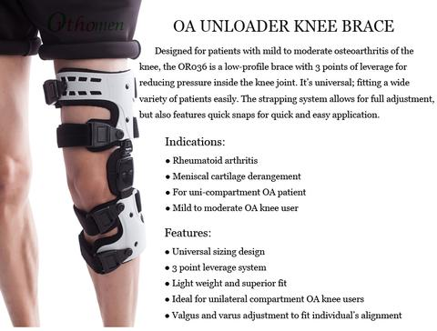
RECOMMENDATION 4
Moderate:
UNABLE to recommend for or against the use of a valgus directing force brace (medial compartment unloader) for patients with symptomatic osteoarthritis of the knee

Slide 7
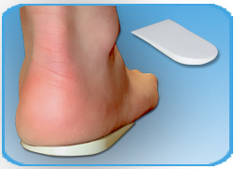
RECOMMENDATION 5
Moderate:
CANNOT suggest that lateral wedge insoles be used for patients with symptomatic medial compartment osteoarthritis of the knee

Slide 8
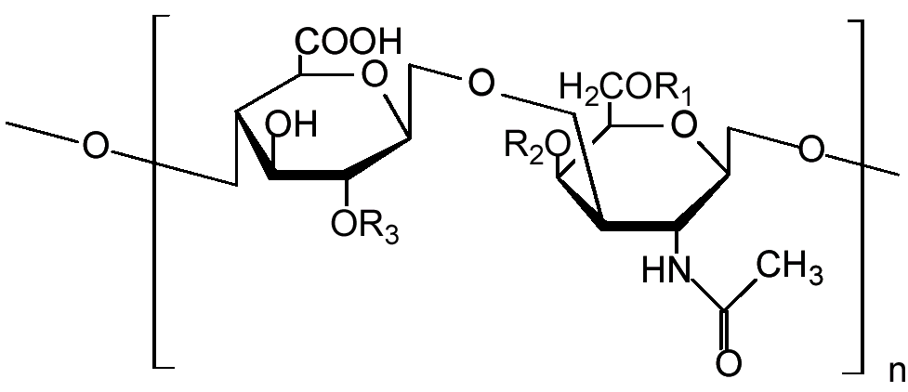
RECOMMENDATION 6
Strong:
CANNOT recommend using glucosamine and chondroitin for patients with symptomatic osteoarthritis of the knee

Slide 9

RECOMMENDATION 7A
Strong:
recommend nonsteroidal anti-inflammatory drugs (NSAIDs; oral or topical) or Tramadol for patients with symptomatic osteoarthritis of the knee

Slide 10
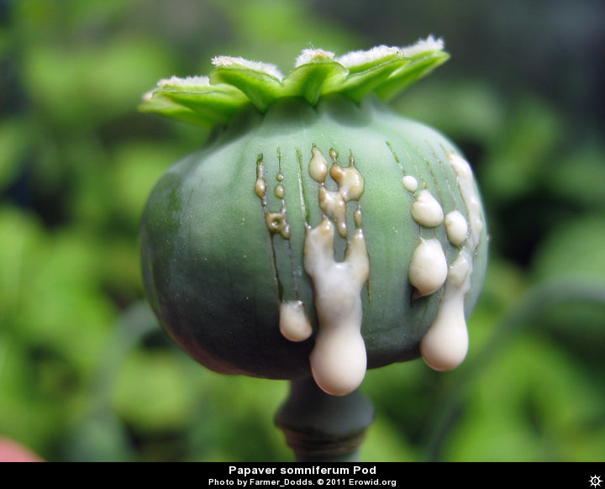
RECOMMENDATION 7B
Inconclusive:
UNABLE to recommend for or against the use of acetaminophen, opioids, or pain patches for patients with symptomatic osteoarthritis of the knee

Slide 11

RECOMMENDATION 8
Inconclusive:
UNABLE to recommend for or against the use of intraarticular (IA) corticosteroids for patients with symptomatic osteoarthritis of the knee

Slide 12
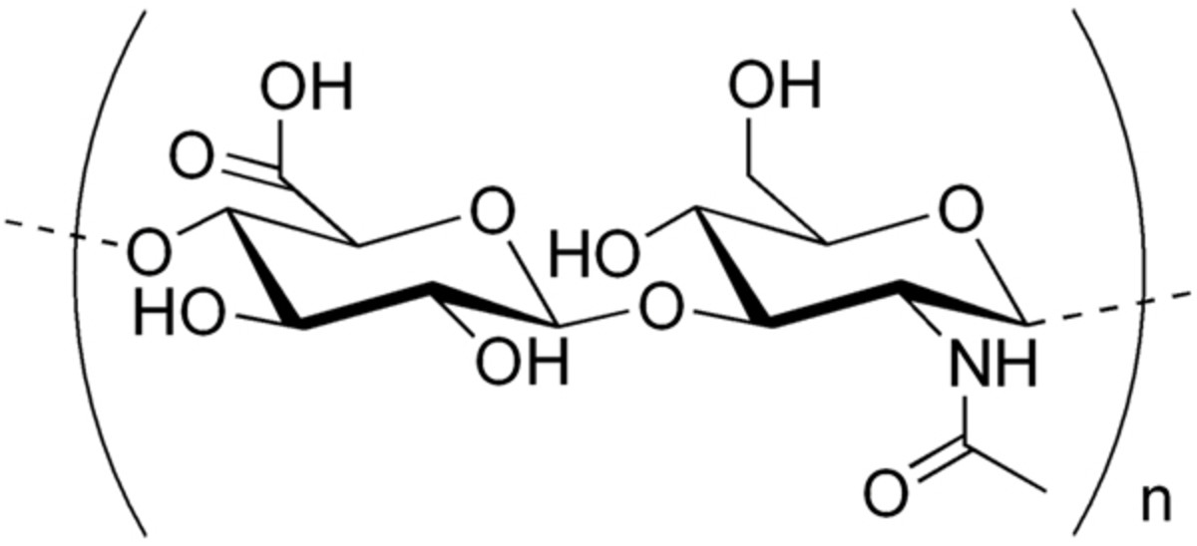
RECOMMENDATION 9
Strong:
CANNOT recommend using hyaluronic acid for patients with symptomatic osteoarthritis of the knee

Slide 13

RECOMMENDATION 10
Inconclusive:
UNABLE to recommend for or against growth factor injections and/or platelet rich plasma for patients with symptomatic osteoarthritis of the knee

Slide 14
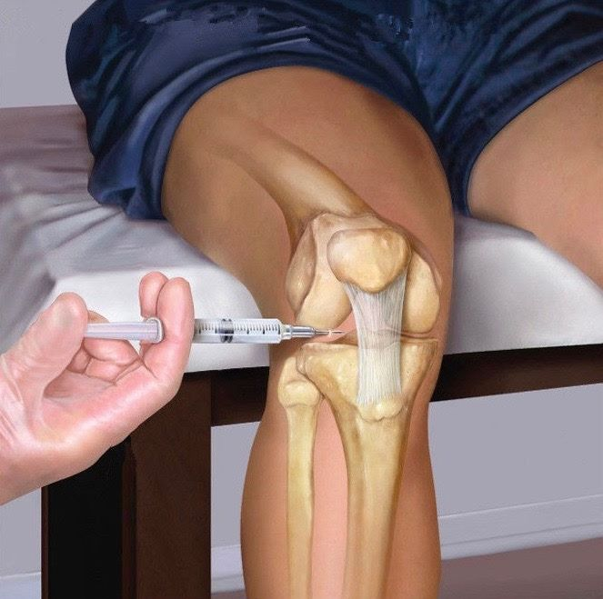
RECOMMENDATION 11
Moderate:
CANNOT suggest that using needle lavage for patients with symptomatic osteoarthritis of the knee

Slide 15
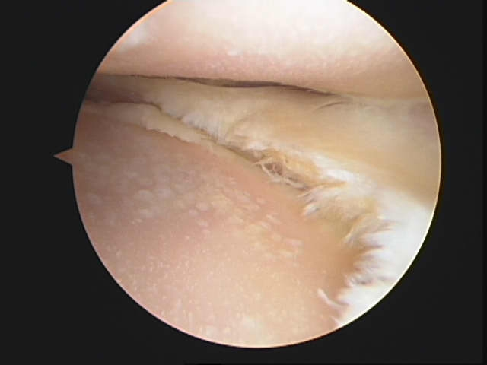
RECOMMENDATION 12
Strong:
CANNOT recommend performing arthroscopy with lavage and/or debridement in patients with a primary diagnosis of symptomatic osteoarthritis of the knee

Slide 16
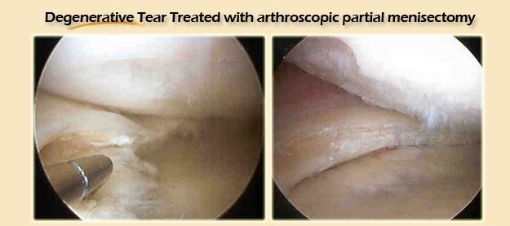
RECOMMENDATION 13
Inconclusive:
UNABLE to recommend for or against arthroscopic partial meniscectomy in patients with osteoarthritis of the knee with a torn meniscus

Slide 17
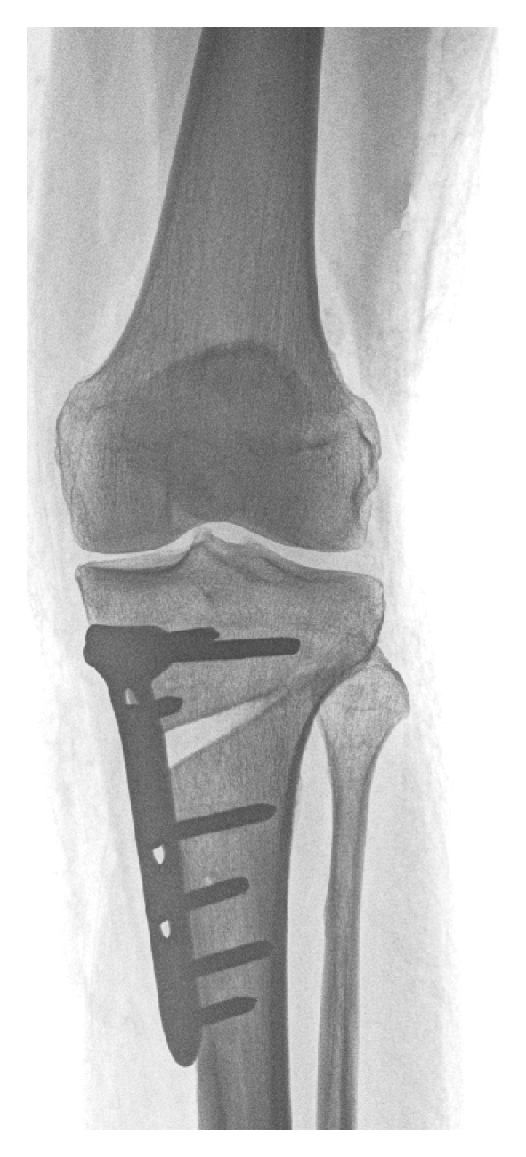
RECOMMENDATION 14
Limited:
might perform a valgus producing proximal tibial osteotomy in patients with symptomatic medial compartment osteoarthritis of the knee

Slide 18
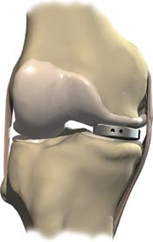
RECOMMENDATION 15
Consensus:
NOT to use the free-floating (un-fixed) interpositional device in patients with symptomatic medial compartment osteoarthritis of the knee

Slide 19

THANK YOU!

