Slide 1
UKR Principles
Rabi Solaiman
MBBS FRACS FAOrthA
Orthopaedic Surgeon
Monash Health, Melbourne

Slide 2
UKR
1/3 of patients with OA have single compartment disease
In 50% of patients, arthritic changes are predominantly in medial compartment
Some of these patients may suitable for UKR

Slide 3
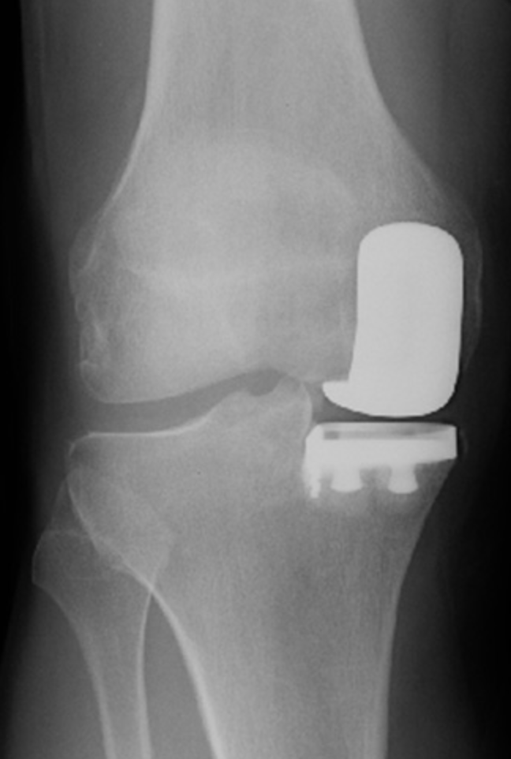
UKR
Medial Compartment Replacement
Lateral Compartment Replacement
Indication
  Severe pain
  Localised to single compartment
  Failed non operative Rx

Slide 4
UKR vs TKR
Preservation of normal knee kinematics
  cruciate ligaments; PFJ tracking
Less
  Morbidity
  Pain, Blood loss, DVT, PE, Infection
  Hospital stay
  expensive
Notes:
Preservation of cruciate ligaments and retaining the patella lead to normal knee kinematics
It is associated with lesser mordities including pain..

Slide 5
UKR vs TKR
Quicker recovery
  Crutches 2-4 weeks
  Cycling, swimming → 6 weeks
  Golf, tennis → 2 to 3 months
Higher Patient Satisfaction
Higher Revision Rate
Notes:
Recreational activities 6 weeks; vigorous activities 2-3 months
80% satisfaction rate with TKR

Slide 6
UKR vs Osteotomy
Faster rehab & quicker recovery
Higher initial success rate
Fewer short term complications
Easier conversion to TKR
Better cosmesis
HTO group had better ROM
  ZenWu et. al. Journal of Arthroplasty 2017

Slide 7
Types of UKR
Fixed Bearing
  10 year 87% - 96%
  Rapid decline 2nd decade
Notes:
Following publication of successful results in the 90s, there was a rapid increase in the number of UKRs worldwide.

Slide 8
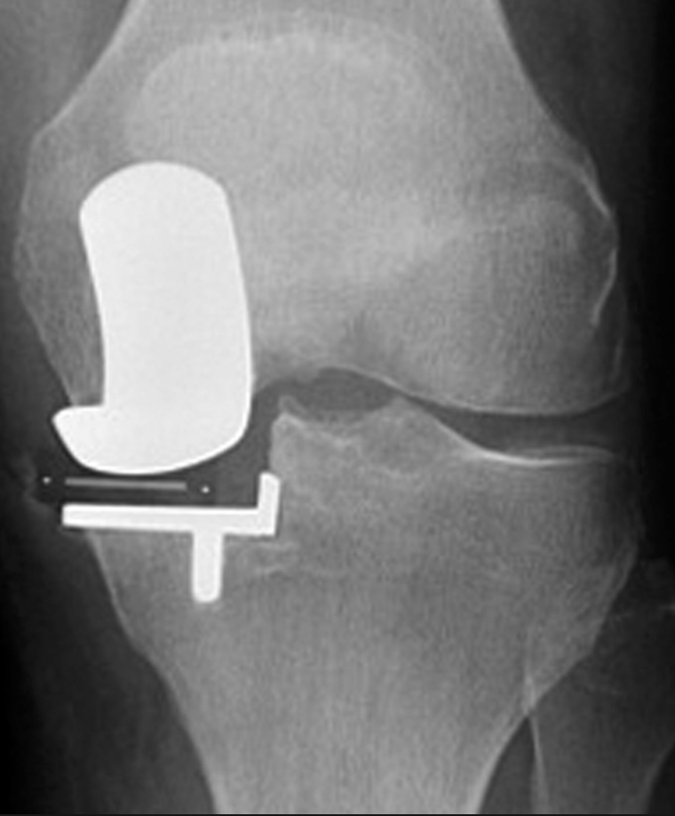
Types of UKR
Fixed Bearing
Mobile Bearing
  15 year 93% survival (Oxford)
Notes:
Following publication of these successful results, there was a rapid increase in the number of UKRs worldwide.

Slide 9
UKR
Australian Experience
14.5% in 2003
4% in 2013
5.1% of all Knee Replacements in 2016
Notes:
It peaked to nearly 15% of all TKR in 2003. However, our results did not reflect the success rate by the Oxford Group which lead to rapid decline in the number of UKRs performed.
UKR is on the rise again since introduction of PSI and Robotic Assisted Surgery; more strict on selection criteria

Slide 10
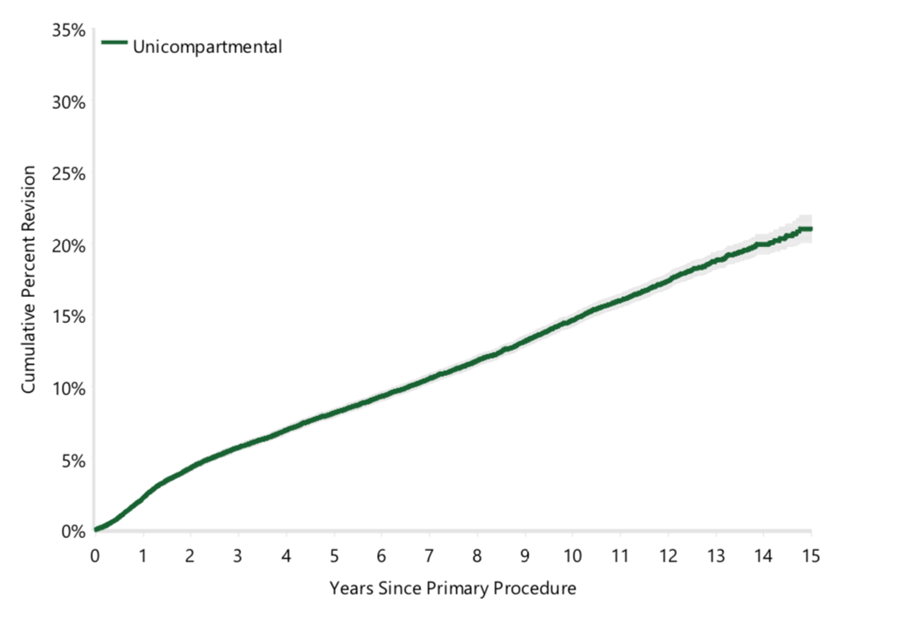
Cumulative Percent Revision of Primary UKR
Notes:
23.4% at 16 years vs 8% for TKR

Slide 11
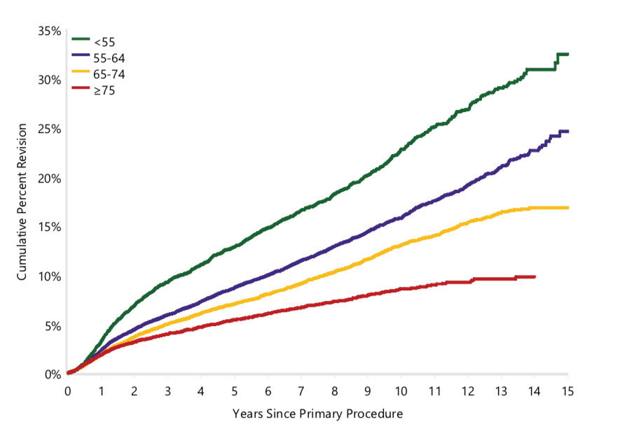
Cumulative Percent Revision of Primary UKR by Age

Slide 12
Why such high failure revision rate?
Poor Patient Selection
Notes:
Patient Selection is the most significant determinant whether a UKR is going to be successful or not.
Failure to strictly adhere to selection criteria will lead to early failure.

Slide 13
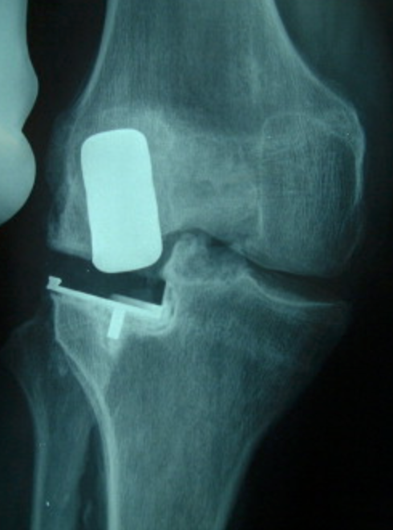
Why such high failure revision rate?
Poor Patient Selection
Poor Technique
Relative ease of conversion to TKR
Notes:
Patient Selection is the most significant determinant whether a UKR is going to be successful or not.
Failure to strictly adhere to selection criteria will lead to early failure.

Slide 14
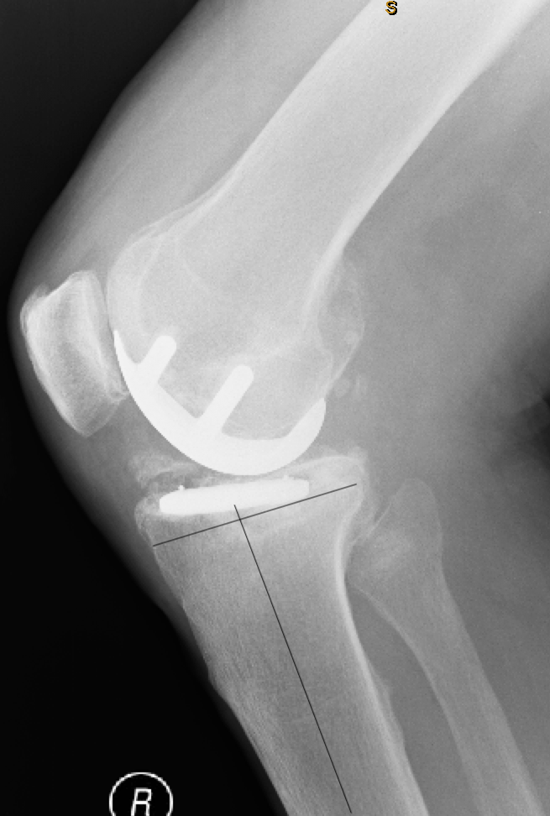
Why such high failure revision rate?
Poor Patient Selection
Poor Technique
Relative ease of conversion to TKR
Notes:
Patient Selection is the most significant determinant whether a UKR is going to be successful or not.
Failure to strictly adhere to selection criteria will lead to early failure.

Slide 15
UKR
Patient Selection
Pre operative planning
Surgical Technique
Notes:
The key to a successful UKR is appropriate patient selection

Slide 16
Selection Criteria
Controversial and vary widely
Age >60
Low demand
Light weight (<82kg)
Single compartment disease
  Clinical & Radiological

Slide 17
Contraindications
ACL deficiency
Fixed Flexion Deformity >10°
Arch of Motion <90°
Fixed varus deformity > 10°
Fixed valgus > 5°
Meniscectomy in other compartment
Tricompartmental Disease (Inflammatory)

Slide 18
Relative Contraindications
Younger Active Patients
Overweight Patients
Grade IV PFJ disease (anterior knee pain)

Slide 19
2. P

Slide 20
UKR
Patient Selection
Pre operative planning
Surgical Technique
Notes:
The key to a successful UKR is appropriate patient selection

Slide 21
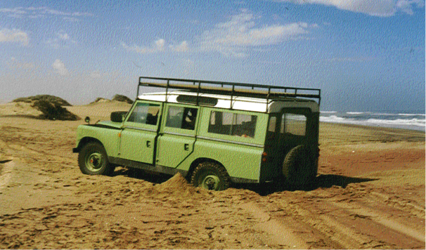
“Failure to plan is planning to fail”

Slide 22
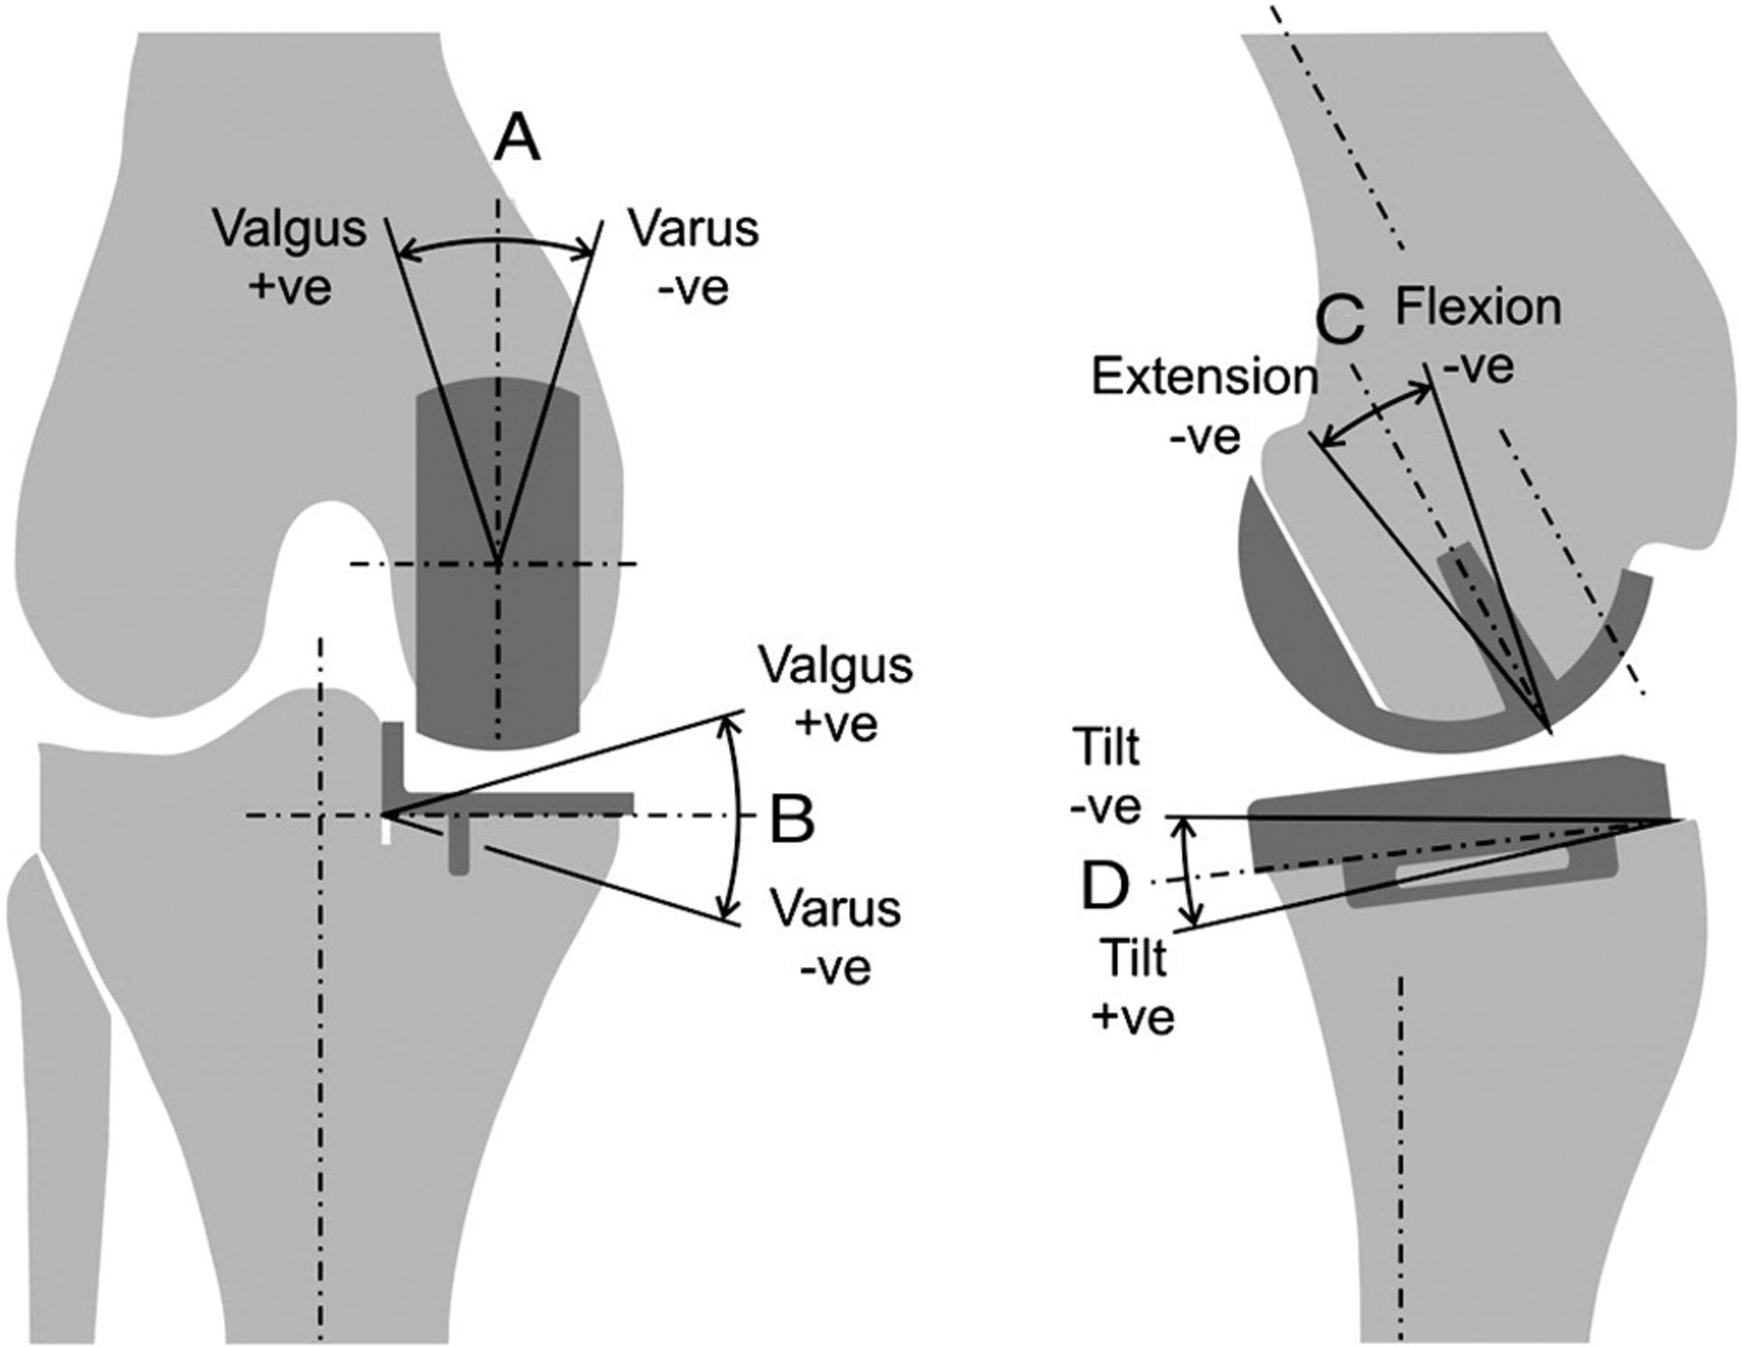
Preoperative Planning
Xray Templating
Notes:
Determine the varus valgus alignment
Size of the implant &
Tibial slope

Slide 23
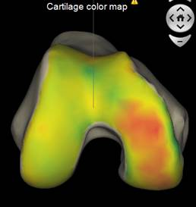
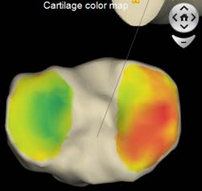
Preoperative Planning
PSI
Notes:
Determine the varus valgus alignment
Size of the implant &
Tibial slope

Slide 24
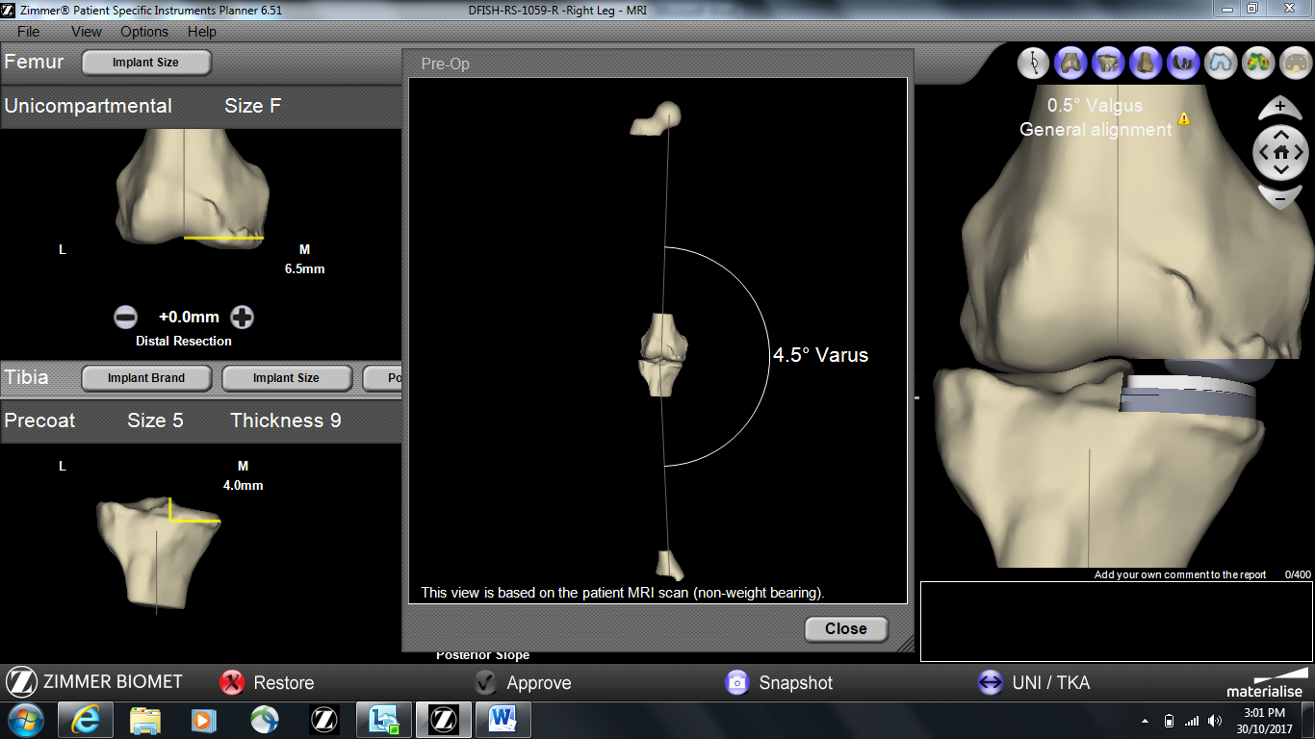
Preoperative Planning
PSI
Notes:
Pre operative non WB alignment

Slide 25
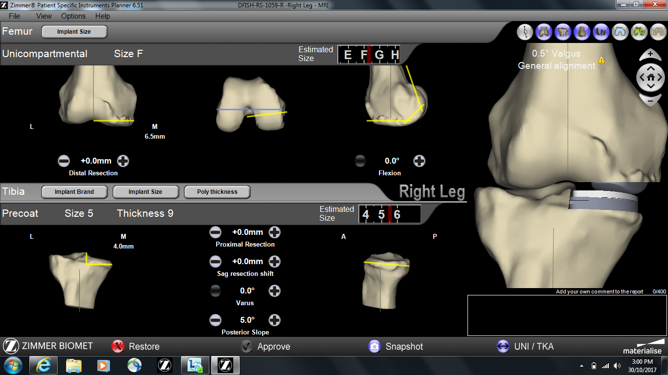
Notes:
Standard tibial resection (4.0mm) and femoral resection (6.5mm) which gives a valgus measure this patient

Slide 26
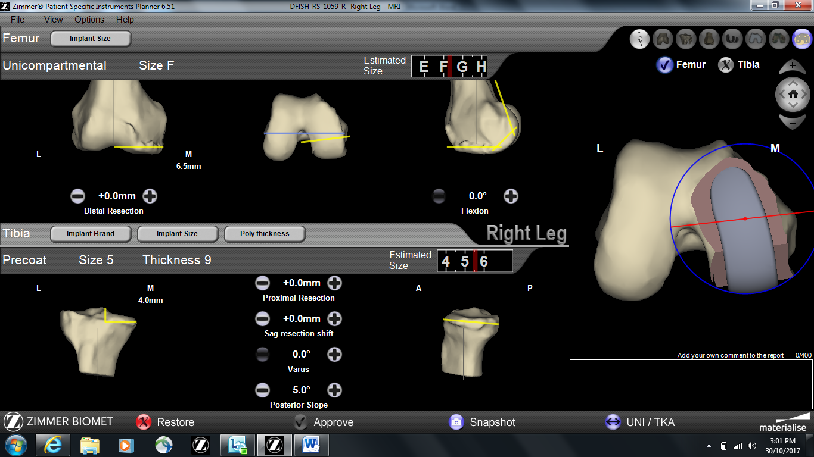
Notes:
Can change ML position of femur and femoral rotation

Slide 27
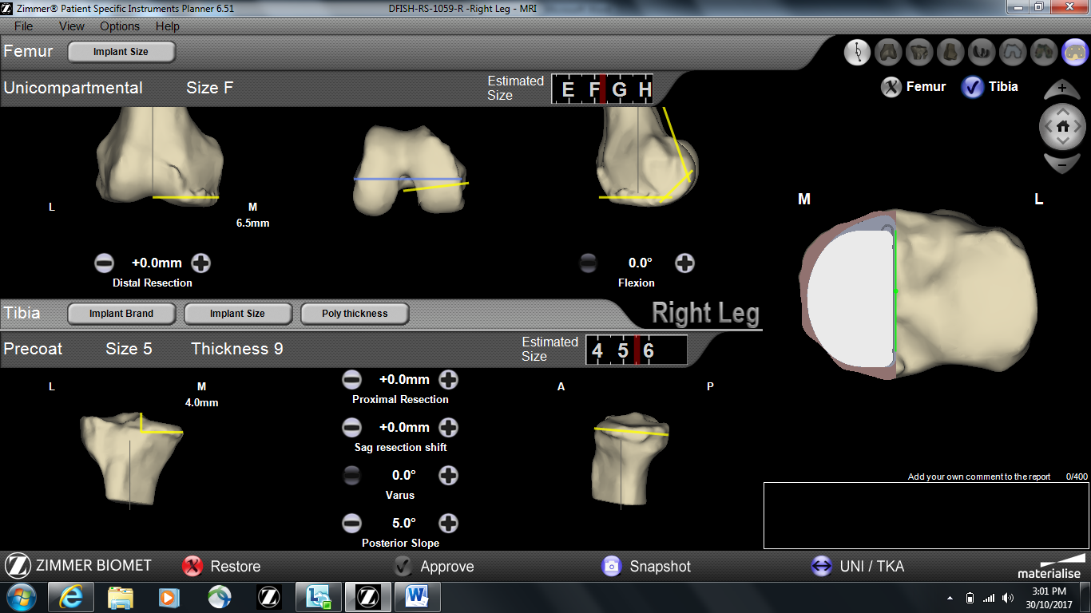
Notes:
Can change tibial size and position including medial and lateral shift through sagittal resection shift
Can always make adjustments on the day with tibial size and placement

Slide 28
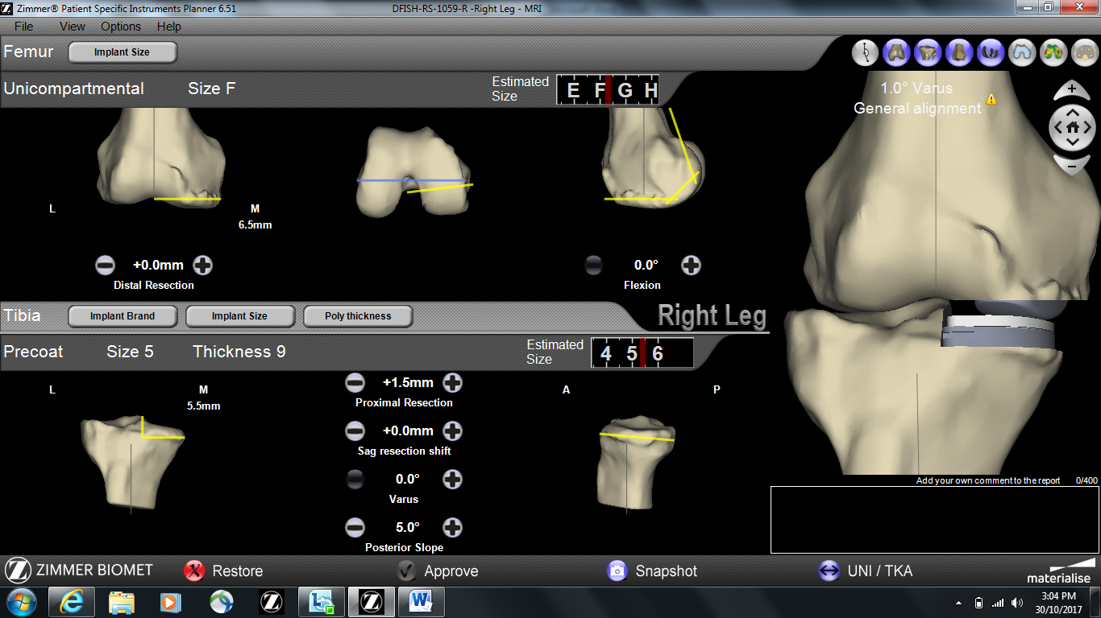
Notes:
increase tibial cut to change post op alignment

Slide 29
UKR
Patient Selection
Pre operative planning
Surgical Technique
Notes:
The key to a successful UKR is appropriate patient selection

Slide 30
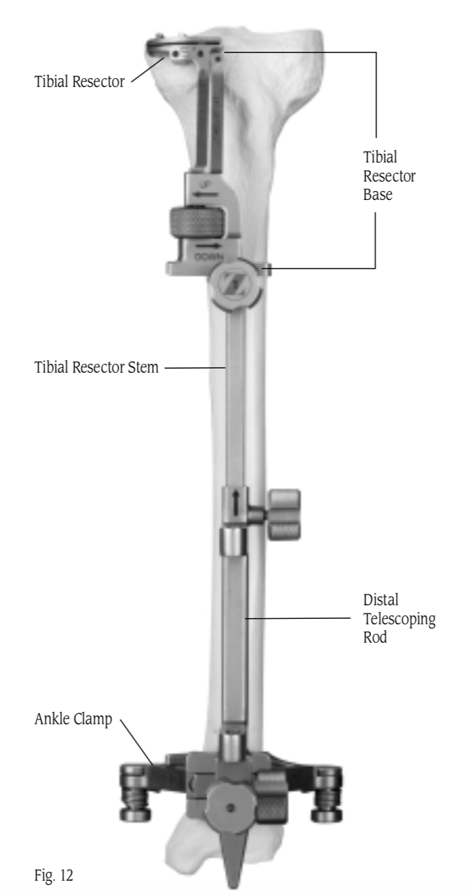
3. Surgical Technique
Instrumention Technique
  Extramedullary
  Intramedullary
Patient Specific Instrumention (PSI)
Robotic Assisted
Notes:
You can deliver the preoperative plan using

Slide 32
3. Surgical Technique
Instrumention Technique
  Extramedullary
  Intramedullary
Patient Specific Instrumention (PSI)
Robotic Assisted

Slide 33
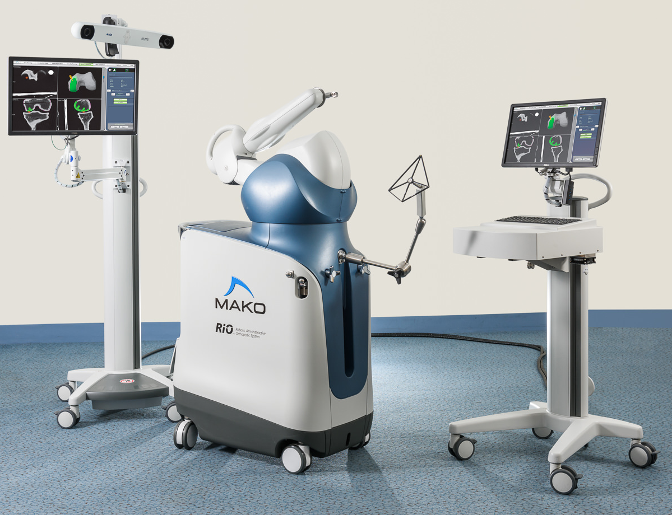
3. Surgical Technique
Instrumention Technique
  Extramedullary
  Intramedullary
Patient Specific Instrumention (PSI)
Robotic Assisted

Slide 34
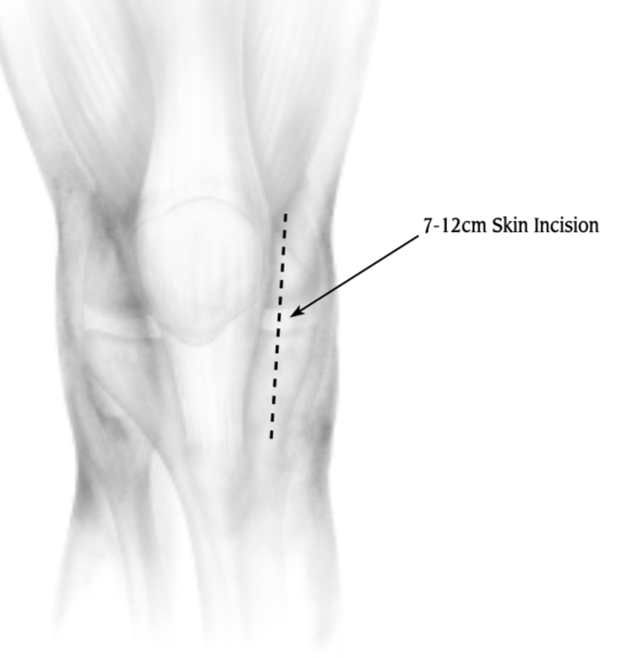
UKR Technical Tips
Longitudinal Incision
Remove osteophytes
Avoid extensive releases
Notes:
Over correction places excess load on unresurfaced compartment
Mediolateral placement → Tibial spine impingement
Undersizing femoral component → patella impingement

Slide 35
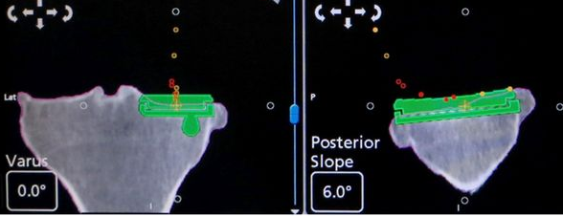
UKR Technical Tips
Longitudinal Incision
Remove osteophytes
Avoid extensive releases
Resect minimal bone
Avoid overcorrection
Avoid edge loading
Avoid impingement
Notes:
Over correction places excess load on unresurfaced compartment
Mediolateral placement → Tibial spine impingement
Undersizing femoral component → patella impingement

Slide 36
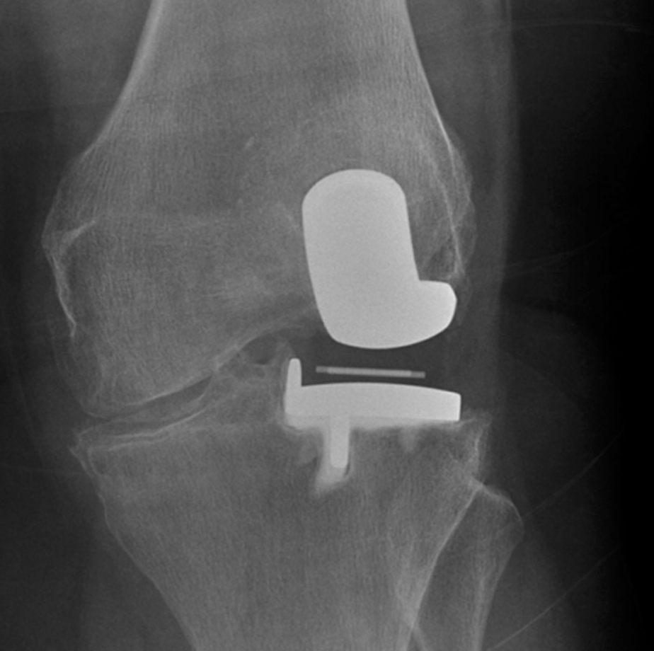
UKR Technical Tips
Longitudinal Incision
Remove osteophytes
Avoid extensive releases
Resect minimal bone
Avoid overcorrection
Avoid edge loading
Avoid impingement
Notes:
Over correction places excess load on unresurfaced compartment
Mediolateral placement → Tibial spine impingement
Undersizing femoral component → patella impingement

Slide 37
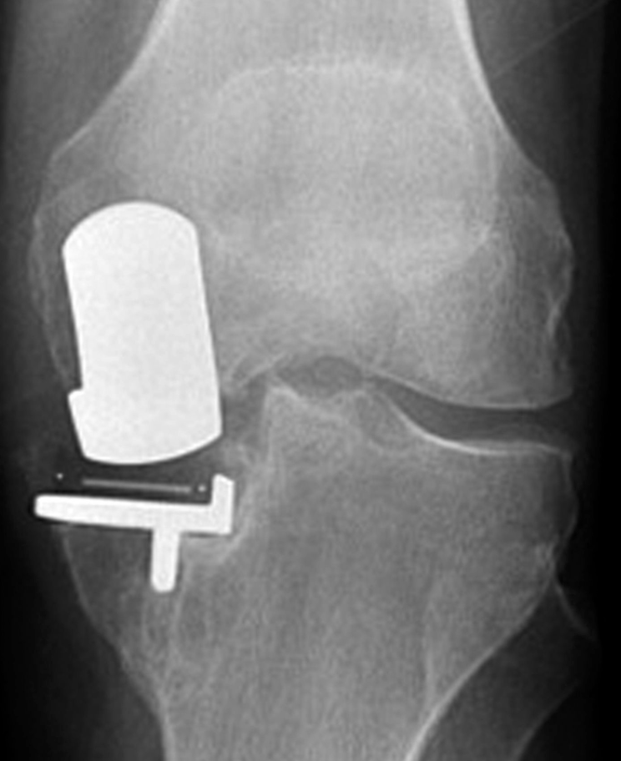
UKR Technical Tips
Longitudinal Incision
Remove osteophytes
Avoid extensive releases
Resect minimal bone
Avoid overcorrection
Avoid edge loading
Avoid impingement
Notes:
Over correction places excess load on unresurfaced compartment
Mediolateral placement → Tibial spine impingement
Undersizing femoral component → patella impingement

Slide 38
UKR Technical Tips
Longitudinal Incision
Remove osteophytes
Avoid extensive releases
Resect minimal bone
Avoid overcorrection
Avoid edge loading
Avoid impingement
Notes:
Over correction places excess load on unresurfaced compartment
Mediolateral placement → Tibial spine impingement
Undersizing femoral component → patella impingement

Slide 39
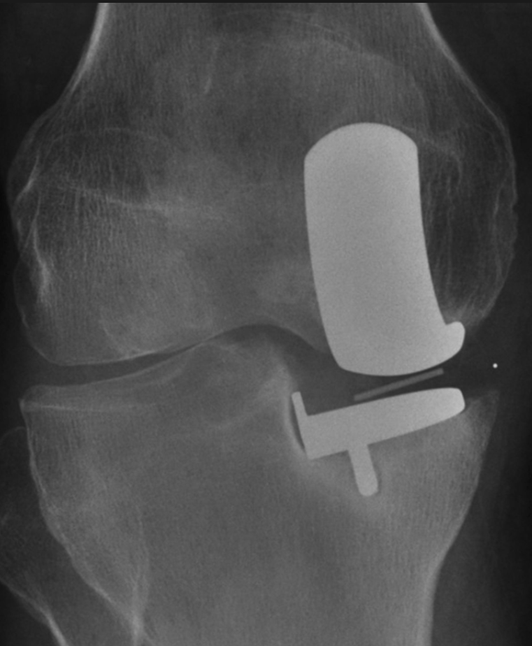
Early Failure
Fracture
  Tibial stress fracture
  Tibial component subsidence
  Osteoporotic bone
Infection
Pain
Notes:
Stress fracture; in young, overweight and over active.

Slide 40
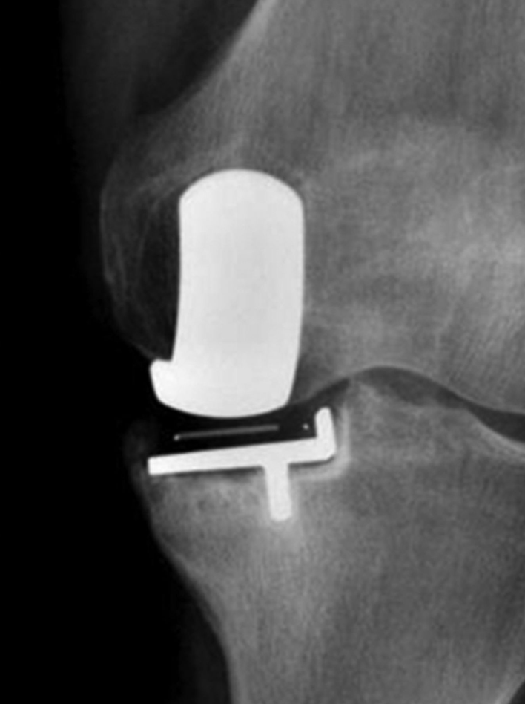
Late Failure
Loosening

Slide 41
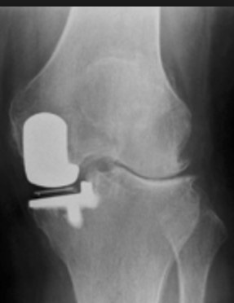
Late Failure
Loosening
Progression of Disease

Slide 42
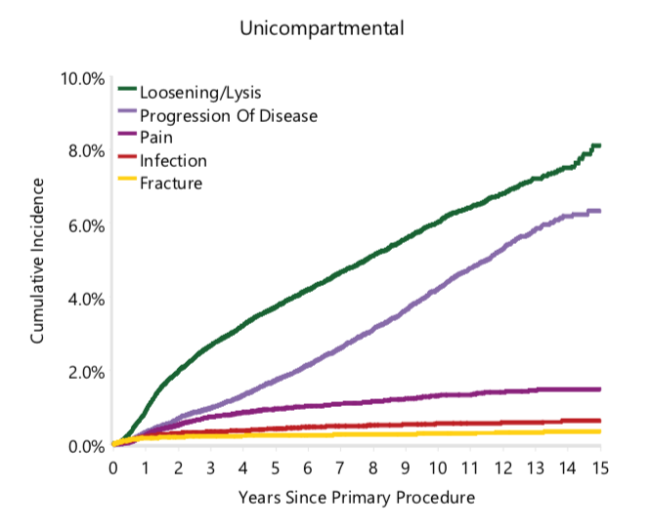
Cumulative Incidence of Revision by Diagnosis

Slide 43
Summary
Why do I prefer UKR?
  Patient satisfaction
  Better outcome
  Patient Selection Criteria
Technically demanding
  PSI
  Robotic Assisted

Slide 44
Thank You

