Slide 1
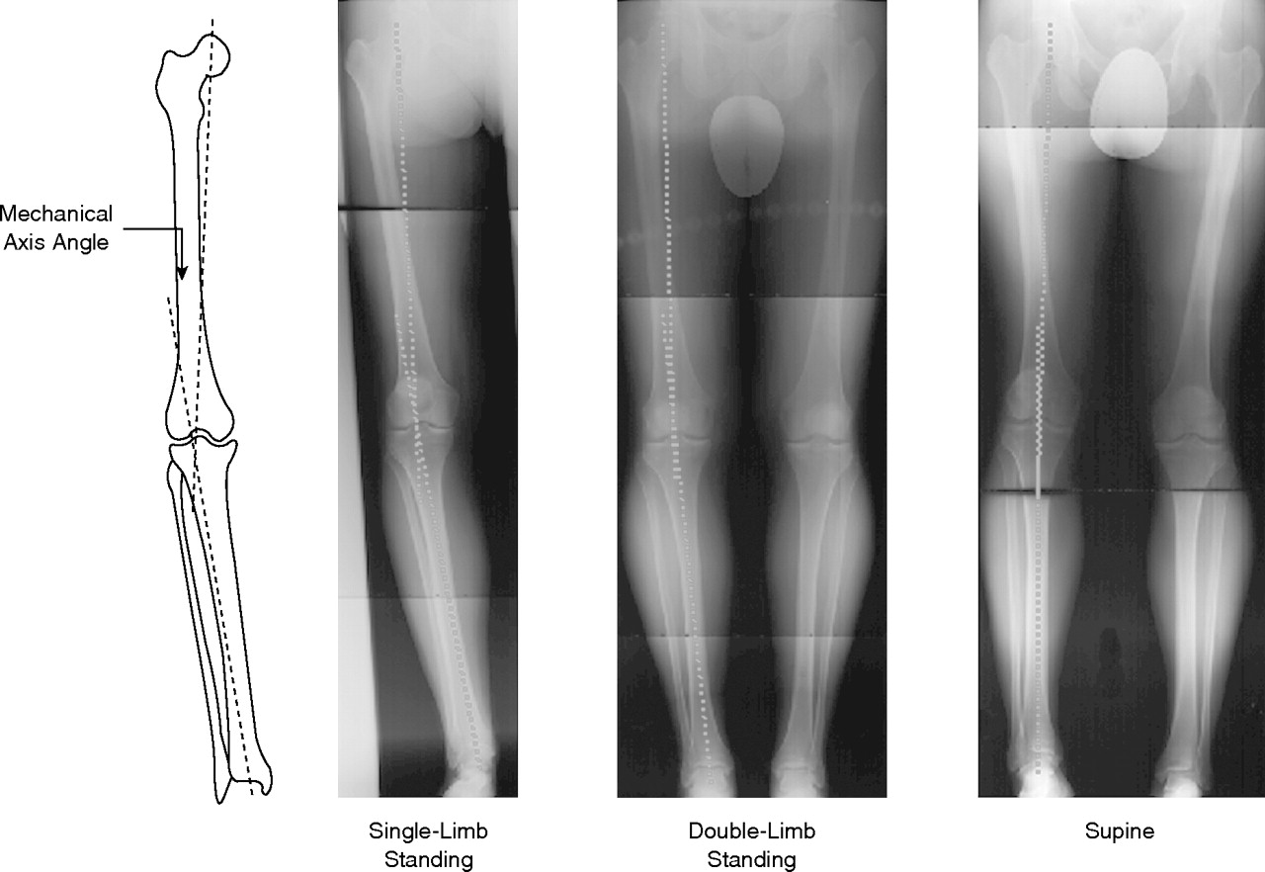
Alignment Principles in TKA

Slide 2

Balancing the Joint to Achieve Limb Alignment
TKR is a “soft tissue procedure.”

Slide 3


Coronal Alignment Choice
Since the onset of the modern era of TKA, the commandment has been to align the limb to a neutral mechanical axis.

Slide 4
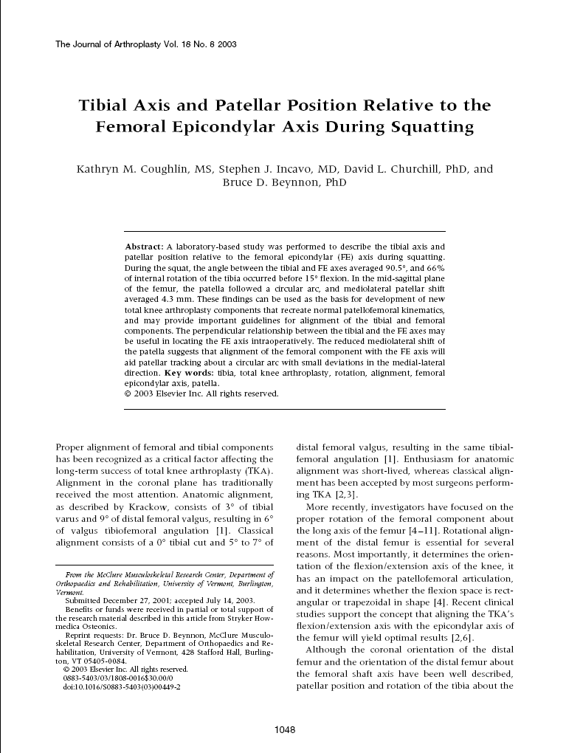
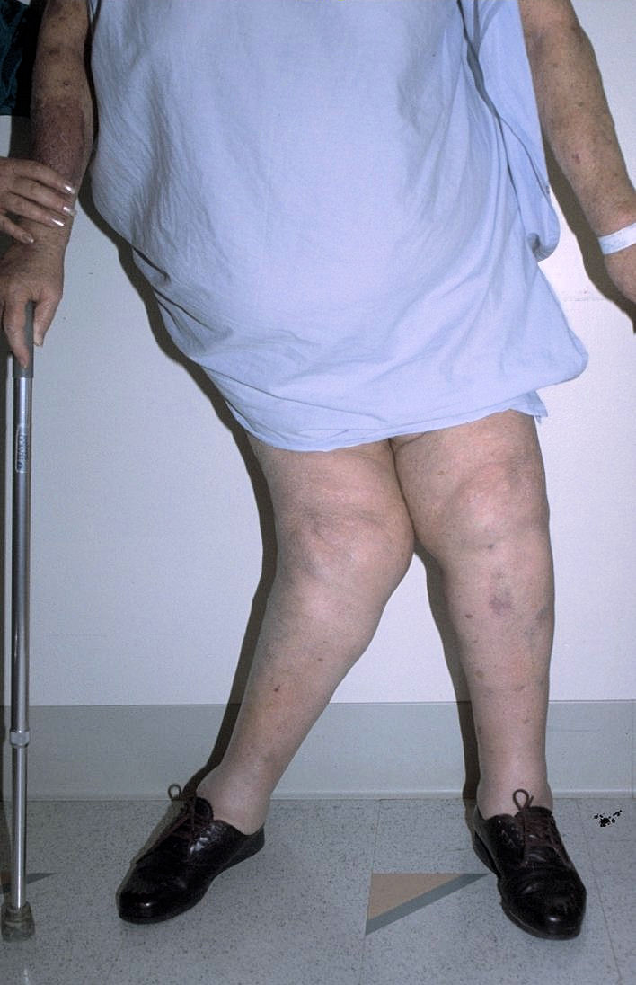
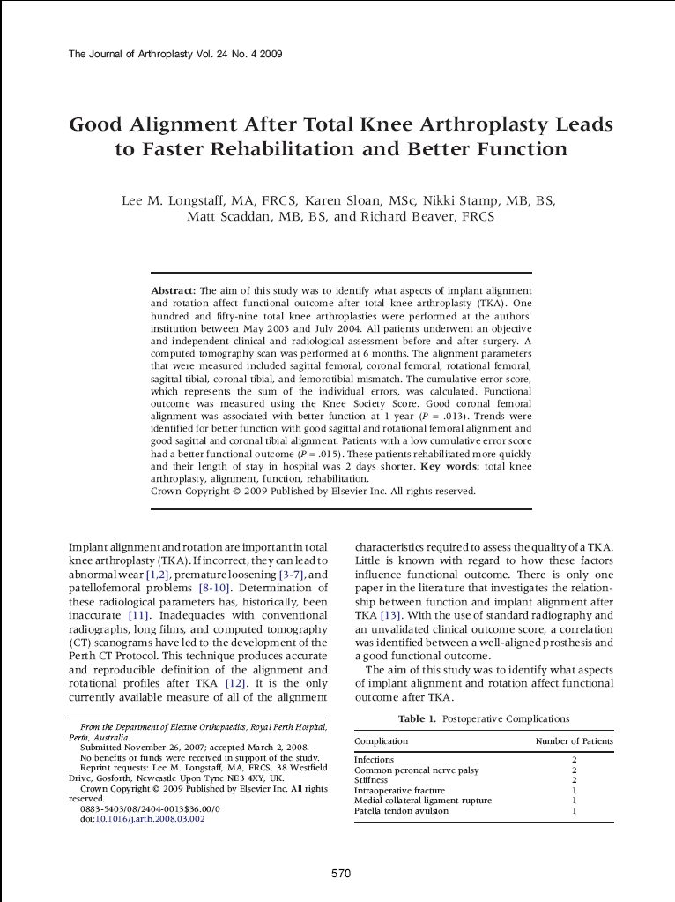
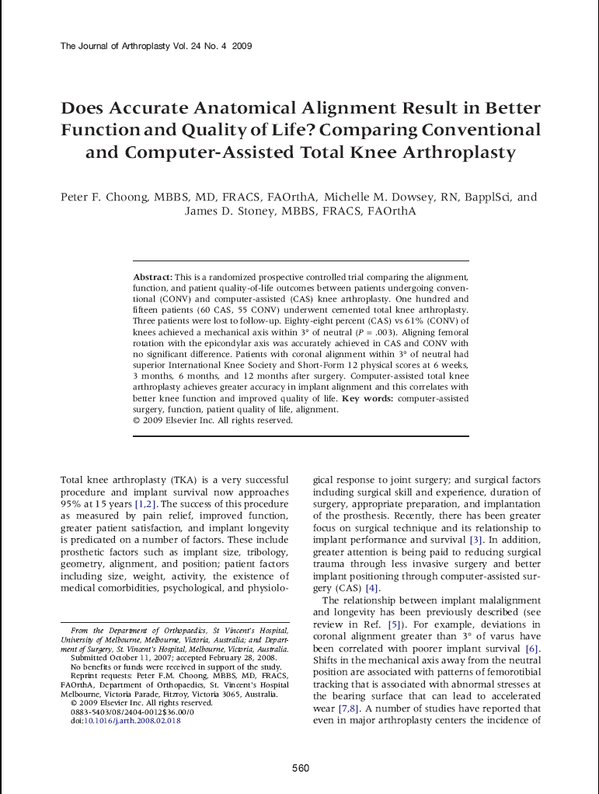
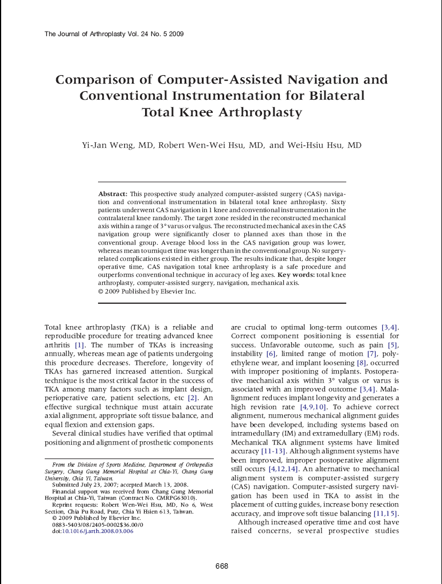
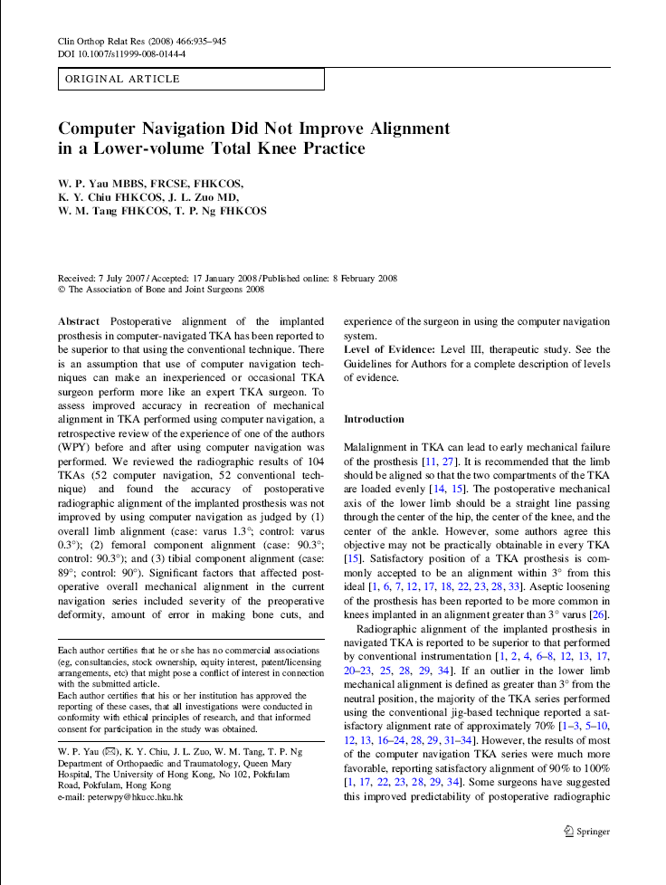
Alignment has become a topic of some philosophical debate
Alignment Principles in TKA

Slide 5
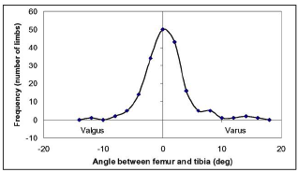
Normal Population Alignment
  Neutral MA is quite rare
  Limb alignment is distributed around Neutral MA
Only 4 of 180 (2.2%) knees in normal (non-arthritic) patients had a neutral mechanical axis.
103 Varus (57.2%)
73 Valgus (40.6%)
Range : 12.2 Varus – 16.2 Valgus
Eckhoff et al. Three dimensional mechanics, kinematics and morphology of the knee viewed in virtual reality. J Bone Joint Surg Am. 2005; 87;71-80
Notes:
Why has neutral mechanical limb alignment been the target?
If so few patients have a neutral mechanical limb alignment, why do surgeons want to change patients to that alignment? ¹
For many reasons that trace back to the early development of TKA:
1. Rudimentary instruments meant accurate preparation
and alignment was difficult.²
2. It was theorized that aligning the limb in a straight line would more evenly distribute the stress to the proximal tibia and tibial implant and bearing surfaces.
Standardized target
4. Historically achieved satisfactory results in terms of implant survivorship

Slide 6
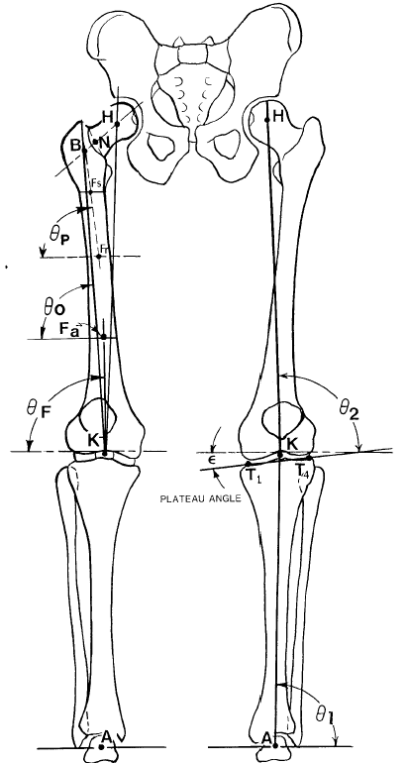
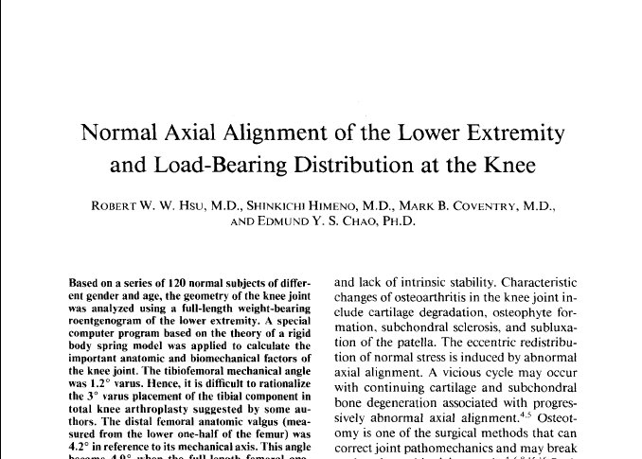
Normal Population Alignment
Hsu et al, CORR 1990
Analyzed Long Standing X-rays on 120 normal subjects
Results: Mean mechanical axis was 1.2 ± 2.2° Varus
Hsu RW et al. Normal axial alignment of the lower extremity and load-bearing distribution at the knee. Clin Orthop Relat Res. 1990 Jun; 255:215-27.
Notes:
Why has neutral mechanical limb alignment been used?
Coronal post-op x-ray alignment was the historical benchmark for a successful TKR.
Inferior implant designs and materials were not able to replicate patient anatomy due to:
- Early Polyethylene² with insufficient mechanical properties
- Articulating contact stresses were high (low contact area)³
- Limited knowledge of knee kinematics

Slide 7
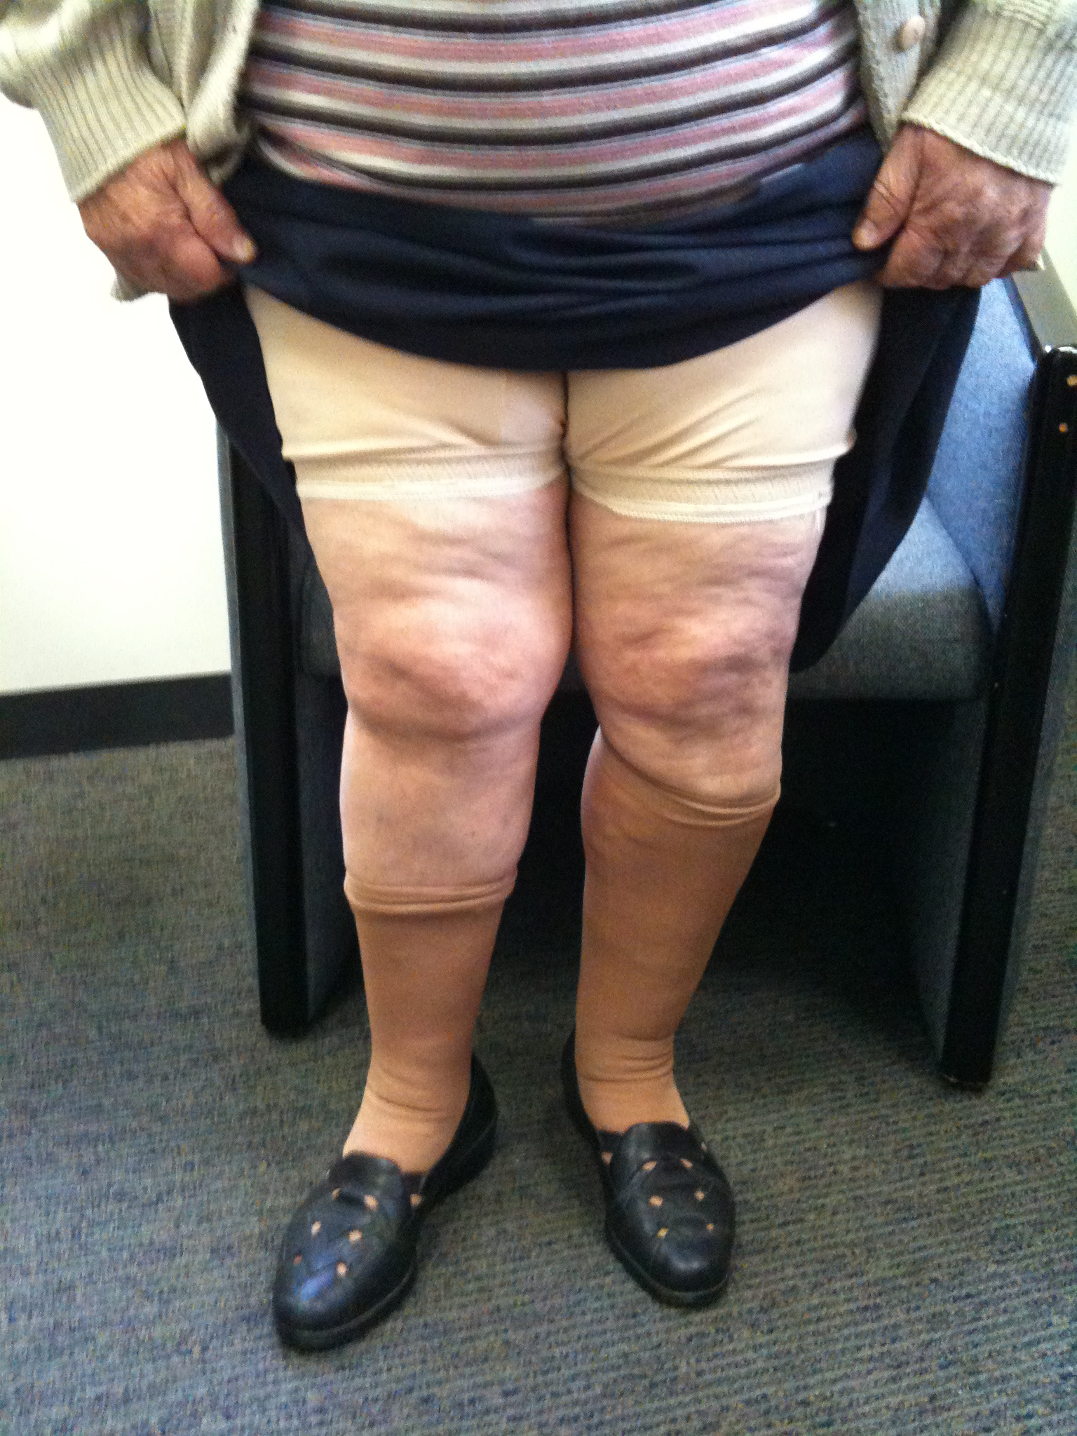

Priority?

Slide 8
Why has neutral mechanical limb alignment been the target?
If so few patients have a neutral mechanical limb alignment, why do surgeons want to change patients to that alignment? ¹
1. Rudimentary instruments meant accurate preparation
and alignment was difficult.²
2. It was theorized that aligning the limb in a straight line would more evenly distribute the stress to the proximal tibia and tibial implant and bearing surfaces.
.
References:
1 Eckhoff et al. Three dimensional mechanics, kinematics and morphology of the knee viewed in virtual reality. J Bone Joint Surg Am. 2005; 87;71-80.
2 Kinzel V et al. Varus/Valgus alignment of the femur in total knee arthroplasty. Can accuracy be improved by pre-operative CT scanning. The Knee. 2004; 11(3): 197-201

Slide 9
Why has neutral mechanical limb alignment been used?
3. Standardized target
4. Historically achieved satisfactory results in terms of implant survivorship
5. Coronal post-op x-ray alignment was the historical benchmark for a successful TKR.

Slide 10
Why has neutral mechanical limb alignment been used?
6. Inferior implant designs and materials were not able to replicate patient anatomy due to:
- Early Polyethylene² with insufficient mechanical properties
- Articulating contact stresses were high (low contact area)³
- Limited knowledge of knee kinematics
References:
Wylde V et al. Patient reported outcomes after total hip and knee arthroplasty: comparison of midterm results. J Arthroplasty. 2009 Feb; 24(2): 210-6.
Chiese R et al. Enhanced wear performance of highly crosslinked UHMWPE for artificial joints. J Biomed Mater Res. 2000 Jun. 50(3):381-77.
Brown TD et al. What design factors influence wear behavior at the bearing surfaces in total joint replacements? J Am Acad Orthop Surg. 2008;16 Suppl:S101-6.

Slide 11
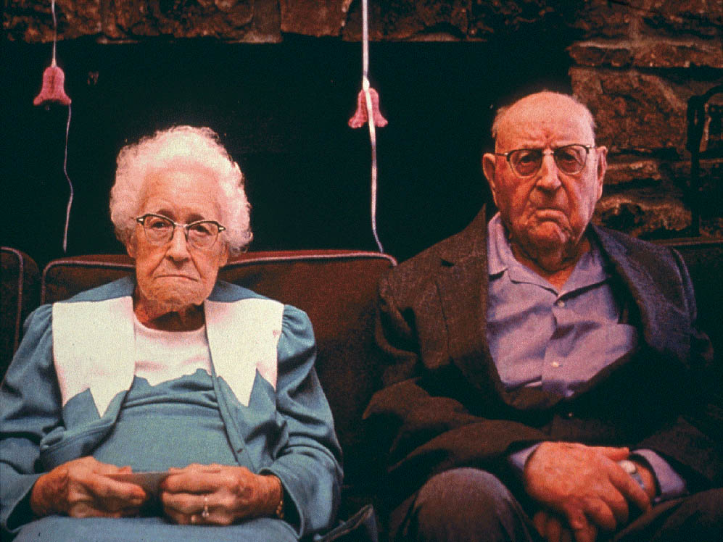
Patient Satisfaction following TKA
Knee survivorship and satisfaction are not the same.
17% to 25% of TKA patients are dissatisfied with their outcome following TKA. ^{1,2,3}
Baker PN, van der Meulen JH, et al. The role of pain and function in determining patient satisfaction after total knee replacement. Data from the National Joint Registry for England and Wales. J Bone Joint Surg Br. 2007; 89(7): 893-900.
Noble PC, Conditt MA, Cook KF et al. The John Insall Award: Patient expectations affect satisfaction with total knee arthroplasty. Clin Orthop Relat Res. 2006 Nov; 452: 35-43.
Wylde V et al. Patient-reported outcomes after total hip and knee arthroplasty: comparison of midterm results. J Arthroplasty. 2009 Feb; 24(2): 210-6.

Slide 12
Patient Expectations following TKA
70
Changing Expectations
60
50
40
30
20
10
0
dancing
swimming
squatting
golfing
gardening
kneeling
stretching
downhill skiing
racquet sports
moving laterally
sexual activities
stationary biking
turning and cutting
cross-country skiing
carrying heavy objects
leg strengthening exercises
Weiss J. et al. CORR 2002
Notes:
Patients are no longer happy with just pain relief but they have specific lifestyles they expect to continue with AFTER knee replacement surgery. The red circles will be emphasised on the next slide so ask the audience to take a note of where they are on the graph.

Slide 13
Patient Expectations following TKA
Reality
Squatting
Expectation 38 %
Reality 74% could not
Golf
Expectation 39%
Reality 36% could not
Weiss J. et al. CORR 2002

Slide 14
In TKA is Neutral Alignment Best ?
If Safe Zone reached (around Mechanical Axis ± 3°) are best results obtained?
Published alignment results using conventional and navigated instruments report the mechanical axis (± 3 degrees) is achieved from 61% - 84% of the time.^{1,2,3}
Reference:
Sparmann, Wolke, Czupalla et al. Positioning of total knee arthroplasty with and without navigation support. A prospective, randomized study JBJSB. 2003 Aug;85(6):830-5.
Matziolis, Krocker, Weiss et al. A prospective, randomized study of computer-assisted and conventional total knee arthroplasty. Three-dimensional evaluation of implant alignment and rotation. JBJS A. 2007 Feb;89(2):236-43.
Choong, Dowsey, and Stoney. Does accurate anatomical alignment result in better function and quality of life? Comparing conventional and computer-assisted total knee arthroplasty. JOA 2009 Jun;24(4):560-9. Epub 2008 May 19.
Pagnano MW, Trousdale RT, Berry DJ, Parratte S. The mechanical axis may be the wrong target in computer-assisted TKA. #203. Presented at the American Academy of Orthopaedic Surgeons 75th Annual Meeting. March 5-9, 2008.

Slide 15
In TKA is Neutral Alignment Best ?
If Safe Zone reached (around Mechanical Axis ± 3°) are best results obtained?
Parratte, Pagnano, Troudsdale, et al. AAOS (2007): Dallas, TX
Review of 399 TKA’s @ 14± 4.7 year follow up
Inside ±3° window (n=293) : 85% survivorship
Outside ±3° window (n=106): 87% survivorship
? other factors besides coronal alignment influence performance and longevity
Sparmann, Wolke, Czupalla et al. Positioning of total knee arthroplasty with and without navigation support. A prospective, randomized study JBJSB. 2003 Aug;85(6):830-5.
Matziolis, Krocker, Weiss et al. A prospective, randomized study of computer-assisted and conventional total knee arthroplasty. Three-dimensional evaluation of implant alignment and rotation. JBJS A. 2007 Feb;89(2):236-43.
Choong, Dowsey, and Stoney. Does accurate anatomical alignment result in better function and quality of life? Comparing conventional and computer-assisted total knee arthroplasty. JOA 2009 Jun;24(4):560-9. Epub 2008 May 19.
Pagnano MW, Trousdale RT, Berry DJ, Parratte S. The mechanical axis may be the wrong target in computer-assisted TKA. #203. Presented at the American Academy of Orthopaedic Surgeons 75th Annual Meeting. March 5-9, 2008.

Slide 16
Mechanical Alignment
Factors Affecting Poly Wear¹
Implant:
Poly Fabrication; Poly Sterilisation; Shelf age; Implant geometry
10 Factors
Alignment
Surgeon:
Post op’ Alignment; Ligament Balance
Patient :
Age; Activity; Weight; Sex
12 Collier et al: Factors Associated with the Loss of Thickness of Polyethylene Tibial Bearings After Knee Arthroplasty. JBJS [Am] 2007: 89;1306-1314

Slide 17

What is the mechanical axis? and
Why has it been historically referenced?

Slide 18
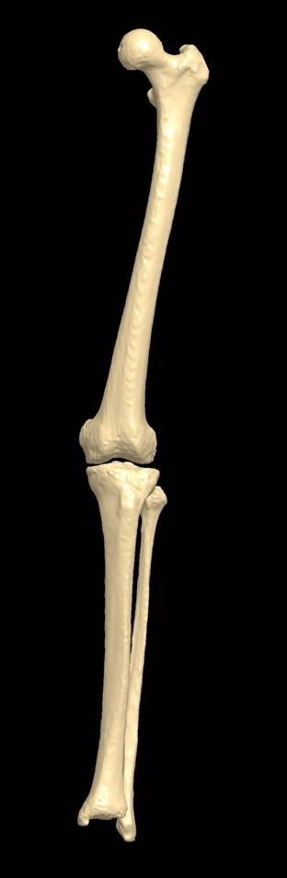
Mechanical Axis
Definition;
The mechanical axis of the femur (MAF) = the center of the femoral head to the center of the knee.
The mechanical axis of the tibia (MAT) = the center of the tibia to the center of the ankle.
Neutral mechanical axis (MA) of a limb = 0° between MAF & MAT.
This limb alignment is used in both classical and anatomic alignment methods.
Reference:
Krackow KA. The Technique of Total Knee Arthroplasty. C.V. Mosby Company. Philadelphia, PA. 1990
Notes:
Be sure to mention that only 2.2% of the population have a neutral mechanical alignment (Eckhoff)

Slide 19
Mechanical Axis
Most patients do not reside on a neutral mechanical axis. (2.2% of population)
Patients with knee arthritis generally have knees that deteriorate into greater degrees of varus or valgus as the disease progresses.
Reference:
1. Eckhoff et al. Three dimensional mechanics, kinematics and morphology of the knee viewed in virtual reality. J Bone Joint Surg Am. 2005; 87;71-80.

Slide 20
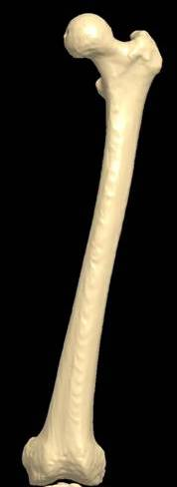
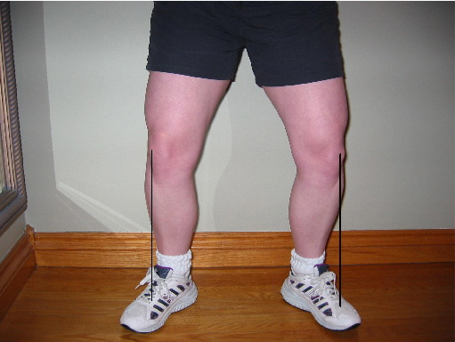
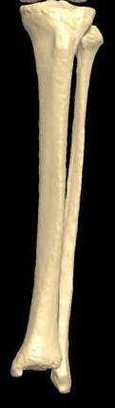
Mechanical Axis - Varus
10°

Slide 21
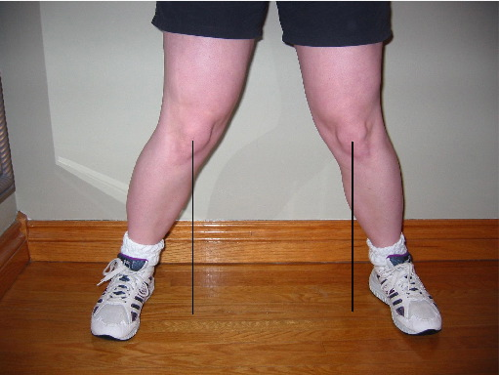
Mechanical Axis - Valgus
10°

Slide 22
What are Classical and Anatomic
Alignment?

Slide 23
Classical and Anatomic
Two ways to achieve neutral limb alignment (straight hip, knee, ankle line.)
Neutral Mechanical Limb Alignment
Classical Alignment
Anatomic Alignment
Reference:
Krackow KA. The Technique of Total Knee Arthroplasty. C.V. Mosby Company. Philadelphia, PA. 1990

Slide 24
Classical Alignment
Classical Alignment:
- is a perpendicular, 0 degree resection of the proximal tibia with respect to the mechanical axis of the tibia (MAT) and subsequent compensatory femoral resections based off the resected tibia
-90° to mechanical axis of the tibia (bone cut on the tibia)
0° cut on
the tibia
Reference:
Krackow KA. The Technique of Total Knee Arthroplasty. C.V. Mosby Company. Philadelphia, PA. 1990

Slide 25
Anatomic Alignment
Anatomic:
- is a 3 degree* varus resection of proximal tibia with respect to the mechanical axis of the tibia (MAT) and subsequent compensatory femoral resections based off of the resected tibia.
- 3°(or 87°) to the mechanical axis of the tibia and parallel to the floor
*Based on “average” anatomy
3° cut on the tibia
Reference:
Krackow KA. The Technique of Total Knee Arthroplasty. C.V. Mosby Company. Philadelphia, PA. 1990

Slide 26
Alignment Basics
Classical Alignment Anatomic Alignment

Slide 27
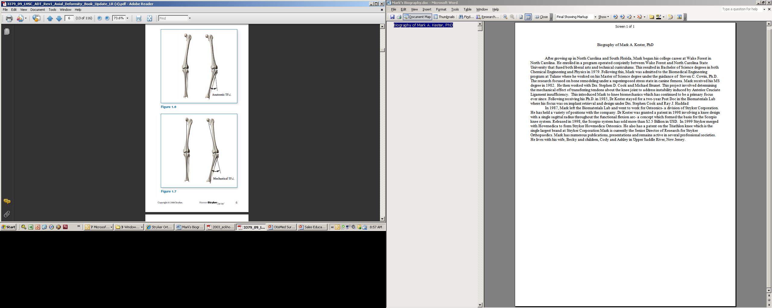
How Do The Traditional Alignment Philosophies Differ/Compare – Classical and Anatomic
Similar:
Same limb alignment goal:
Mechanical axis line passes through the centers of the femoral head, knee, and ankle (neutral).
Reference:
Krackow KA. The Technique of Total Knee Arthroplasty. C.V. Mosby Company. Philadelphia, PA. 1990

Slide 28
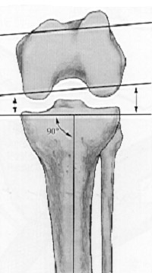
How Do The Traditional Alignment Philosophies Differ/Compare – Classical and Anatomic
Classical - the tibia is resected perpendicular to the long axis of the tibia (MAT)
0°
Reference:
Krackow KA. The Technique of Total Knee Arthroplasty. C.V. Mosby Company. Philadelphia, PA. 1990

Slide 29
How Do The Traditional Alignment Philosophies Differ/Compare – Classical and Anatomic
Classical - the tibia is resected perpendicular to the long axis of the tibia (MAT)
Anatomic - The tibia is resected at 2 - 3 degrees of varus to the long axis of the tibia (MAT)
0°
3°
Reference:
Krackow KA. The Technique of Total Knee Arthroplasty. C.V. Mosby Company. Philadelphia, PA. 1990

Slide 30
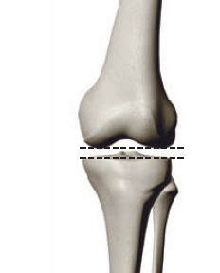
Classical Alignment
Extension
The “normal” femoral joint line is in about 8 - 9 degrees of valgus to the mechanical axis of the femur (MAF).
In order to balance the knee ligaments and provide for a symmetric extension gap, a compensatory cut must be made on the femur in extension.
Reference:
Krackow KA. The Technique of Total Knee Arthroplasty. C.V. Mosby Company. Philadelphia, PA. 1990
Notes:
Mark Check Picture and do you know a reference?

Slide 31
Classical Alignment
How to balance the knee in extension and create a symmetric extension gap?
Resect LESS lateral condyle to
make up for the increased cut
on the lateral tibial plateau.
This reduces the valgus angle of the femur (i.e. more varus)
Reference:
Krackow KA. The Technique of Total Knee Arthroplasty.
C.V. Mosby Company. Philadelphia, PA. 1990
Notes:
Mark Check Pictures

Slide 32
Classical Alignment
Extension
Most surgeons select 5 - 6 ° of valgus for the femur instead of the “normal” 8 – 9°.
i.e. 3 deg
This compensatory cut makes up for the lateral tibia over-resection caused by the 0° “neutral” cut.
Reference:
Krackow KA. The Technique of Total Knee Arthroplasty.
C.V. Mosby Company. Philadelphia, PA. 1990
Notes:
Mark Check Pictures

Slide 33
Classical Alignment
Flexion
The “normal” femur is in neutral rotation relative to the tibial articular surface.
In order to balance the knee ligaments and provide a symmetric flexion gap, a compensatory cut must be made on the femur in flexion.
Reference:
Krackow KA. The Technique of Total Knee Arthroplasty. C.V. Mosby Company. Philadelphia, PA. 1990

Slide 34
Classical Alignment
How to balance the knee in flexion
Externally rotate the femoral component
Less bone resected off the posterior lateral condyle.
Achieved by externally rotating the femoral component 3 ° with respect to the posterior condyles (i.e. compensate for neutral tibial resection).
Reference:
Wheeless Textbook of Orthopaedics. www.wheelessonlin.com. Accessed on: June 4, 2010.

Slide 35
Classical Alignment
To make up for the increased lateral resection of the proximal tibia, compensatory resections must be made on the femoral side in both flexion and extension to end up with a rectangular joint space and balanced MCL and LCL.
Extension
The valgus angle of the femoral cut must be decreased by about 3° (equal in value to the tibial resection angle).
Flexion
Similarly, the femoral component must be externally rotated by about 3°.
These adjustments allow for parallel resection gaps and make up for the lateral laxity that is introduced in the knee by over-resecting the lateral side of the proximal tibia.
Reference:
Krackow KA. The Technique of Total Knee Arthroplasty. C.V. Mosby Company. Philadelphia, PA. 1990

Slide 36
Classical Alignment
Perpendicular cut on the proximal tibia - 90° to the MAT
Compensatory cuts are required on the femur.
Require soft tissue balancing since the limb is usually being aligned to a position that the patient never had.
Referencing worn joint surfaces which often moves the joint line.
Most widely used alignment technique in TKR - both conventional and navigated.
Reference:
Krackow KA. The Technique of Total Knee Arthroplasty. C.V. Mosby Company. Philadelphia, PA. 1990

Slide 37
Anatomic Alignment
Anatomic alignment tries to replicate the “average” joint line alignment of the lower limb.
The “average” tibia is in 2 - 3 ° of varus with respect to the MAT and the “average” femur is in 8 - 9 ° of valgus with respect to the MAF.¹
Like classical alignment, on average this results in a neutral mechanical limb alignment. ¹
Reference:
Krackow KA. The Technique of Total Knee Arthroplasty. C.V. Mosby Company. Philadelphia, PA. 1990
Notes:
Krakow says 8-9 degrees

Slide 38
Anatomic Alignment
A slight varus cut on the proximal tibia relative to MAT
As a result, compensatory cuts are not required on the femur.
87°
Reference:
Krackow KA. The Technique of Total Knee Arthroplasty. C.V. Mosby Company. Philadelphia, PA. 1990

Slide 39
Anatomic Alignment
In Extension
The “normal” femoral joint line is in about 8 - 9 ° of valgus with respect to the MAF.
In order to balance the knee ligaments and provide a symmetric extension gap, an 8 - 9 ° valgus cut is made on the femur in extension.
Reference:
Krackow KA. The Technique of Total Knee Arthroplasty. C.V. Mosby Company. Philadelphia, PA. 1990

Slide 40
Anatomic Alignment
In Flexion
The “normal” femur is in neutral rotation relative to the tibial joint surface.
As a result, there is no need to rotate the femur in reference to the posterior condylar geometry.
87
Reference:
Krackow KA. The Technique of Total Knee Arthroplasty. C.V. Mosby Company. Philadelphia, PA. 1990

Slide 41
Anatomic Alignment
Varus cut on the proximal tibia mimicking “average” anatomy (tibial joint line).
Anatomic cuts on the femur (referencing femoral joint line).
May require soft tissue balancing to obtain neutral mechanical limb alignment.
Referencing worn joint surfaces which often moves the joint line.
NOT widely used due to
  historic difficulty in accurately reproducing a 3 ° tibial cut
  historic concerns about varus tibias causing Poly wear

Slide 42
Which alignment philosophy is more commonly used?

Slide 43
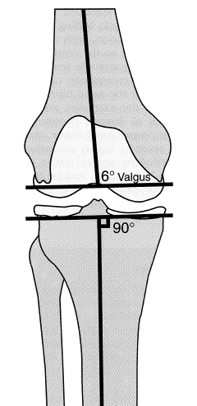
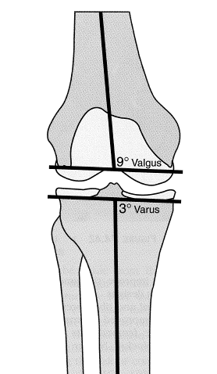
Classical Alignment Is Preferred...
Early Poly with insufficient mechanical properties
Thin Poly
Difficulty in reliably reproducing a 3° varus tibial resection.
Classical
Anatomic

Slide 44
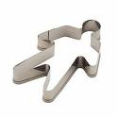

TKA Alignment One Size Fits All?
Is 0° MA right for everyone?
Or is there an optimum alignment for every patient?

Slide 45
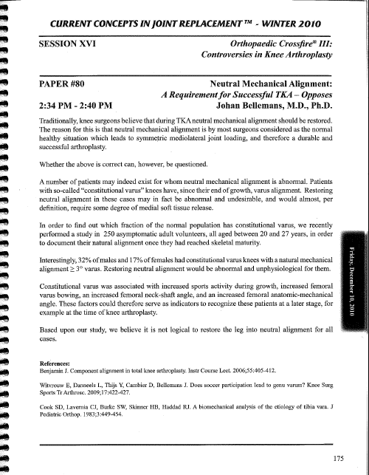
Kinematic Alignment
  Neutral Mechanical Alignment – A Requirement for Successful TKA?
Interestingly, 32% of males and 17% of females had constitutional varus knees with a natural mechanical axis ≥ 3˚ varus. Restoring neutral alignment would be abnormal and unphysiological for them...
…Based upon our study, we believe it is not logical to restore the leg into neutral alignment for all cases.
  Bellemans, Current concepts Joint Replacements 2010

Slide 46
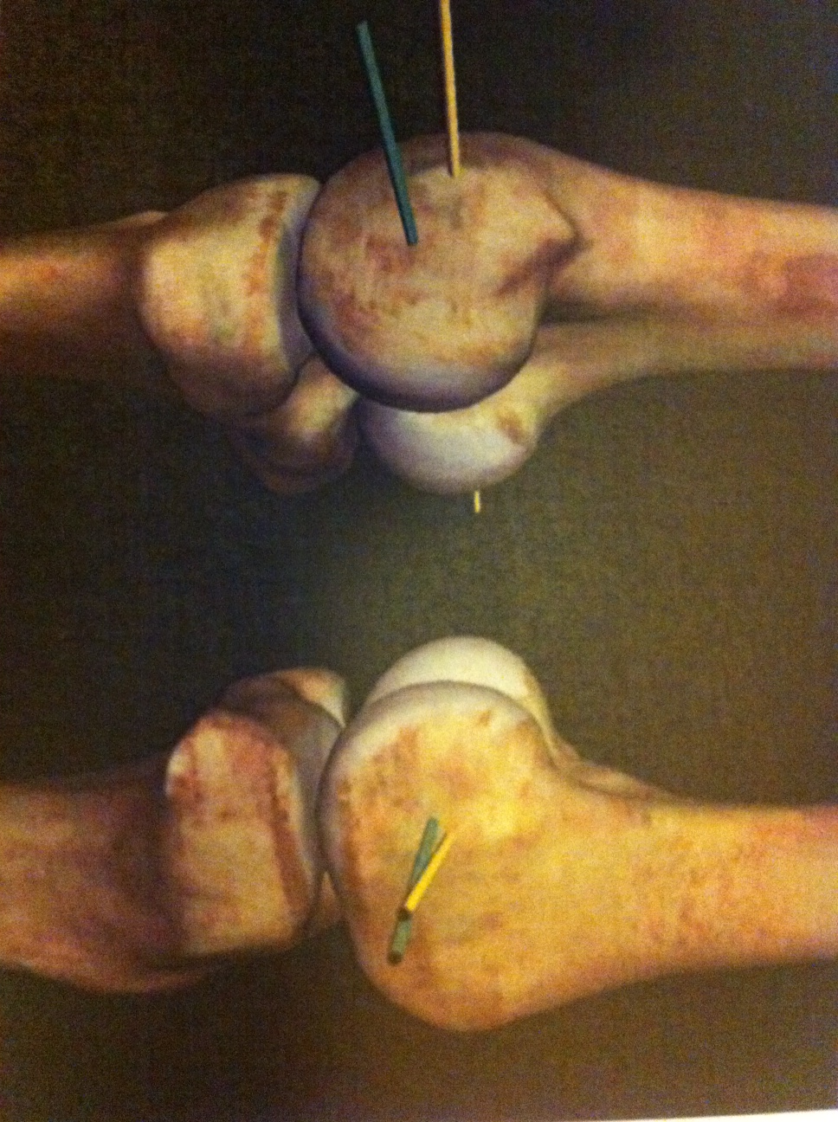
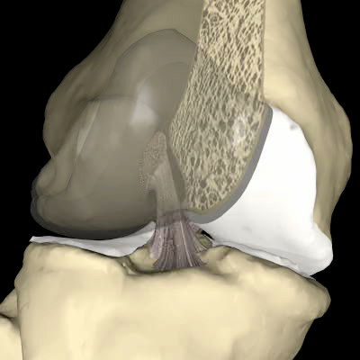
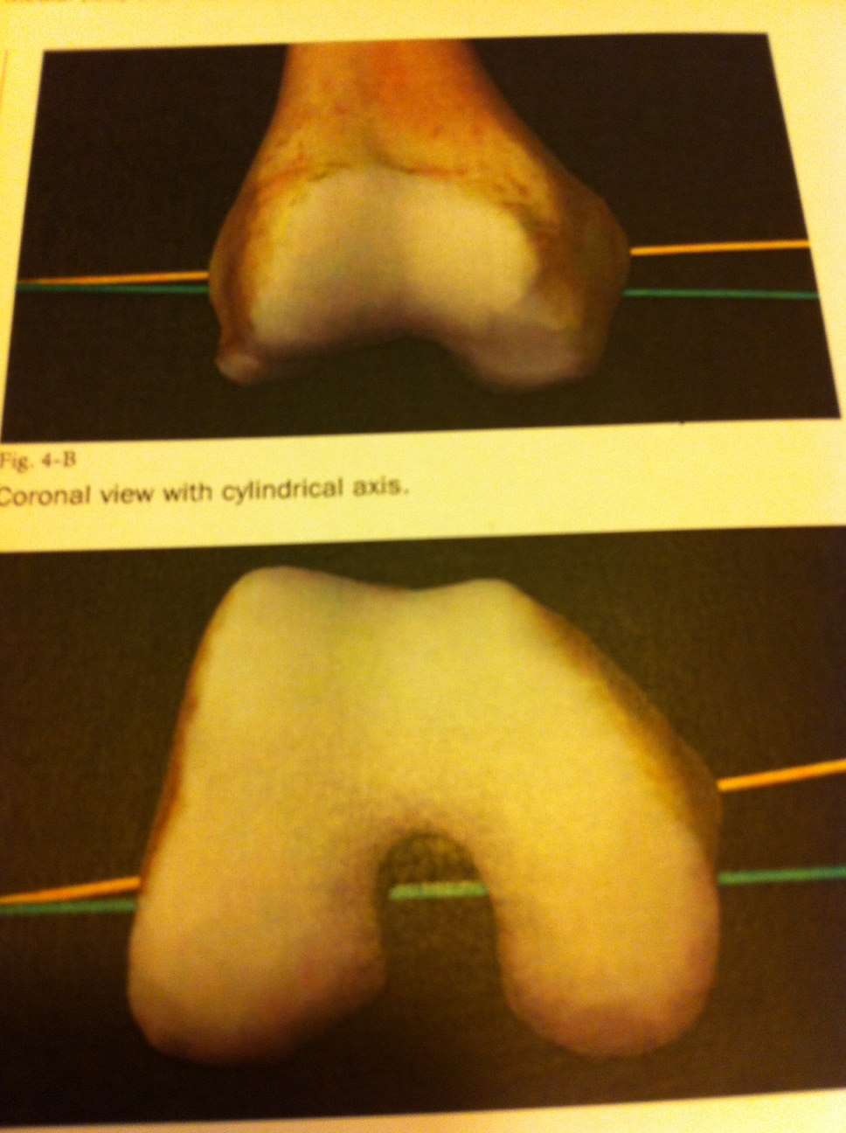
Kinematic Alignment
Kinematic Axes of the Knee
F/E Axis of the Femur
Patella Axis
Tibial Axis (IR/ER Axis)

Slide 47
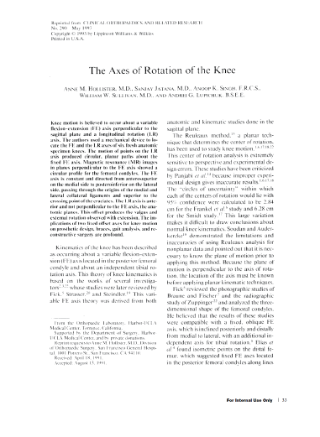
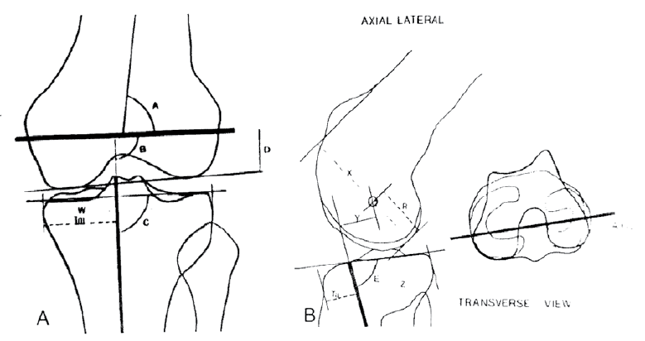
Kinematic Alignment – FE Axis
  Single, patient specific FE Axis
  Holister et Al. CORR 1993

Slide 48
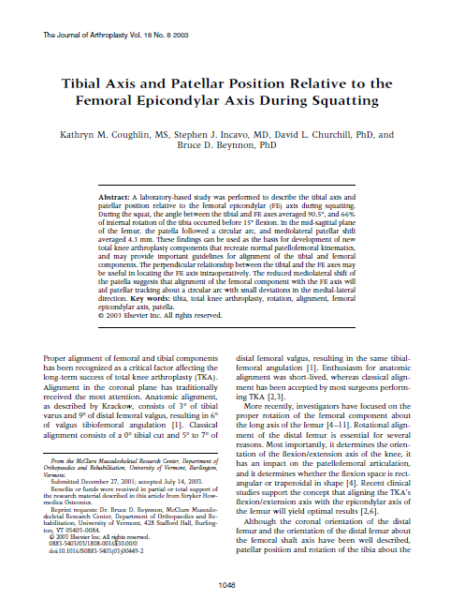
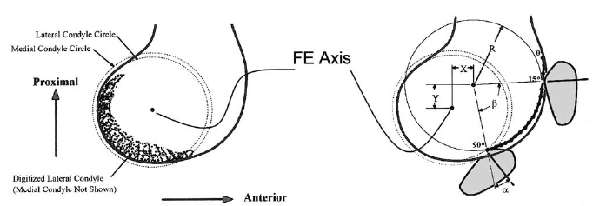
Kinematic Alignment – Patella & Tibial Axis
  Tibial Axis and Patella Position Relative to the Femoral TEA During Squatting
  Patella axis parallel to FE Axis
  Coughlin Et Al, JOA 2003

Slide 49
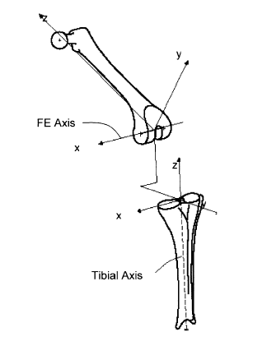
Kinematic Alignment – Patella & Tibial Axis
  Longitudinal (IR/ER) Tibial Axis Perpendicular to FFE axis
  Coughlin Et Al, JOA 2003

Slide 50
Kinematic Alignment
Three Axes of the Knee
FE Axis
Single, Non Orthogonal Axis
Can be described as the axis of a cylinder that fits in the condyles
IR/ER Axis
Perpendicular to FE Axis
Patella Axis
Parallel to the FE Axis
  Holister et Al. CORR 1993.
  Eckhoff et Al, JBJS, 2005.
  Coughlin Et Al, JOA 2003

Slide 51
The Flexion Axis Determines the Kinematics of the Knee
Get this one right…
… And these will follow
can we find it??)

Slide 52
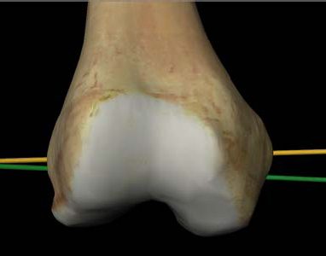
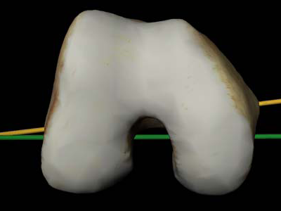
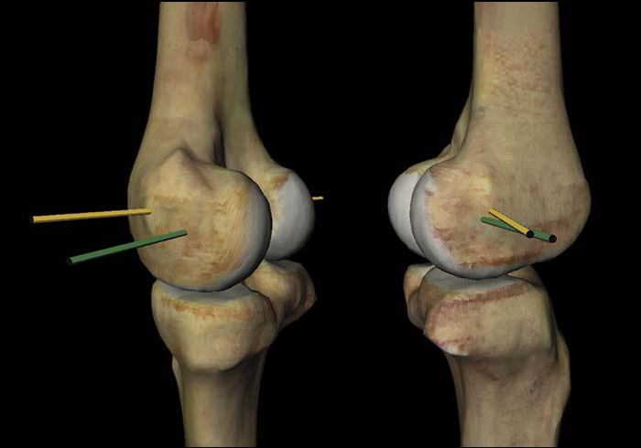
Kinematic Alignment
FE Axis differs from the TEA
1.8˚
2.3˚
4.6˚
2D Orthogonal
3D
  Eckhoff et Al, JBJS 2001, 2003, 2005

Slide 53
Coronal Alignment - Mechanical
Neutral Mechanical Alignment
Pre Op Constitutional Alignment
Post Op Alignment

Slide 54
Coronal Alignment - Kinematic
Patient Specific Kinematic Alignment
Pre Op Constitutional Alignment
Post Op Alignment
Deformity correction

Slide 55
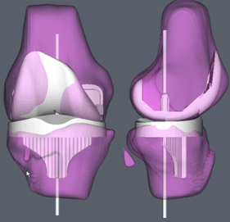
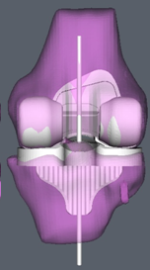
If We Could Find the Flexion Axis Then We Could...
  ….Use an implant with a single axis design and place it along the patients own flexion axis, better reproducing the kinematics of each individual knee

Slide 56

If We Can Find the Flexion Axis Then Perhaps We Can...
  …Place the knee components within the confines of the normal ligamentous envelope reducing the need for soft tissue rebalancing and maybe give patients a knee that “feels more normal”

Slide 57
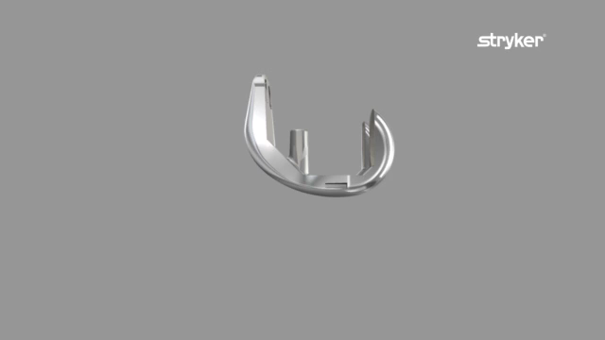
Knee kinematics

Slide 58
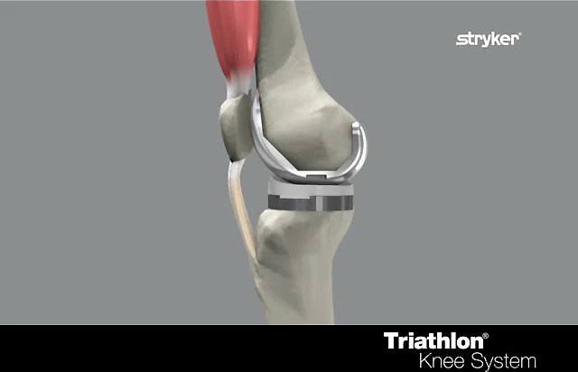
Knee kinematics
Single axis – Quad work

Slide 59
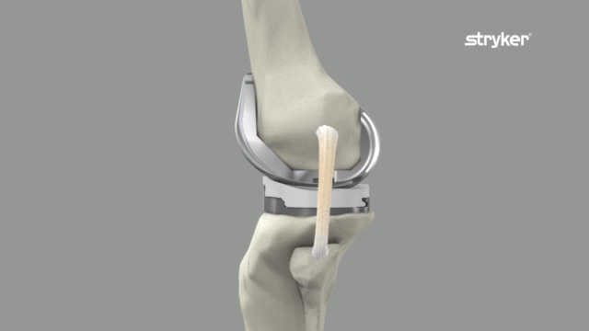
Knee kinematics

Slide 60
Kinematic Alignment
Flexion Extension (F/E) Axis Is The Key
If the flexion/extension axis is restored and the tibial resection is based off the F/E axis, then the knee will be balanced throughout the ROM with normal kinematics

Slide 61
Kinematic Alignment
Flexion Extension (F/E) Axis Is The Key
Re-establishing the patient’s joint line maintains the soft tissue envelope.

Slide 62
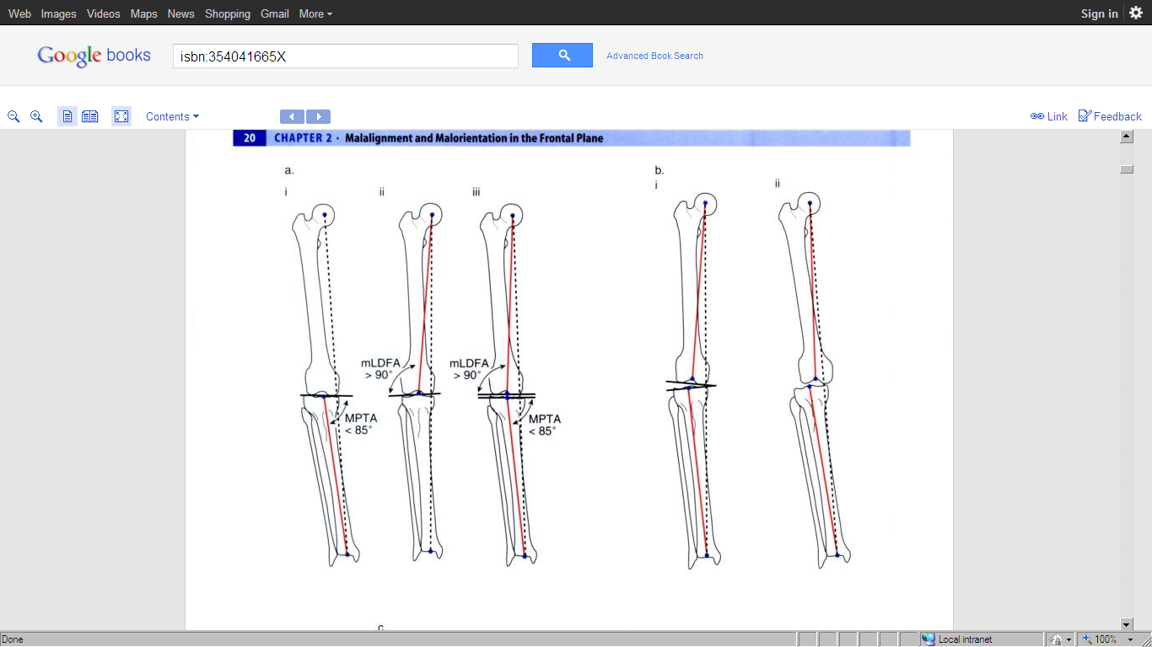
Kinematic vs Mechanical Alignment
Mechanical Alignment
Kinematic Alignment
Soft tissue release is performed to balance bone cuts made to align implants to an arbitrary axis.
Bone cuts are made to align the implants to an individual axis within the patients soft tissue envelope.
Soft tissue balance is achieved via ligament releases.
Soft tissue balance is achieved via bone cuts and osteophyte removal
Notes:
Mechanical Alignment one size fits all, all patients aligned to an arbitrary axis no matter where their natural alignment sits on the natural alignment distribution curve. Soft tissue release are then performed to balance the knee with the new alignment the surgeon has created. Soft tissue release required to create rectangular space in flexion and extension as obliquity of natural joint line has been negated.
Kinematic Alignment restores the natural obliquity and level of the patients natural joint line, aligning the implants within the patients unique soft tissue envelope. Balance achieved via boney cuts rather than releases.
Mechanical Alignment requires soft tissue releases to match the boney cuts made, kinematic alignment performs boney cuts to match the patients soft tissues, providing a knee that potential feels more normal.

Slide 63
Kinematic alignment
Knee survivorship and satisfaction are not the same
Neutral mechanical alignment in the coronal plane doesn’t lead to better patient satisfaction or survivorship.
Restoration of the joint using kinematic alignment may result in a more natural motion and a better functioning knee.
Eckhoff - Neutral mechanical limb alignment within safe window (+/- 3 degrees) is achieved in the majority of patients restored using kinematic alignment

Slide 64


Slide 65

Questions?

